Slide 1


RAID BOSS
Peter Ahn
Perry Li
Kelvin Lee
Amir Kbah
Sam Lee
COMP2910

Slide 2
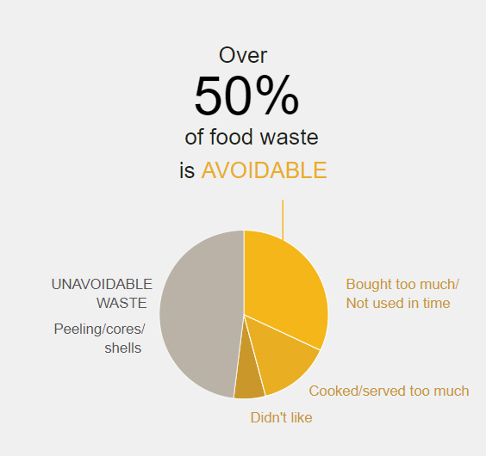
Statistics
16,000 heads of lettuce,
40,000 tomatoes,
80,000 potatoes,
32,000 loaves of bread,
55,000 apple,
70,000 cups of milk
30,000 eggs!

Slide 3


Target Audience

Slide 4

Tap’N Cook

Slide 5

Tap and cook

Slide 6
Tap’N Cook
Reduce food waste
Healthy lifestyle
Cleaner environment

Slide 7











Tap’N Cook
What do you have in your fridge?
Egg
Bread
Cheese
Lettuce
Carrot
Banana
Notes:
So let’s see general concept of Tap & cook and how it works.
Basically, Tap & cook accepts ingredients that a user has and introduce recipes that can be cooked with those.
we are designing Tap & Cook for mobile environment.
So, instead of typing a word, we prompt users to tap ingredients they have or they might wanna use.
These ingredient icons are based on most common ingredients that people throw waste as we saw previous slide.

Slide 8


Tap’n Cook
What do you have in your fridge?
Egg
Bread
Cheese
Lettuce
Carrot
Banana
Get
recipes
Notes:
So if a user tabs an icon, the ingredients are going to be stored in the basket

Slide 9

Tap’n Cook
What do you have in your fridge?
Egg
Bread
Cheese
Lettuce
Carrot
Banana
Get
recipes
Notes:
So I picked egg and lettuce
And let’s see what recipes tap&n cook suggest by clicking this button

Slide 10

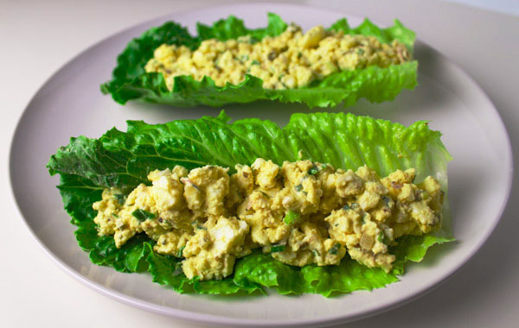
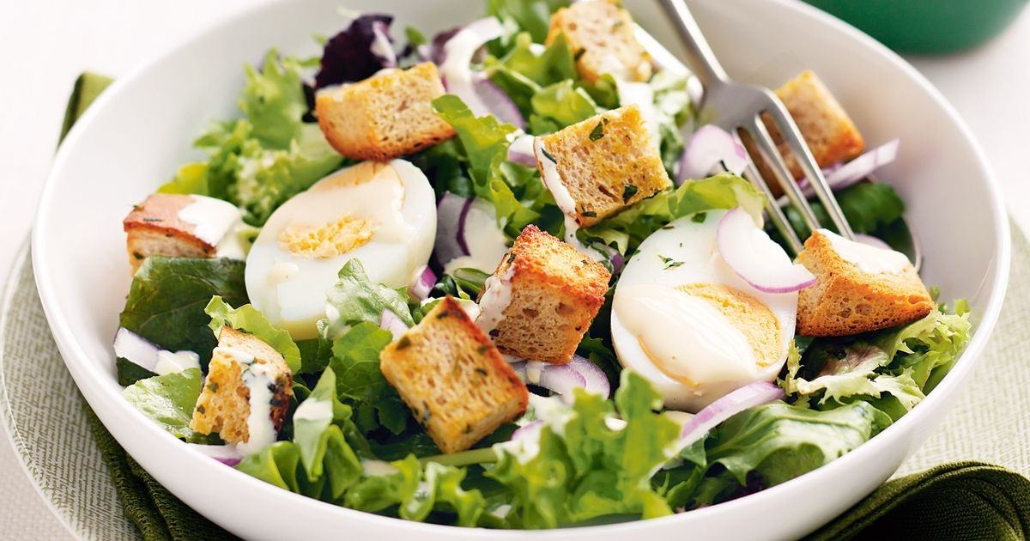
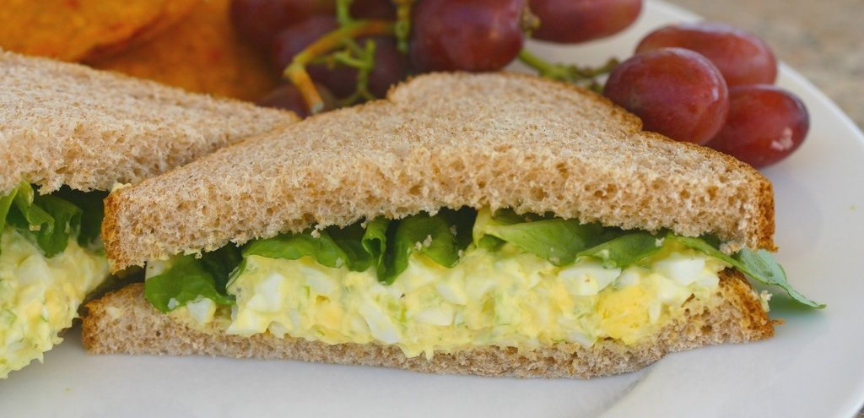
Tap’n Cook
EGG SALAD LETTUCE WRAPS
Egg, Lettuce (15min)
EGG SALAD LETTUCE with croutons
Egg, Lettuce + 2 (15min)
EGG SALAD Sandwiches
Egg, Lettuce + 2 (15min)
Notes:
Once we click the get recipe button, recipes that primarily require egg and lettuce appear on the app.
Oh egg salad wraps looks so simple for us let’s take a look at it.

Slide 11
Tap’n Cook
EGG SALAD LETTUCE WRAPS
Information
Ingredients
Instructions
Notes:
And there are some drop down bars to inform users.

Slide 12
Tap’n Cook
EGG SALAD LETTUCE WRAPS
Information
Recipe type: Lunch
Cuisine: Low Carb
Prep time: 10 mins
Cook time: 10 mins
Total time: 20 mins
Serves: 2-3
Ingredients
Instructions
Notes:
We can see what kind of food it is.
And the cooking time

Slide 13
Tap’n Cook
EGG SALAD LETTUCE WRAPS
Information
Ingredients
4-6 Romaine Leaves
6 hard boiled Eggs
1 Green Onion stalk chopped thin
1 Tbs Shallots finely chopped
1 Tbs Dill Pickles finely chopped
¼ cup Mayo
1 Tbs Honey Dijon Mustard
1 tsp Tarragon
Salt and Pepper to taste
Notes:
And ingredients

Slide 14
Tap’n Cook
EGG SALAD LETTUCE WRAPS
Information
Ingredients
Instructions
1. Add eggs to medium saucepan and fill water just above eggs.
2. Bring to boil, the reduce heat to a high simmer for 10 minutes.
3. Run eggs under cold water and peel.
4. Add eggs to medium size bowl and mash with a whisk or fork.
5. Add the rest of the ingredients and stir well.
6. Scoop egg salad onto romaine leaves and serve.
7. Enjoy!
Notes:
And instructions.
Through Tap & Cook, we strongly believe we can bring up user’s behavioral change and it leads to reduction of food waste and healthier life.

Slide 15


Questions?

