Slide 1










Your food deserves better!
What do you have in your fridge?
Egg
Bread
Cheese
Lettuce
Carrot
Banana
Notes:
Typing is optional , ignore it

Slide 2

Your food deserves better!
What do you have in your fridge?
eg
Egg

Slide 3


Your food deserves better!
What do you have in your fridge?
Egg
Bread
Cheese
Lettuce
Carrot
Banana
Get
recipes
Notes:
If I add more the icons are slideable

Slide 4
Your food deserves better!
What do you have in your fridge?
Egg
Bread
Cheese
Lettuce
Carrot
Banana
Get
recipes
Notes:
Can get rid of it by drag and drop

Slide 5
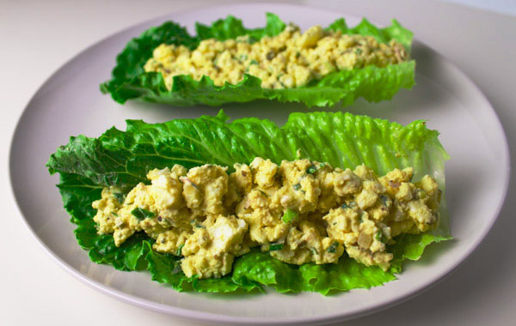
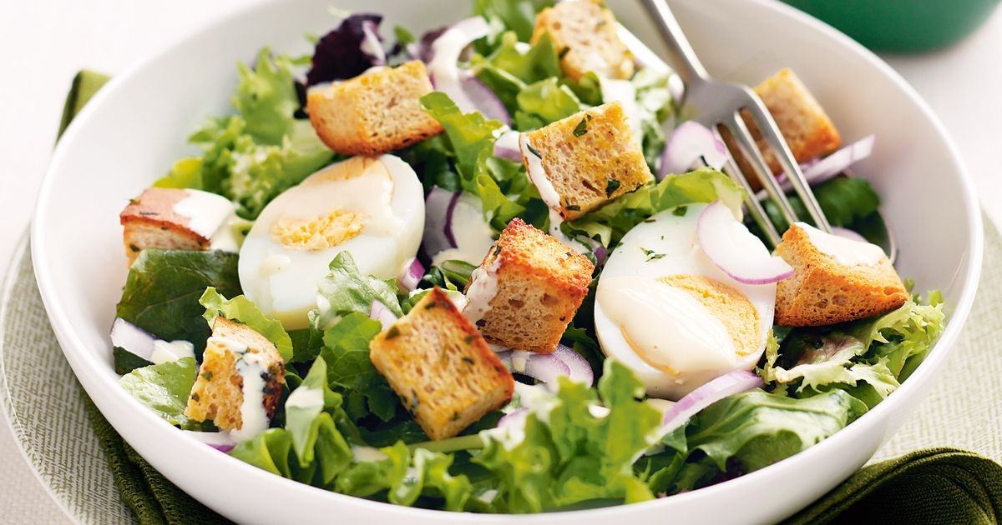
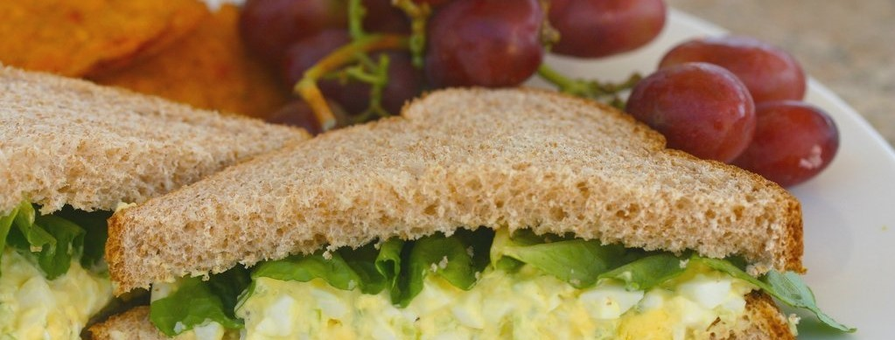

Your food deserves better!
EGG SALAD LETTUCE WRAPS
Egg, Lettuce (15min)
EGG SALAD LETTUCE WRAPS
Egg, Lettuce + 2 (15min)
Notes:
Mobile screen maybe I can get rid of the bottom bar

Slide 6
Your food deserves better!
Here are some recipes with your pick!
EGG SALAD LETTUCE WRAPS
Breakfast
Egg, Lettuce (15min)
Egg and lettuce salad
Breakfast / Salad
Egg, Lettuce, croutons (15min)
Notes:
Recipe list on web

Slide 7
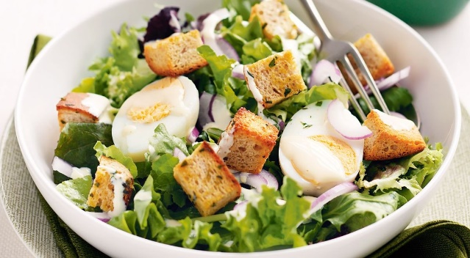
Your food deserves better!
Here are some recipes with your pick!
EGG SALAD LETTUCE WRAPS
EGG SALAD LETTUCE WRAPS
Breakfast
Egg, Lettuce (15min)
Breakfast
Egg, Lettuce (15min)
Egg and lettuce salad
Egg and lettuce salad
Breakfast / Salad
Egg, Lettuce, croutons (15min)
Breakfast / Salad
Egg, Lettuce, croutons (15min)
Egg and lettuce salad
Breakfast / Salad
Egg, Lettuce, croutons (15min)

Slide 8
Your food deserves better!
Here are some recipes with your pick!
EGG SALAD LETTUCE WRAPS
Breakfast
Egg, Lettuce (15min)
Egg and lettuce salad
Breakfast / Salad
Egg, Lettuce, croutons (15min)
Notes:
Different color

Slide 9
Your food deserves better!
Here are some recipes with your pick!
EGG SALAD LETTUCE WRAPS
EGG SALAD LETTUCE WRAPS
Breakfast
Egg, Lettuce (15min)
Breakfast
Egg, Lettuce (15min)
Egg and lettuce salad
Egg and lettuce salad
Breakfast / Salad
Egg, Lettuce, croutons (15min)
Breakfast / Salad
Egg, Lettuce, croutons (15min)
Egg and lettuce salad
Breakfast / Salad
Egg, Lettuce, croutons (15min)

Slide 10
Your food deserves better!
EGG SALAD LETTUCE WRAPS
Information
Ingredients
Instructions

Slide 11
Your food deserves better!
EGG SALAD LETTUCE WRAPS
Information
Recipe type: Lunch
Cuisine: Low Carb
Prep time: 10 mins
Cook time: 10 mins
Total time: 20 mins
Serves: 2-3
Ingredients
Instructions

Slide 12
Your food deserves better!
EGG SALAD LETTUCE WRAPS
Information
Ingredients
4-6 Romaine Leaves
6 hard boiled Eggs
1 Green Onion stalk chopped thin
1 Tbs Shallots finely chopped
1 Tbs Dill Pickles finely chopped
¼ cup Mayo
1 Tbs Honey Dijon Mustard
1 tsp Tarragon
Salt and Pepper to taste

Slide 13
Your food deserves better!
EGG SALAD LETTUCE WRAPS
Information
Ingredients
Instructions
1. Add eggs to medium saucepan and fill water just above eggs.
2. Bring to boil, the reduce heat to a high simmer for 10 minutes.
3. Run eggs under cold water and peel.
4. Add eggs to medium size bowl and mash with a whisk or fork.
5. Add the rest of the ingredients and stir well.
6. Scoop egg salad onto romaine leaves and serve.
7. Enjoy!

