Slide 1









Your food deserves better!
What do you have in your fridge?
Egg
Bread
Cheese
Lettuce
Carrot
Banana

Slide 2

Your food deserves better!
What do you have in your fridge?
eg
Egg

Slide 3


Your food deserves better!
What do you have in your fridge?
Egg
Bread
Cheese
Lettuce
Carrot
Banana
Get
recipes

Slide 4
Your food deserves better!
What do you have in your fridge?
Egg
Bread
Cheese
Lettuce
Carrot
Banana
Get
recipes

Slide 5
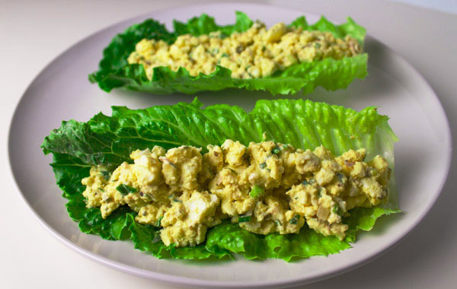
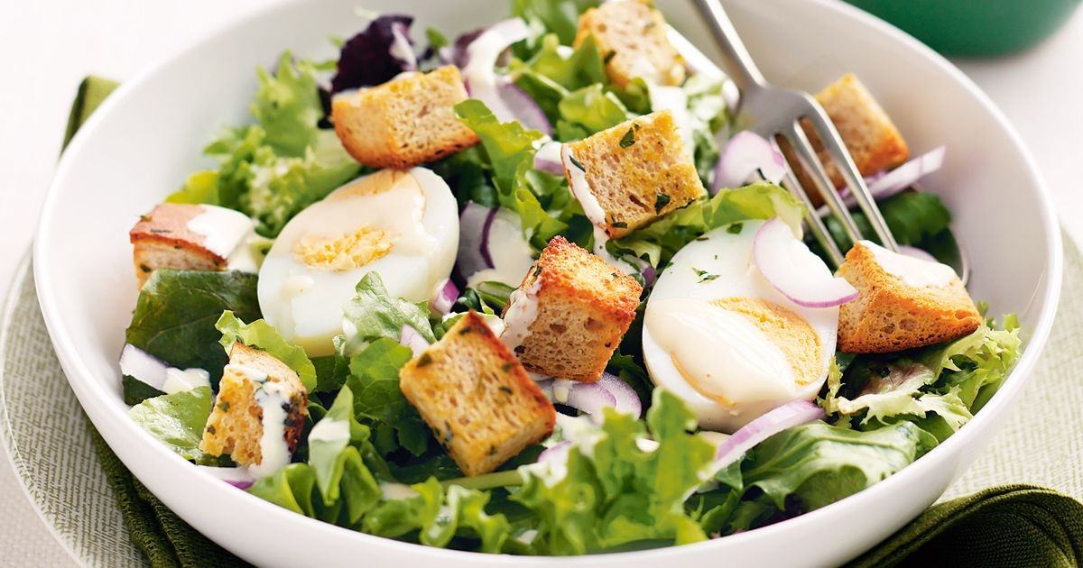
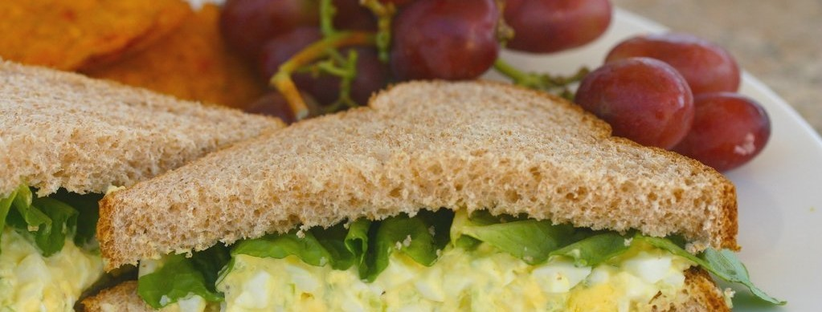

Your food deserves better!
EGG SALAD LETTUCE WRAPS
Egg, Lettuce (15min)
EGG SALAD LETTUCE WRAPS
Egg, Lettuce + 2 (15min)

Slide 6
Your food deserves better!
Here are some recipes with your pick!
EGG SALAD LETTUCE WRAPS
Breakfast
Egg, Lettuce (15min)
Egg and lettuce salad
Breakfast / Salad
Egg, Lettuce, croutons (15min)
Get
recipes

Slide 7
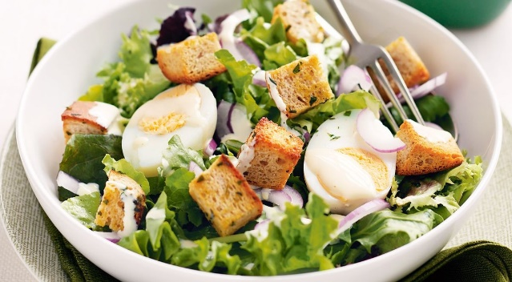
Your food deserves better!
Here are some recipes with your pick!
EGG SALAD LETTUCE WRAPS
EGG SALAD LETTUCE WRAPS
Breakfast
Egg, Lettuce (15min)
Breakfast
Egg, Lettuce (15min)
Egg and lettuce salad
Egg and lettuce salad
Breakfast / Salad
Egg, Lettuce, croutons (15min)
Breakfast / Salad
Egg, Lettuce, croutons (15min)
Egg and lettuce salad
Breakfast / Salad
Egg, Lettuce, croutons (15min)
Get
recipes

Slide 8
Your food deserves better!
Here are some recipes with your pick!
EGG SALAD LETTUCE WRAPS
Breakfast
Egg, Lettuce (15min)
Get
recipes

