Slide 1











Tap’N Cook
What do you have in your fridge?
Egg
Bread
Cheese
Lettuce
Carrot
Banana
Notes:
So let’s see general concept of Tap & cook and how it works.
Basically, Tap & cook accepts ingredients that a user has and introduce recipes that can be cooked with those.
we are designing Tap & Cook for mobile environment
So, instead of typing a word, we induced users to tap ingredients they have.
These ingredient icons are based on most common ingredients that people throw waste.

Slide 2


Tap’n Cook
What do you have in your fridge?
Egg
Bread
Cheese
Lettuce
Carrot
Banana
Get
recipes
Notes:
So if a user tab an icon, the ingredients are going to be stored in the basket

Slide 3

Tap’n Cook
What do you have in your fridge?
Egg
Bread
Cheese
Lettuce
Carrot
Banana
Get
recipes
Notes:
Let’s see what kind of foods we can cook with egg and lettuce

Slide 4


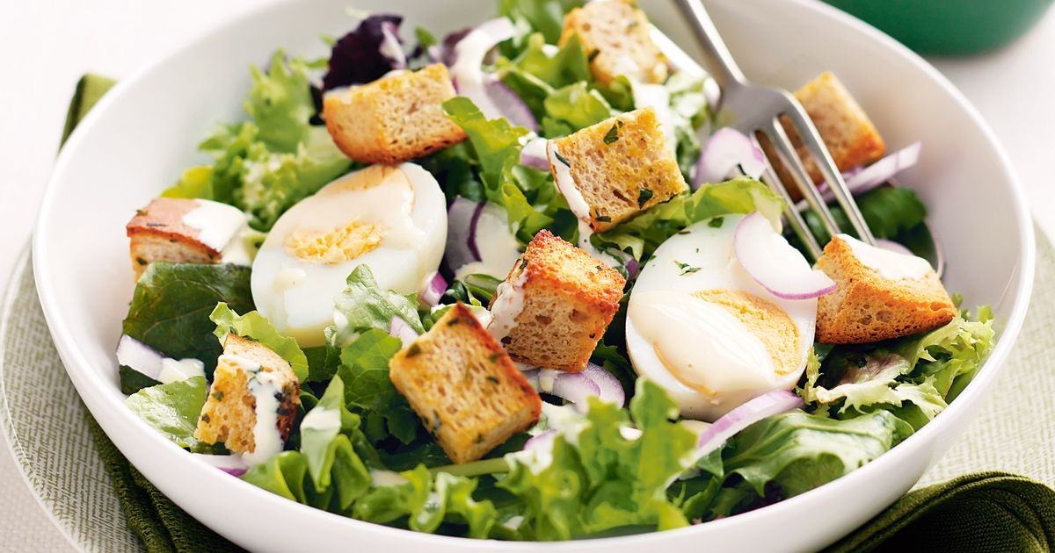
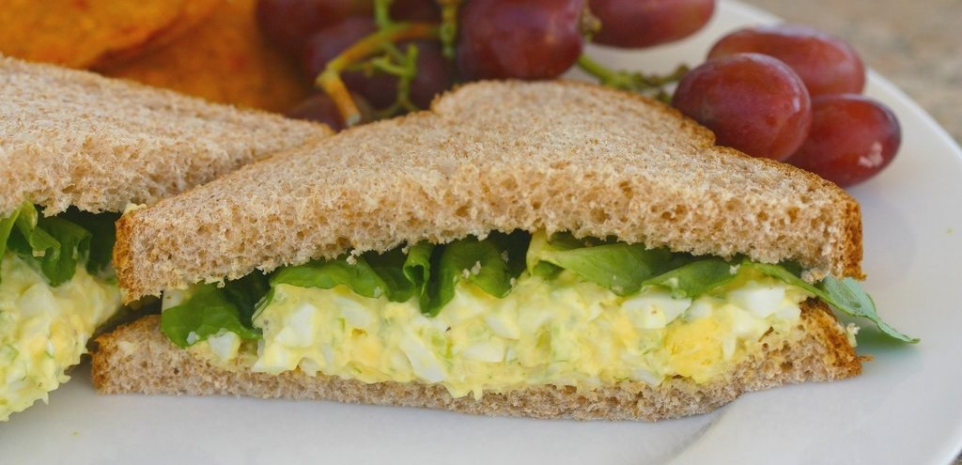
Tap’n Cook
EGG SALAD LETTUCE WRAPS
Egg, Lettuce (15min)
EGG SALAD LETTUCE with croutons
Egg, Lettuce + 2 (15min)
EGG SALAD Sandwiches
Egg, Lettuce + 2 (15min)
Notes:
Once we click the get recipe button, recipes that primarily require egg and lettuce appear on the app.
Oh egg salad wraps looks so simple for us let’s take a look at it.

Slide 5
Tap’n Cook
EGG SALAD LETTUCE WRAPS
Information
Ingredients
Instructions
Notes:
And there are some drop down bars to inform users.

Slide 6
Tap’n Cook
EGG SALAD LETTUCE WRAPS
Information
Recipe type: Lunch
Cuisine: Low Carb
Prep time: 10 mins
Cook time: 10 mins
Total time: 20 mins
Serves: 2-3
Ingredients
Instructions
Notes:
We can see what kind of food it is.
And the cooking time

Slide 7
Tap’n Cook
EGG SALAD LETTUCE WRAPS
Information
Ingredients
4-6 Romaine Leaves
6 hard boiled Eggs
1 Green Onion stalk chopped thin
1 Tbs Shallots finely chopped
1 Tbs Dill Pickles finely chopped
¼ cup Mayo
1 Tbs Honey Dijon Mustard
1 tsp Tarragon
Salt and Pepper to taste
Notes:
And ingredients

Slide 8
Tap’n Cook
EGG SALAD LETTUCE WRAPS
Information
Ingredients
Instructions
1. Add eggs to medium saucepan and fill water just above eggs.
2. Bring to boil, the reduce heat to a high simmer for 10 minutes.
3. Run eggs under cold water and peel.
4. Add eggs to medium size bowl and mash with a whisk or fork.
5. Add the rest of the ingredients and stir well.
6. Scoop egg salad onto romaine leaves and serve.
7. Enjoy!
Notes:
And instructions.
Through Tap & Cook, we strongly believe we can bring up user’s behavioral change and it leads to reduction of food waste and healthier life.

