Slide 1
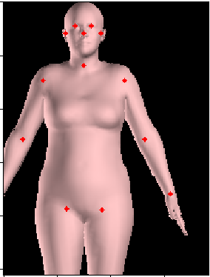
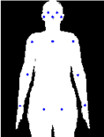
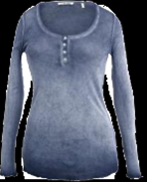
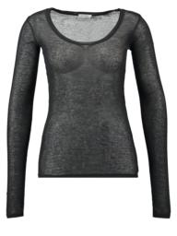
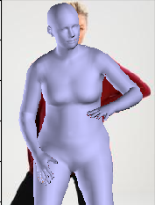
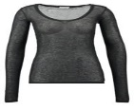
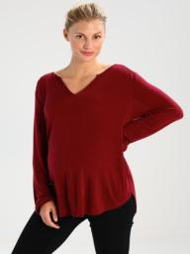

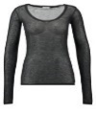
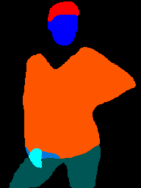
전체 시스템
1.1 2D matching
1.2 3D reconstruction
SMPL model
Cloth 3-D model
Relation-ship
rendering
2D matching
(semi-automatic)
3D Recon
Reference-SMPL
SMPL model
Cloth 3-D model
Relation-ship
Source Cloth
TON+
2D-pose
estimator
SMPLify
3D Shape transfer and Re-posing
Masking
Blending
pose, shape
2d joints
3D Wared cloth
2D-human
segmentation
Target human
Final Warped
Clothed for original pose
Segmentation mask
2. Human body modeling
3. Cloth 3D warping
4. bledning

Slide 2
1.1 2D matching
1.2 3D reconstruction
rendering
3D Reconstruction
2D matching
(semi-automatic)
Reference-SMPL
SMPL model &
Cloth 3D model
Relationship
Try-on Cloth
Try-on network
2D pose
estimation
SMPLify
Masking
Blending
3D Shape transfer and Re-posing
pose, shape
2D joints
Warped
Cloth model for target pose
3D Warped cloth
Try-on result
2D human
segmentation
Target human
Segmentation mask
3. Cloth 3D warping
4. Blending
2. Human body modeling

Slide 3
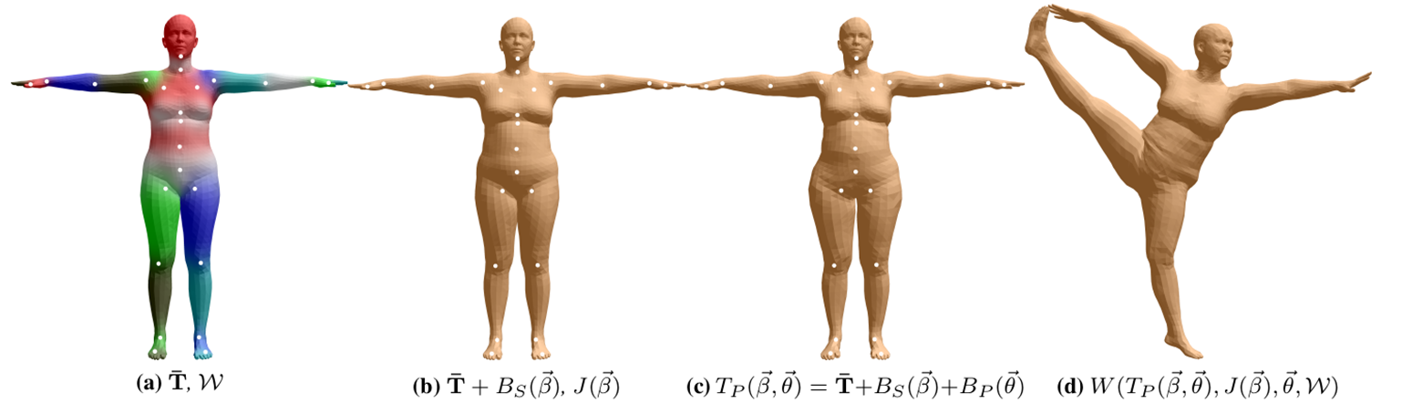
SMPL (skinned multi-person linear model) a Parametric 3D human body model[Loper2016]
체형변수
자세:변형
자세:이동

Slide 4
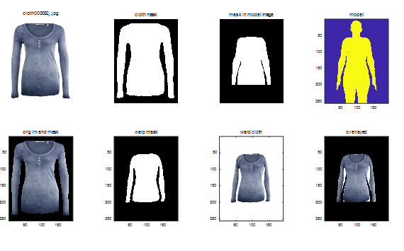
2D Rough Matching

Slide 5
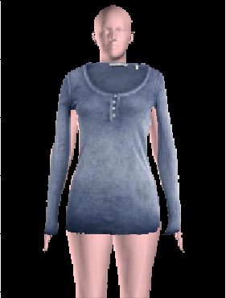
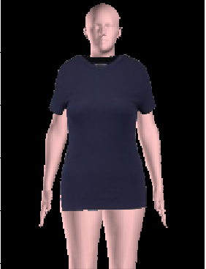
3D Recovery: method
Long sleeved cloth
Short sleeved cloth

Slide 6
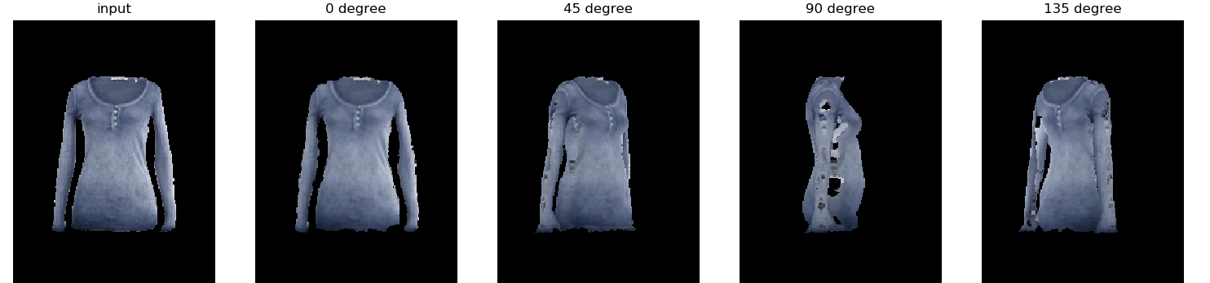
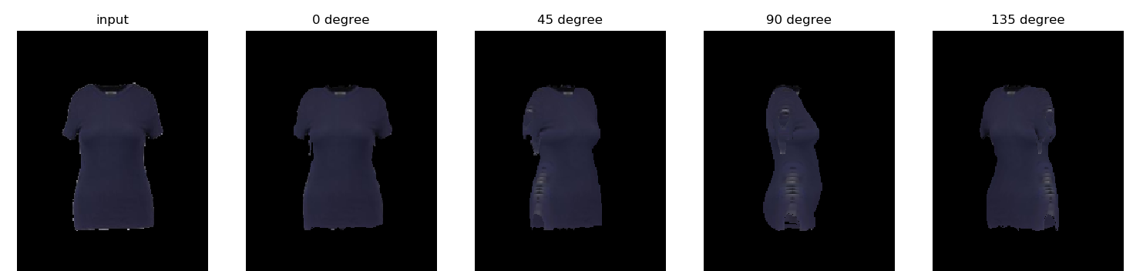
3D Recovery: result

Slide 7
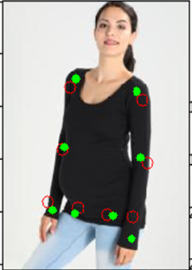
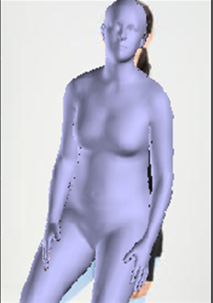
Modeling Target human using SMPLify
parameter estimation of 3D body of target human
Joint matching
Priors
2-D joints

Slide 8
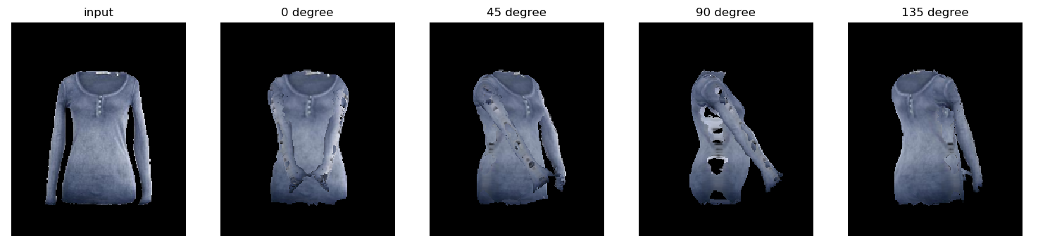
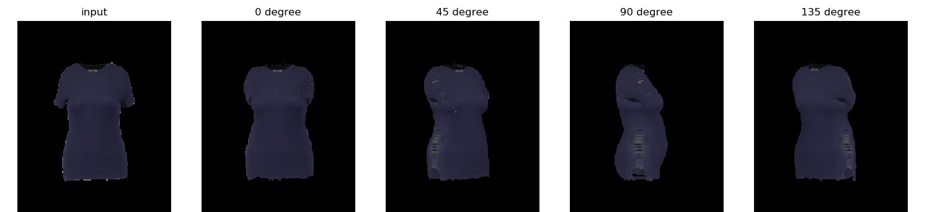
Transfer of the Cloth to target user’s shape and pose
Long sleeved cloth
Short sleeved cloth

Slide 9
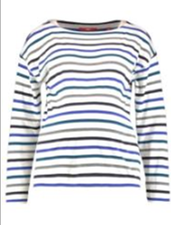
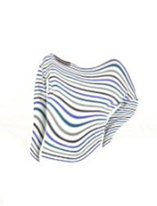
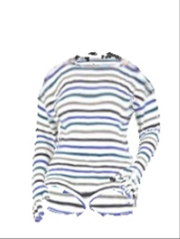
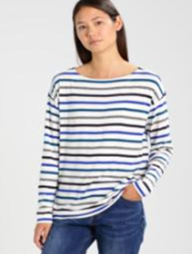
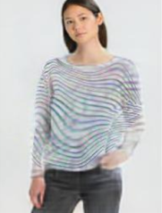
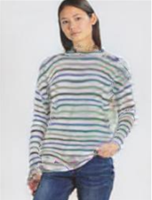
Blending : result
State-of-the-art Image based VTON
Proposed
Try-on Cloth
Ground truth

Slide 10
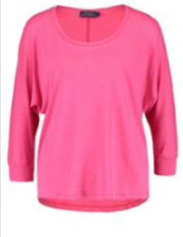
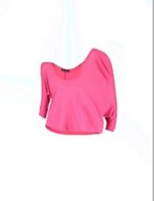
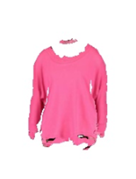
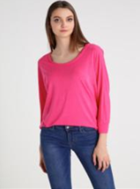
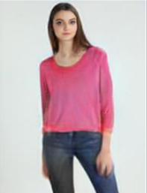
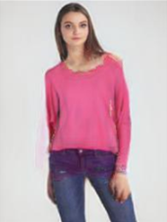
Blending : result (2)
State-of-the-art Image based VTON
Proposed
Try-on Cloth
Ground truth

Slide 11
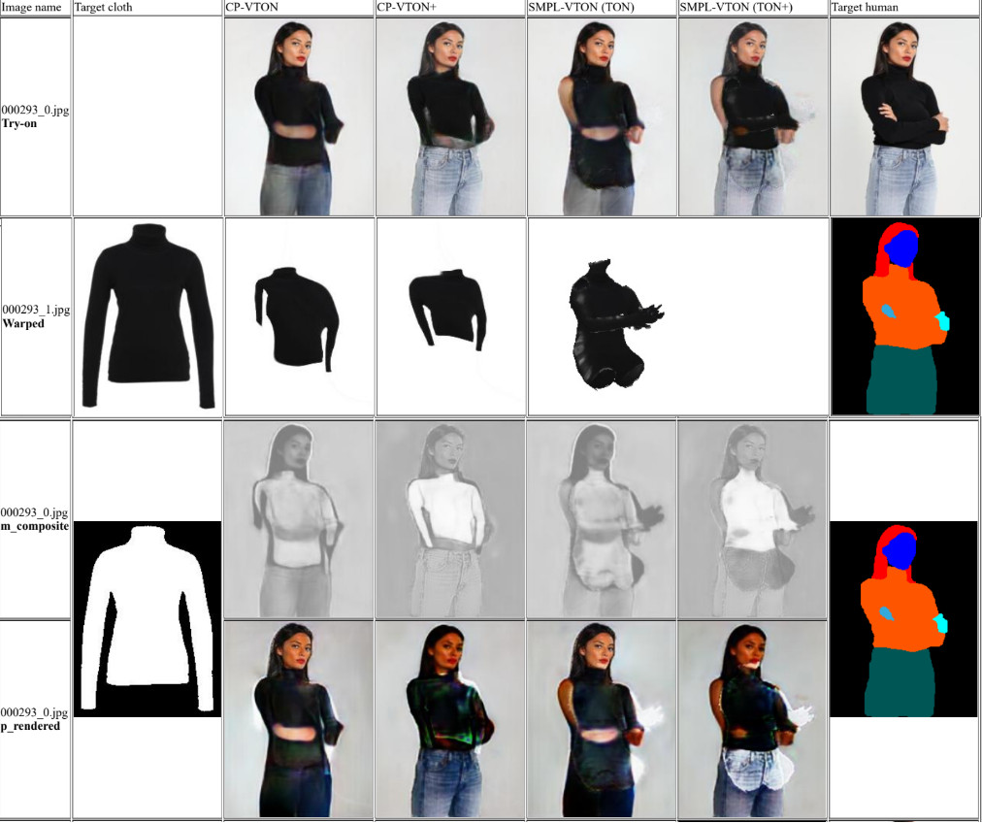
Further Issues
1. in-accurate SMPL; some body part are not covered in rendering
2. Original TON (Blender) network use upper cloth pixels over pants; TON+ use pants pixels over upper cloth
Solution ?
Change TON for considering our cloth. How?
Use 3D models for area of upper cloth except the head and pants

