Slide 1
IS my music taste bad?
Ahna Cecil

Slide 2
Introduction

Slide 3
Introduction
What?
How?
Comparison between the top 100 trending songs now to my personal Spotify Wrapped playlists by year.
Covers the years 2017-2021
Utilization of the Spotify API data on the following factors:
Danceability
Energy
Speechiness
Acousticness
Popularity Rating
- Loudness
Liveness
Valence

Slide 4
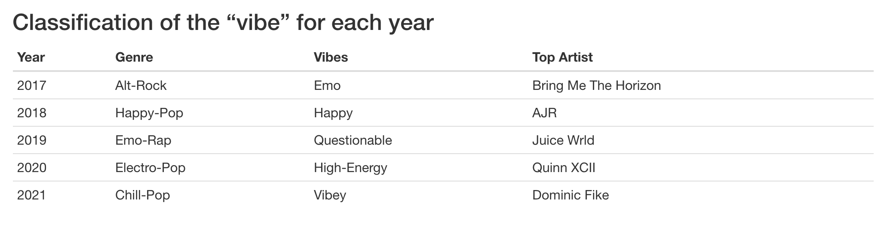
Summary of Data

Slide 5
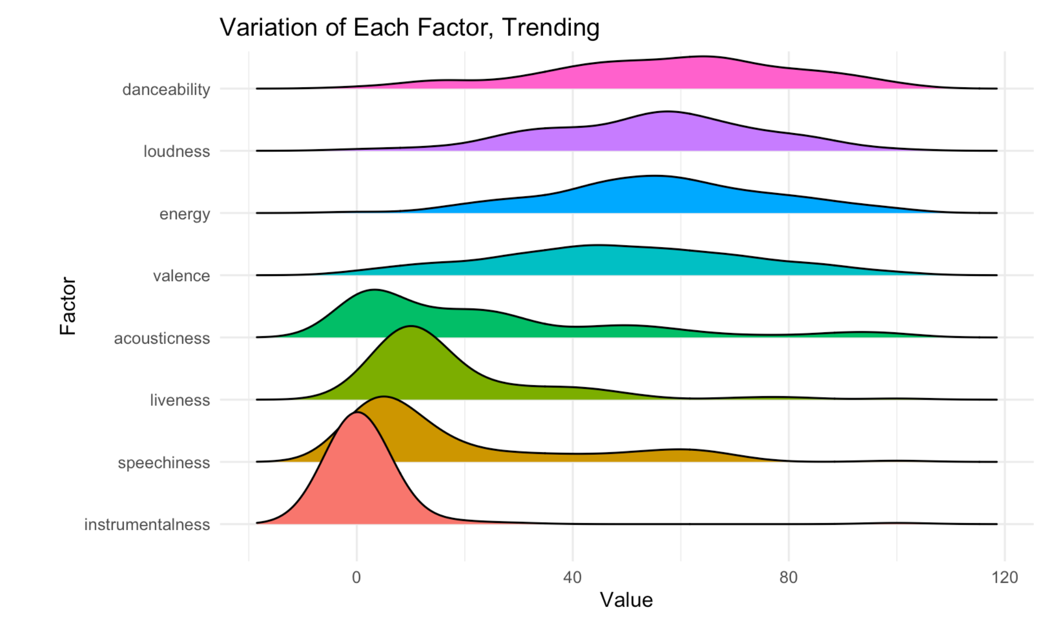
Distribution

Slide 6
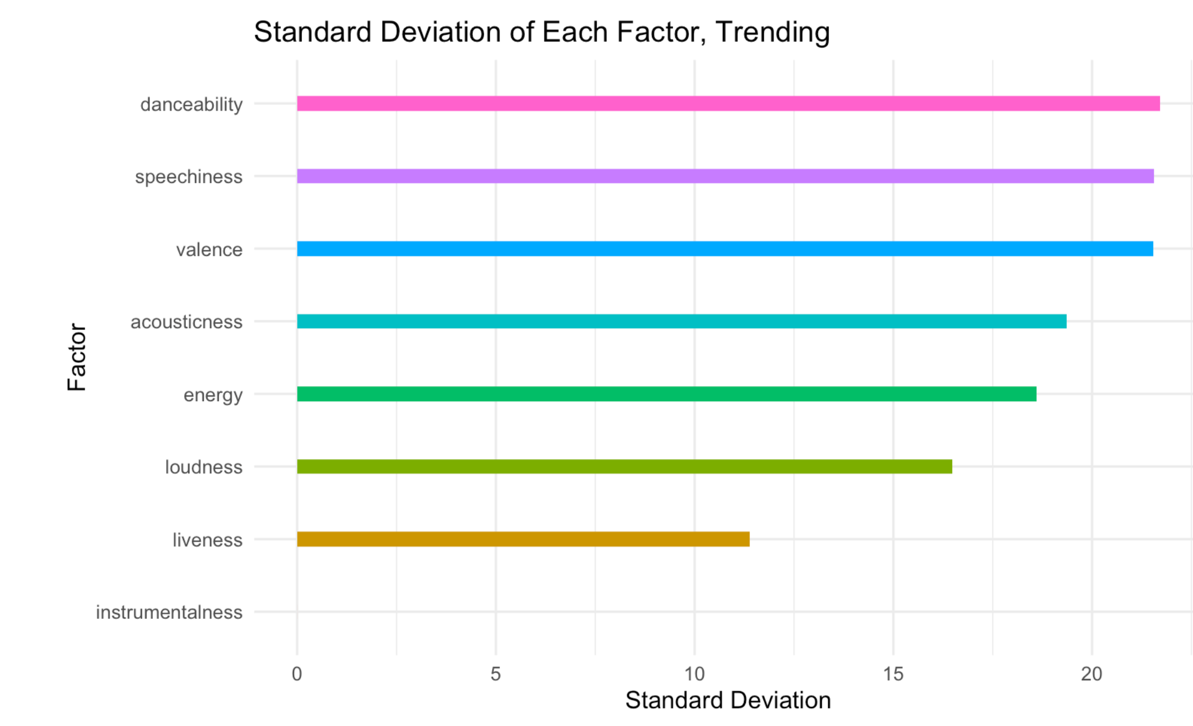
Standard Deviation

Slide 7
Scoring

Slide 8
Scoring Explanation
Utilized mean and standard deviation to create a scale
Score decreases as the values get further from the mean
A negative score is assigned to values that fall below the mean
The total score is equal to the sum of the absolute value of each individual score

Slide 9
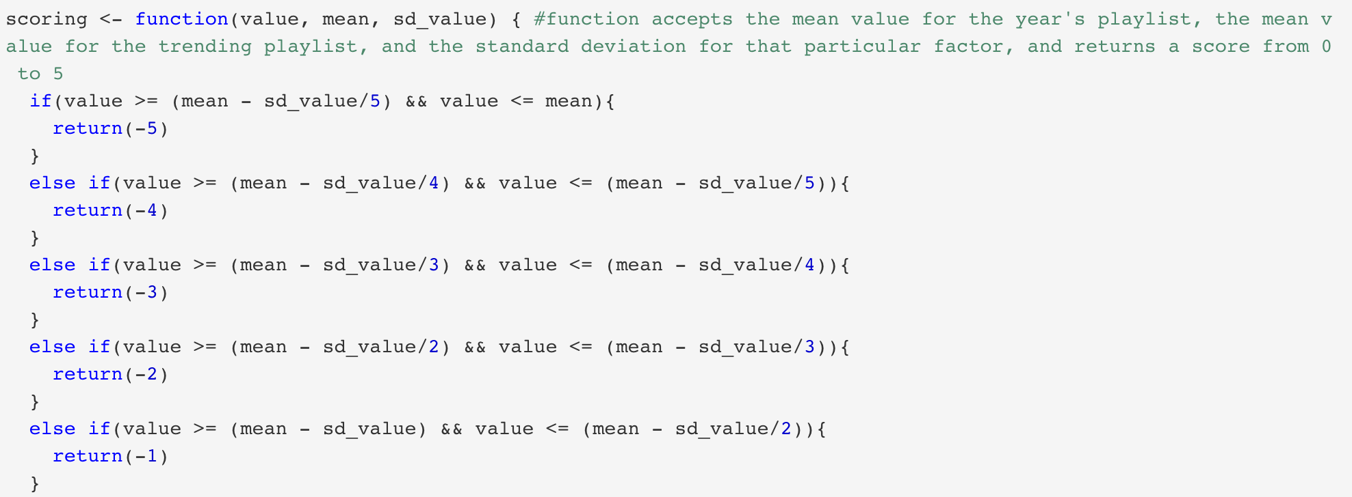
Scoring Function

Slide 10
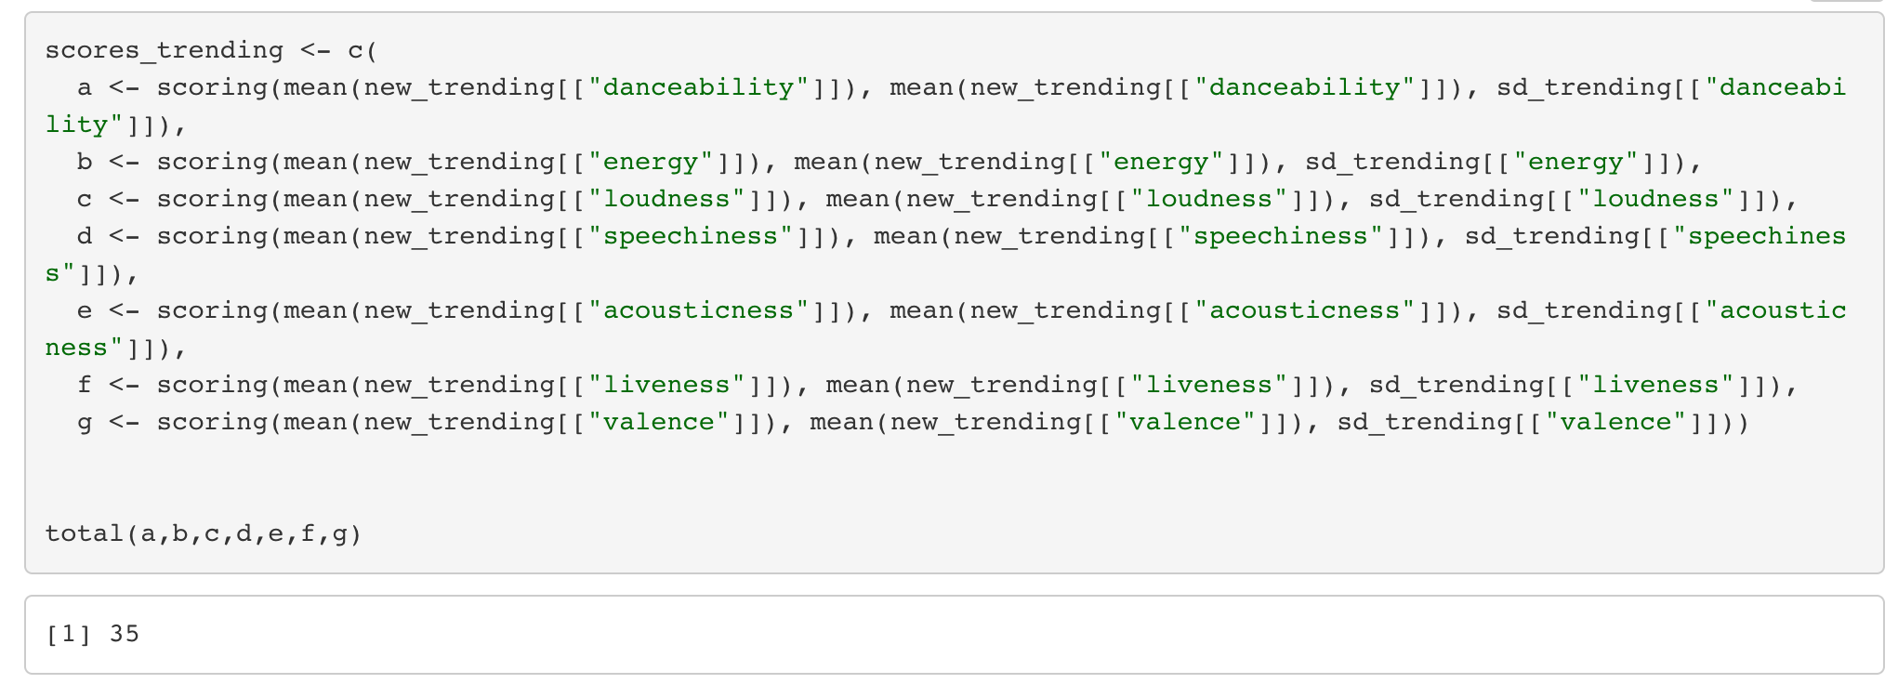
Scoring Example

Slide 11
Results

Slide 12
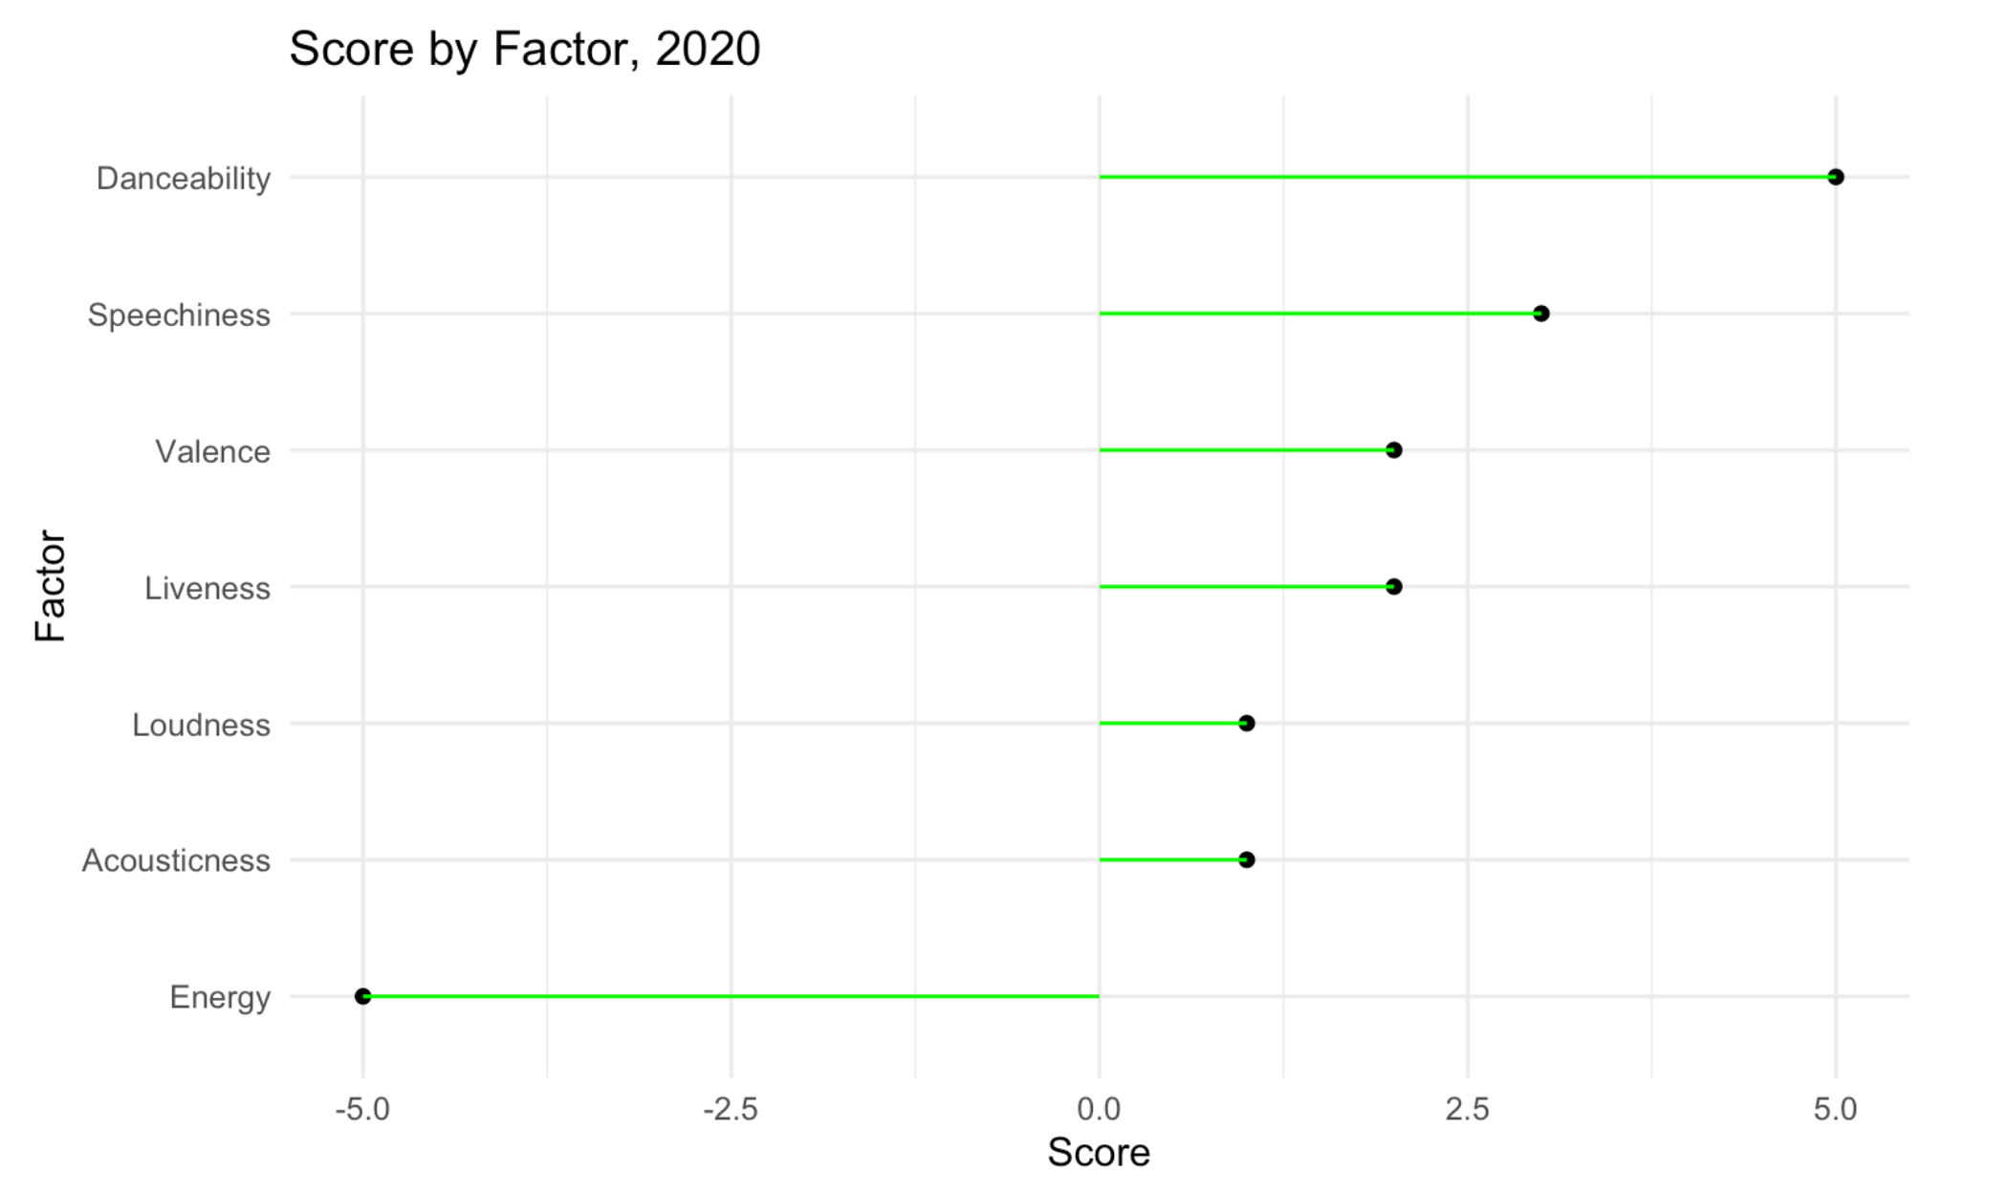
Last Place The year of Chaotic Energy

Slide 13
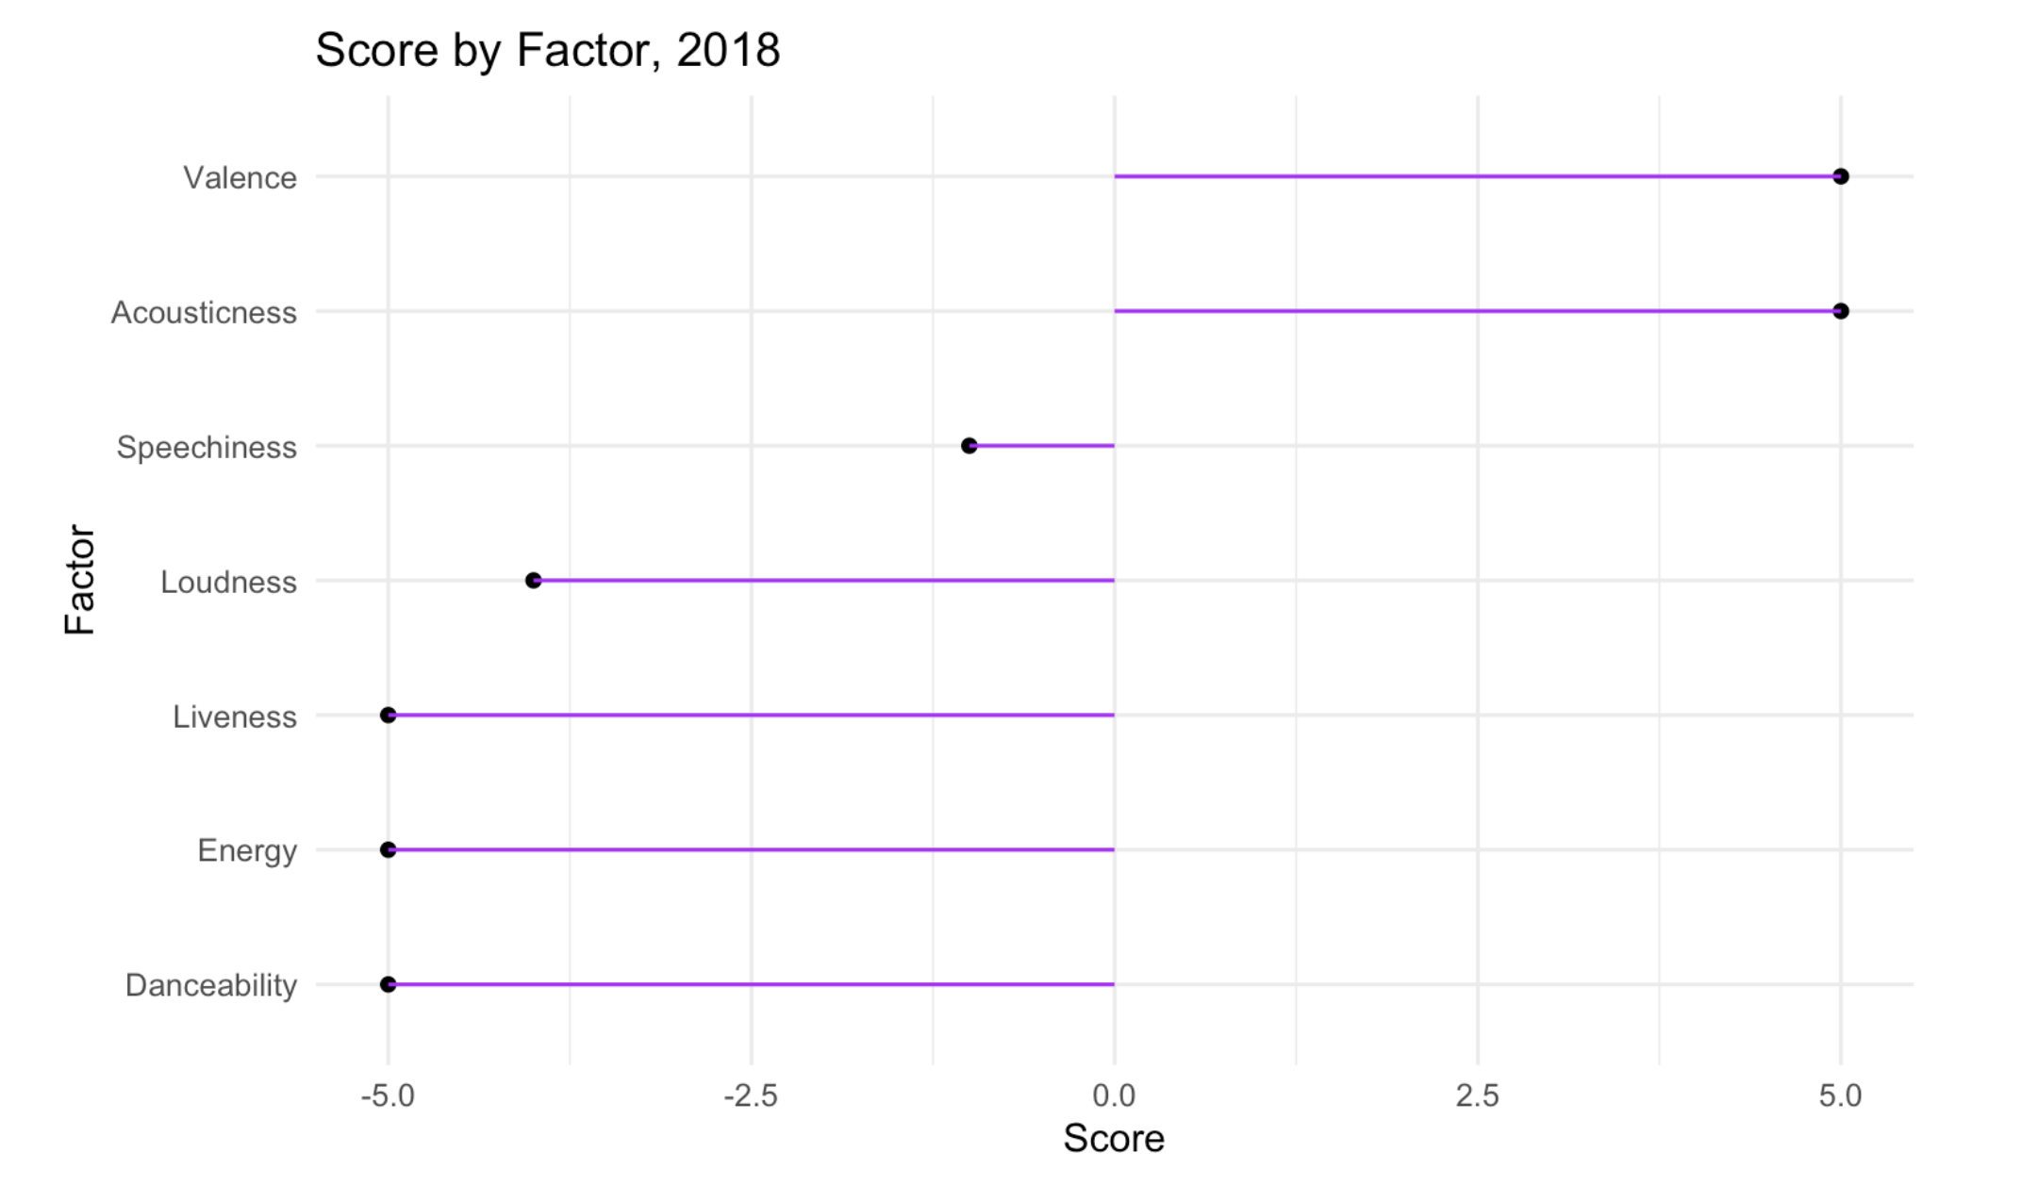
First Place The year of happy

Slide 14
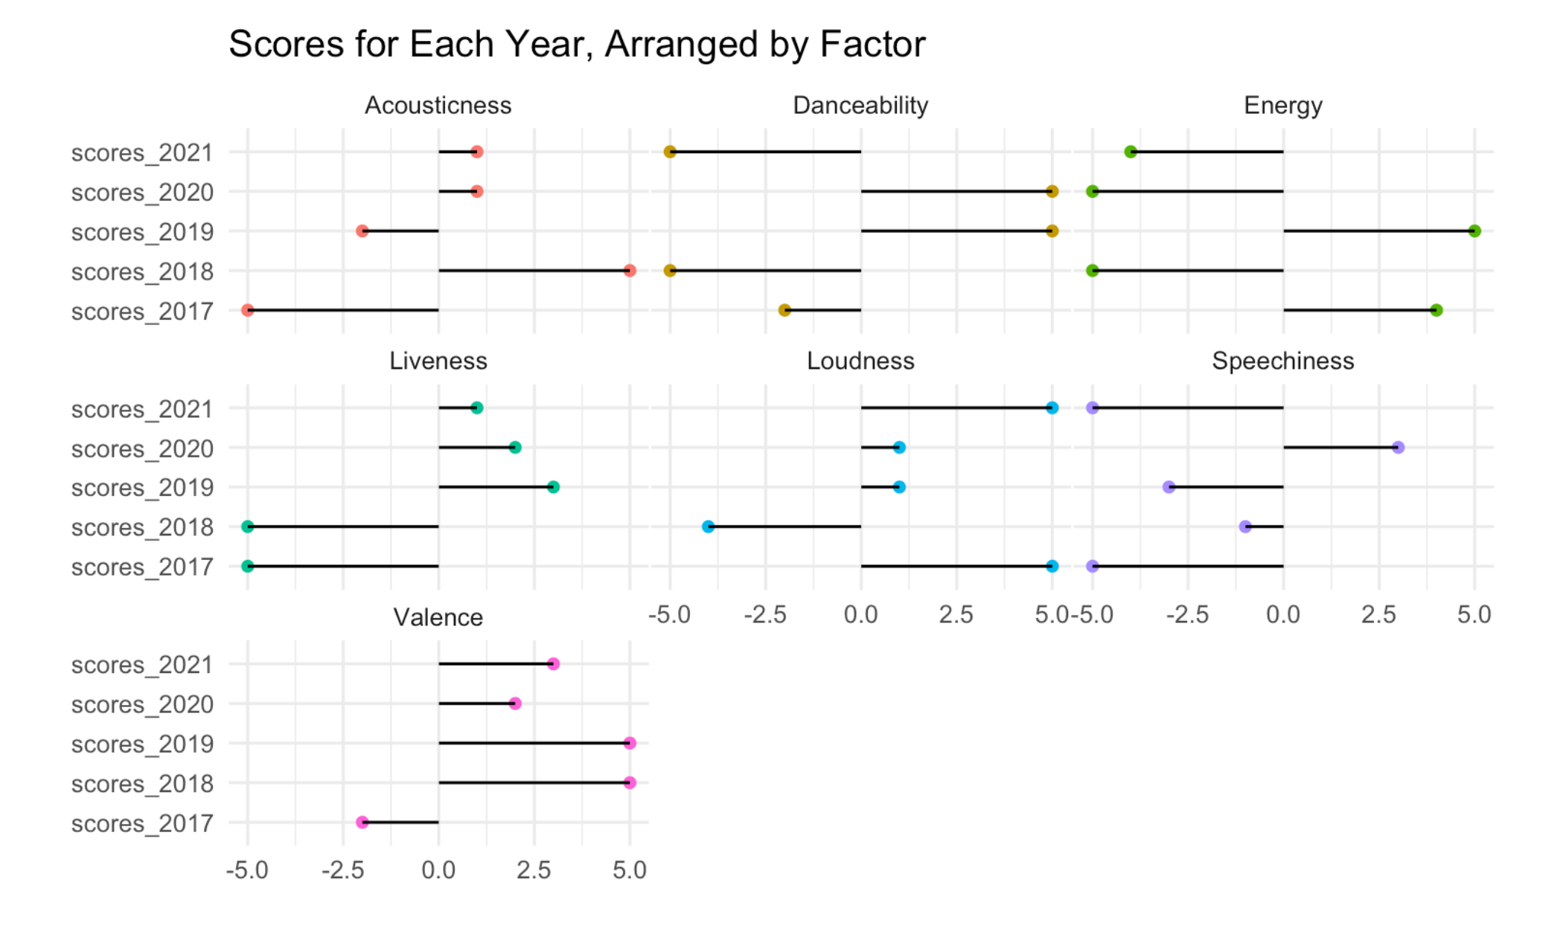
Overview of Scores

Slide 15
So, is my music taste bad?

Slide 16
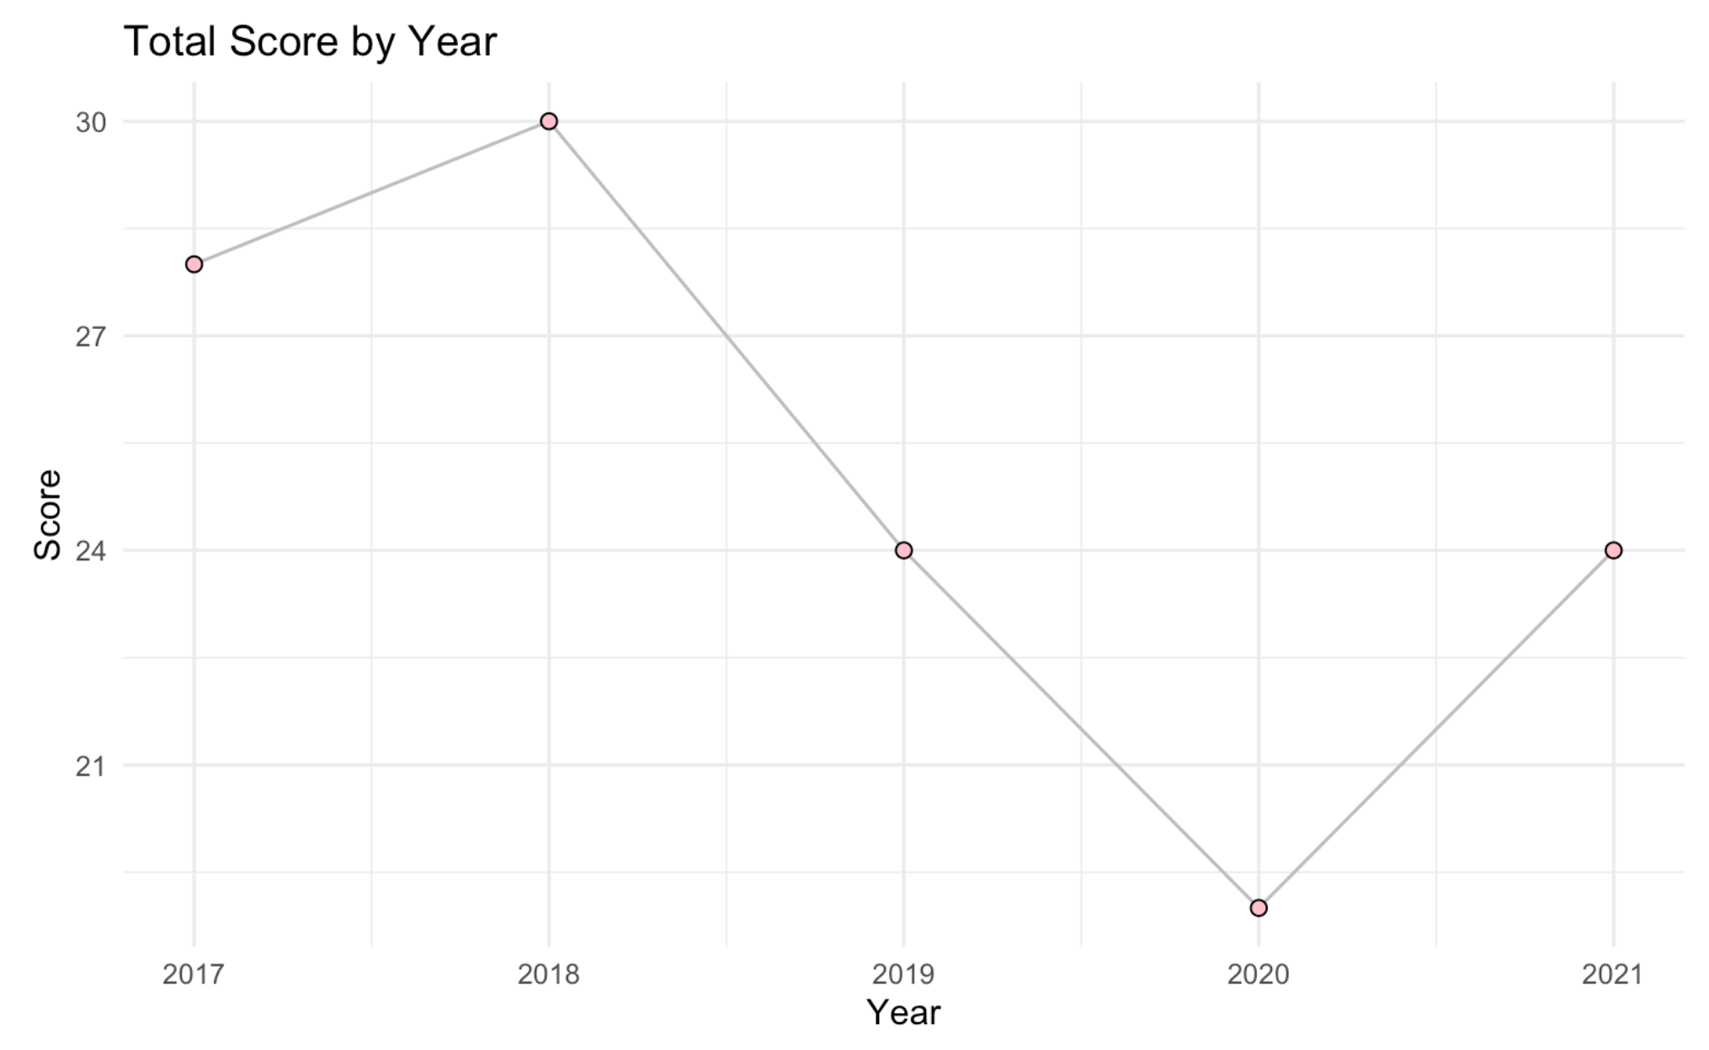
Summary of Scores

Slide 17
Questions?

