Slide 1
Anomaly Detection in weather data exchanging IoT devices
Saadat Hasan Khan
CS 700 – Fall 2022

Slide 2
Motivation of Research
IoT is a hot field – applied in weather data exchanging stations
Such networks maybe be subject to exchange of anomalous values
Anomalous values in a weather data exchanging IoT can come from
Intrusion in network | Abnormal Weather conditions | Sensor malfunction
Need to be detected to make the network more reliable and robust
Anomaly detection done using Machine Learning Algorithms

Slide 3
List of Techniques used
Sampling
Feature selection
Mean, Median, Quartiles – Box and Scatter Plots
K Means Algorithm for clustering data
Naïve Bayes and Decision Tree Classifiers for classifying anomalous/normal data
Hypothesis Testing
Calculation of Confidence Intervals
Approximate Visual Test
Paired Observations
ANOVA

Slide 4
Research Methodology
Sample the data , perform feature selection and find the statistics of the samples. Statistics of data include mean, median and quartiles of the features
Draw a Box plot and Scatter plot to represent data statistics and Anomalies in the data
Clustering using K-means Algorithm to cluster Anomalous and Non-Anomalous data
Train Machine Learning algorithms: Naïve Bayes and Decision Tree Classifiers to test on unseen data to predict whether they are anomalous or normal
Use Approximate Visual Test, ANOVA, Paired Observations on the results of the Machine Learning algorithms’ performance to conclude whether they are significantly different from each other and whether one is better than the other at specific Confidence Interval levels.

Slide 5
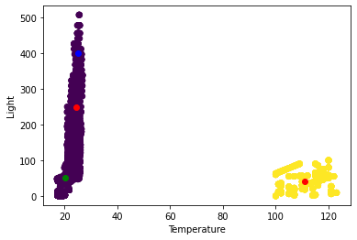
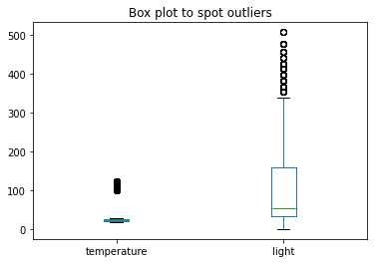
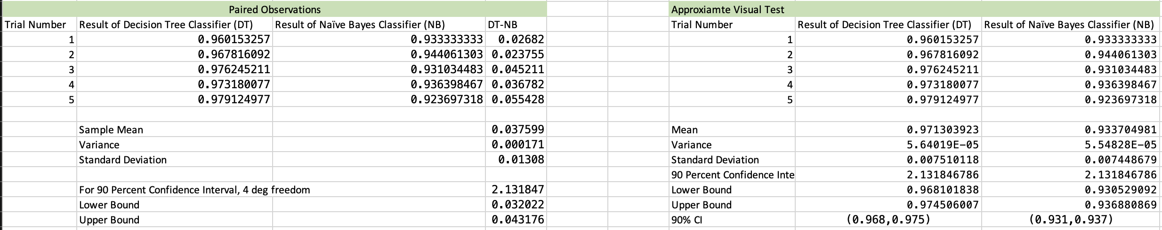
Preliminary Experimental Results
Figure: 2D Scatter plot to visualize anomalies
Figure: Box Plot to visualize anomalies
Figure: Shows Paired Observations Approximate Visual Test

