Slide 1
Implementation of Scheduling Algorithms to Accelerate Robotic Applications
Institute of Computer Engineering/ Chair of Adaptive Systems
Andreas Andreou

Slide 2
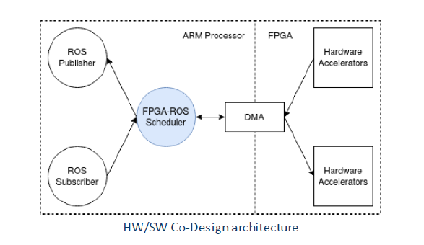
Objective
RTL-Implementation of Scheduling Algorithms
Internal Characteristics
Generalizability
Scalability
Feasibility
Performance

Slide 3
State-of-the Art Scheduling Algorithms
Fixed Priority
Non-Pre-emptive
Pre-emptive
Earliest Deadline First
Pessimistic
Optimized
Least Slack Time

Slide 4
Related Works
Characteristics | [Tanase] | [Doerflinger et al. ] | [M. Vetromille et al.] | [Dannev & Platzner] | [Tang , Neil W.Bergmann] | This Work
Generalized Approach | ✓ | ✓ | ✓ | ✓ | ✓ | ✓
Vendor Independent | ✘ | ✘ | ✓ | ✓ | ✓ | ✓
Adaptability | ✘ | ✘ | ✘ | ✘ | ✘ | ✓
Scalability | ✘ | ✘ | ✓ | ✓ | ✘ | ✓
Fixed & Dynamic Priority | ✘ | ✘ | ✓ | ✘ | ✓ | ✓
Preemptive & Non-Preemptive | ✘ | ✘ | ✘ | ✘ | ✓ | ✓

Slide 5
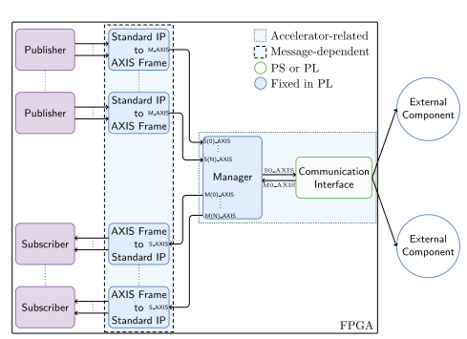
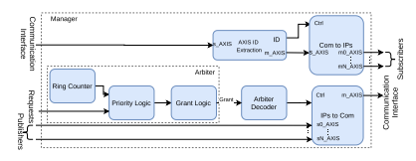
Communication Infrastructure
Figure 1 & 2.
Ariel Podlubne et al. “Model-Based Approach for Automatic Generation of Hardware Architectures for Robotics”

Slide 6
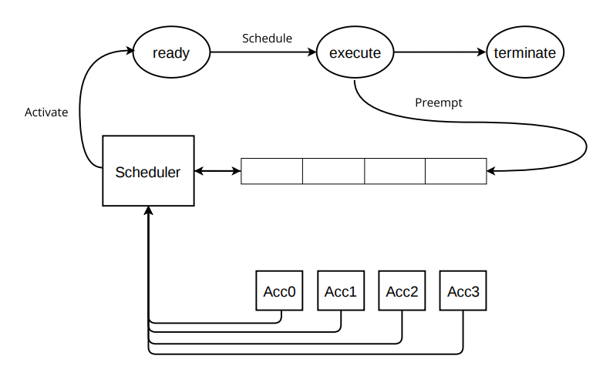
Scheduler Design
States
Queue
Priority Computation
Fixed or dynamic
Preemption or Non-Preemption
Acc0
Acc1
Acc2
Acc3

Slide 7
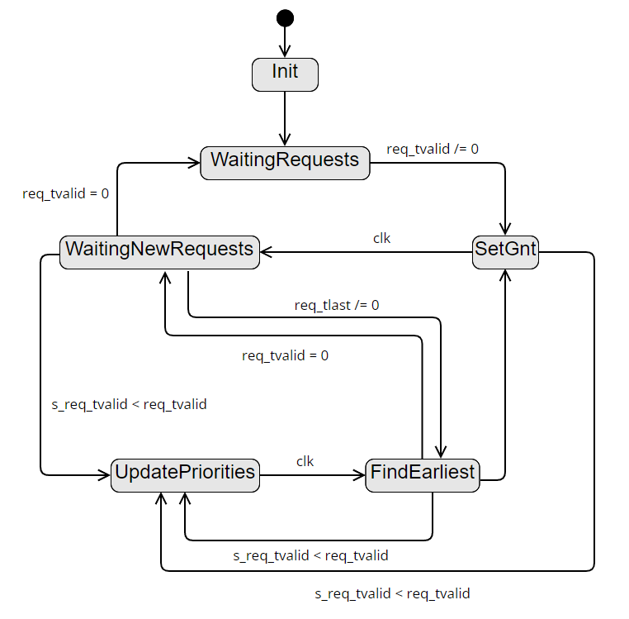
Pessimistic EDF State Machine
Init
WaitingRequests
SetGnt
WaitingNewRequests
UpdatePriorities
FindEarliest

Slide 8
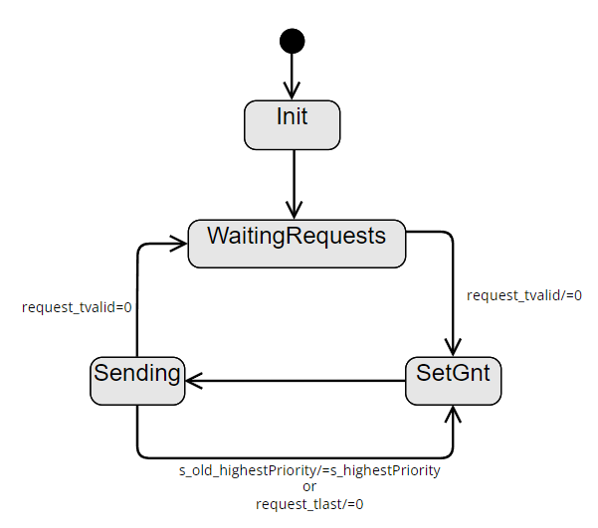
Homogeneous State Machine
Init
WaitingRequests
SetGnt
Sending

Slide 9
Analysis and Evaluation
Scalability
LUT
FF
Scaling Factor
Schedulability
Accelarators served
Length/Period ratio
Latest Transmission
Performance
Average Response Time
Communication Channel Utilization
Lateness
Number of late Jobs
Maximum Latency

Slide 10
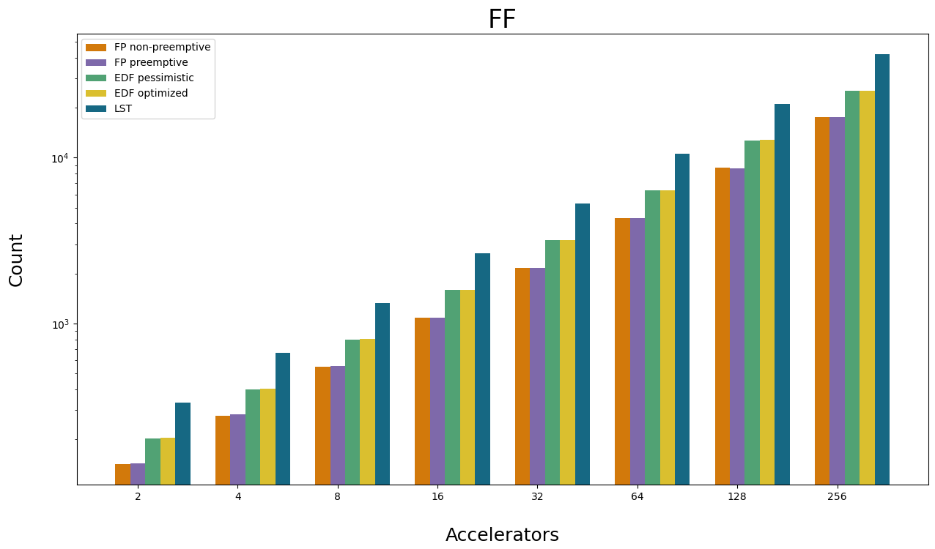
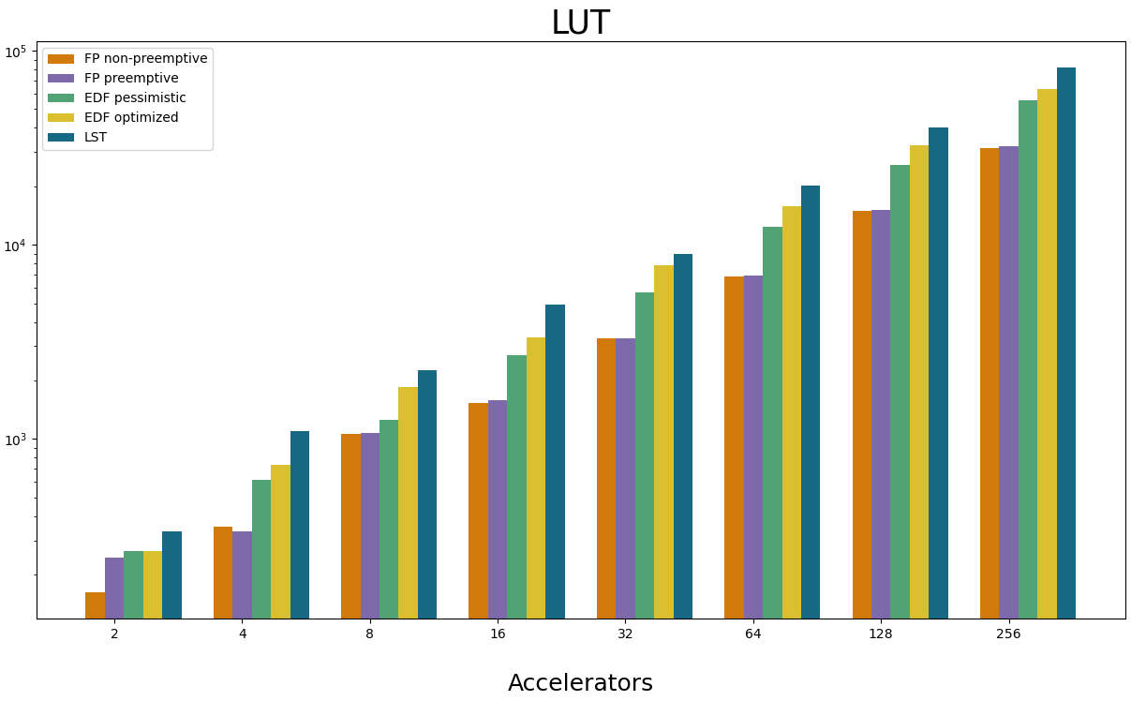
Scalability
 | Non-preemptive FP |  | Preemptive FP |  | Pessimistic EDF |  | Optimized EDF |  | LST
Average Scaling Factor | FF | LUT | FF | LUT | FF | LUT | FF | LUT | FF | LUT
 | 1.99 | 2.17 | 1.99 | 1.80 | 1.99 | 2.15 | 1.99 | 2.21 | 1.99 | 2.23
Linear Scalability
Linear Scalability

Slide 11
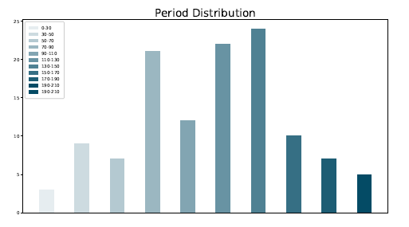
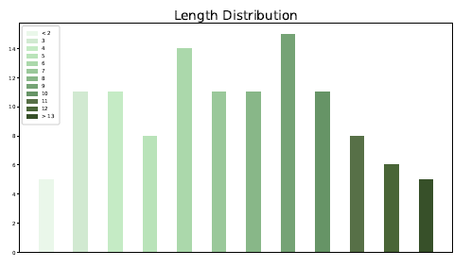

Generated Values

Slide 12
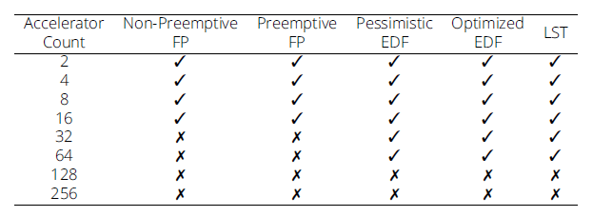
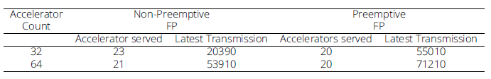
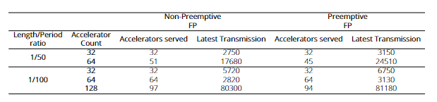
Schedulability
Length/Period ratio
1/15
Length/Period ratio
1/15
Length/Period ratio
1/50
1/100

Slide 13

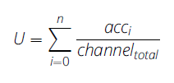



Performance
Average Response Time
Communication Channel Utilization
Lateness
Number of late Jobs
Maximum Latency

Slide 14
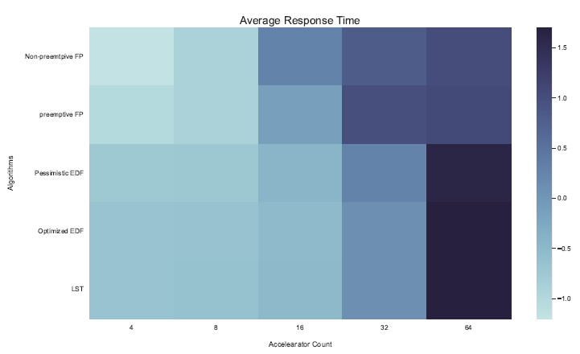
Average Response Times
Normalized horizontally.
Average response is larger with more accelerators.
More apparent in Fixed Priority Schedulers.
EDF and LST more apparent for 32 or more Accelerators.

Slide 15
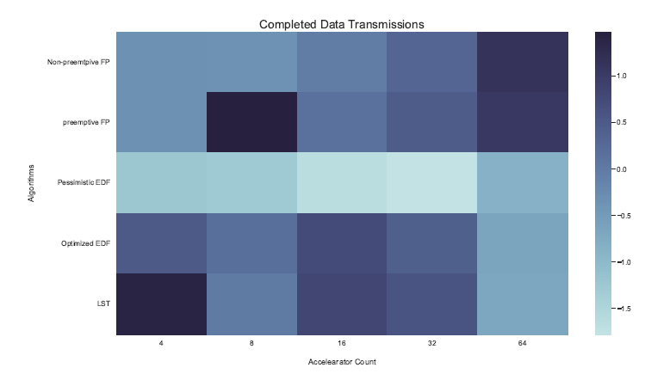
Completed Data Transmissions
Normalized vertically.
Emphasis on comparison of algorithms.
Pessimistic EDF least completed data transmissions.
Completed Transmission less for optimized EDF
and LST with more Accelerators.
Most data transmission for LST for 4 Accelerators
Preemptive fixed Priority for 8 Accelerators

Slide 16
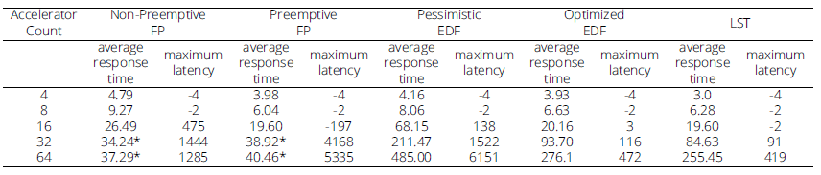
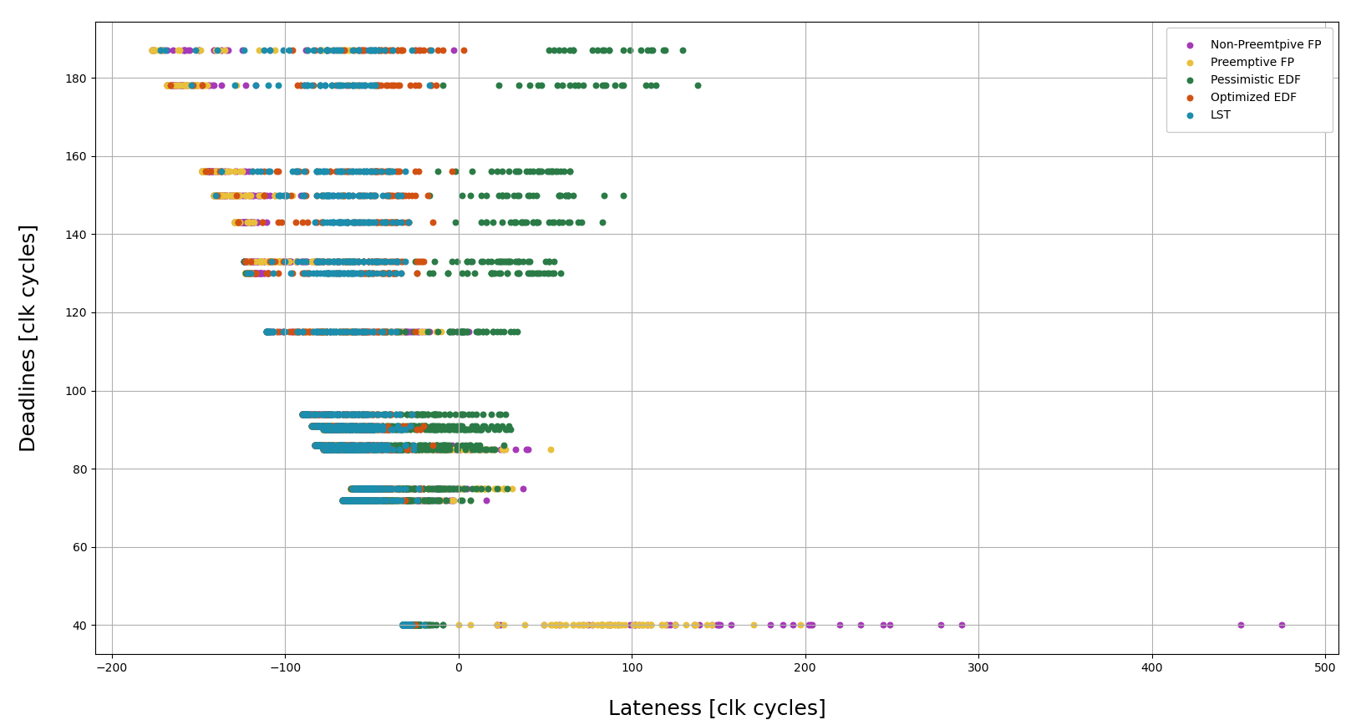
Lateness

Slide 17
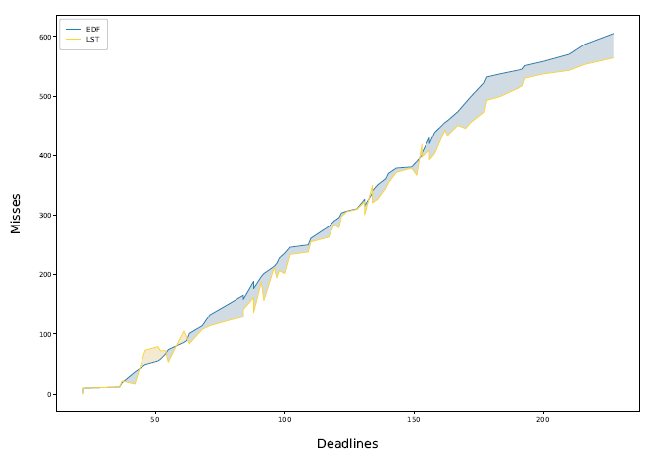
Optimized EDF vs LST
 | Optimized EDF |  | LST
Acc | LUT | FF | LUT | FF
2 | 265 | 205 | 333 | 335
4 | 736 | 405 | 1098 | 665
8 | 1853 | 803 | 2271 | 1327
16 | 3340 | 1601 | 4919 | 2643
32 | 7864 | 3185 | 8986 | 5264
64 | 15761 | 6379 | 20079 | 10553
128 | 32467 | 12756 | 40317 | 21017
256 | 6375 | 25390 | 81939 | 42034

Slide 18
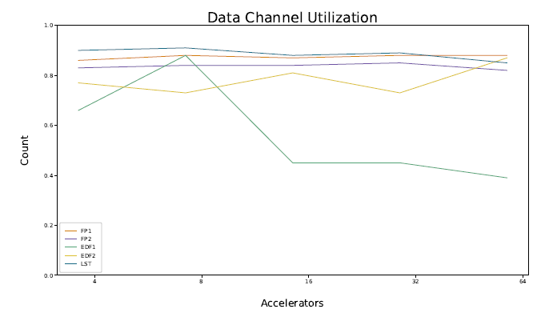
Data Channel Utilization
Pessimistic EDF Scheduler less than 50% for more than 8 Accelerators.
Only sends in one state
Optimized EDF slightly worse than the rest.
LST and Fixed Priorities more than 80%.

Slide 19
Conclusions and Outlook
Generalizable, Feasible, Adaptable
Design Decisions effect on Performance
Schedulability differences between fixed and dynamic Priority implementations
Length/Period effect on Schedulability
Linear Scalability for resources for all algorithms
Consideration of resource utilization should accompany an increase in performance

Slide 20
Bibliography
[1] Cristian Tanase. “Dynamic scheduler implementation used for load distribution between hardware accelerators (RTL) and software tasks (CPU) in heterogeneous systems”. In: The Journal of Supercomputing 76 (Dec. 2020).
DOI: 10.1007/s11227-020-03242-w.
[2] Alexander Doerflinger et al. “Hardware and Software Task Scheduling for ARM-FPGA Platforms”. In: Aug. 2018, pp. 66–73.
DOI: 10.1109/AHS.2018.8541481.
[3] M. Vetromille et al. “RTOS Scheduler Implementation in Hardware and Software for Real Time Applications”. In: Seventeenth IEEE International Workshop on Rapid System Prototyping (RSP’06). 2006, pp. 163–168.
DOI: 10.1109/RSP.2006.34.
[4] K. Danne and Marco Platzner. “Periodic real-time scheduling for FPGA computers”. In: June 2005, pp. 117–127. ISBN: 3-902463-03-1.
DOI: 10.1109/WISES.2005.1438720.
[5] Yi Tang and Neil W. Bergmann. “A Hardware Scheduler Based on Task Queues for FPGA-Based Embedded Real-Time Systems”. In: IEEE Transactions on Computers 64.5(2015), pp. 1254–1267.
DOI: 10.1109/TC.2014.2315637.
[6] Ariel Podlubne et al. “Model-Based Approach for Automatic Generation of Hardware Architectures for Robotics”. In: IEEE Access 9 (2021), pp. 140921–140937.
DOI: 10.1109/ACCESS.2021.3119061.

Slide 21
Thank you for your attention!

Slide 22
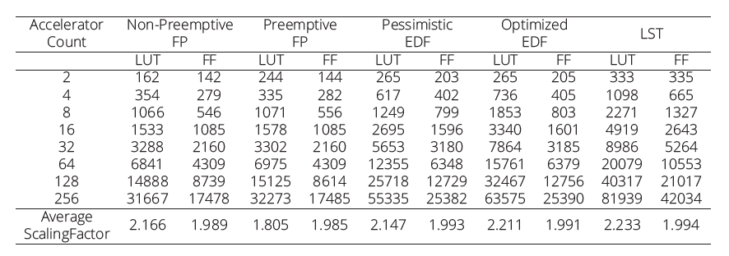
LUT and FF

Slide 23
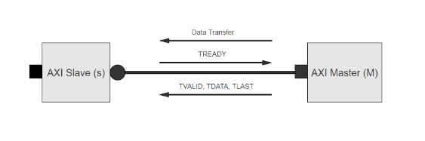
IPs to Com Interface
Accelerators

Slide 24
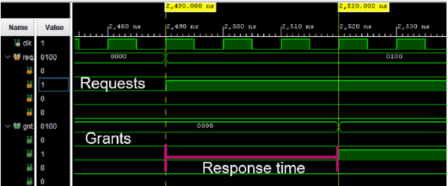
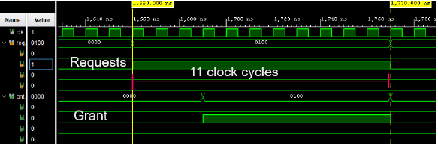

Slide 25
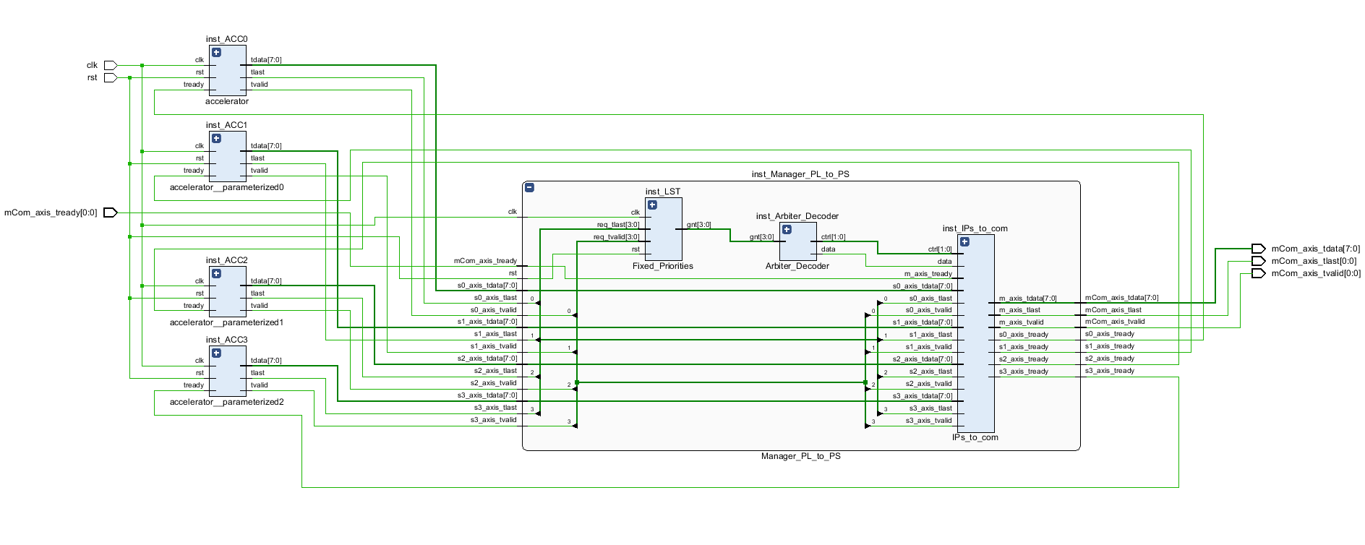
Communication Infrastructure

