Slide 1
CS111
LAB 1B
- GAYATHRI MURALIDHARAN

Slide 2
GAYATHRI MURALIDHARAN
OFFICE HOURS
WEDNESDAY 10:30 – 12:30 PM
Boelter 2432 (TA Room)
MAIL ID :
gayathri92@ucla.edu
Note : Please drop a mail for request for topics to be covered/recapped
It will be covered in class.

Slide 3
Before we begin..
What can you expect from us?
Clear all doubts regarding project spec and expectations
Cover topics that might be needed for the projects
Topics to be covered as per requests by some/all of you
What we expect from you?
Academic honesty **
Ask questions if you do not understand a topic ! We are here to help ☺
Run the sanity test script before submitting the assignment
Make sure you download your submission and double check to prevent uploading faulty submissions !
Use discussion board to post questions and help others as well

Slide 4
Lab0 spec
http://web.cs.ucla.edu/classes/spring17/cs111/index.html

Slide 5
Building blocks - lab0
Posix system calls
File descriptors
Gdb
MakeFile

Slide 6
Posix system calls
Use the man pages !! (man –S <section-number> command)
write(2) - write(int fildes, const void *buf, size_t nbyte);
write() attempts to write nbyte of data to the object referenced by the descriptor fildes from the buffer pointed to by buf.
read(2) - ssize_t read(int fd, void *buf, size_t count);
read() attempts to read up to count bytes from file descriptor fd into the buffer starting at buf.
On success, the number of bytes read is returned (zero indicates end of file), and the file position is advanced by this number. On error, -1 is returned, and errno is set appropriately. In this case, it is left unspecified whether the file position (if any) changes.
close() - int close(int fd);
close() returns zero on success. On error, -1 is returned, and errno is set appropriately.
dup() - The dup() system call creates a copy of the file descriptor oldfd, using the lowest-numbered unused descriptor for the new descriptor.
he dup2() system call performs the same task as dup(), but instead of using the lowest-numbered unused file descriptor, it uses the descriptor number specified in newfd. If the descriptor
newfd was previously open, it is silently closed before being reused.
signal() - signal(int sig, sig_t func);
creat() - int creat(const char *pathname, mode_t mode);

Slide 7
open() - int open(const char *pathname, int flags, mode_t mode);
flags:
O_RDONLY Open the file so that it is read only.
O_WRONLY Open the file so that it is write only.
O_RDWR Open the file so that it can be read from and written to.
modes:
S_IRUSR Set read rights for the owner to true.
S_IWUSR Set write rights for the owner to true.
S_IXUSR Set execution rights for the owner to true.

Slide 8
char *strerror(int errnum);
The strerror() function returns a pointer to a string that describes
the error code passed in the argument errnum
int getopt(int argc, char * const argv[], const char *optstring);
The getopt() function parses the command-line arguments. Its arguments argc and argv are the argument count and array as passed to the main() function on program invocation. An element of argv that starts with '-' (and is not exactly "-" or "--") is an option element. The characters of this element (aside from the initial '-') are option characters. If getopt() is called repeatedly, it returns successively each of the option characters from each of the option elements.
optstring is a string containing the legitimate option characters.

Slide 9
File Descriptors

Slide 10
Using Makefiles
a target (usually a file)
the dependencies (files which the target depends on)
and commands to run, based on the target and dependencies.

Slide 11
Signal handler
signal handling function :
void <signal handler function name> (int sig);

Slide 12
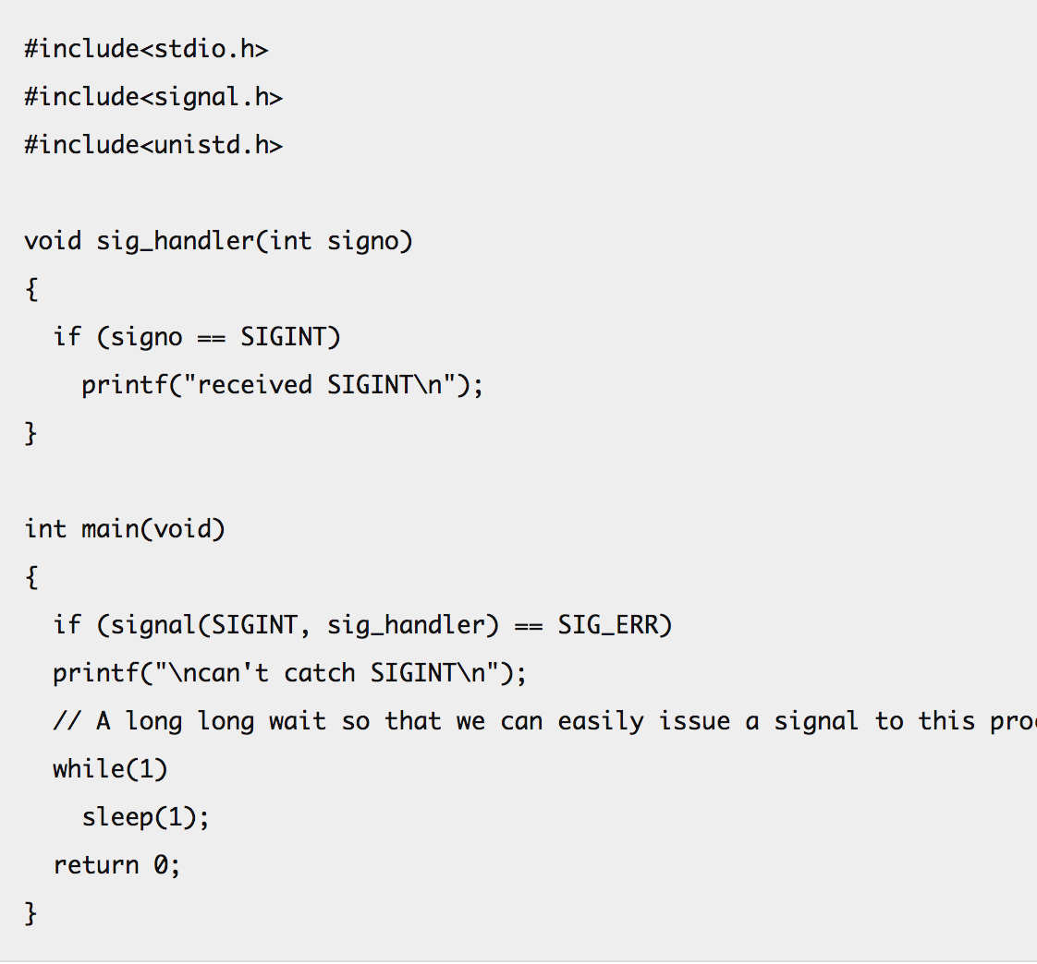

Slide 13
Debugging using GDB
One additional step while compiling, add –g.
Starting gdb -> gdb lab0(the object file)
Running the gdb -> run [optional command line arguments]
Breakpoint -> break lab0.c:61 or break main
continue
step
next
Conditional breakpoints -> break lab0.c:51 if i>=ARRAY_SIZE
backtrace
info breakpoints
https://www.cs.umd.edu/~srhuang/teaching/cmsc212/gdb-tutorial-handout.pdf

Slide 14
Makefile
https://www.cs.umd.edu/class/fall2002/cmsc214/Tutorial/makefile.html

Slide 15
