Slide 1



IT must support, not prevent innovation The world is not in a steady state. Companies have to respond effectively to changes or face disruption FutureForms enables you to react rapidly to accommodate new business needs

Slide 2
FutureForms
Alex Høffner
Oracle, Microsoft, Miracle42
Consultant for more than 30 years
Application development, database tuning, Integration ….
FutureForms
Help customers migrating from Oracle to PostgreSQL
The most comprehensive component library for building database apps
Implement everything I missed in other products/frameworks ☺

Slide 3
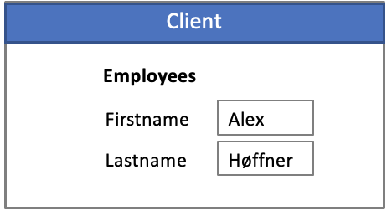
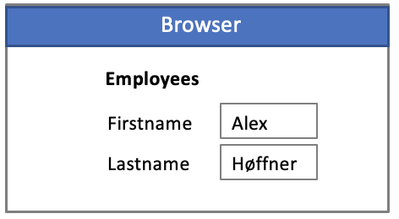
Development tools
1985
2000
2023
Focus:
Business applications
OracleForms
Informix 4GL
PowerBuilder
Microsoft Access
…
Focus:
Web applications
Vue
React
Angular
Focus:
Business (low code)
Apex
Visual Builder
MS Power apps
stateless
Lack of tools for building business applications
Open source FutureForms delivers the efficiency of old 4GL/RAD tools, on bleeding edge technology

Slide 4
Applications
Standard approach
Javascript
Services invoking database
FutureForms
Parses html and binds tags to database tables and columns
OpenRestDB exposes the database as REST
Add business logic
Rest

Slide 5
FutureForms
HTML
datasources
Logic
80+ Objects
Form:
Blocks, Eventhandling
Block:
Optional intersection between Datasource & Fields
Datasource: (Interface)
Get data from any source
ListOfValues: (Interface)
List of valid values for given field
CustomTag:
Replace any tag with custom code
Menu:
Create static or datadriven menues
Inject
Inject
Add
Form
Rest

Slide 6
Integration
Presentation
JSX
Conditional Rendering
( based on state )
React
FutureForms
(React component)
HTML
Conditional Rendering
( based on data )
Business Logic

Slide 7
HTML Generator
Command line tool
htmlgen [options] table template
Iterative process:
Extract properties from the database
Merge properties with template.html
Edit properties
Templates:
Form template <input>
Report template <span>
Make your own templates

Slide 8
FutureForms
Key features
Open Source
Components not framework
Integrates with other frameworks
Object oriented (80+ objects)
Easy to extend
Easy to customize
Easy to create custom tags
Familiar event trigger model
Written in TypeScript
Total segregation of duties
Supports continuous integration
Scales to large development projects
Mouseless operation
No restrictions on html
Rest

Slide 9



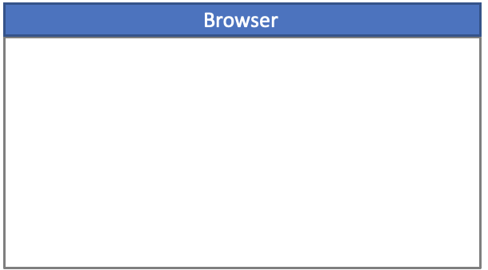
IT Architecture
SaaS
Integration
Custom
HR
CRM
ERP
FutureForms
90% of business needs
The last 10%. That makes the difference

Slide 10
Database
1985
Dedicated
Connections
2023
Pooled
Client/Server
1000 concurrent users
(StateFul)
Leveraging all database features.
Transactions, row-locking, read consistency, cursors etc.
High performance
3 Tier Architecture
50000 concurrent users
(Stateless)
Poor utilization of database features.
Concurrency issues
Compensating transactions
Bad performance due to excessive commits and query re-executions
Rest

Slide 11
Architecture
Internal use
External use
Dedicated
Connections
Pooled
Stateful
Hybrid
Stateless
Standard approach
Authenticated
Not authenticated
Stateless
Connection pool using fixed application user
Security by service implementation
FutureForms
Authenticated
Fixed application user
Stateless, Stateful, Hybrid
Fixed, User, Hybrid
Database security
SQL Validator plugin
SQL Rewriter plugin (VPD)
Rest

Slide 12
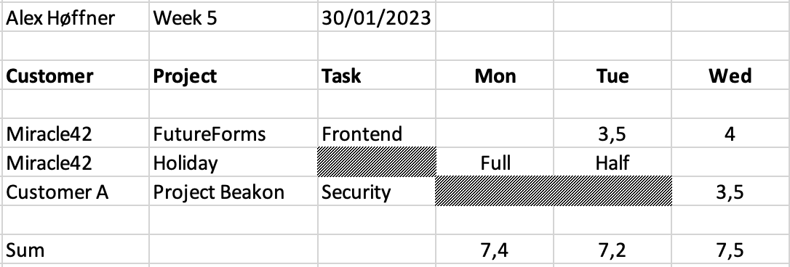
FutureForms
Application is not just about performing CRUD operations
Task is mandatory, except for holidays
Cannot choose same project/task twice
When holiday, limit time entry to Full/Half
Beakon is closed every monday and tuesday
If data has been processed it cannot be updated
Most columns are “lookups”, but should be queryable
Underlying table is “normalized” and has 1 row per date/task
Employee_id
Customer_id
Project_id
Task_id
Date
Hours
Processed
No code and Low code tools are not always adequate

