Slide 1



IT must support, not prevent innovation

Slide 2


PostgreSQL
Best choice when developing custom applications?
100% SaaS
Set role
Updateable views
Insert.. Returning
Select for update nowait
Lots of features that I wouldn’t be without
Integration
HR
CRM
ERP
90% of business needs?
Competitive edge?
Is everything Honky Dory then?

Slide 3
Frameworks
What about efficient development tools?
Open source
Vue
React
Angular
Misc database-aware projects
Oracle
Visual Builder (LC)
ADF
APEX (LC)
Oracle Forms
Fear no more
FutureForms: No Limits Framework

Slide 4
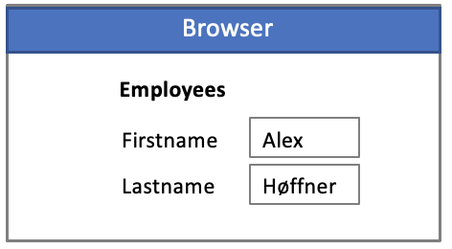
FutureForms
Key features
Open Source
Best Practice Components
Object-oriented (80 objects)
Easy to extend
Easy to customize
Easy to create custom tags
Familiar event trigger model
Written in TypeScript
Total segregation of duties
Supports continuous integration
Scales to large development projects
Mouseless operation
No restrictions on html
OpenRestDB

Slide 5
Simple FutureForm
HTML ←→ Form ←→ Datasource
<table>
<tr>
<th>Code</th><th>Country</th>
</tr>
<tr>
<td><input name="country_id" from="CountryDS"></td>
<td><input name="country_name" from="CountryDS"></td>
</tr>
</table>
import content from './Countries.html’;
@datasource("CountryDS",CountryDS)
export class Countries extends Form
{
constructor()
{
super(content);
}
}
export class CountryDS extends DatabaseTable
{
constructor()
{
super(FormsModule.DATABASE,"countries");
this.sorting = "country_id";
this.primaryKey = "country_id";
}
}
Code goes in here

Slide 6
FutureForms
Is stateless always the best choice?
FutureForms supports 3 models
Statefull
1000 concurrent users
Leveraging all database features.
Transactions, row-locking, read consistency, cursors etc.
High performance
Stateless
50000 concurrent users
Poor utilization of database features (persistent storage).
Concurrency issues
Compensating transactions
Bad performance due to excessive commits and query re-executions
Rest

