Slide 1


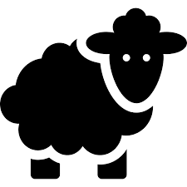
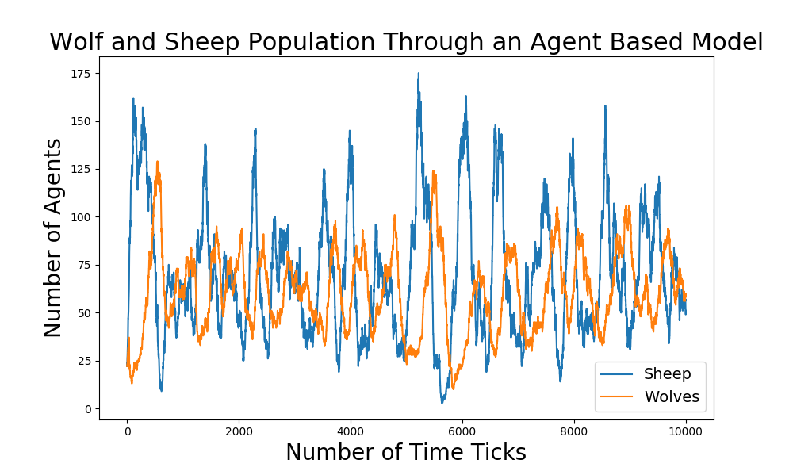
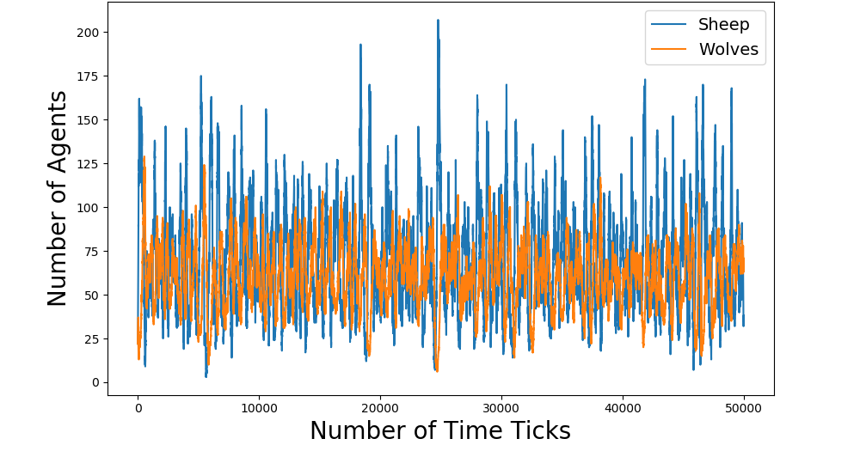
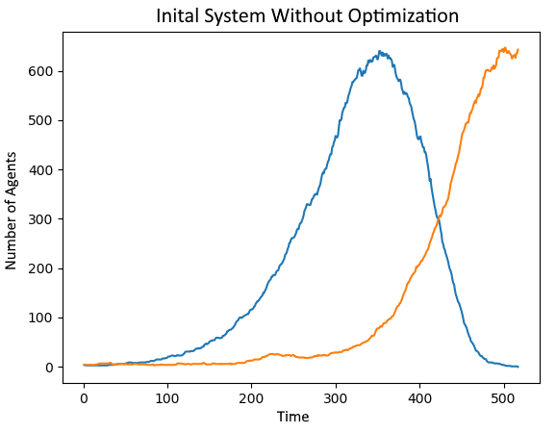
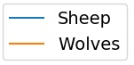
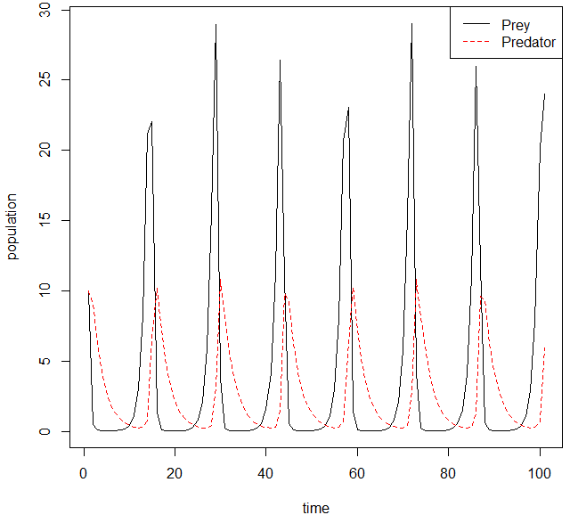
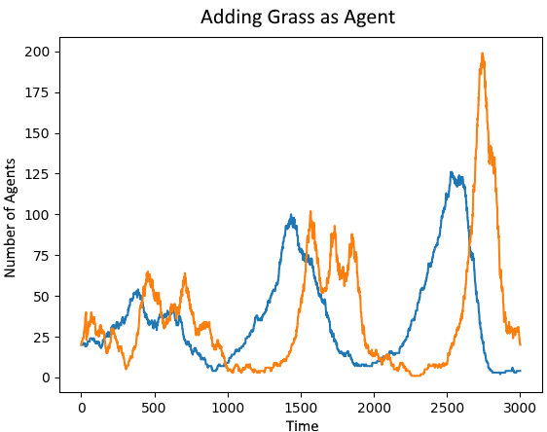
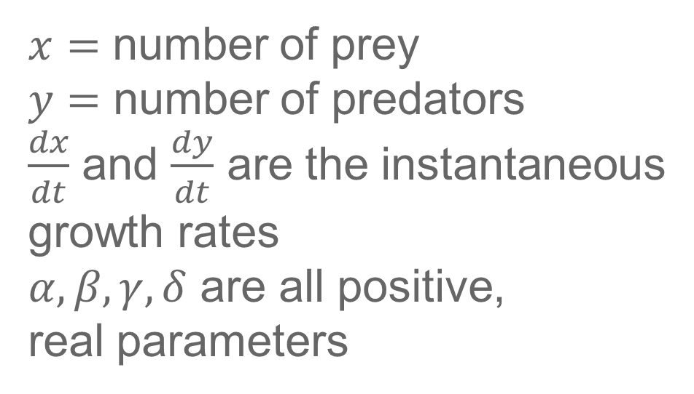
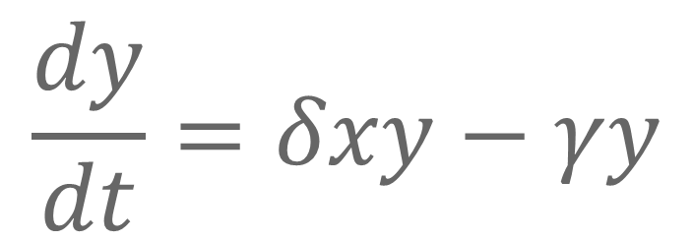
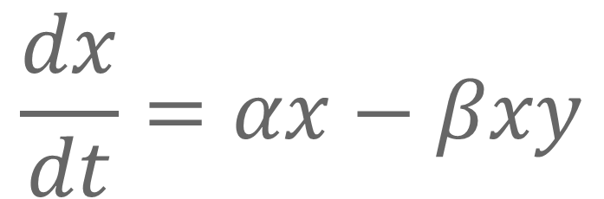
Agent-Based Model for Predator-Prey Relations
Computationally Simulating a Stable Ecosystem
Aaron Holman
Introduction
While in nature ecosystems are incredibly diverse and complex, it is important to develop simple models that reflect these systems accurately. One such interaction is the one between predator and prey. Using an agent-based model, I looked to find what parameters were essential to a stable ecosystem. By observing the number of agents in the system at specific times, I was able to observe trends of the whole system.
Methods
Move animals
Decrease energy
Check wolf actions
Check sheep actions
Reproduce asexually
Repeat
Results
Parameters
Size of grid, number of time ticks, agent production rates, initial agent energies, initial agent positions, initial number of agents, energy gained from actions
Background
The approach to this model I used was an agent-based one. This means I created autonomous agents, in this case wolves and sheep, and observed their effects on the system as a whole. Monte Carlo methods are used in the agents actions to introduce randomness. I used the NetLogo Models Library as a reference for the basic idea on how the agents could act.
The math that underlies this relationship is the Lotka-Volterra equations:
Process
Without a limit on how the sheep population can grow, we see the system is unstable as the wolf population eventually exterminates the sheep.
Size of grid: 50x50, Sheep Production: 3.0%, Wolves Production: 1.0%, Wolf Energy: 40, Sheep Energy: 25, Initial Number of Agents: 20 of each, Energy Gained from Eating Sheep: 40, Energy Gained from Eating Grass: 2, Time Needed for Grass to Grow Back: 60 ticks
$$\frac{dx}{dt}=αx−βxy$$
Conclusion
From this model arises the necessity for a limiting factor on the prey. Without this part of the system in place, the predators would grow at a pace that eventually exterminates the prey. Another important aspect of this model was the need for a higher prey reproduction rate, which reduced the probability of the predators dying off as there was always prey to feed off of. The benefits of an agent-based model is the ability to actually include random fluctuations rather than simply oscillate up and down at a fairly regular period which is predicted by the Lotka-Volterra equations.
$$\frac{dy}{dt}=δxy−γy$$
Through adding the necessity for sheep to eat grass to stay alive, the total population is limited which greatly increased the stability of the total ecosystem, but still it oscillated out of control.
$x=$ number of prey
$y=$ number of predators
$\frac{dx}{dt}$ and $\frac{dy}{dt}$ are the instantaneous
growth rates
$α,β,γ,δ$ are all positive,
real parameters
Basic Latka-Volterra relationship

