Slide 1

How To
Ask For Help

Slide 2
Why People Avoid Asking for Help
Many people wait too long to ask
Worries about asking could include:
Don't want to look inexperienced
Think they should already know the answer
Worry about bothering others
Hope the problem will resolve itself
Unfortunately, waiting too long often creates bigger problems
Do not wait until:
The night before a deadline
A project has completely failed
A small issue becomes a major issue
You're in a panic

Slide 3
Try First
Students
Re-read instructions
Review course materials
Check examples
Review feedback (if applicable)
Search notes and resources
Workplace
Review documentation
Search internal knowledge bases
Check project requirements
Review previous communications
Examine similar examples (if applicable)
The goal is to understand enough to ask a meaningful question.
Decide how much time you will spend reviewing materials and researching on your own before asking for help.

Slide 4
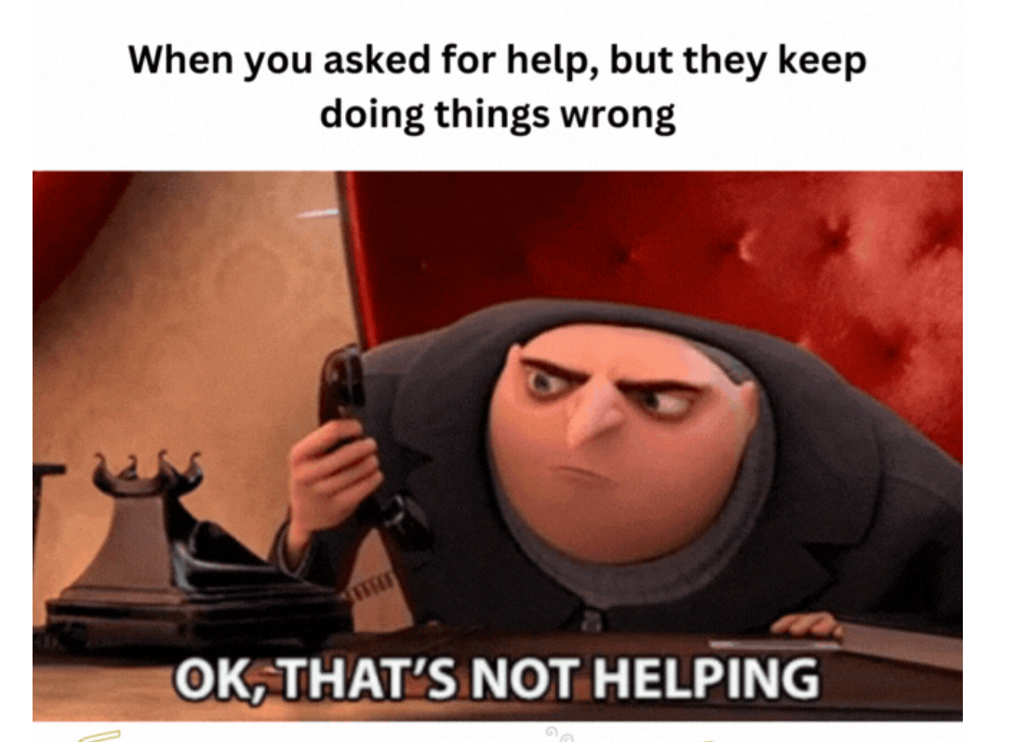
Identify the Specific Problem
Specific questions receive faster and more useful responses
Good questions also lead to shorter discussions because there is less back and forth hoping the right question gets asked or an answer is stumbled on
Bad Example:
"I don't get it."
Good Example:
"I understand how to create the database table, but I'm unsure how to connect it to my web application."

Slide 5

Ask yourself some questions
Before reaching out, write down:
What are you trying to do?
What actually happened?
What did you expect to happen?
What have you already tried?
What specific question do you need answered?

Slide 6
Find the right person to talk to
If you are a student, your teacher/professor is a good potential first person to reach out to, they might not have the answer, but they might be able to suggest another person
Examples of who to go to when
Supervisor:
Priorities
Expectations
Decision-making
Coworker:
Processes
Tools
Procedures
Internal Documentation
Subject Matter Expert:
Specialized knowledge
Instructor:
Assignment expectations
Course concepts
Grading questions
Tutor:
Practice and reinforcement
Classmate:
Clarification and discussion

Slide 7
Ask a Clear Question
A good help request includes:
Context
What you tried/What didn't work
The obstacle
A specific clear question
Help Request Formula:
Context
What are you working on?
Effort
What have you already tried?
Problem
What is preventing progress?
Question
What specific help do you need?

Slide 8

Example of an unhelpful help request
Poor Requests:
"Hi. I don't understand the paper. Can you help?"
"What do I do?"
"This doesn't make sense"
The instructor has no information about the problem.

Slide 9
Example of a helpful help request
Hello Professor Smith,
I am working on the research paper due next week and have completed my initial source gathering.
I found six sources, including two academic journal articles, two government reports, and two news articles. After reviewing the assignment instructions, I am unsure whether the news articles meet the requirement for scholarly sources.
I reviewed the assignment sheet and the example bibliography but am still uncertain about the expectations.
Could you clarify whether news articles are acceptable supporting sources, or should I replace them with more scholarly articles?
Thank you for your time
Why this is better: Provides context, Demonstrates effort, Explains the specific concern, Asks a focused question

Slide 10

Example for a workplace
Scenario:
An employee is working on a website update and encounters a problem connecting to a database.
Poor Request
The website is broken. What should I do?
This requires the other person to investigate everything

Slide 11
Example for a workplace
Hi Betty,
I'm currently working on the customer portal update and am trying to connect the application to the new database server.
I reviewed the deployment documentation and verified that the connection string matches the project requirements. I also tested the database credentials provided in the setup guide.
The application starts successfully, but I receive a connection timeout whenever it attempts to retrieve customer data.
Before I continue troubleshooting, can you confirm whether there are any firewall or network configuration steps required for development environments?
Thank you

Slide 12

Common Mistakes
Avoid:
"It doesn't work."
Explain what happened instead.
Asking Multiple Unrelated Questions
Focus on the most important issue first.
Waiting Too Long
Small problems become larger problems.
Hiding What You Tried
Sharing your attempts helps others avoid repeating steps.
Asking for the Entire Solution
Ask for guidance, not for someone else to complete the work.

Slide 13
Following Up After Receiving Help
Acknowledge the Help
Thank the person for their time.
Apply the Advice
Attempt the suggested solution.
Report Results or follow up if needed
If appropriate, explain whether the suggestion worked.
Example:
Thank you for the recommendation. Updating the connection settings resolved the issue and the application is now communicating with the database correctly.

