Slide 1

How to
Communicate professionally

Slide 2

Why Professional Communication Matters
Strong communication helps people build trust, avoid misunderstandings, solve problems faster, collaborate more effectively and create positive professional relationships
Professional communication is not about sounding formal or using complicated language
It is about being clear, respectful, and purposeful

Slide 3
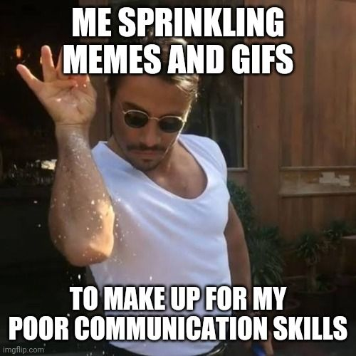
Consider Your Audience
Before communicating, ask: Who am I communicating with? How might they best hear and understand me?
For example, slang may be ok to include for peers, but not welcome for professors or supervisors at work. No cap.
What do they need to know?
Provide enough information to understand the situation without overwhelming them
What outcome am I hoping for?
Asking a question
Providing information
Requesting help
Giving an update
Solving a problem

Slide 4
How to refer to people
Consider titles and if the person you are talking to wishes to have things like Professor, Dr or something else included
Don't assume gender or marital status
For example, Ms. Mrs. Or Miss are not interchangeable and people can have strong feelings about what they want to be called
Consider including your pronouns as way to indicate you are open to using what someone else prefers
Consider using generic pronouns (they/them) until you know what the person you are talking to prefers
If someone asks you to refer to them by a specific name, use it

Slide 5
Choose the Right Communication Method
Situation | Best Method
Complex discussion | Meeting or conversation with notes and a summary
Quick question | Chat/IM
Formal request | Email
Documentation | Email and/or internal documents
Urgent issue | Call or direct message

Slide 6
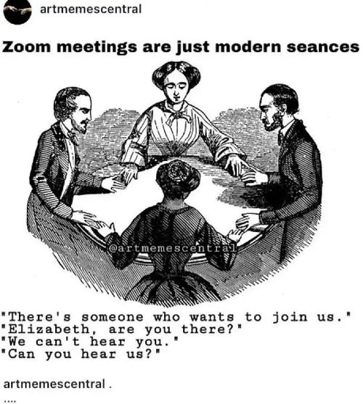
In-Person Communication
Be Prepared
Know:
Why you're meeting
What questions you have
What information you need
Listen Actively
Focus on understanding
Consider taking notes, recording or another way to remember the conversation
Ask the other people if they are ok with notes/recording
Do a follow-up email/chat to check understanding

Slide 7
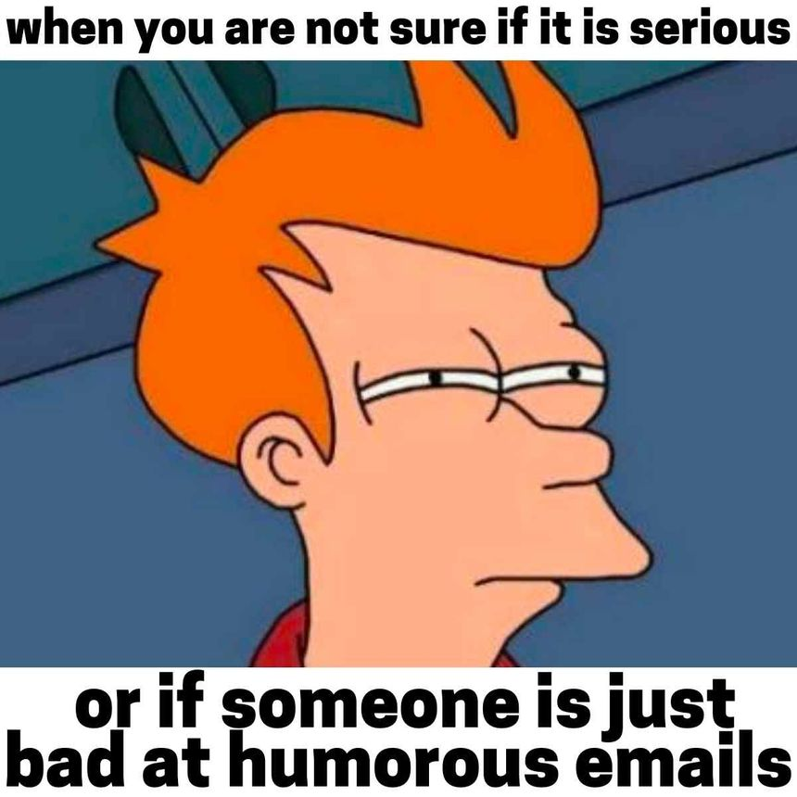
Email Communication
Structure Emails Professionally
A professional email should include:
Subject Line
Greeting
Context
Purpose
Closing
Signature

Slide 8
Chat Platforms (Teams, Slack, Discord, etc)
Write Clear Chat Messages
A good chat message includes:
Context
Purpose
Specific question or update
Brievity
Do | Avoid
Be concise | One-word messages
Be respectful | Excessive abbreviations
Use complete thoughts | Sending multiple fragmented messages
Provide context | Using chat for complex discussions

Slide 9
Handling Difficult Conversations
Professional communication is especially important during disagreement
Focus on the Problem
Instead of:
You never finish your work.
Try:
The task assigned for Tuesday hasn't been completed yet. Can we discuss how to move forward?
Ask Questions instead of making assumptions
Be Solution-Oriented
Focus on:
Next steps, Clarification, and Resolution
Don't forcus on:
Blame, Frustration, Personal criticism

Slide 10
Review Before Sending messages/emails
Ask:
Is my purpose clear?
Have I provided enough context?
Is my tone professional?
Practice Active Listening In meetings and conversations:
Listen fully
Ask clarifying questions
Summarize next steps
Match the Communication Method to the Situation
Focus on Clarity
The best professional communicators are not the most formal.
They are the clearest.

