Slide 1

How To
Solve Large Problems

Slide 2

Read the Assignment/Project
Consider how you process information best
Would it help to have someone read it out loud?
Would it help to take notes or highlight?
Can you identify what your teacher/professor/supervisor is trying to have you learn or create?
Read through the assignment and any auxiliary materials

Slide 3
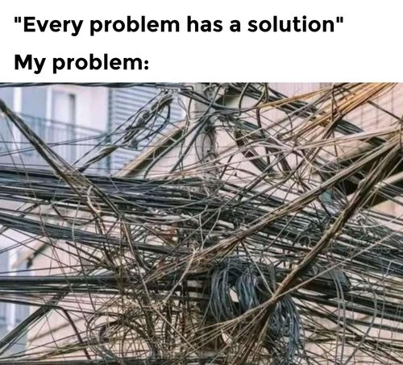
Start the Break down – What to look for
Reverse-engineer the assignment. Highlight required deliverables, rubric, criteria, formatting requirements, citation rules, and deadlines.
Ask yourself:
What must exist at submission for full credit?
What is the goal for this problem?
What are some potential roadblocks or issues you see?

Slide 4
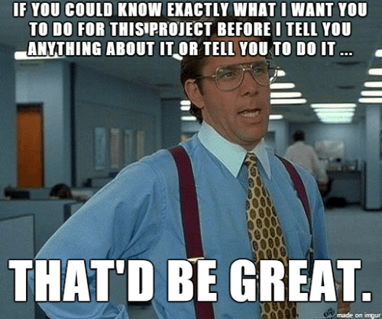
Identify Deliverables
Identify visible deliverables.
Break the assignment into measurable outputs
Examples might include:
Outline
Draft
Prototype
Report
Something else?

Slide 5

Create micro-tasks
Convert deliverables into micro-tasks
If a task feels overwhelming, it is still too large
Be honest about your time, availability, and attention span
Consider having tasks with different needs, for example you could have heavier thinking tasks, easy tasks, tasks that require research, or tasks that you can do without assistance

Slide 6
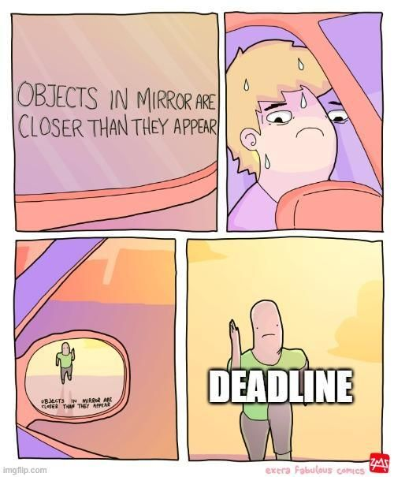
Timeline
Create a timeline using backward planning from the due date and add 1–2 buffer days.
Add timeline to your calendar
Make reminders
Identify what other tools, resources or reminders might be helpful for you
For example, do you need external deadlines? Ask a friend to check in with you
Do you have a device that's always with you that you could use for reminders?

Slide 7
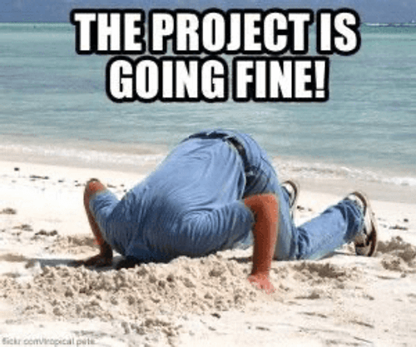
Check ins
Build structured check-ins at approximately 30%, 60%, and 90% completion
Check-ins could be just you for 5 minutes reviewing your project
A check in could be with another student or team member
A check in could be with a friend to have some accountability
Check-ins should be on the calendar
Have a plan for if the check in is missed, or the expected materials weren't completed, make it specific! Don't just say you'll work harder or do better, have specific changes you'll make

Slide 8

Example 1 – Research Paper
Assignment: Write an 8–10 page research paper due in 2 months
Deliverables: Topic approval, annotated bibliography (6 sources), outline, full draft, final paper

Slide 9

Example 1 Breakdowns
Micro-task breakdown example:
Choose topic;
Find 6 sources
Annotate sources
Draft introduction
Draft body section 1
Check Draft/Revise
Body section 2
Draft conclusion
Edit for clarity and do your revisions
Read the entire paper out loud
Format citations

Slide 10
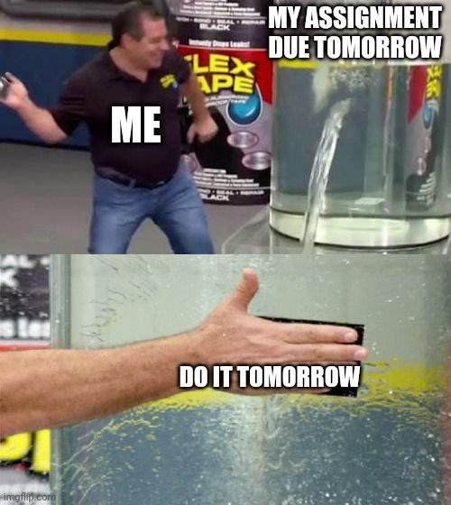
Example 1 – Timeline and Check-ins
Timeline Example:
March 25 – Topic approval
April 2 – Annotated bibliography complete
April 5 – Detailed outline
April 7 – Draft body section 1
April 8 – Draft body section 2
April 9 – Combine into Full draft complete
April 11 – Peer review
April 13 – Final edits
April 15 – Submit final paper
Check-ins:
Source quality review
Rubric alignment review
Formatting and citation check​

Slide 11
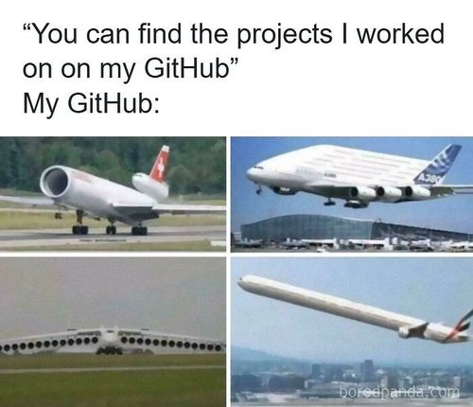
Example 2 – Website or Application
Assignment: Design and build a functional app with user input, data storage, and at least three core features. Due May 1
Deliverables: Project proposal, feature list, wireframes/mockups, technical design plan, working prototype, deployed application, documentation (README/report), presentation/demo

Slide 12
Example 2 First Breakdown
Proposal tasks: Define app purpose; Identify target users; List required features; Submit short description
Design tasks: Sketch wireframes; Define user flow; Choose tech stack; Design database schema
Development tasks per feature: Create database table; Build UI components; Implement backend logic; Validate inputs; Test features independently
Testing tasks: Test edge cases; Validate inputs; Check responsiveness; Review logs; Fix integration errors
Documentation tasks: Write README; Add installation steps; Include screenshots; Describe features; List known limitations

Slide 13

Example 2 Timeline Breakdown
April 5 – Proposal approved
April 8 – Wireframes complete
April 12 – Database schema finalized
April 16 – Feature 1 complete
April 20 – Feature 2 complete
April 23 – Feature 3 complete
April 25 – Full integration testing
April 27 – Documentation written
April 29 – Final bug fixes
May 1 – Submission
Check-ins: Does design support all features? Do features work independently? Does full system function without errors? Does documentation match the product?

Slide 14
Project Management Suggestions
Use visible tracking tools (checklists, calendars, Kanban boards)
Define minimum viable progress for low-energy days (small task completion)
Separate creation from editing/debugging to maintain momentum
Use structured time blocks (25-minute focused sessions if that is how you work well )
Avoid single-point failure by spreading work across multiple days
For programming projects: Develop one feature fully before starting another and commit frequently using version control

