Slide 1

How To
Collaborate as a Team

Slide 2
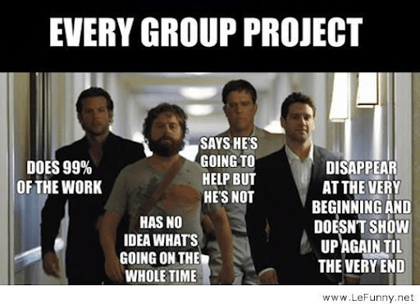
Why Team Projects Fail
No clear division of responsibilities
Team members assume someone else is doing the work
Poor communication
Work starts too late
One person does most of the work
Conflicts are ignored until the deadline approaches
No system for tracking progress

Slide 3
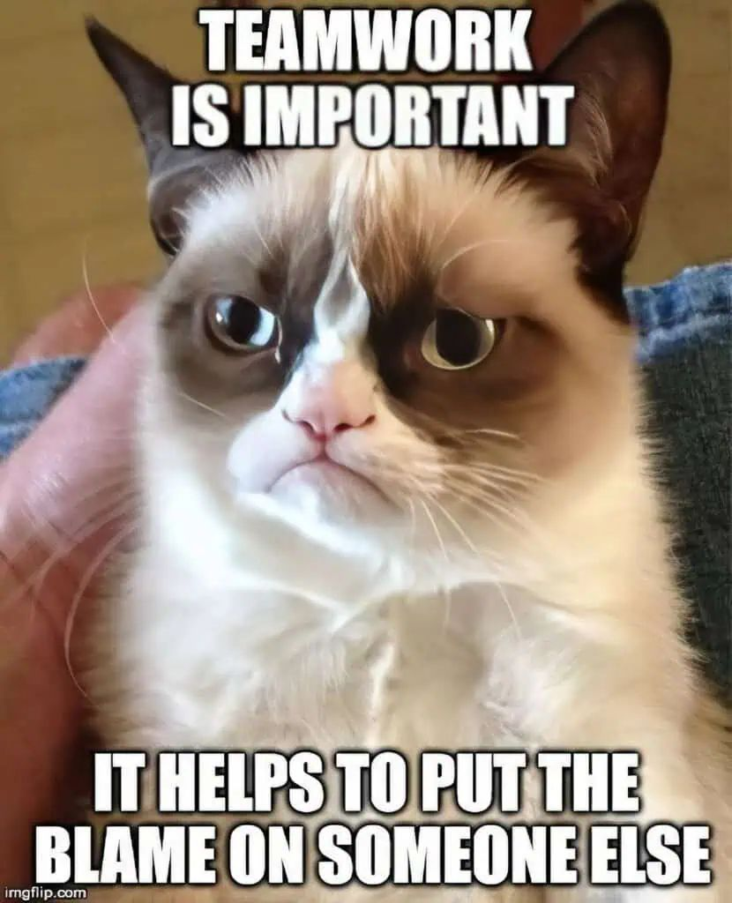
Step 1: Define the Project
Discuss:
What does success look like?
What are the required deliverables?
What are the grading criteria?
What are the major milestones?
Create a shared project summary that includes everything spelled out including communication methods, project summary with deadlines and anything else that the team thinks is important to bring up

Slide 4
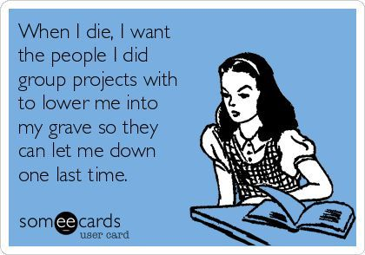
Step 2: Establish Team Expectations
Communication
How will we communicate?
How quickly should messages be answered?
What happens if someone is unavailable?
Meetings
How often will we meet?
In person or online?
Who schedules meetings?
Accountability
What happens if a deadline is missed?
How will concerns be raised?
How will work be reviewed before submission?

Slide 5
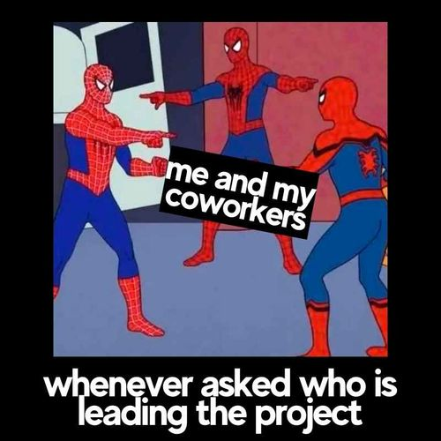
Step 3: Break Work Into Tasks
Avoid agreeing to vague responsibilities
Tasks should be:
Specific
Measurable
Assigned to specific people
Time-bound

Slide 6
Step 4: Create Internal Deadlines
Never use the final due date as the first deadline
Internal deadlines create room for revisions and unexpected problems
Plan for issues and roadblocks
Make sure to take into account everyone's schedule and availability
For example, if you have things do in 3 classes on one day that might not be a good day to have more things due

Slide 7
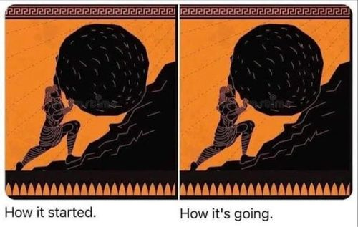
Step 5: Track Progress
Teams should always know:
What is complete
What is in progress
What still needs to be done
Who is working on what
Tool Ideas/Suggestions:
Trello
GitHub Projects
Microsoft Planner
Sticky notes
Whiteboard

Slide 8
Step 6: Address Problems Early
Most team conflicts become difficult because nobody addresses them
Clear and straightforward communication is important
Remember everyone wants to do well and thinks they are a good person; conflicts can come from misunderstandings and communication issues
Focus on: | Avoid:
Actions | Personal attacks
Expectations | Assumptions
Solutions | Public confrontation

Slide 9
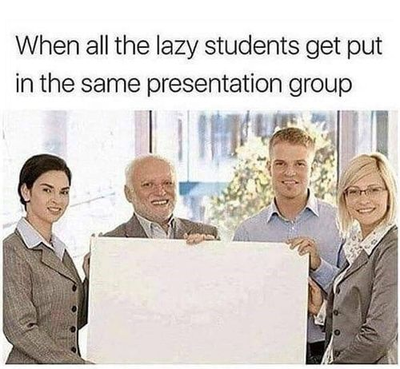
Example: Research Presentation Team
Assignment: Create a 15-minute presentation on renewable energy policy
Team: 4 students
Things to do:
Topic selection
Research
Content development
Slide creation
Presentation preparation

Slide 10

Example – Research Phase
Research Phase: Each student finds 2–3 credible sources and does some research on the topic independently
As a group Discuss:
Evaluate source quality
Compare findings
Identify common themes
Decide which information to include

Slide 11

Example – Start the project
Content Development:
Create presentation outline together
Determine and list key points
Decide who will explain each section
Slide Development could be done together or independently for each section

Slide 12
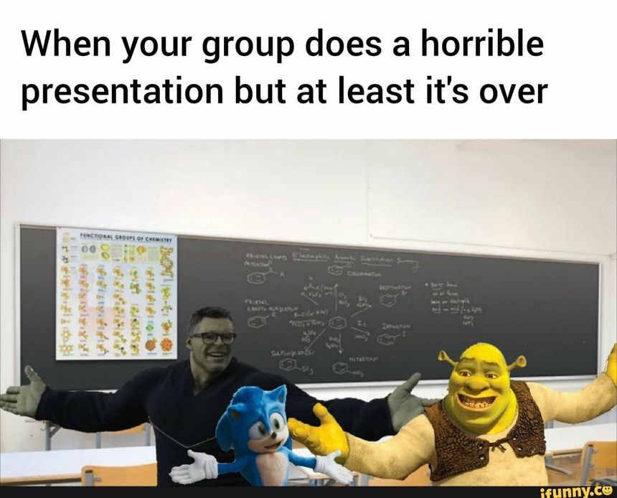
Example - Practice and Revision
Review visual design, slides and citations
Suggest improvements and practice
Practice presentation
Time each section
Identify unclear explanations
Revise if needed!

Slide 13
Example – Check-ins and what's a success
Check-In 1
Are the sources credible and relevant?
Check-In 2
Does the presentation address all assignment requirements?
Check-In 3
Can every team member explain the project and answer questions?
Success Factors
Shared understanding of the topic
Regular meetings
Collective review of all materials
Everyone participates throughout the project

