Slide 1

How To
use Version Control

Slide 2
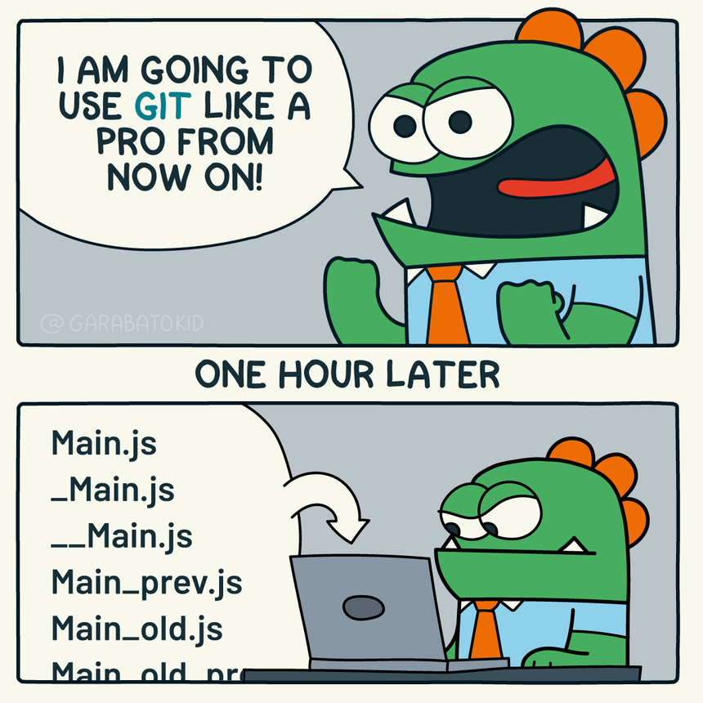
What Is Version Control?
Version control is a system for tracking changes to files over time.
Think of it as a detailed history of a project.
Avoids issues such as: paper.docx paper_final.docx paper_final_v2.docx paper_FINAL_FINAL.docx
Github is a commonly used version control option
There are a lot of free options they offer

Slide 3

Why Use Version Control?
Benefits include:
Change history
Backup and recovery
Collaboration
Accountability
Experimentation without risk
With version control:
Every change is recorded
Previous versions can be restored
Teams can work simultaneously
Contributions are documented
Without version control:
Changes can be lost
Multiple copies become confusing
Collaboration becomes difficult
Mistakes are difficult to undo

Slide 4
Key Terms and common vocabulary
Repository (Repo) - A project managed by version control.
Commit - A saved checkpoint in project history.
Branch - A separate workspace used for developing changes without affecting the main project
Merge - Combining completed work back into the primary project.
Pull Request (PR) - A request to review and merge changes.
Fork – Make a copy of the project/code/repo/app

Slide 5
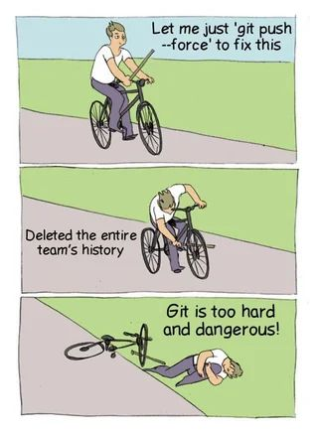
Example: Basic Workflow
The fundamental workflow is:
Create → Edit → Commit → Push → Review

Slide 6
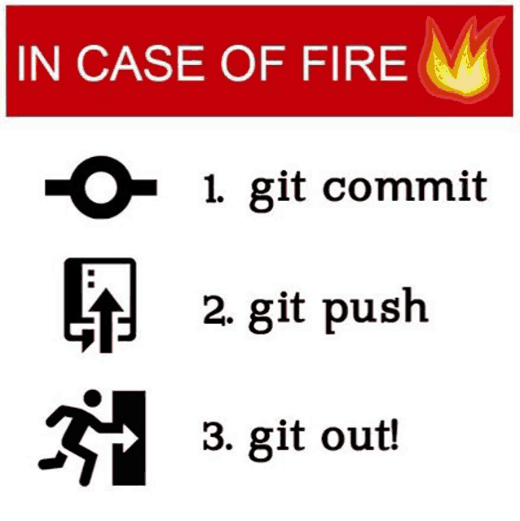
Steps
Step 1: Create a Repository
Only needed on the start of the project
Step 2: Make Changes
Step 3: Commit Changes
Step 4: Push Changes
Step 5: Review Progress
Go back to Step 2

Slide 7

Common Mistakes
Waiting Too Long to Commit
Daily is better than weekly
Vague Commit Messages
Changes! Did things! Updates!
Committing Broken Work Without Explanation
Document changes and what needs to be done next
Even brief explanations such as "Commit before trying X" is better than nothing
Working Directly on Main in group projects
Working on main in personal projects is ok to avoid losing branches of work
Ignoring README Documentation

Slide 8

Example 1: Individual Student Project
Scenario: A student is creating a personal website for a web development course
Repository created
Commit Initial project setup
Follow general steps
Step 1: Make Changes
Step 2: Commit Changes
Step 3: Push Changes

Slide 9
Example 2: Industry Team Workflow
Scenario: A software development team is building a customer management application.
Five developers are contributing simultaneously
Shared Repository
Each developer has a branch
Step 1: they create the branch before work is started
Step 2: They do the work and have commits (with good messages!)
Step 3: Push the branch (uploads changes to version control)
Step 4: Pull Request (requests review from other devs)
Step 5: (once it's approved) Merge into main/master

Slide 10
Example 3: Open Source Contribution Workflow
Scenario: A student wants to contribute to an open-source project.
Unlike workplace projects, no one besides the owner/maintainer usually would have direct write access
Step 1: Fork the Repository
Step 2: Create a Branch
Step 3: Make Changes
Step 4: Commit Changes (with good commit messages)
Step 5 Push commit to your fork
Step 6: Submit Pull Request (This requests feedback on changes)
Step 7: Respond to Feedback if needed
Step 8: the maintainer of the project does the merge

