Slide 1

Enhancing Clinical Decision Making with Advanced AI Techniques
Opportunities and Strategic Investments for Cotiviti
Avery Marcell Holloman
September 2024

Slide 2
Introduction
Exploring how AI models improve decision-making for Treatment, Payment, and Operations (TPO).
Focus on Random Forest classification, regression modeling, K-means clustering, and anomaly detection.
Real-world application of machine learning (ML) in healthcare settings.
Welcome to my presentation on the use of artificial intelligence (AI) and machine learning (ML) in healthcare, focusing on how these technologies can transform clinical decision-making in treatment, payment, and operations (TPO). In this presentation, I will walk you through key AI techniques—Random Forests, regression models, K-means clustering, and anomaly detection—using real-world healthcare data. Each section corresponds to one piece of R code, and I’ll explain the results in detail.

Slide 3
Key AI Techniques for Clinical Decision Making
Chain Reasoning & Agentic Generative AI: Simulating decision pathways and generating solutions.
Classification & Prediction Models: Risk assessment and outcome forecasting.
Inference & Clustering: Uncovering hidden patterns and patient segmentation.
Time-Series Anomaly Detection: Monitoring patient health over time.

Slide 4
Current Trends in AI for Healthcare
Data Quality and Feature Engineering: Success of AI models heavily depends on the quality of data and the thoughtful design of features for robust prediction and classification.
Challenges in Model Sensitivity: Models show high performance in some areas (e.g., predicting patient improvement) but require optimization in areas like anomaly detection and handling "No Change" or "Worsened" outcomes.
AI in Clinical Decision Making: Integrating machine learning (ML) models, such as Random Forests and regression, to improve diagnostic accuracy, treatment prediction, and operational efficiency.

Slide 5
Opportunities for Cotiviti in AI and Healthcare
Enhanced Patient Outcomes: Leveraging AI models like Random Forests and predictive analytics to improve the accuracy of diagnosis and optimize treatment plans.
Operational Optimization: Streamlining administrative processes and improving efficiency through AI-driven automation, reducing operational overheads.
Fraud Detection & Compliance: Utilizing AI to identify anomalies and potential fraud in healthcare claims, enhancing compliance and minimizing financial risks.

Slide 6
Threats and Challenges in AI for Healthcare
Data Privacy and Security: Managing the risks associated with handling sensitive patient data while ensuring compliance with data protection laws.
Algorithmic Bias: Addressing the potential for AI models to introduce biases in healthcare decisions, leading to unequal treatment outcomes.
Regulatory Hurdles: Navigating the evolving landscape of healthcare regulations to ensure compliance in the development and deployment of AI technologies.

Slide 7
Strategic Options for Cotiviti
Invest in AI-powered decision support systems to improve diagnostic accuracy and tailor treatment recommendations through advanced AI models like Random Forests and Neural Networks.
Expand predictive analytics by developing robust tools for patient monitoring, risk assessment, and early intervention using predictive models.
Enhance ethical AI and data governance to strengthen data privacy and reduce algorithmic bias by establishing fair and transparent AI practices.
Collaborate with healthcare providers and researchers to foster innovation and develop clinically relevant AI tools through partnerships with medical professionals and academic institutions.

Slide 8
Understanding the Confusion Matrix Results of a Random Forest Model
The confusion matrix is an essential tool for evaluating the performance of a classification model, providing detailed insights into how well a model predicts different categories. In this analysis, we applied a Random Forest model to predict outcomes across three categories: “Improved,” “No Change,” and “Worsened.” The matrix reveals both the strengths and weaknesses of the model’s performance, offering a clear look at its predictive capabilities.
First, let’s consider the true positives, or the correct predictions, for each class. The model predicted 797 instances correctly for the "Improved" class, making this the most accurately predicted outcome. For the "No Change" class, the model correctly predicted 31 instances, and for the "Worsened" class, the model was accurate 13 times. These numbers show that while the model did well in predicting "Improved" outcomes, it struggled significantly with identifying "No Change" and "Worsened" instances.
The confusion matrix also highlights where the model went wrong, showing false positives and false negatives. For the "Improved" class, 61 instances were incorrectly labeled as "No Change", and 8 were mislabeled as "Worsened." This shows some confusion between "Improved" and other classes, but not as severe as the errors in the other categories. In the case of "No Change," the model struggled significantly, incorrectly labeling 473 instances as "Improved" and 22 as "Worsened." This suggests that the model had difficulty distinguishing between stable outcomes and significant changes. Lastly, for the "Worsened" class, 337 instances were mislabeled as "Improved" and 7 as "No Change.“
Overall, the confusion matrix shows that while the model can handle predicting improvement relatively well, it faces challenges in differentiating between stable and worsened outcomes. This indicates that further refinement is needed, particularly in addressing the high rate of misclassification between "Improved" and "No Change," as well as improving the sensitivity to detect the "Worsened" category accurately. These insights are crucial for understanding the real-world applicability of the model and point to areas where additional training data or model adjustments might help enhance performance in future iterations.

Slide 9
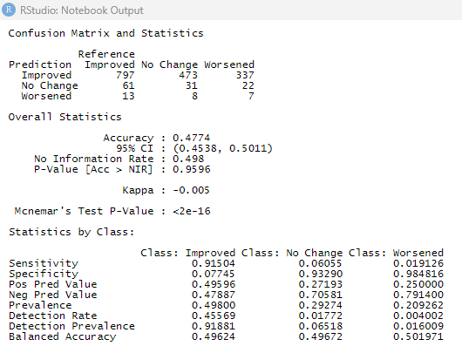

Slide 10
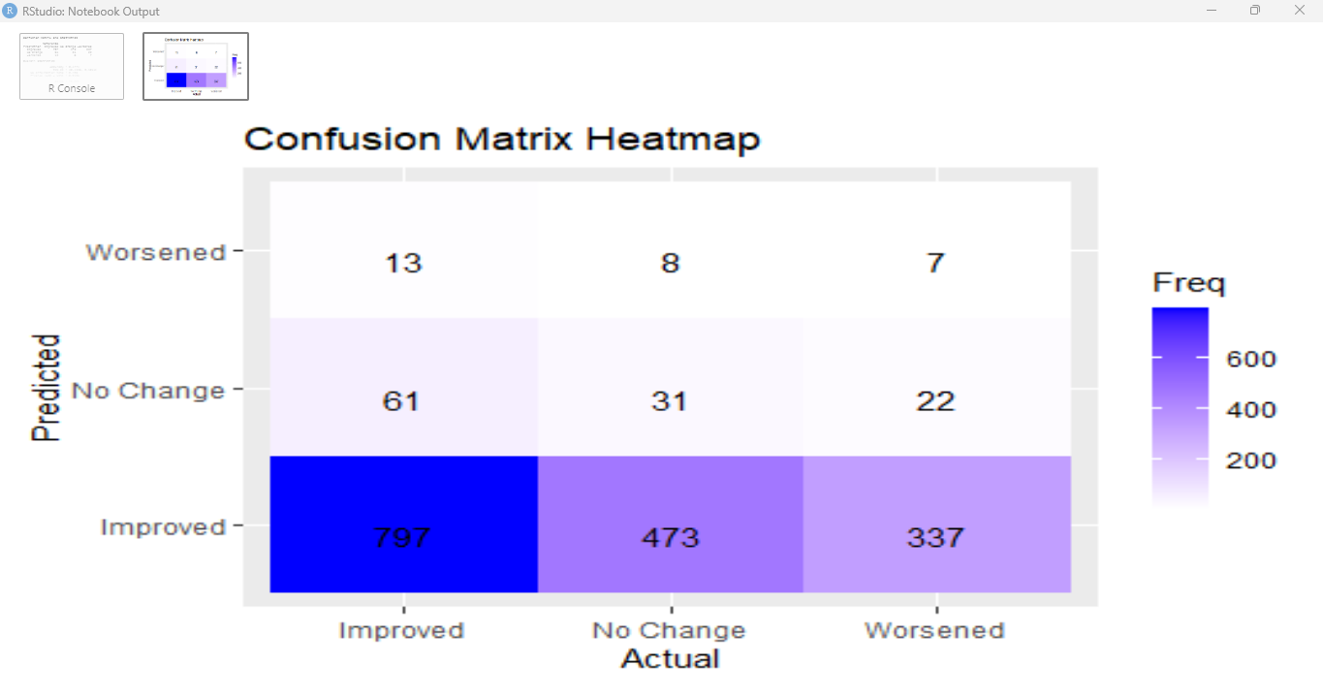

Slide 11
Linear Regression for Treatment Duration
In this section, I applied a linear regression model to predict the duration of treatment based on several factors, including age, medication dosage, and social interaction scores. The model’s performance was evaluated using key metrics. Unfortunately, the results indicated a poor fit, with a Root Mean Squared Error (RMSE) of 104.8782, signifying substantial deviation between the predicted and actual values. Additionally, the R-squared value was near zero, showing that the model failed to explain the variance in treatment duration. This prompted me to consider more sophisticated modeling approaches, such as Gradient Boosting, to achieve better predictive accuracy.
Linear Regression for Predicting Treatment Duration Results:
The linear regression model aimed to predict treatment duration using age, dosage, and social interaction scores. The results were as follows:
RMSE (Root Mean Squared Error):
The model had an RMSE of 104.8782, which indicates a significant discrepancy between the predicted and actual treatment durations.
R-squared:
The R-squared value was near zero, revealing that the model did not explain the variance in treatment duration effectively, suggesting that a linear relationship may not be the best approach for this prediction task.
Conclusion:
The high RMSE and low R-squared values demonstrate that linear regression was insufficient for predicting treatment duration in this case. This leads to the need for alternative modeling techniques, such as Gradient Boosting, which can potentially handle complex, nonlinear relationships between predictors and the outcome more effectively.

Slide 12


Slide 13
K-Means Clustering for Patient Segmentation
In this section, I utilized K-means clustering to segment patients based on two features: age and medication dosage. The algorithm successfully identified three distinct clusters; however, there was considerable overlap in terms of age categories, suggesting that medication dosage played a more pivotal role in forming these clusters. This analysis provides insights into patient grouping, particularly for determining which groups might benefit from tailored treatment strategies. While this approach offered a basic segmentation, it highlights the importance of introducing additional clinical features for more precise and actionable clusters.
K-Means Clustering for Patient Segmentation Results:
The K-means clustering algorithm was used to segment patients based on medication dosage and age. Key results include:
Cluster Identification: The model identified three distinct clusters. However, these clusters showed significant overlap in patient ages, which suggests that age may not be the strongest distinguishing factor for segmentation in this context.
Medication Dosage: Clusters were far more distinct when segmented by medication dosage, indicating that this variable had a greater impact on patient grouping than age.
Conclusion: While K-means clustering effectively segmented patients, the overlap in age groups highlights a limitation in the model. To improve cluster separation and increase actionability, additional features such as clinical scores or patient histories should be considered. These enhancements could lead to more meaningful and targeted patient groupings, allowing for better-informed clinical decisions.

Slide 14
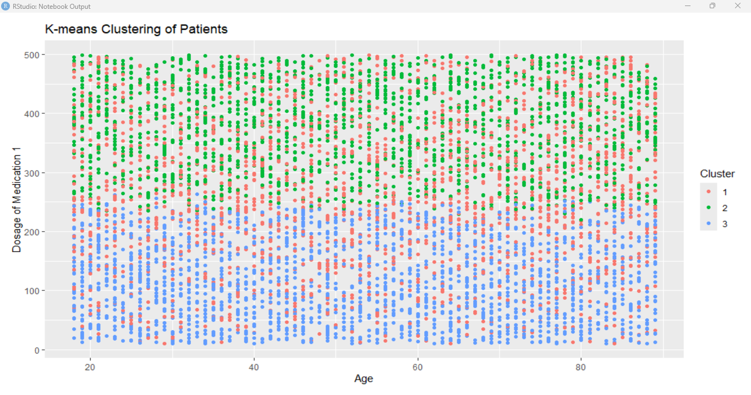

Slide 15
Linear Regression Model for Predicting Treatment Duration
The results displayed are from a multiple linear regression model where the dependent variable, Days_On_Treatment, is predicted based on four independent variables: Age, Dosage_Med1_mg, Dosage_Med2_mg, and Social_Interaction_Score. The analysis involves the interpretation of the model’s coefficients, significance levels, residuals, and overall performance metrics such as R-squared and the F-statistic.
Coefficients and Significance Levels
The table of coefficients shows the estimated impact of each independent variable on Days_On_Treatment. Each coefficient provides the direction and magnitude of the effect:
Intercept: The intercept is 173.84, suggesting that when all independent variables are zero, the predicted treatment duration is approximately 174 days.
Age: The coefficient for Age is 0.047466, indicating a small positive association with Days_On_Treatment. However, the p-value is 0.5498, which is far above the standard significance threshold of 0.05, suggesting that Age is not a statistically significant predictor of treatment duration in this model.
Dosage_Med1_mg: The coefficient is -0.002237, implying a very slight negative relationship with treatment duration. The p-value is 0.8475, well above 0.05, indicating that Dosage_Med1_mg is also not a significant predictor.
Dosage_Med2_mg: The coefficient for Dosage_Med2_mg is 0.019421, suggesting a positive relationship with Days_On_Treatment. The p-value of 0.0984 indicates a near-significant effect (approaching the 0.1 threshold), meaning there may be a weak association between Dosage_Med2_mg and treatment duration, but further investigation with additional data may be necessary to confirm this.
Social_Interaction_Score: This coefficient is 0.082860, showing a positive impact on treatment duration. The p-value is 0.1442, which, like the other variables, does not meet the significance threshold, indicating no strong evidence to suggest this factor significantly predicts the length of treatment.
Residuals
The residuals section shows the distribution of differences between observed and predicted values of Days_On_Treatment. The range of residuals goes from -189.721 to 187.988, suggesting that the model has large errors when predicting individual cases. The median residual is close to zero, which is a good indication that the model’s predictions are centered, though the large range of residuals raises concerns about the model’s overall predictive accuracy.

Slide 16
Model Performance
The overall performance of the model is summarized by key statistics:
Residual Standard Error (RSE): The RSE is 105.1, indicating that the model’s predictions, on average, deviate from the actual values of Days_ On Treatment by approximately 105 days. This large error suggests that the model is not performing well in terms of precise predictions.
Multiple R-squared:
The R-squared value is 0.001314, which indicates that the model explains only about 0.13% of the variance in treatment duration. This is an extremely low value, meaning the model fails to capture the variation in Days_On_Treatment. A higher R-squared would imply that the model better explains the data, but in this case, it reveals that the chosen independent variables are not good predictors of treatment duration.
Adjusted R-squared:
The adjusted R-squared is 0.0003346, which accounts for the number of predictors and still remains very low. This confirms that even after accounting for the number of variables in the model, the predictive power remains minimal.
F-statistic:
The F-statistic is 1.342 with a p-value of 0.2519, which is not statistically significant (the p-value is much greater than 0.05). This indicates that, collectively, the model’s predictors do not provide a significantly better prediction than a model with no predictors (i.e., the intercept-only model). In simpler terms, the model as a whole does not perform significantly better than random guessing.
Conclusion
Overall, the linear regression model does not perform well in predicting Days_On_Treatment based on the variables included in this analysis. None of the predictors are statistically significant, and the model explains a negligible amount of the variance in treatment duration. The residual standard error is high, and the R-squared values are extremely low, suggesting that the chosen independent variables are not strong predictors of treatment duration.To improve the model, it may be necessary to incorporate other, more relevant predictors, or to explore non-linear relationships and interaction effects between variables. Additionally, the use of alternative modeling techniques such as decision trees, gradient boosting, or random forests might better capture complex patterns in the data and provide better predictive power.

Slide 17
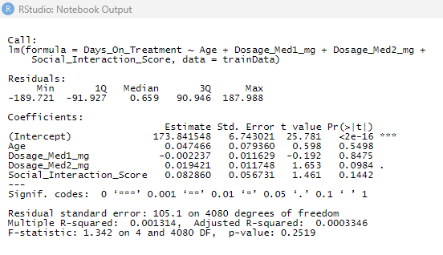

Slide 18
Time-Series Anomaly Detection for Blood Pressure
In this section, I applied time-series anomaly detection to blood pressure data to identify potential irregularities that could indicate critical changes in a patient’s condition. Using the time-series data, I performed decomposition and anomaly detection to uncover any outliers. However, no significant anomalies were detected in this dataset. This raises concerns about the sensitivity of the model, suggesting that adjustments to the detection thresholds or the use of z-scores might be necessary to capture more subtle irregularities in real-time data. Such refinements are crucial for practical applications in real-time patient monitoring, where early detection of abnormalities can make a significant difference in patient outcomes.
Time-Series Anomaly Detection for Blood Pressure Results:
The time-series anomaly detection approach was applied to monitor blood pressure fluctuations. Key observations include:
No Significant Anomalies Detected:
Despite decomposing the time-series data and running anomaly detection, the model did not flag any major irregularities.
Sensitivity Issues:
The lack of detected anomalies suggests that the model's sensitivity may need enhancement. Adjusting the threshold or incorporating z-scores could improve the detection of more subtle irregular patterns.
Conclusion:
While the current implementation of time-series anomaly detection did not identify any significant outliers, further refinement is required. These adjustments are essential for ensuring the model is effective in real-time patient monitoring, where subtle changes in vital signs can be critical for timely medical intervention.

Slide 19
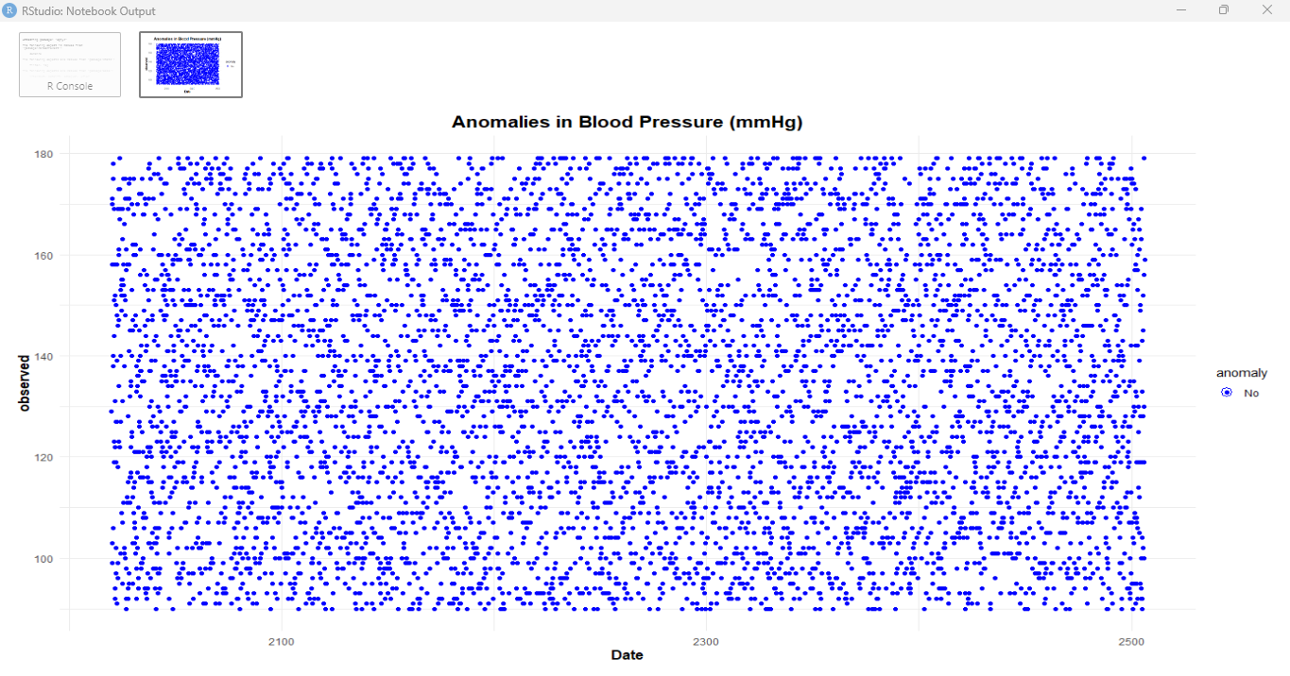

Slide 20
Conclusion
In this presentation, I explored the use of various machine learning models—Random Forests, linear regression, K-means clustering, and anomaly detection—within the domain of clinical decision-making in healthcare. Each model offered unique insights into enhancing treatment outcomes, improving operational efficiency, and advancing predictive analytics in medical practice.
The Random Forest model was particularly effective in predicting "Improved" patient outcomes, yet it faced challenges with less frequent cases such as "No Change" and "Worsened." This highlighted the importance of model optimization and the need for more balanced datasets to improve predictive accuracy across all categories.
Linear regression was applied to predict treatment duration, but the model was not successful. With a Root Mean Squared Error (RMSE) of 104.8782 and an R-squared value near zero, it was clear that this approach did not adequately capture the relationship between the predictors and treatment duration. This underperformance pointed to the necessity for more advanced techniques, such as Gradient Boosting, to address complex, nonlinear relationships.
K-means clustering proved valuable in segmenting patients based on medication dosage, but there was significant overlap in age categories. This suggests that while medication dosage was a strong factor for clustering, the model could benefit from incorporating additional features like clinical scores to create more distinct and actionable patient segments.
Anomaly detection showed promise in identifying outliers in patient vital signs, which is crucial for real-time health monitoring. However, the model requires further tuning to increase its sensitivity to detect more subtle anomalies, ensuring that it can capture critical variations in patient data promptly.
Overall, the results demonstrated that while AI and machine learning hold immense potential for improving healthcare outcomes, particularly in the areas of Treatment, Payment, and Operations (TPO), the quality of data and the design of model features are fundamental to the success of these applications. Going forward, Cotiviti can explore more advanced AI models and emphasize the ethical use of AI to uphold privacy, fairness, and compliance in healthcare.
By investing in cutting-edge AI technologies and fostering collaborations with healthcare providers and researchers, Cotiviti can lead innovation in AI-powered decision support systems, driving improvements in patient care and operational efficiency

Slide 21
References
References
Karalis, V. D. (2024). The Integration of Artificial Intelligence into Clinical Practice. Applied Biosciences, 3(1), 14-44. https://www.mdpi.com/2079-6374/11/6/174
Implementation Science. (2024). Generative AI in Healthcare: An Implementation Science Informed Translational Path on Application, Integration, and Governance. https://implementationscience.biomedcentral.com/articles/10.1186/s13012-020-01043-x
MDPI. (2024). Clinicians’ Perceptions of Artificial Intelligence: Focus on Workload, Risk, Trust, Clinical Decision Making, and Clinical Integration. https://www.mdpi.com/2227-9032/10/2/214
Frontiers in Medicine. (2023). Rethinking Clinical Decision-Making to Improve Clinical Reasoning. https://www.frontiersin.org/articles/10.3389/fmed.2021.667772/full

Slide 22
Exploring 3D Clustering in Healthcare Data utilizing K-Means and Gaussian Mixture Models
In this analysis, I utilized 3D plotting to explore clustering in healthcare data, specifically focusing on blood pressure (mmHg) and cholesterol levels (mg/dL). The objective was to understand how different clustering algorithms—K-means and the Gaussian Mixture Model (GMM)—can be applied to segment patients based on these key health indicators. To achieve this, I used Plotly’s interactive 3D plotting capabilities, allowing for better visualization of clustering patterns.

Slide 23
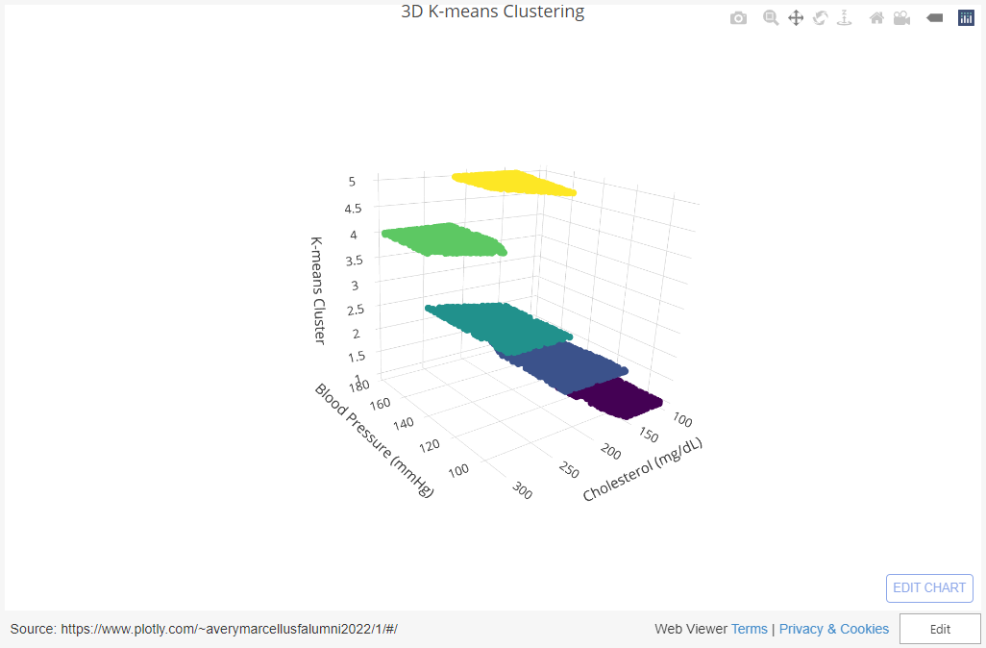
https://plotly.com/~averymarcellusfalumni2022/3/#/

Slide 24
Clustering Health Metrics: K-means Analysis of Blood Pressure and Cholesterol Patterns
The image shows a K-means clustering analysis with five groups based on blood pressure (mmHg) and cholesterol levels (mg/dL). I used this scatterplot to visualize how individuals are grouped, and the centroids for each cluster are marked with large crosses.
Overview of K-means Clustering
K-means clustering is an unsupervised learning algorithm that I used to partition the data into five clusters. My goal was to group individuals in such a way that those within the same cluster are more similar to each other than to those in other clusters. The algorithm worked by adjusting the centroids, which represent the center of each group, and reassigning data points to the nearest centroid until the clusters were optimized.
Interpretation of the Clusters
Cluster 1 (Red): These individuals have both low blood pressure (90–130 mmHg) and low cholesterol (100–150 mg/dL).
Cluster 2 (Olive Green): This group has moderate blood pressure (100–160 mmHg) and cholesterol levels (200–250 mg/dL).
Cluster 3 (Teal): These individuals show lower blood pressure but higher cholesterol (250–300 mg/dL).
Cluster 4 (Blue): People here have both high blood pressure (140–180 mmHg) and high cholesterol (250–300 mg/dL).
Cluster 5 (Purple): This group has higher blood pressure (150+ mmHg) and moderate cholesterol (150–200 mg/dL).
Summary of Results
I can see clear separations between people with high and low cholesterol, across different blood pressure ranges. For example, Cluster 1 shows those with both low blood pressure and cholesterol, while Cluster 4 represents high levels for both. There may also be outliers, especially in Cluster 3, where some individuals have high cholesterol but normal blood pressure. I also used the centroids to summarize each group, making it easy to identify average health metrics for each cluster. Cluster 1 has the healthiest stats overall, while Cluster 4 and 5 represent higher risk groups.
Conclusion
This K-means clustering helps me understand how blood pressure and cholesterol levels relate to each other. The five clusters reveal different health subgroups, which could guide future medical studies or interventions. The centroids provide a clear summary of each group’s health profile, helping me simplify the analysis.

Slide 25
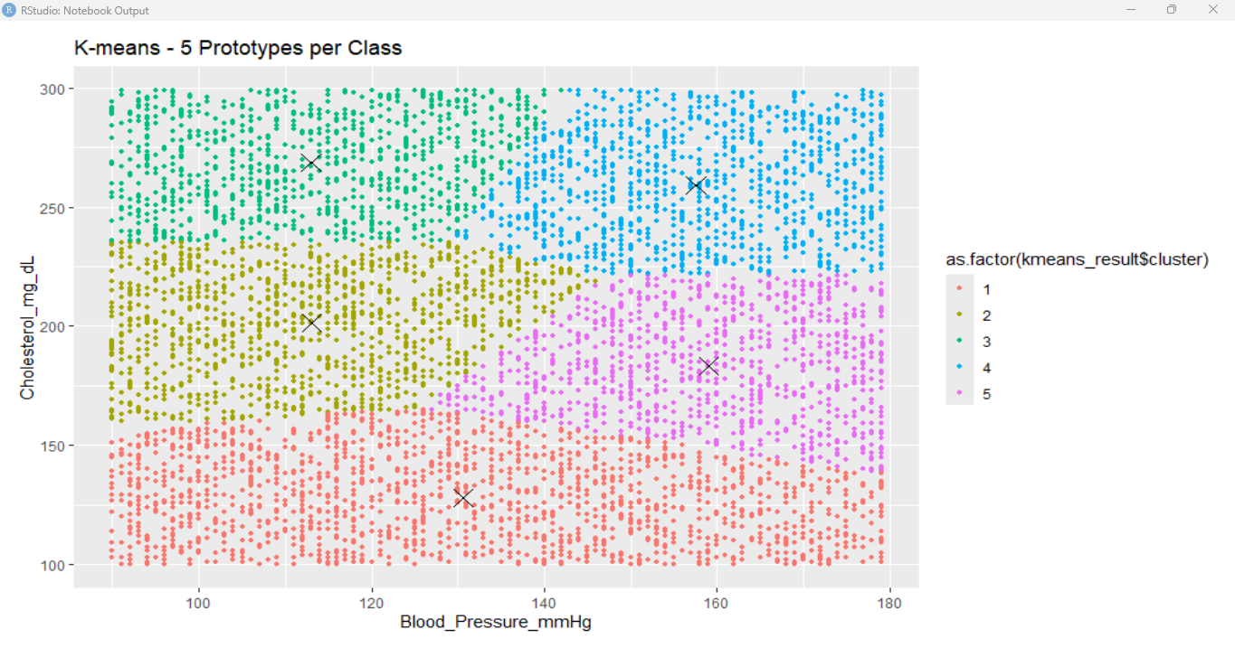

Slide 26
Refining Health Data Clustering with K-means and Bayes Decision Boundaries
The image illustrates a K-means clustering analysis with five groups using a Bayes decision boundary, which helps separate the clusters more effectively.
Overview
I applied K-means clustering with a Bayes decision boundary to classify data points based on blood pressure and cholesterol levels. The decision boundary helps distinguish the groups and is indicated by the dashed lines.
Cluster Interpretation
Cluster 1 (Red): Low blood pressure (75–125 mmHg) and low cholesterol (100–150 mg/dL).
Cluster 2 (Green): Moderate blood pressure (100–150 mmHg) and cholesterol (200–250 mg/dL).
Cluster 3 (Teal): Lower blood pressure (90–130 mmHg) but high cholesterol (250+ mg/dL).
Cluster 4 (Blue): Higher blood pressure (125–175 mmHg) and high cholesterol (250+ mg/dL).
Cluster 5 (Purple): Higher blood pressure (125–175 mmHg) but moderate cholesterol (150–200 mg/dL).
Results Summary
With the Bayes boundary, I can better separate the clusters. Cluster 1 represents those with healthier stats, while Clusters 4 and 5 capture the high-risk individuals with elevated blood pressure and cholesterol.
Conclusion
By incorporating the Bayes decision boundary, I improved the classification of individuals based on health metrics, making it easier to identify the boundaries between clusters for clearer analysis.

Slide 27
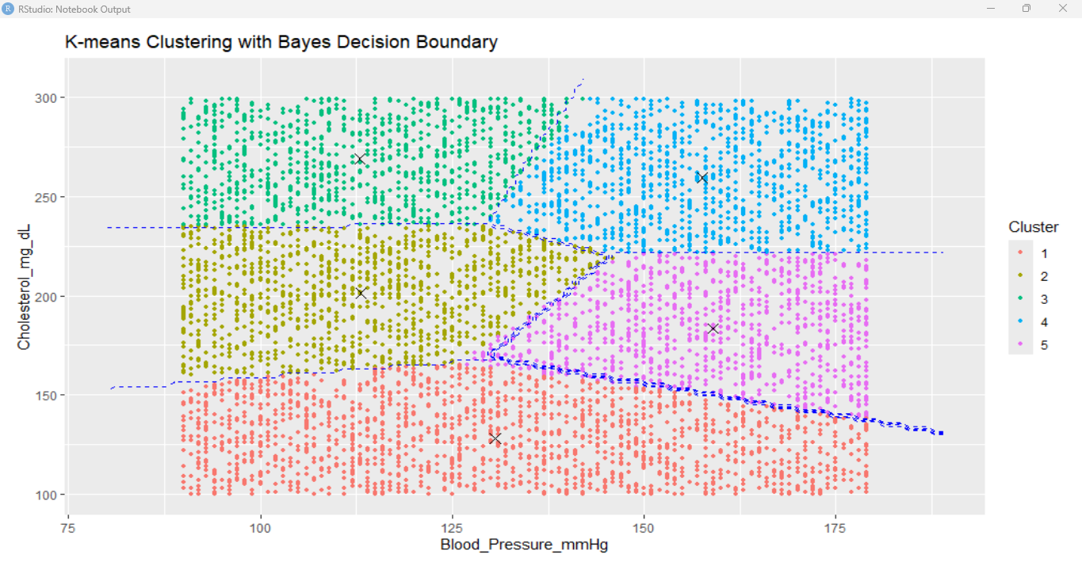

Slide 28
Comparative Analysis of Health Data Clustering with K-means and GMM Decision Boundaries
The image shows two comparative visualizations: one using K-means clustering with piecewise linear decision boundaries and the other using Gaussian Mixture Model (GMM) with a common covariance and Bayes decision boundary.
K-means Clustering
In the first plot, I applied K-means clustering with five clusters. The piecewise linear decision boundaries are used to separate the clusters based on blood pressure and cholesterol levels. Each cluster is defined by its centroid, and the boundaries are marked with dashed lines.
Cluster 1 (Red): Individuals with lower blood pressure (75–125 mmHg) and low cholesterol (100–150 mg/dL).
Cluster 2 (Green): Moderate blood pressure (100–150 mmHg) and cholesterol (200–250 mg/dL).
Cluster 3 (Teal): Higher cholesterol (250 mg/dL+) with low-to-moderate blood pressure.
Cluster 4 (Blue): High cholesterol and blood pressure.
Cluster 5 (Purple): Moderate cholesterol with higher blood pressure.
GMM with Common Covariance
In the second plot, I used GMM clustering, which assumes that the clusters follow a Gaussian distribution. The Bayes decision boundary is included to better separate the overlapping regions between clusters, with smoother transitions between groups compared to K-means.
Summary
The K-means clustering plot shows more distinct boundaries between clusters, while the GMM visualization with common covariance and Bayes decision boundary captures a more flexible, probabilistic separation. Both methods reveal key health groups but offer different views on how tightly or flexibly individuals are categorized.
Conclusion
Using K-means and GMM allowed me to compare different clustering methods and decision boundaries, each highlighting unique health profiles based on blood pressure and cholesterol levels. The Bayes decision boundary in GMM adds flexibility, while K-means provides a more rigid separation between groups.

Slide 29
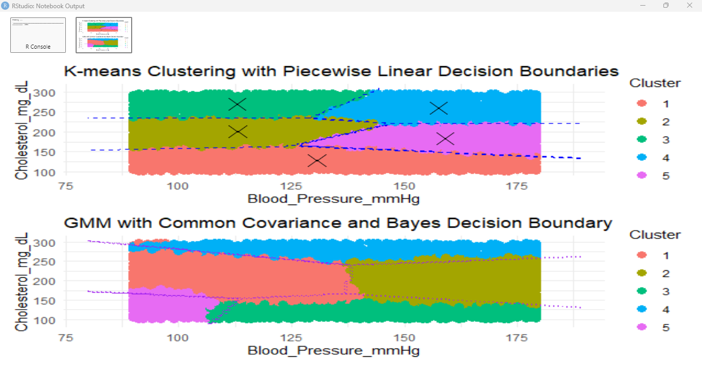

Slide 30
k-NN Classification and Bayes Decision Boundaries: Comparative Health Data Clustering
The image shows two visualizations: the top plot using k-NN classification with decision boundaries, and the bottom plot using Bayes decision boundaries to classify clusters based on blood pressure and cholesterol levels.
k-NN Classification
In the top plot, I applied k-nearest neighbors (k-NN) classification to separate the data into clusters. The decision boundaries, marked with dashed lines, help classify individuals based on their nearest neighbors.
Cluster 1 (Red): Individuals with lower blood pressure and cholesterol.
Cluster 2 (Green): Moderate blood pressure and cholesterol levels.
Cluster 3 (Teal): Higher cholesterol with lower-to-moderate blood pressure.
Cluster 4 (Blue): High blood pressure and cholesterol.
Cluster 5 (Purple): Moderate cholesterol with elevated blood pressure.
Bayes Decision Boundaries
In the second plot, I used Bayes decision boundaries for classification. The smooth curves between clusters provide a probabilistic decision boundary, giving a more flexible separation of groups compared to the rigid k-NN lines.
Summary
The k-NN classification results in distinct, piecewise boundaries, while the Bayes method produces a smoother separation between clusters. Both methods show different perspectives in clustering the health data based on blood pressure and cholesterol, highlighting various health risk categories.
Conclusion
Comparing k-NN and Bayes decision boundaries allows me to assess the effectiveness of each classification method. While k-NN provides clearer, more distinct boundaries, Bayes offers a softer, more probabilistic approach, providing insights into how individuals are categorized in health data analysis.

Slide 31
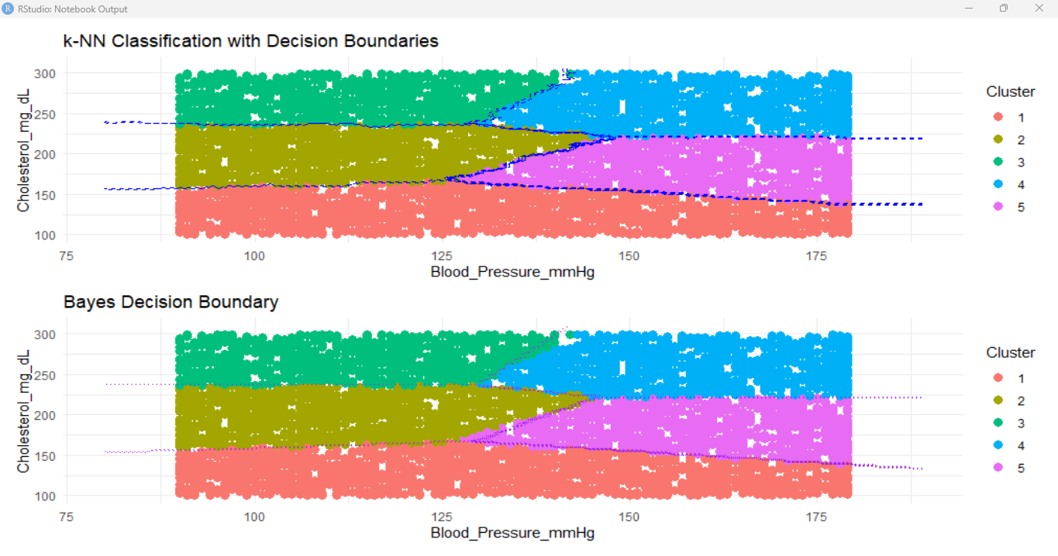

Slide 32
Optimizing k-NN Classification with Misclassification Error and Bayes Decision Boundaries
The image presents two key visualizations: the top plot illustrates the misclassification error as a function of k (the number of neighbors in k-NN), and the bottom plot shows the decision boundary for k = 7 with a Bayes decision boundary.
Misclassification Error as a Function of k
In the first plot, I evaluated the misclassification error for various values of k (number of neighbors) in a k-NN classifier. The x-axis represents the number of neighbors (ranging from 2 to 14), while the y-axis shows the corresponding misclassification error. The error bars indicate the variability of the error across different iterations.
Observation
The misclassification error generally remains low across different values of k. The lowest error seems to occur around k = 4, where the model achieves better classification accuracy. As k increases, the misclassification error slightly rises but remains fairly stable within a narrow range.
Decision Boundary for k = 7 with Bayes Decision Boundary
The second plot illustrates the decision boundary for k = 7 in the k-NN classification model with a Bayes decision boundary. The data is separated into two classes (Class 1 and Class 2) based on blood pressure and cholesterol levels.
Class 1 (Red): Individuals with higher blood pressure and cholesterol levels are classified into this group.
Class 2 (Teal): This class represents individuals with lower blood pressure and cholesterol levels.
The Bayes decision boundary (indicated by dashed blue lines) marks the separation between the two classes, providing a probabilistic decision rule.
Summary
From the misclassification error plot, I can see that smaller values of k (around 4 to 7) offer better performance with lower error rates. The decision boundary visualization for k = 7 shows a clear separation between the two classes, using both k-NN classification and the Bayes boundary for more accurate predictions.
Conclusion
This analysis helps me identify the optimal k value for the k-NN classifier, where k = 4 provides the lowest misclassification error. By also visualizing the decision boundary at k = 7, I can see how well the model distinguishes between the two classes using both classification methods.

Slide 33
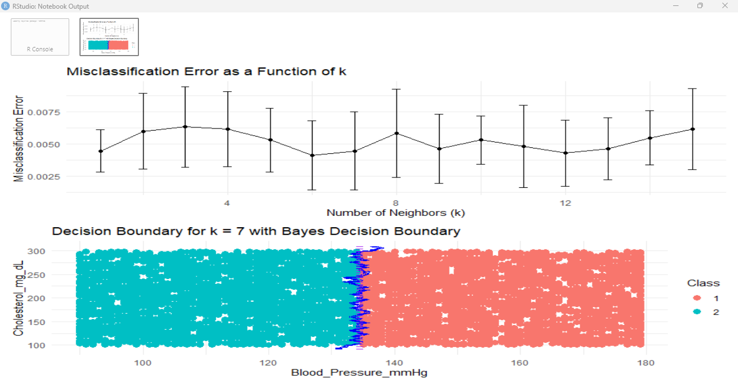

Slide 34
Comparing Classification Methods for K-means, k-NN, and LVQ Misclassification Errors
The bar chart compares the mean misclassification errors (with one standard error) for three different classification methods:
K-means (blue), k-NN (green), and LVQ (red).K-means shows the highest misclassification error, around 0.5, indicating that this method has the least accuracy among the three for this dataset.
k-NN has a much lower error, almost negligible, suggesting it performs well with minimal misclassification.
LVQ (Learning Vector Quantization) has a moderate error, higher than k-NN but significantly lower than K-means.
This visualization highlights the relative performance of the three methods, showing that k-NN outperforms K-means and LVQ in terms of misclassification error for this specific task.

Slide 35
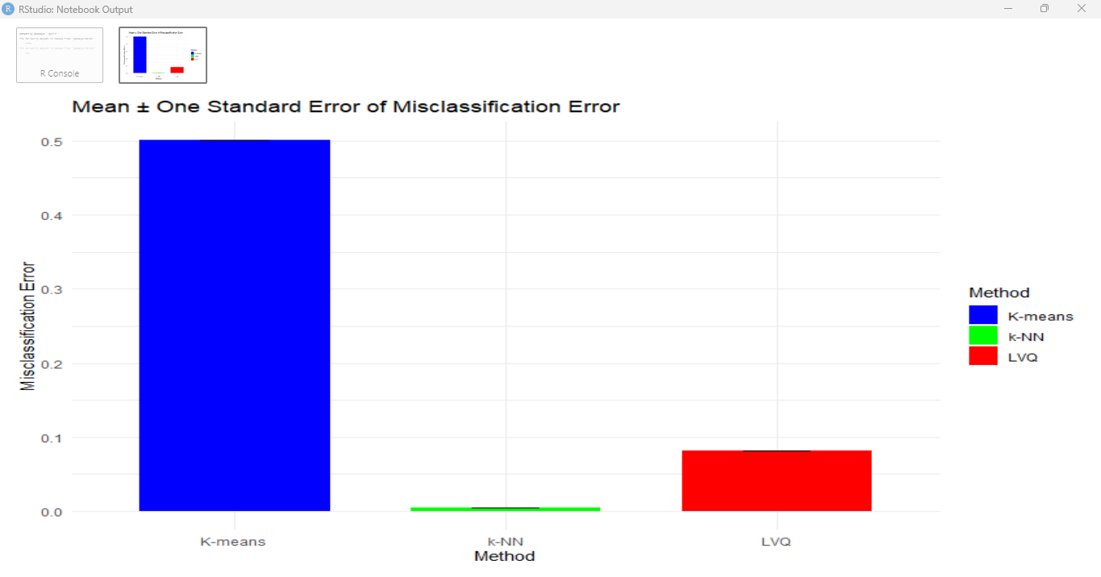

Slide 36
Misclassification Error Comparison for Nearest Neighbors vs. K-means & LVQ
This image displays two line plots comparing the misclassification errors for different methods:
Nearest Neighbors (Left Plot)
The left plot shows the misclassification error for the k-nearest neighbors (k-NN) algorithm as a function of the number of neighbors. The x-axis represents the number of neighbors, while the y-axis represents the misclassification error.
Observation:
The misclassification error remains near zero regardless of the number of neighbors, indicating that the k-NN classifier performs consistently well across a wide range of neighbor values.
K-means & LVQ (Right Plot)
The right plot compares the misclassification error of K-means (blue) and LVQ (red) as a function of the number of prototypes per class. The x-axis shows the number of prototypes, and the y-axis shows the corresponding misclassification error.
K-means: The misclassification error varies more significantly, peaking when the number of prototypes per class is around 10 and decreasing as the number increases.
LVQ: The misclassification error consistently decreases as the number of prototypes per class increases, indicating that adding more prototypes improves the classifier's performance.
Conclusion
This visualization highlights how k-NN maintains a stable and low misclassification error across different neighbor counts, while K-means and LVQ show varying error rates based on the number of prototypes. The LVQ method, in particular, demonstrates improved performance as the number of prototypes increases.

Slide 37
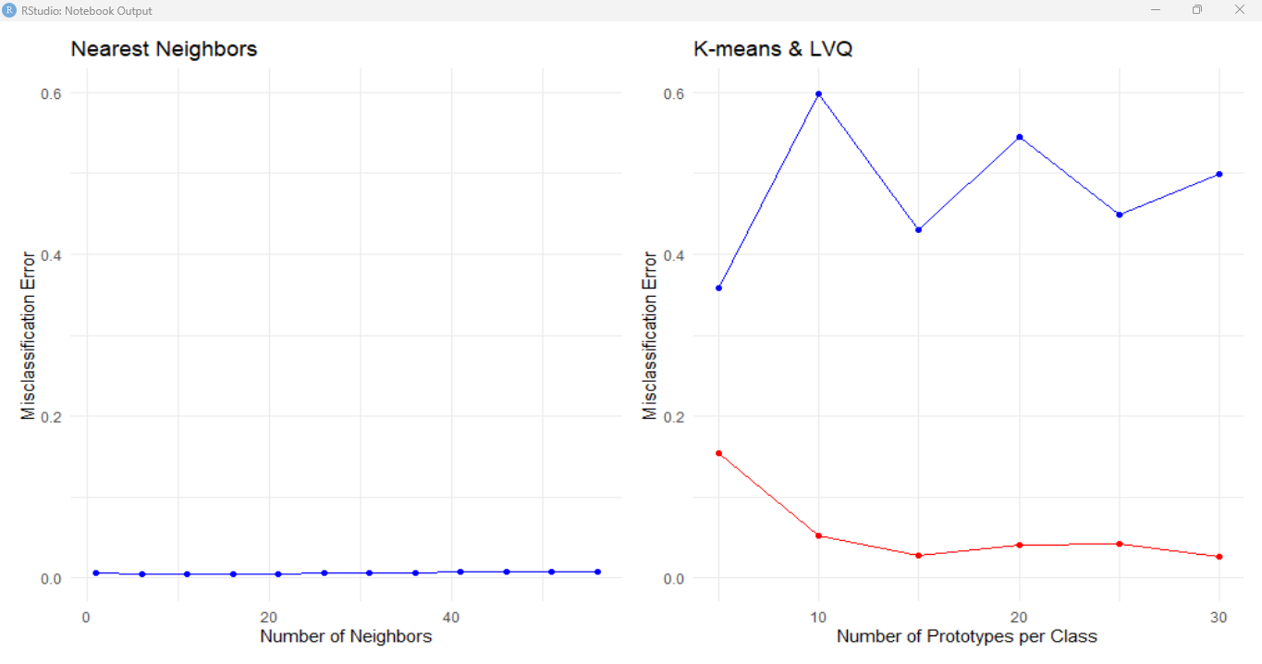

Slide 38
Comparison of Actual vs Predicted Land Usage Using 5-NN Classification
The image compares actual land usage (left plot) with predicted land usage using a 5-nearest neighbors (5-NN) classifier (right plot).
Actual Land Usage (Left Plot)
This plot visualizes the real distribution of land usage across two categories, represented by red (Class 1) and green (Class 2). The land is spatially mapped with these two usage types interspersed, likely representing different land features such as agriculture or urban areas.
Predicted Land Usage (5-NN) (Right Plot)
The right plot shows the predicted land usage using a 5-nearest neighbors (5-NN) classifier, which attempts to replicate the actual land usage distribution based on the proximity of data points. The color distribution is similar, with red representing Class 1 and green representing Class 2.
Summary
The 5-NN classifier closely mirrors the actual land usage patterns, with some minor deviations in how certain areas are classified.
Both plots show a predominantly accurate prediction of land usage patterns, but there may be some discrepancies in areas where the classifier struggles to replicate the more intricate, interspersed patterns.
Conclusion
The comparison highlights the effectiveness of 5-NN in predicting land usage. The results suggest that 5-NN is capable of producing highly accurate predictions when spatial dependencies are important, as seen in the land usage classifications. However, some minor differences between the actual and predicted plots point to areas for further optimization in prediction accuracy.

Slide 39
