Slide 1
Types in Software
Aaron Holmes
April 21, 2021
Notes:
Haven’t given this presentation – fresh content
House keeping – can’t see participants; will ask questions
Talking about types in software, different kinds of types, why they matter, what they’re for
Will show how types fit into real work we are doing in the lab
Mostly from my experience – “limited scientific rigor”

Slide 2
What is a Type?
“In computer science and computer programming, a data type or simply type is an attribute
of data which tells the compiler or interpreter how the programmer intends to use the data.”
Wikipedia https://en.wikipedia.org/wiki/Data_type
Thanks Aaron, what the heck does that mean?
A Type tells you and your software tools what data a variable contains or what your data “looks like.”
Notes:
* Here’s the definition lifted from Wikipedia, but it’s a bit obtuse. So, here’s what I like to say a type is.

Slide 3
Types of Types
# Python
my_integer = 123
my_float = 1.0
my_string = 'Hello!'
my_character = 'X'
<class 'int'>
<class 'float'>
<class 'str'>
<class 'str'>
Common types:
Integers
Floats; Doubles; Decimals
Characters; Strings
# R
my_integer <- as.integer(123)
my_float <- 1
my_string <- 'Hello!'
my_character <- 'X'
[1] "integer“
[1] “double“
[1] “character“
[1] “character"
// C#
var my_integer = 123;
var my_float = 1.0;
var my_string = "Hello!";
var my_character = 'X';
Int32 Double String Char
Notes:
Every programming language has types. Some are more explicit than others.
These handful of types are common across most languages
They include number types like integers, float, doubles, and decimals
And types to represent text
Here are some examples of these types
On the left is the declaration and definition of a variable in the language, and on the right is how the language displays the name of that type
Notice that Python shows “string” for the my_character variable
Every language has different default types. In R, the default numeric type is “double” so we need to be explicit to get an integer
Notice that R shows “character” for the my_string variable
Finally, C# is a language with a different type system we’ll get to soon. Here we see type inference with the use of the “var” keyword. While we don’t see it here, the language treats these variables with strict type rules even though their type is inferred.
Notice there is an explicit type for each variable.

Slide 4
Types of Types
# Python
my_integer = 123
my_float = 1.0
my_string = 'Hello!'
my_character = 'X'
<class 'int'>
<class 'float'>
<class 'str'>
Common types:
Integers
Floats; Doubles; Decimals
Characters; Strings
# R
my_integer <- as.integer(123)
my_float <- float(1.0)
my_string <- 'Hello!'
my_character <- 'X'
[1] "integer“
[1] “float32“
[1] “character"
// C#
var my_integer = 123;
var my_float = 1.0f;
var my_string = "Hello!";
var my_character = 'X';
Int32 Single String Char
Notes:
Those particular types I said to notice, we can see more prominently here.
In Python, there is no “character” type, whereas in C#, a character is a type that represents a single letter or character.
Similarly, R does not have a “string” type. Instead, strings are a vector of characters with a length greater than 1.
Interestingly, R doesn’t have a native float type. The example here is done with a 3rd-party library.

Slide 5
Types of Types
Classes, Structs, and Interfaces
“In computer science, a type class is a type system construct that supports ad hoc polymorphism.”
Wikipedia https://en.wikipedia.org/wiki/Type_class
… or,
# Python
class Foo:
def __init__(self, bar):
self.bar = bar
print(type(Foo)) # <class 'type'>
a construct describing the shape of something.
Objects
“In computer science, an object can be a variable, a data structure, a function, or a method,
and as such, is a value in memory referenced by an identifier.”
Wikipedia https://en.wikipedia.org/wiki/Object_(computer_science)
… meaning,
baz = Foo('Hello!')
print(baz) # <__main__.Foo object at 0x0000024ACF98A8E0>
print(vars(baz)) # {'bar': 'Hello!'}
print(type(baz)) # <class '__main__.Foo'>
an application’s in-memory instance of a class or other type.
Notes:
There are more complex types in most languages
Some of these types are called classes, structs, or interfaces
You can think of these types as an abstract construct that describes what something looks like
In some languages, even the basic types like integers have classes underlying them
Objects, on the other hand, are the in-memory instances of a type. These are the values software operates on.
Here’s a simple class in Python called Foo
When an object, or an instance, or Foo is created, it expects to be given a value that we store in the variable called “bar”
Notice when we print out the type of the Foo class, Python tells us Foo is a “type”
This is similar to how an integer might have an underlying class. In Python, printing the type of “int” also shows “type.”
Down here we create an instance of the Foo type and assign it to baz
There’s nothing special about these names, by the way, I just ran out of creativity.
Now we can print out some information about this in-memory instance of the Foo type
Baz is a Foo with a memory address
Baz has a variable (by the way, this form of object-variable association is called a property) called bar whose value is “hello!”
A lastly, the type of baz is the class Foo

Slide 6
Types of Types
Common but unimposing or trivial types
Methods; Functions
Delegates; Lambdas
Decorators; Attributes
Events
Operators
Syntax
Notes:
There are many more types of types, including some that most don’t think of as types
Even the syntax is some languages can be considered a type
Python is a good example of this, through metaprogramming, though I am hardly knowledgeable about that subject

Slide 7
Do Types Matter?
YES!
An empirical study on the impact of static typing on software maintainability
October 2013
Stefan Hanenberg · Sebastian Kleinschmager · Romain Robbes · Eric Tanter ·Andreas Stefik
This paper describes an experiment that tests whether static type systems improve the maintainability of software systems …
The results show rigorous empirical evidence that static types are indeed beneficial to these activities[, except when fixing semantic errors].
https://www.researchgate.net/publication/259634489_An_empirical_study_on_the_impact_of_static_typing_on_software_maintainability
Notes:
So do types matter?
Yes, absolutely!
First, regardless of the type system a language uses, types are in-use implicitly or explicitly.
Computers need to know how to add different types of numbers, or how to concatenate strings, and so on.
However what I really want to focus on are statically-typed languages, which are explicit in their use of types.
There is empirical evidence that static types help with software quality.
Here is one research paper on the subject.

Slide 8
Why Types Matter
Types allow computers to operate correctly on data
Types enable validation of software behavior
Types help humans understand code
Types help software tooling (like an IDE) understand code
Types enable automatic documentation, linting, etc.
Notes:
There are a lot of reasons types matter, some I already mentioned.
Let’s talk about the different type systems and how some type systems might fail us.

Slide 9
Why Types Matter – Types of Type Systems
Dynamic Typing
“Dynamic type checking is the process of verifying the type safety
of a program at runtime.”
Wikipedia https://en.wikipedia.org/wiki/Type_system
Examples
// JavaScript
my_integer = 123;
my_name = 'Aaron';
say_hi = (input)
=> console.log(`Hi ${input}`);
say_hi(my_integer);
say_hi(my_name);
Hi 123
Hi Aaron
# R
my_integer <- as.integer(123)
my_name <- 'Aaron'
say_hi <- function(input)
print(paste('Hi', input))
say_hi(my_integer)
say_hi(my_name)
[1] "Hi 123"
[1] "Hi Aaron"
# Python
my_integer = 123
my_name = 'Aaron'
def say_hi(input):
print(f'Hi {str(input)}')
say_hi(my_integer)
say_hi(my_name)
>>> Hi 123
>>> Hi Aaron
Notes:
Dynamically-typed languages do not verify data is passed through the system correctly until the application is actually running.
Here are some examples where some code calls the same method that operators on any type
In Python there is no ceremony around type declaration. Just name a variable, assign a value, and use it.
Notice the “input” variable needs to be “cast” to a string?
If you don’t know, “cast” means to change the type. So for example, the number 123 is “cast” or “changed to” a string.
Here’s the same example in R.
In this case, getting an integer requires a little more ceremony.
However, there are no special operations like “casting” when the text is displayed.
Here’s an example in JavaScript.
There is no ceremony here, and no special operations to display the text.

Slide 10
Why Types Matter – Types of Type Systems
Static Typing
“Static type checking is the process of verifying the type safety of a program based
on analysis of a program's text (source code).”
Wikipedia https://en.wikipedia.org/wiki/Type_system
Example
// C#
void SayHi(int input) => Console.WriteLine($"Hi {input}");
void SayHi(string input) => Console.WriteLine($"Hi {input}");
public void Main() {
var my_integer = 123;
var my_name = "Aaron";
SayHi(my_integer);
SayHi(my_name);
}
Hi 123
Hi Aaron
Notes:
In statically-typed languages, data usage is verified, typically by a compiler, before an application is executed.
This is done ahead of time so it does not need to happen every time the application is started.
Notice that in this case I had to write two methods; one that expects and integer, and another that expects a string.

Slide 11
Why Types Matter – Types of Type Systems
Gradual and Optional Typing
“Gradual typing is a type system in which some variables and expressions may be
given types and the correctness of the typing is checked at compile time and some
expressions may be left untyped and eventual type errors are reported at runtime”
Wikipedia https://en.wikipedia.org/wiki/Gradual_typing
Examples
# Python
from typing import Union
my_integer: int = 123
my_name: str = 'Aaron'
def say_hi(input: Union[str,int]) -> None:
print(f'Hi {str(input)}')
say_hi(my_integer)
say_hi(my_name)
>>> Hi 123
>>> Hi Aaron
// TypeScript
var my_integer: number = 123;
var my_name: string = 'Aaron';
var say_hi = (input: number|string): void
=> console.log(`Hi ${input}`);
say_hi(my_integer);
say_hi(my_name);
Hi 123
Hi Aaron
Notes:
Another type system that sits between dynamically and statically-typed languages is called Gradual or Optional typing.
As the names imply, types can be added gradually, and they are not required.
Like dynamically-typed languages, data is verified at runtime.
Some languages, like TypeScript, have a compiler that can verify software the same way a statically-typed languages is verified.
Here’s an example of “type hints” in Python.
I’ve explicitly stated the integer and string types, and the say_hi method now takes either a string or an integer
This “union” is another complex type.
It represents a non-discriminated union of the two types, which means it can be one or the other.
I have also specified that the method does not return anything.
Here is the same kind of type system in TypeScript.
I have done all the same things here as in the Python example.

Slide 12
Why Types Matter – Types of Type Systems
Hindley–Milner typing
“A Hindley–Milner (HM) type system is a classical type system for the
lambda calculus with parametric polymorphism.”
Wikipedia https://en.wikipedia.org/wiki/Hindley%E2%80%93Milner_type_system
Example
// F#
type IntStringUnion = | MyInt of int | MyString of string
let SayHi input = printfn "%s" ("Hi " + match input with
| MyInt i -> i.ToString()
| MyString s -> s);
let my_integer = MyInt 123;
let my_name = MyString "Aaron";
SayHi(my_integer)
SayHi(my_name)
Hi 123
Hi Aaron
Notes:
Okay, one more kind of type system. There are many others, but I’ll keep it limited.
A Hindley-Miler type system works by determining types from the usage of parameters.
That’s kind of cool! But as you can see, it’s sometimes confusing. I don’t find this code very clear at all.
This example can be cleaned up – I compacted it to make space for it here.
Like statically-typed languages, HM languages are verified at compile-time, before the application is executed.

Slide 13
Why Types Matter – What Types Help to Prevent
Type Errors
“A type error is an unintended condition which might manifest in multiple stages of a program's
development. Thus a facility for detection of the error is needed in the type system.”
Wikipedia https://en.wikipedia.org/wiki/Type_system
This class of error causes:
Unexpected runtime failure and crashes of applications
Mishandling of data opening the door to security bugs
Frustration for users
Frustration for developers spending time debugging these issues
And more
Notes:
Okay, now that we’ve visited a handful of type systems, let’s look at one of their primary benefits for programmers.
I mentioned data verification several times.
This is used to avoid type errors, which occur when different types of data are acted on together in unsupported ways.
For example, how do you add an integer to a string?
What are some things that might arise from type errors?
Developer time is a big issue that can cost individual companies millions of dollars each year.

Slide 14
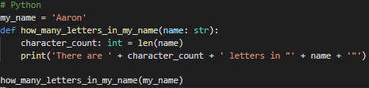
Why Types Matter – What Types Help to Prevent
Runtime Failures – Python
What happens here?
my_name = 'Aaron'
def how_many_letters_in_my_name(name):
character_count = len(name)
print('There are ' + character_count + ' letters in "' + name + '"')
how_many_letters_in_my_name(my_name)
my_name = 'Aaron'
def how_many_letters_in_my_name(name):
character_count = length(name)
print('There are ' + character_count + ' letters in "' + name + '"')
how_many_letters_in_my_name(my_name)
Type hints and editors don’t always help
Traceback (most recent call last):
File “code.py", line 6, in <module>
how_many_letters_in_my_name(my_name)
File “code.py", line 3, in how_many_letters_in_my_name
character_count = length(name)
NameError: name 'length' is not defined
Traceback (most recent call last):
File “code.py", line 7, in <module>
how_many_letters_in_my_name(my_name)
File "code.py", line 5, in
how_many_letters_in_my_name
print('There are ' + character_count + ' letters in "' + name + '"')
TypeError: can only concatenate str (not "int") to str
Notes:
Okay, let’s look at some type errors in Python.
This code takes a variable called my_name, whose value is my name, passes it to a function, and that function then prints the number of characters in my name.
By the way, I use this same example in the next few slides.
Take a few second to read this and tell me what will happen.
- In this case, “length” isn’t a function, but this is not flagged until the application executes, which then crashes the application.
Okay, we fixed the “length” error and we’re now using the “len” function, which is correct. Does this code work now?
- No. In this case, Python does not let us concatenate an integer and a string. Remember my question about adding an integer and a string?
Frustratingly, tooling and editors either cannot catch these errors for us due to complexities beyond this presentation, or in some cases just aren’t mature enough.
Even with type hints, VS Code, MyPy, and the Python language server did not catch this error for me.

Slide 15

Why Types Matter – What Types Help to Prevent
Runtime Failures – JavaScript
What happens here?
my_name = undefined;
function how_many_letters_in_my_name(name) {
character_count = name.length;
console.log('There are ' + character_count + ' letters in "' + name + '"');
}
how_many_letters_in_my_name(my_name);
my_name = 123;
function how_many_letters_in_my_name(name) {
character_count = name.length;
console.log('There are ' + character_count + ' letters in "' + name + '"');
}
how_many_letters_in_my_name(my_name);
my_name = 'Aaron';
function how_many_letters_in_my_name(name) {
character_count = name.length;
console.log('There are ' + character_count + ' letters in "' + name + '"');
}
how_many_letters_in_my_name(my_name);
Editors don’t help here either
No error, but …
This works fine
code.js:3
character_count = name.length;
^
TypeError: Cannot read property 'length' of undefined
There are undefined letters in "123"
There are 5 letters in "Aaron"
Notes:
Let’s look at the same example in JavaScript.
What happens?
- Okay, trick question. This is actually fine. But can you tell without referencing whether the string “name” has a property called “length?”
Okay, same code, except my_name is now the integer 123. What happens?
- Well, it doesn’t error, but it now displays the word “undefined” – surely that isn’t what we want!
Okay same code again, except my_name is now the special value “undefined” which means it doesn’t have a value. What happens?
- Whew, there’s that crash we were expecting! Or … well, I guess we didn’t really want our code to crash but it did despite our best intentions.
Like Python, tooling and editors usually don’t catch these errors.
In dynamically-typed languages, there are few situations where a type error can be detected before execution.

Slide 16
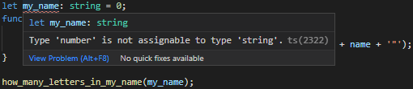
Why Types Matter – What Types Help to Prevent
Runtime Failures – TypeScript
What happens here?
let my_name: string = 0;
function how_many_letters_in_my_name(name: string) {
let character_count: number = name.length;
console.log('There are ' + character_count + ' letters in "' + name + '"');
}
how_many_letters_in_my_name(my_name);
Nothing! The compiler caught a type error.
Editors can catch and flag this error
$ tsc code.ts
code.ts:1:5 - error TS2322: Type 'number' is not assignable to type 'string'.
10 let my_name: string = 0;
Notes:
Let’s try TypeScript. This language is gradually and optionally typed, and it has a compiler – so we should be able to catch anything thrown at us, right?
What happens?
- Cool! The TypeScript compiler did catch this error for us.
- VS Code also catches this error.

Slide 17
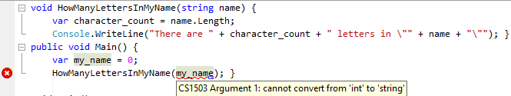
Why Types Matter – What Types Help to Prevent
Runtime Failures – C#
What happens here?
void HowManyLettersInMyName(string name) {
var character_count = name.Length;
Console.WriteLine("There are " + character_count + " letters in \"" + name + "\"");
}
public void Main() {
var my_name = 0;
HowManyLettersInMyName(my_name);
}
Nothing! The compiler caught a type error.
Editors can catch and flag this error
code.cs(6,26): CS1503 Argument 1: cannot convert from 'int' to 'string'
Notes:
Onto a statically-type language, and my personal favorite – C#.
Again, it’s the same simple application as the previous examples. What happens?
- Awesome – the compiler caught this one for us too!
- My editor also catches this type error.

Slide 18

Why Types Matter – What Types Help to Prevent
Runtime Failures – F#
What happens here?
Last One!
let Divide(x, y) = x / y;
let y1 = Divide(10, 2.0);
let y2 = Divide(10, 2);
Nothing! The compiler caught multiple type errors.
code.fs(2,23): error FS0001: The type 'float' does not match the type 'int'
code.fs(1,24): error FS0043: The type 'float' does not match the type 'int'
code.fs(3,23): error FS0001: This expression was expected to have type
'float'
but here has type
'int'
Editors can catch and flag this error
Notes:
Okay last one. F# is a Hindley-Milner typed language. Just a reminder, this means it is effectively statically-typed, but the types are determined by how the parameters and variables are used.
This example is much simpler, but it takes some careful examination to figure out what’s going on.
What do you think happens?
It turns out there are several type errors here, but only one of the reported errors is actually an issue, and there are a few ways to fix it.
All of these are caused by the fact that, in one call to the divide function, the divisor is a float, and in the other, it is an integer.
The two types are not necessarily compatible, so F# disallows this. [why: precision may be truncated]

Slide 19
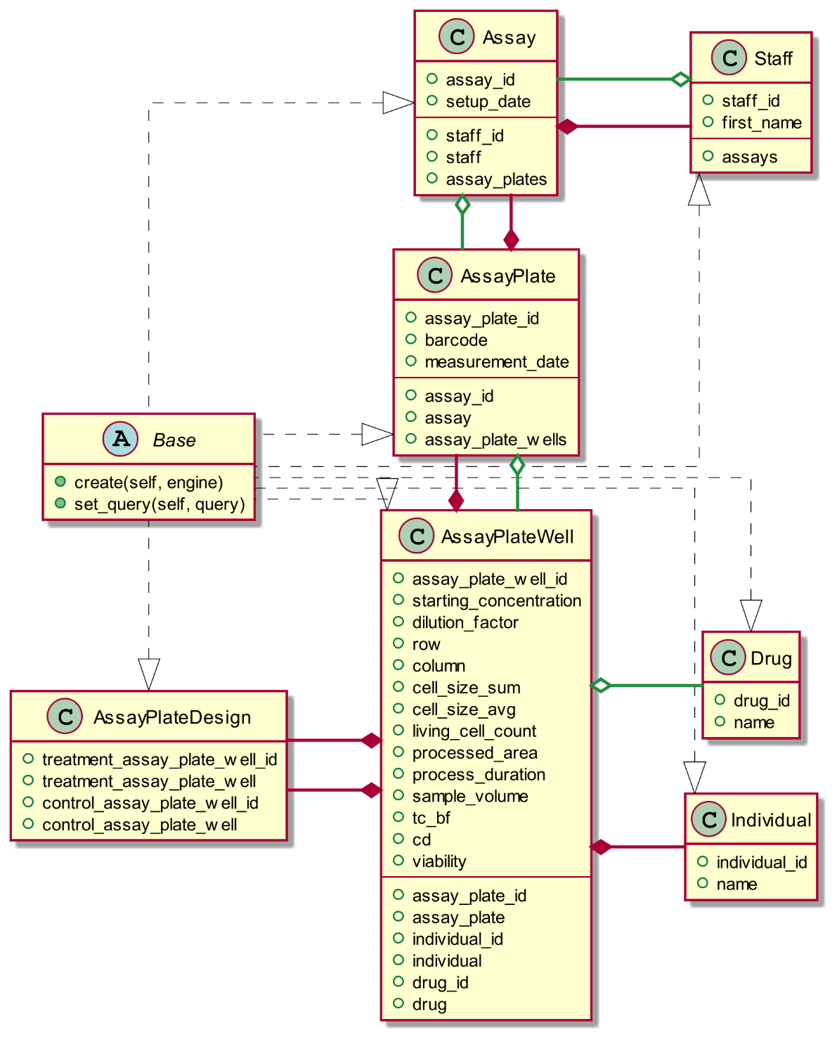
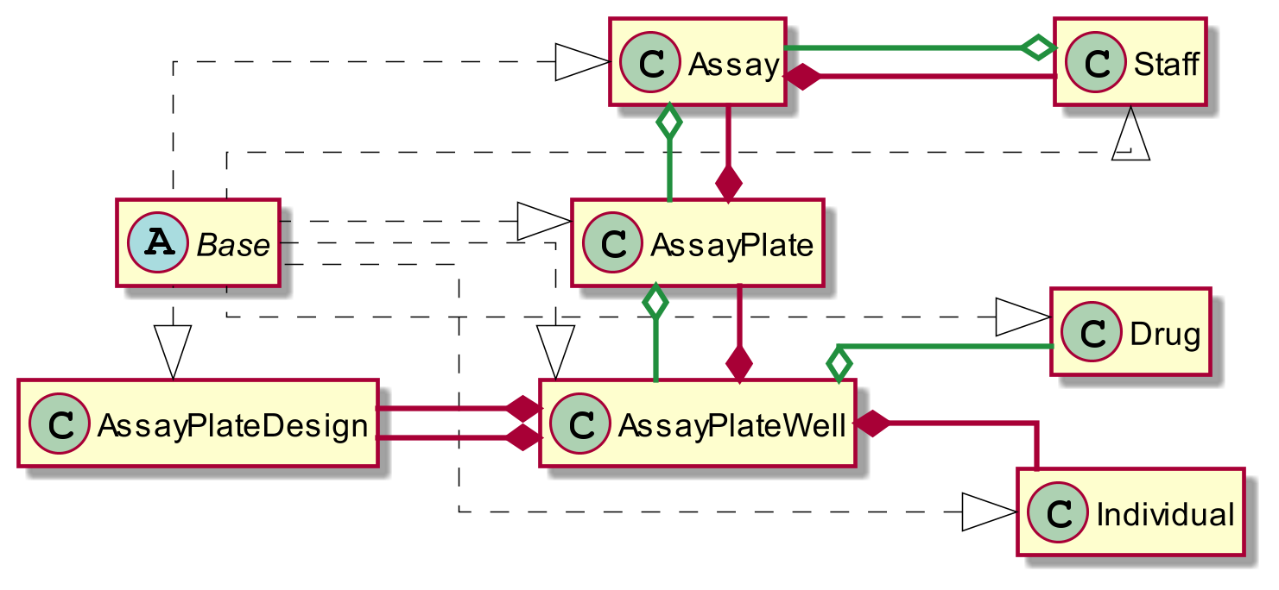
Real-life Use Cases – Compound Assay Platform
String
None
AssayPlateWell
Notes:
Okay enough of that. Let’s look at a real-world example.
Here I have a class diagram for the Compound Assay Platform Caden, Gina, and Myself are building for the Translational Oncology Research Laboratory.
First off, it’s quite a few classes and complex types to keep in your head. Tooling can really help us maintain a mental model of what we’re working with.
From a high level, we have a base type called Base. What the means is a little beyond this talk.
Then we have several relationships mapped out.
An Assay has several AssayPlates, which themselves have several AssayPlateWells. An Assay is owned by a Staff, which is a person.
Each AssayPlateWell has a Drug and an Individual or cell line
Then there is an AssayPlateDesign which reflects relationships between treatment and control plates
Getting a little more detailed, here are all the individual properties these classes have. There are quite a few!
Let’s take a look at a few. Caden and Gina are barred from answering. What is the data type of a barcode in AssayPlate?
It’s a string
In Base, what data type does set_query return?
It doesn’t return anything
Okay last one. In AssayPlateDesign, what is treatment_assay_plate_well?
It’s an AssayPlateWell. That one was a bit easier because the property name partially matches the type. Incidentally, that is one strategy to make dynamically-typed languages more manageable.

Slide 20
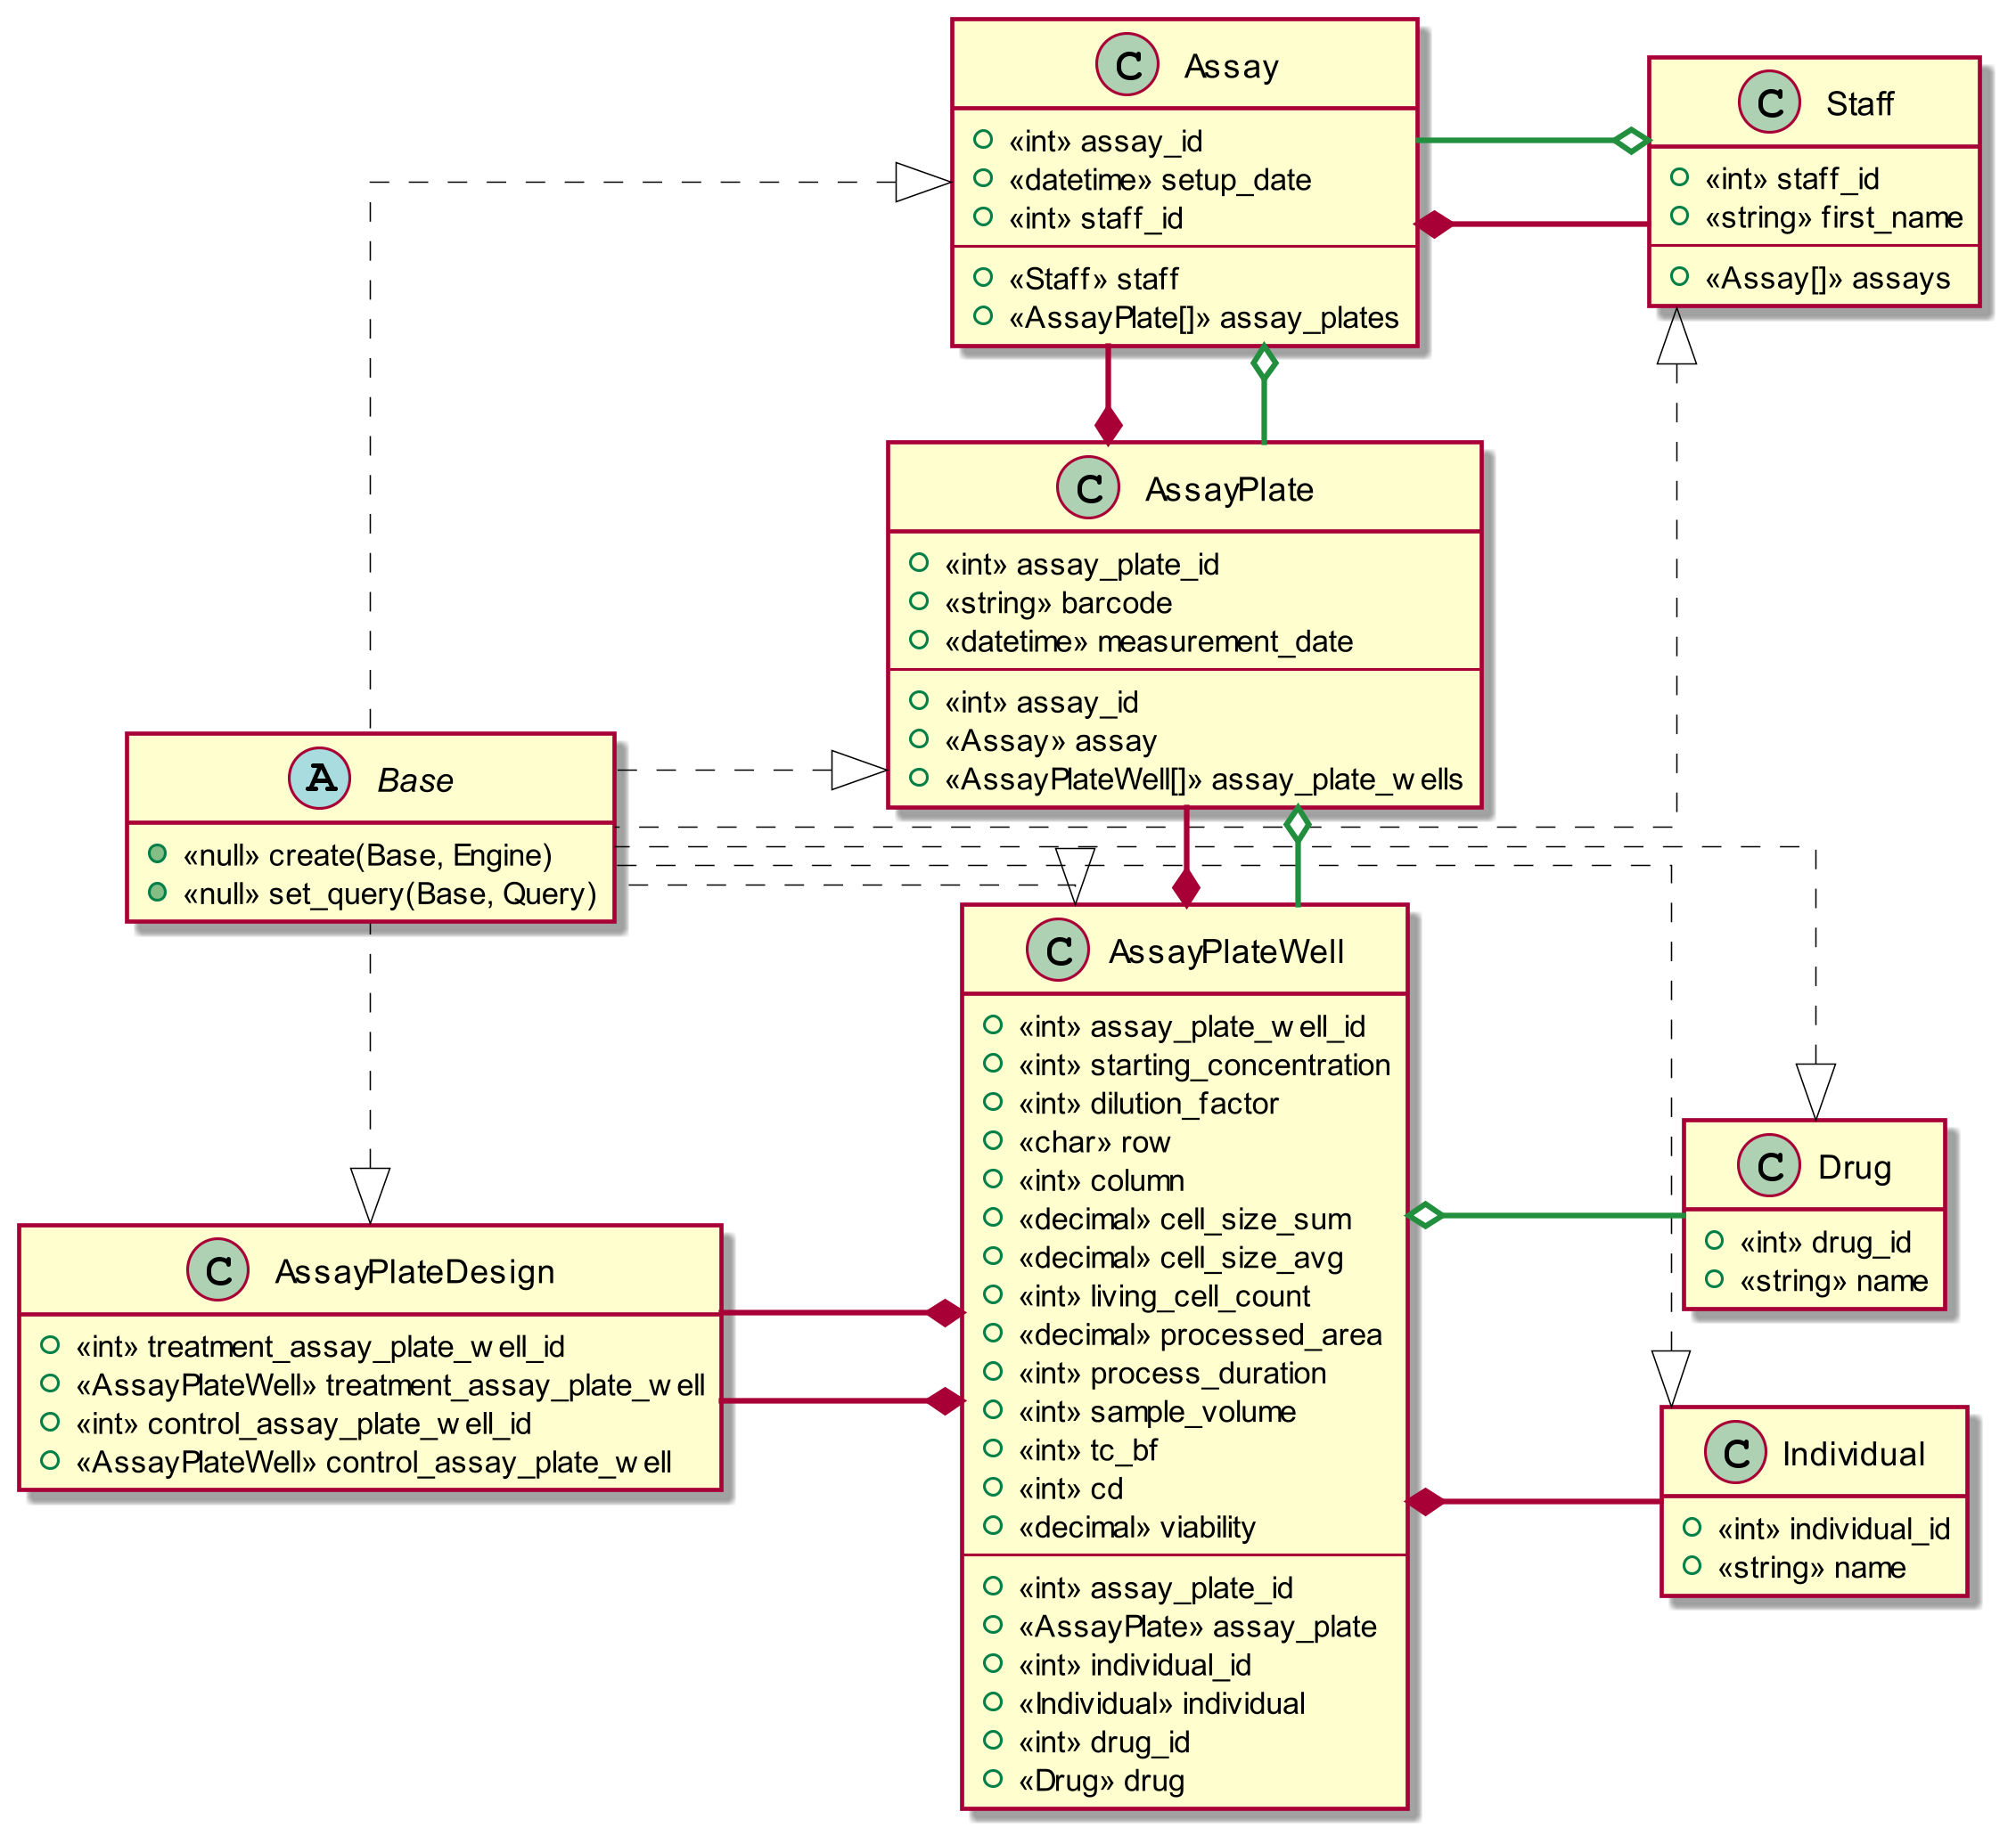
Real-life Use Cases – Compound Assay Platform
Array of AssayPlate
Array of AssayPlateWell
Char
Notes:
Okay now we have a more complete picture of these classes. Each property is preceded by its type, enclosed in brackets.
Let’s take a look at these 3.
Assay has a set of AssayPlates, which is represented by an array of that class type
Similarly, AssayPlate has an array of AssayPlateWell instances
AssayPlateWell, then, has a row property that is a character data type. The actual values in the application are A, B, C, D, E, and F.

Slide 21
Real-life Use Cases – Compound Assay Platform
String
Integer
How do I know what these are?
Read the code for context.
def testdb(table, entity_id):
session = self._db.get_session()
if table == 'assay':
result = session.query(Assay).filter(Assay.assay_id == entity_id)
return str(result.first().assay_id)
if table == 'staff':
result = session.query(Staff).filter(Staff.staff_id == entity_id)
return result.first().first_name
I need to find out what this is too!
Notes:
We are writing the CAP application in Python, so let’s examine some challenges we will face with using a dynamically-typed language.
Here is a test method lifted out of the application we are writing.
The function “testdb” takes two parameter values for “table” and “entity_id”
How do I know what the data types for these variables are?
I have to read the code to find how the parameters are used to know what their type should be, though it’s not always a guarantee.
In the case of entity_id, I also need to figure out what the type of assay_id in the Assay class is. In this case it’s obvious, but it usually isn’t.
It’s like my eyes and brain are a Hindley-Milner type system!

Slide 22
Real-life Use Cases – Compound Assay Platform
def testdb(table, entity_id):
session = self._db.get_session()
if table == 'assay':
result = session.query(Assay).filter(Assay.assay_id == entity_id)
return str(result.first().assay_id)
if table == 'staff':
result = session.query(Staff).filter(Staff.staff_id == entity_id)
return result.first().first_name
Complex types need more work to discover.
Notes:
Here is an example where it’s not always obvious what the type of a variable may be.
What type is result? (it’s a Query object)
What does first() return? (an Assay or Staff) Does it take any parameters?
What is the type of first_name? (string)
Interestingly, first() actually causes database operations to occur, which can be hidden by not knowing that result is a Query type.

Slide 23
Real-life Use Cases – Compound Assay Platform
def testdb(table, entity_id):
session = self._db.get_session()
if table == 'assay':
result = session.query(Assay).filter(Assay.assay_id == entity_id)
return str(result.first().assay_id)
if table == 'staff':
result = session.query(Staff).filter(Staff.staff_id == entity_id)
return result.first().first_name
Did you notice `testdb` needs to return a string?
Notes:
Incidentally, did you notice that testdb returns a string? You’d be forgiven for not catching this.

Slide 24
Real-life Use Cases – Compound Assay Platform
def testdb(table, entity_id):
assert type(table) == str
assert type(entity_id) == int
session = self._db.get_session()
assert type(session) == ScopedSession
if table == 'assay':
result = session.query(Assay).filter(Assay.assay_id == entity_id)
assert type(result) == Query
return str(result.first().assay_id)
if table == 'staff':
result = session.query(Staff).filter(Staff.staff_id == entity_id)
assert type(result) == Query
return result.first().first_name
Notes:
I mentioned earlier that the name of variables is one strategy used to contend with not knowing what kind of data you’re working with.
In Python, another common approach is to do type checks yourself.
These assert statements will cause an error to occur if the type of the variables is not correct.
Unfortunately, this does not avoid runtime type errors, but it does tend to make them occur earlier in an application’s execution

Slide 25
Real-life Use Cases – Compound Assay Platform
def testdb(table: str, entity_id: int) -> str:
session: ScopedSession = self._db.get_session()
if table == 'assay':
result = session.query(Assay).filter(Assay.assay_id == entity_id)
# Item "None" of "Optional[Assay]" has no attribute "assay_id“
# https://github.com/python/mypy/issues/4805
return str(result.first().assay_id)
if table == 'staff':
result = session.query(Staff).filter(Staff.staff_id == entity_id)
return result.first().first_name
Notes:
We can do better though, in my opinion. Python type hints get us part of the way there. Of course, we could mix this with type checks as well.
Frustratingly and humorously, when I declared that session’s type is ScopedSession, the MyPy type checker popped up this incorrect error that I will need to tell MyPy to ignore.

Slide 26
Real-life Use Cases – Compound Assay Platform
public string TestDb(string table, int entityId)
{
var session = _db.GetSession();
if (table == "assay")
{
var result = session.Query<Assay>().First(assay => assay.AssayId == entityId);
return result.AssayId.ToString();
}
if (table == "staff")
{
var result = session.Query<Staff>().First(assay => assay.StaffId == entityId);
return result.FirstName;
}
}
Notes:
Okay, so how might that look in a statically-typed language like C#?
Not too different, actually. We can see that TestDb takes a string and an integer and returns a string.
Less obviously, there are some aspects of C# that show other type information here, but this requires some familiarity with the language to recognize.
One of the more important parts of this example regards the tooling for the language. Static typing makes compile-time type validation possible.

Slide 27
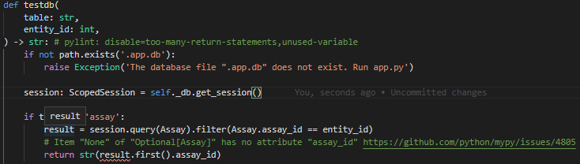
Real-life Use Cases – Compound Assay Platform
Notes:
Speaking of tooling, even with type hints in Python, VS Code does not recognize what the type of “result” is.

Slide 28
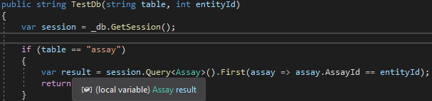
Real-life Use Cases – Compound Assay Platform
Notes:
However, VS Code does recognize what the type of “result” is with C#.
[now summarize]

Slide 29
class ThankYou
{
public void SayThanks
=> Console.WriteLine("Thank You!");
public List<Question> GetQuestions() { ... }
}
var ending = new ThankYou();
ending.SayThanks();
ending.GetQuestions();
T
h
a
n
k
Y
o
u
!
_
Code examples can be found here.
https://github.com/aholmes/PresentationCodeExamples

