Slide 1
Basics of treatment for primary headaches
Erik Reinertsen

Slide 2
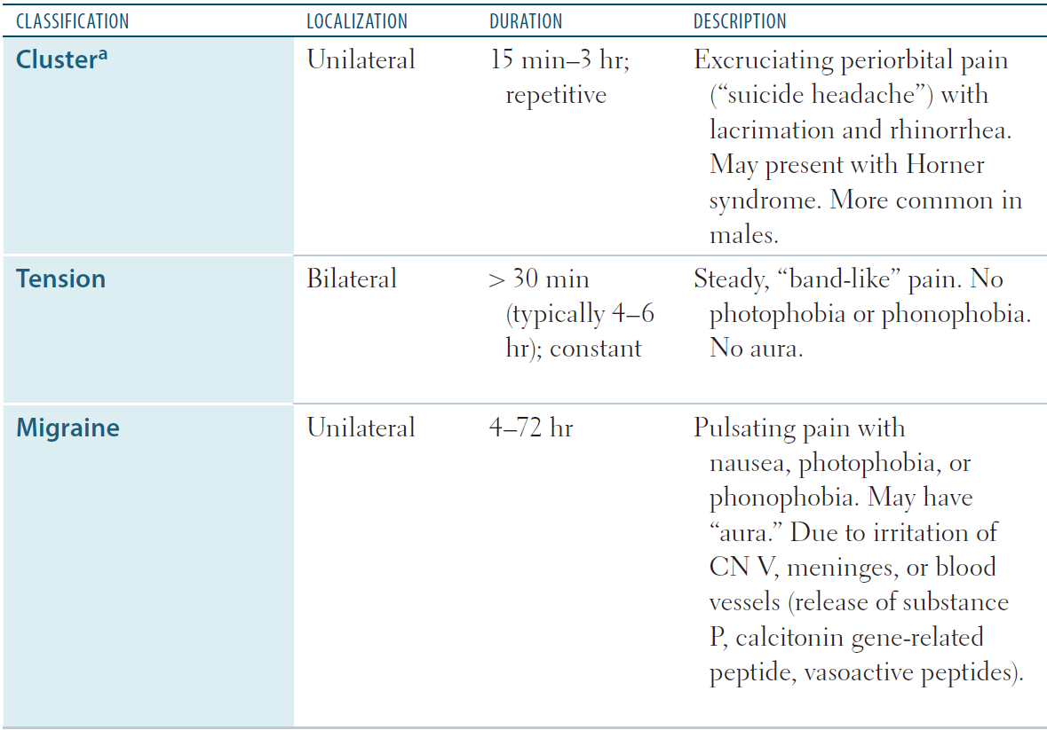

Slide 4
Cluster headache treatment
Abortive
Prophylactic
100% O₂
Sumatriptan SQ
Sumatriptan IN
Lidocaine IN, ergotamine PO, dihydroergotamine IV
Verapamil
Glucocorticoids
Start at onset of cluster episode to suppress further attacks. Requires weeks of therapy.
Notes:
Blue to red = order of tx, progress if current tx fails.
Administer intranasal sumatriptan CONTRALATERAL to the side of headache.
Headache prevention — Preventive therapy should be started without delay at the onset of a cluster episode. The goal is to suppress attacks over the expected duration of the cluster period. An effective preventive regimen is of utmost importance because patients typically have one to eight cluster headaches a day, and repeated use of abortive medications may result in toxicity and/or rebound.
For patients with chronic cluster headache and those with relatively long-lasting (ie, two months or longer) active periods of episodic cluster headache, we recommend initial preventive therapy with verapamil(see 'Verapamil' below), in agreement with national and expert consensus guidelines [2,7].
Many preventive drugs require several weeks of therapy and dose escalation until efficacy is achieved [2]. Due to the relatively long time needed to titrate verapamil to an effective dose, glucocorticoids (or dihydroergotamine where available) may be used as adjunctive therapy in the first two weeks of verapamil administration. Glucocorticoids in particular can rapidly suppress cluster attacks during the time required for the longer-acting preventive agents to take effect. An alternative is greater occipital nerve block ipsilateral to the headache attacks. (See 'Greater occipital nerve blocks' below.)
For patients with episodic cluster headache who have active cluster periods that last less than two months, we suggest initial preventive therapy with glucocorticoids alone (see 'Glucocorticoids' below). Because of their potential for systemic side effects, glucocorticoids should only be used for short-term prophylaxis.

Slide 5
Why are ergots contraindicated in pregnancy?
Because of the potential to induce hypertonic uterine contractions and vasospasm/vasoconstriction, which could cause adverse fetal effects.

Slide 7

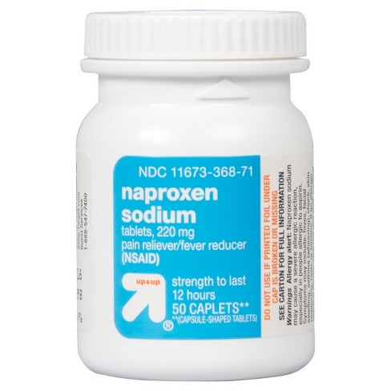
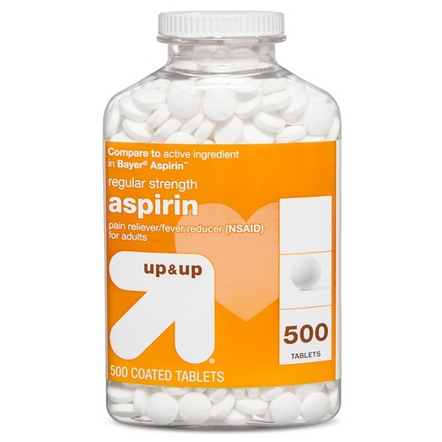
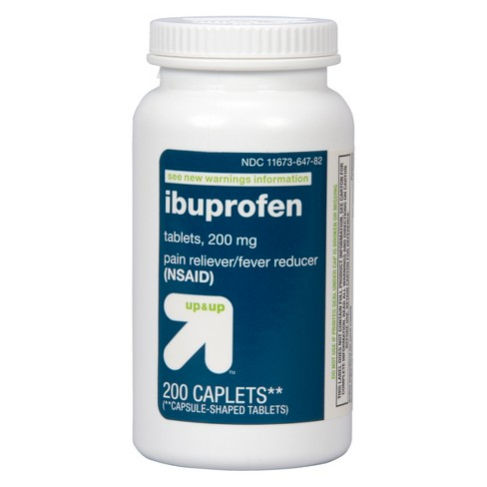

Tension headache treatment
Notes:
For patients with pure episodic tension-type headache (TTH), we recommend treatment with simple analgesics such as nonsteroidal anti-inflammatory drugs (NSAIDs) or aspirin (Grade 1A). Reasonable choices include a single dose of ibuprofen (400 mg), naproxen sodium (220 mg or 550 mg) or aspirin (650 to 1000 mg). Acetaminophen (1000 mg) is probably less effective than NSAIDs or aspirin, but is preferred in pregnancy. (See 'Simple analgesics' above.)
●The combination of caffeine with the simple analgesics acetaminophen, aspirin, or ibuprofen is more effective for the treatment of TTH than simple analgesic monotherapy, although side effects are likely to be more frequent with combination therapy. The role of caffeine combined with NSAIDs other than ibuprofen has not been adequately examined. For patients with TTH that is unresponsive or poorly responsive to monotherapy with simple analgesics, we suggest the use of caffeine combined with simple analgesics (Grade 2A). A reasonable choice is a single dose of two tablets of combined acetaminophen 250 mg, aspirin 250 mg, and caffeine 65 mg. (See 'Combination analgesics containing caffeine' above.)
●We recommend not using combination therapies containing either butalbital or opioids for initial treatment of TTH (Grade 1C). These medications are associated with multiple risks, including tolerance, dependency, toxicity, and the development of medication overuse headache. (See 'Combination analgesics containing butalbital and codeine' above.)
●For patients with definite or probable TTH of severe intensity who are acutely evaluated and managed in a medical facility, additional treatment options include parenteral chlorpromazine, metoclopramide, the combination of metoclopramide plus diphenhydramine, or intramuscular ketorolac. (See 'Parenteral treatments' above.)

Slide 9
Migraine treatment
Mild
Moderate
Severe
Emergency
NSAIDs or combo analgesics
*Antiemetics PO or PR
Sumatriptan SQ
Antiemetics IV or IM
Dihydroergotamine IV
Ketorolac IV or IM
Triptans PO
Sumatriptan-Naproxen
*Triptans nasal & SQ
*Antiemetics IV or IM *Dihydroergotamine PO
*Complicated by nausea and vomiting

Slide 10
Antiemetics used in the treatment of migraine include the dopamine receptor antagonists metoclopramide, chlorpromazine, and prochlorperazine. Diphenhydramine is sometimes administered concurrently to prevent which side effects?
Akathisia and acute dystonic reactions.

Slide 11
Chlorpromazine, prochlorperazine, droperidol, and diphenhydramine are associated with what cardiac side effects?
QT interval prolongation and torsades de pointes .

Slide 12
34F p/w 3-year hx of disabling pounding pain over one temple, with nausea and light sensitivity. Headaches triggered by lack of sleep, and associated with menstruation. Prodrome of shimmering light. What should you give this patient if she has a moderate to severe headache without nausea?
Triptan or sumatriptan-naproxen PO.

Slide 13
42M p/w “tightness” like rubber band around back of head. Denies n/v, photophobia, throbbing, or pain with movement. Headache is exacerbated by stress.
Ibuprofen PO.

Slide 14
36M p/w sudden onset severe pain behind right eye. Accompanied by rhinorrhea, lacrimation, and drooping in right eyelid. You administer 100% O₂ and sumatriptan SQ, but he does not feel relief. What should you give next?
Intranasal triptans to the contralateral side.

Slide 15
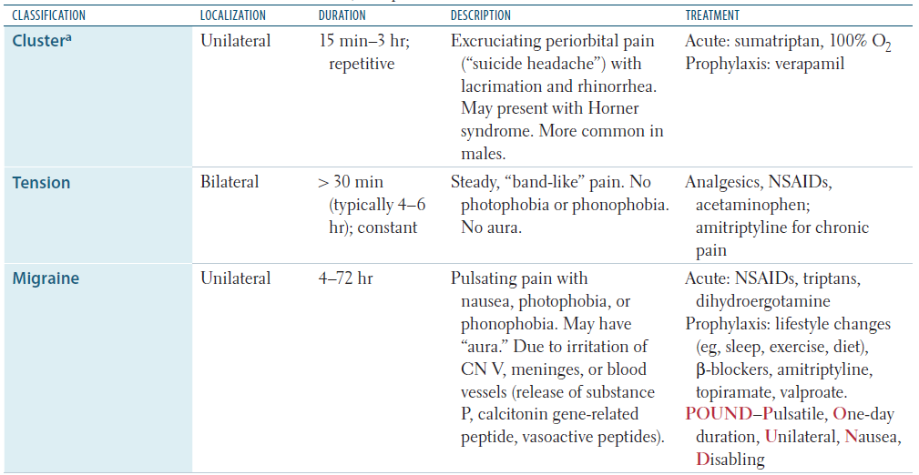
Notes:
And if this fails, you can try lidocaine IN.

