Slide 1
chapter 1
Based on Lectures by Dix Finlay and Abowd Beale
HUMAN–COMPUTER INTERACTION

Slide 2
WHY HUMAN–COMPUTER INTERACTION?
Systems’ designers need to know how to think in terms of the eventual users’ tasks and how to translate that knowledge into an executable system.
The interface design should be developed integrally with the rest of the system. It should support the tasks that people actually want to do, and forgive the careless mistakes.
We therefore need to consider how HCI fits into the design process.

Slide 3
WHAT IS HCI?
The term human–computer interaction has only been in widespread use since the early 1980s.
As computer use became more widespread, an increasing number of researchers specialized in studying the interaction between people and computers, concerning themselves with the physical, psychological and theoretical aspects of this process.
By user we may mean an individual user, a group of users working together, or a sequence of users in an organization, each dealing with some part of the task or process. The user is whoever is trying to get the job done using the technology.

Slide 4
WHAT IS HCI?
By computer we mean any technology ranging from the general desktop computer to a large-scale computer system, a process control system or an embedded system.
By interaction we mean any communication between a user and computer, be it direct or indirect.
The important thing is that the user is interacting with the computer in order to accomplish something.

Slide 5
THEORY AND HCI
Unfortunately for us, there is no general and unified theory of HCI that we can present.
There is an underlying principle that forms the basis of our own views on HCI, people use computers to accomplish work.
This outlines the three major issues of concern: the people, the computers and the tasks that are performed.
The system must support the user’s task, which gives us a fourth focus, usability: if the system forces the user to adopt an unacceptable mode of work then it is not usable.

Slide 6
THEORY AND HCI
There are three ‘use’ words that must all be true for a product to be successful; it must be:
Useful – accomplish what is required: play music, cook dinner, format a document;
Usable – do it easily and naturally, without danger of error, etc.
Used – make people want to use it, be attractive, engaging, fun, etc.

Slide 7
THE HUMAN
Humans are limited in their capacity to process information. This has important implications for design.
Information is received and responses given via a number of input and output channels:
– Visual channel
– Auditory channel
– Haptic channel
– Movement.

Slide 8
THE HUMAN
The human, the user, is, after all, the one whom computer systems are designed to assist. The requirements of the user should therefore be our first priority.
In order to design something for someone, we need to understand their capabilities and limitations.
We will look at how humans perceive the world around them, how they store and process information and solve problems, and how they physically manipulate objects.

Slide 9
THE HUMAN
In 1983, Card, Moran and Newell described the Model Human Processor, which is a simplified view of the human processing involved in interacting with computer systems.
The model comprises three subsystems:
The perceptual system, handling sensory stimulus from the outside world.
The motor system, which controls actions.
The cognitive system, which provides the processing needed to connect the two.
Each of these subsystems has its own processor and memory.

Slide 10
THE HUMAN
We will use the analogy of the user as an information processing system. Information comes in, is stored and processed, and information is passed out.
In the human, we are dealing with an intelligent information-processing system, and processing therefore includes problem solving, learning, and, consequently, making mistakes.
The human, unlike the computer, is also influenced by external factors such as the social and organizational environment, and we need to be aware of these influences as well.
In this chapter, we will first look at the human’s input–output channels, the senses and responders or effectors.

Slide 11
INPUT–OUTPUT CHANNELS
In an interaction with a computer the user receives information that is output by the computer, and responds by providing input to the computer – the user’s output becomes the computer’s input and vice versa.
Input in the human occurs mainly through the senses and output through the motor control of the effectors.
There are five major senses: sight, hearing, touch, taste and smell.

Slide 12
Vision
Human vision is a highly complex activity with a range of physical and perceptual limitations, yet it is the primary source of information for the average person.
We can roughly divide visual perception into two stages: the physical reception of the stimulus from the outside world, and the processing and interpretation of that stimulus.
We will begin by looking at the eye as a physical receptor, and then go on to consider the processing involved in basic vision.

Slide 13
The Human Eye
The eye is a mechanism for receiving light and transforming it into electrical energy.
Light is reflected from objects in the world and their image is focused upside down on the back of the eye.
The receptors in the eye transform it into electrical signals which are passed to the brain.
The eye can perceive size and depth using the visual angle. If two objects are at the same distance from the eye, the larger one will have a larger visual angle.

Slide 14
Hearing
The sense of hearing is often considered secondary to sight, the auditory system can convey a lot of information about our environment.
Hearing begins with vibrations in the air or sound waves. The ear receives these vibrations and transmits them, through various stages, to the auditory nerves.
The human ear can hear frequencies from about 20 Hz to 15 kHz.
The ear comprises three sections, commonly known as the outer ear, middle ear and inner ear.

Slide 15
Hearing
Physical apparatus:
– outer ear – protects inner and amplifies sound
– middle ear – transmits sound waves as
vibrations to inner ear
– inner ear – chemical transmitters are released
and cause impulses in auditory nerve
The auditory system performs some filtering of the sounds received, allowing us to ignore background noise and concentrate on important information.

Slide 16
Touch
Touch provides us with vital information about our environment. It tells us when we touch something hot or cold, and can therefore act as a warning.
Haptic perception is a secondary source of information, for those whose other senses are impaired, it may be vitally important.
We receive stimuli through the skin.
Some areas more sensitive than others e.g. fingers.

Slide 17
Movement
A simple action such as hitting a button in response to a question involves a number of processing stages.
The stimulus (of the question) is received through the sensory receptors and transmitted to the brain.
The question is processed and a valid response generated.
The brain then tells the appropriate muscles to respond.
Each of these stages takes time, which can be roughly divided into reaction time and movement time.

Slide 18
Movement
Movement time is dependent largely on the physical characteristics of the subjects: their age and fitness.
A person can react to an auditory signal in approximately 150 ms, to a visual signal in 200 ms and to pain in 700 ms.
Fitts' Law describes the time taken to hit a screen target:
Mt = a + b log2(D/S + 1)
where: a and b are empirically determined constants
Mt is movement time
D is Distance
S is Size of target

Slide 19
HUMAN MEMORY
Indeed, much of our everyday activity relies on memory.
Memory is the second part of our model of the human as an information-processing system, memory is associated with each level of processing.
There are three types of memory or memory function: sensory buffers, short-term memory or working memory, and long-term memory.
These memories interact, with information being processed and passed between memory stores.

Slide 20
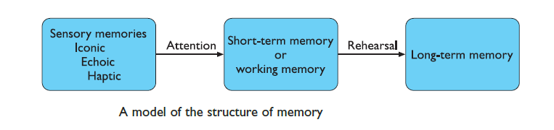
HUMAN MEMORY
Sensory Memory:
The sensory memories act as buffers for stimuli received through the senses.
A sensory memory exists for each sensory channel: iconic memory for visual stimuli, echoic memory for aural stimuli and haptic memory for touch.

Slide 21
Sensory Memory
These memories are constantly overwritten by new information coming in on these channels.
Information is passed from sensory memory into short-term memory by attention, thereby filtering the stimuli to only those which are of interest at a given time.
Attention is the concentration of the mind on one out of a number of competing stimuli or thoughts.
It is clear that we are able to focus our attention selectively, choosing to attend to one thing rather than another. This is due to the limited capacity of our sensory and mental processes.

Slide 22
Short-Term Memory
Short-term memory or working memory acts as a ‘scratch-pad’ for temporary recall of information. It is used to store information which is only required fleetingly.
For example, calculate the multiplication 35 × 6 in your head. You may have used the fact that 6 = 2 × 3 and calculated 2 × 35 = 70 followed by 3 × 70. To perform calculations such as this we need to store the intermediate stages for use later.
In order to comprehend this sentence you need to hold in your mind the beginning of the sentence as you read the rest. Both of these tasks use short-term memory.

Slide 23
Short-Term Memory
Short-term memory can be accessed rapidly, in the order of 70 ms.
It also decays rapidly, meaning that information can only be held there temporarily, in the order of 200 ms.
Short-term memory also has a limited capacity.
There are two basic methods for measuring memory capacity.
The first involves determining the length of a sequence which can be remembered in order. The second allows items to be freely recalled in any order.

Slide 24
Short-Term Memory
Using the first measure, the average person can remember 7 ± 2 digits.
Examples
212348278493202
0121 414 2626
A generalization of the 7 ± 2 rule is that we can remember 7 ± 2 chunks of information.
Therefore chunking information can increase the short-term memory capacity.

Slide 25
Long-Term Memory
• Repository for all our knowledge
  – slow access ~ 1/10 second
  – slow decay, if any
  – huge or unlimited capacity
• Two types of LTM
  – episodic – serial memory of events
  – semantic – structured memory of facts, concepts, and skills that we have acquired.
Semantic LTM derived from Episodic LTM
Information is placed there from working memory through rehearsal.

Slide 26
Long-Term Memory Structure
Semantic memory is structured in some way to allow access to information, representation of relationships between pieces of information, and inference.
One model for the way in which semantic memory is structured is as a network. Items are associated to each other in classes, and may inherit attributes from parent classes.
As an example, our knowledge about dogs may be stored in a network such as that shown in the following Figure.

Slide 27
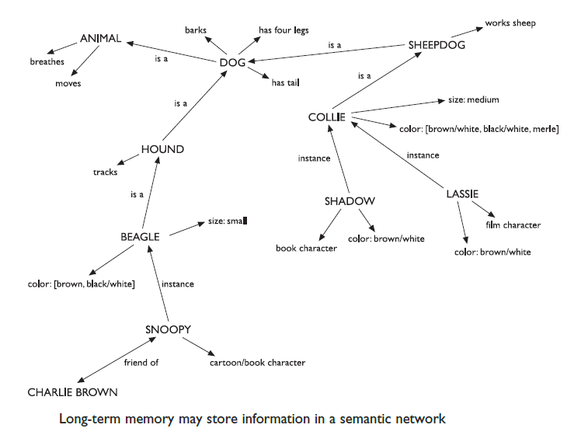
LTM - semantic network
.

Slide 28
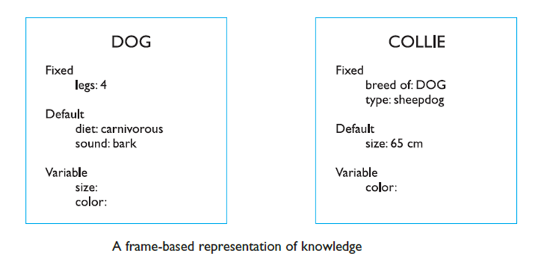
Models of LTM - Frames
Information organized in data structures.
Slots in these structures allow attribute values to be added. Frame slots may contain default, fixed or variable information.

Slide 29
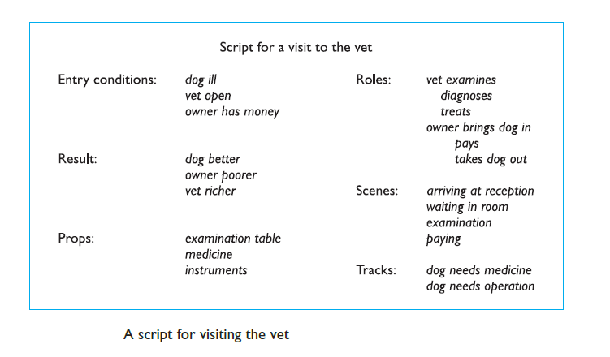
Models of LTM - Scripts
Scripts attempt to model the representation of stereotypical knowledge about situations.
Consider the following sentence:
  John took his dog to the surgery. After seeing the vet, he left.

Slide 30
Models of LTM - Rules
Representation of procedural knowledge.
Condition/action rules
  if condition is matched
  then use rule to determine action.
        IF the lecturer arrives
        go to lecture room
        IF I am sick
        I can stay at home

Slide 31
Long-Term Memory Processes
There are 3 main activities related to LTM:
Storage: The rehearsal of a piece of information from the STM stores it in the LTM.
If the total learning time is increased, information is remembered better.
learning time should be well spread, and repetition alone is not enough: information should be meaningful and familiar.

Slide 32
Long-Term Memory Processes
2. Forgetting: There are 2 main theories of forgetting: decay and interference.
Decay
– information is lost gradually but very slowly
Interference
– new information replaces old: retroactive interference
– old may interfere with new: proactive interference
… Forgetting is affected by emotional factors too.

Slide 33
Long-Term Memory Processes
3. Retrieval: There are 2 types of information retrieval: recall and recognition.
In recall the information is produced from memory. It can be facilitated by providing cues, e.g. the category in which the information may be placed.
In recognition, the presentation of the information provides the knowledge that the information has been seen before.

Slide 34
Thinking: Reasoning and Problem Solving

Slide 35
Thinking
We have considered how information finds its way into and out of the human system and how it is stored. Finally, we come to look at how it is processed and manipulated.
Humans are able to use information to reason and solve problems, and do these activities when the information is partial or unavailable.
We are able to think about things of which we have no experience, and solve problems which we have never seen before.
Thinking can require different amounts of knowledge, Example (Subtraction, Newspaper.)

Slide 36
Reasoning:
Reasoning is the process by which we use the knowledge we have to draw conclusions or infer something new about the domain of interest.
Types of reasoning:
  Deductive.
  Inductive.
  Abductive.

Slide 37
Deductive Reasoning
Deduction:
  derive logically necessary conclusion from given
  premises.
        e.g. If it is Friday then she will go to work
        It is Friday
        Therefore she will go to work.
Logical conclusion not necessarily true:
        e.g. If it is raining then the ground is dry
        It is raining
        Therefore the ground is dry

Slide 38
Inductive Reasoning
• Induction:
  generalizing from cases we have seen to infer information about cases we have not seen.
    e.g. all elephants we have seen have trunks therefore all elephants have trunks.
• Generalization
• Unreliable but useful in learning about our environment.
• We are better at using positive than negative evidence. This is illustrated in an experiment first devised by Wason.

Slide 39
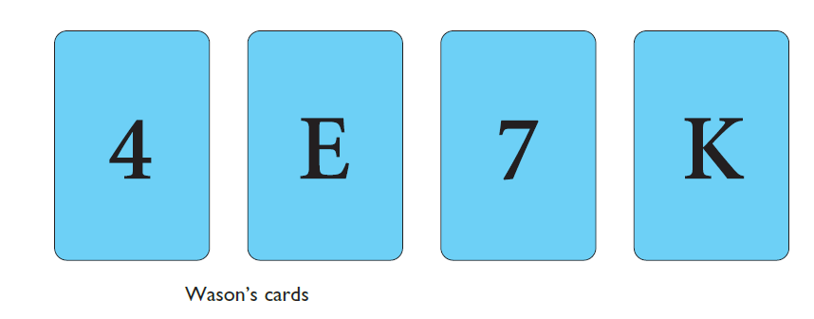
Inductive Reasoning
If a card has a vowel on one side, it must has an even number on the other
Is this true?
How many cards do you need to turn over to find out?
…. and which cards?

Slide 40
Inductive Reasoning
A common response to this is to check the E and the 4.
This uses only positive evidence. In fact, to test the truth of the statement we need to check negative evidence.
If we can find a card which has an odd number on one side and a vowel on the other we have disproved the statement.
We must therefore check E and 7.

Slide 41
Abductive Reasoning
Abduction:
• Reasons from a fact to the action or state that caused it.
    e.g. Sam drives fast when going to work.
    If I see Sam driving fast, assume he is going
    to work.
• Unreliable:
– can lead to false explanations

Slide 42
Problem solving
Is the process of finding a solution to an unfamiliar task, using the knowledge we have.
Human problem solving is characterized by the ability to adapt the information we have to deal with new situations.
There are a number of different views of how people solve problems.
  Gestalt view that problem solving involves both reuse of knowledge and insight.
  Analogy use knowledge of similar problem from similar domain. Analogical mapping difficult if domains are semantically different

Slide 43
Errors and Mental Models
Types of Error:
  Errors result from changes in the context of skilled behavior.
  If a pattern of behavior has become automatic and we change some aspect of it, the more familiar pattern may break through and cause an error.
  A familiar example of this is where we intend to stop at the shop on the way home from work but in fact drive past.
  Here, the activity of driving home is the more familiar and overrides the less familiar intention.

Slide 44
Errors and Mental Models
Types of Error:
  Errors result from an incorrect understanding, or model, of a situation or system.
  Assuming a person builds a mental model of the system being dealt with, errors may occur if the actual operation differs from the mental model.
  Example, Beside the lift door was a button, the lift button was on the inside rim of the lift, hidden from view.
  This illustrates the importance of a correct mental model and the dangers of ignoring conventions.

Slide 45
Emotion
• Various theories of how emotion works
  – James-Lange: emotion is our interpretation of a physiological response to a stimuli.
  – Cannon: emotion is a psychological response to a stimuli.
• Emotion clearly involves both cognitive and physical responses to stimuli

Slide 46
Emotion
• The biological response to physical stimuli is called affect.
• Affect influences how we respond to situations
  – positive: creative problem solving
  – negative: narrow thinking
“Negative affect can make it harder to do even easy tasks; positive affect can make it easier to do difficult tasks” (Donald Norman)

Slide 47
Emotion
Implications for interface design:
– Stress will increase the difficulty of problem solving.
– Relaxed users will be more forgiving of shortcomings in design.
– Enjoyable, pleasing and rewarding interfaces will increase positive affect

Slide 48
Individual Differences
We should be aware of individual differences so that we can account for them as far as possible within our designs.
Differences Type:
long term, such as sex, physical capabilities and intellectual capabilities.
Short term, include the effect of stress or fatigue on the user.
change through time, such as age.
Ask yourself: will design decision exclude section of user
population?

