Slide 1
LMS functions

Slide 2
Table of Content
Quick Agitation
List of functional requirement
Functional requirement UI
Any other business (AOB)

Slide 3
Quick Agitation
According to one of the IT initiative in Bakkah, we represent this prestation for creating new LMS (learning management system)
With no subscription cost and build especially for our need, we will start create this project using Agile mindset for creating sprints
With minimum valuable product, and we can gather our needs from the different LMS in the market to build the idle one to satisfy
Our customer and stakeholders needs,
After the approval on those upcoming requirement the implantation process will take in place.
Keep in mind all the following slide are not written on stone, we can enhance it by the time for what serve Bakkah.

Slide 4
List of the functional requirement
Function | Represent
Home LMS (Dashboard) | A home page that gave the user list of main quick access to any other function
Add user | A page that allow to create a new user manually in the LMS
Edit user | A page that allow to modify, delete or gave certain permeation to an existed user
Add category | A section that allow the admin or the instructor to create a Couse category
Edit category | A section that allow the admin or the instructor to modify, delete a Couse category
Add Branches | A webpage that allow the admin to monitor the branches, create a branch, modify branch, delete branch
Courses dashboard | A fully dashboard that allow the admin and the instructor to view all the courses and add, modify courses
Roles | A dashboard with list of all users with the aplite to assignee roles, remove roles
Reports | A fully dashboard to extract a reports and view diagrams for all the activity in the LMS

Slide 5
UI requirement
UI stand for User interface; it simply mean we as a developers we can't start creating codes without understand the general
concept of the layout GUI in term of expediting the process, also the UI set a clear path and imagination for what the stockholder
actually wants and what they will get before going to the implantation phase.
The upcoming slide will preview every functional requirements that the LMS cannot be valuable without them.
Do not pay attention to the styling it will be enchased, just pay attention to the functions, the buttons, the boxes etc..

Slide 6
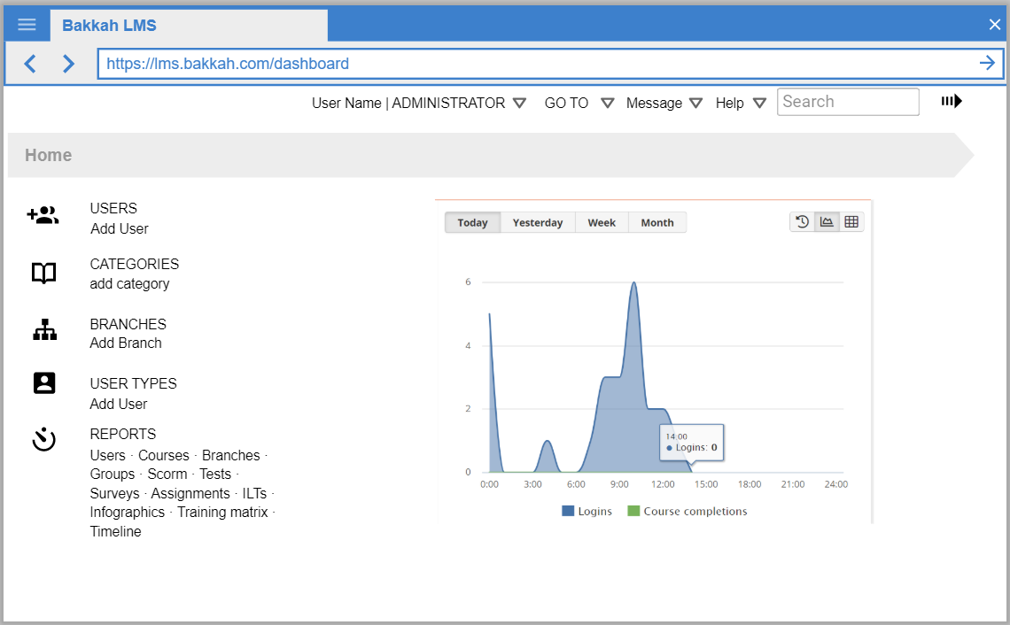
UI requirement : Home Page

Slide 7
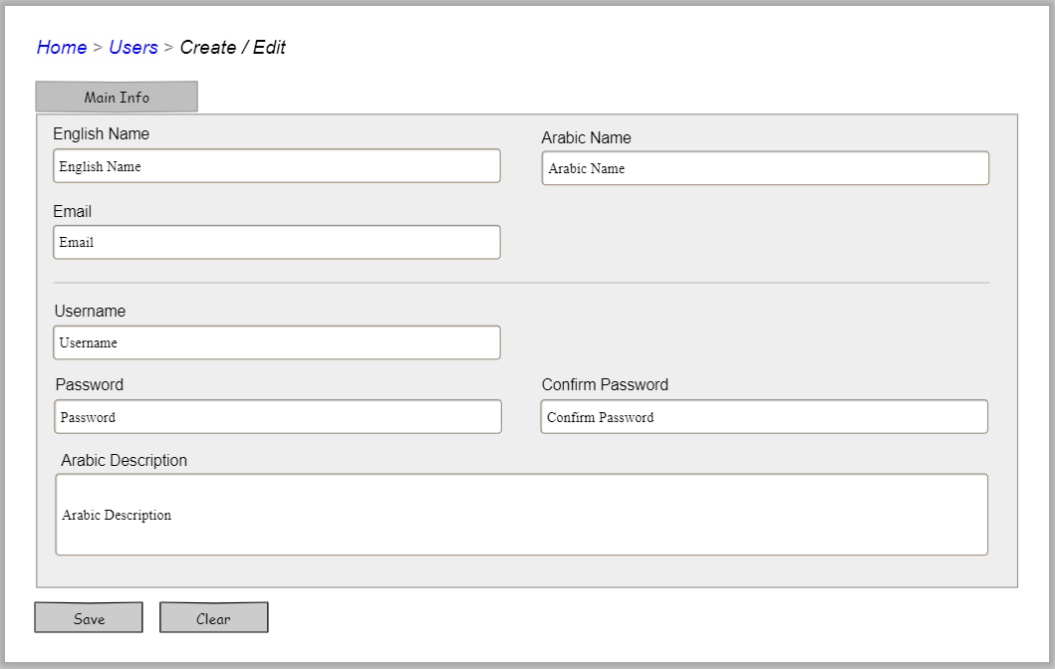
UI requirement: User

Slide 8
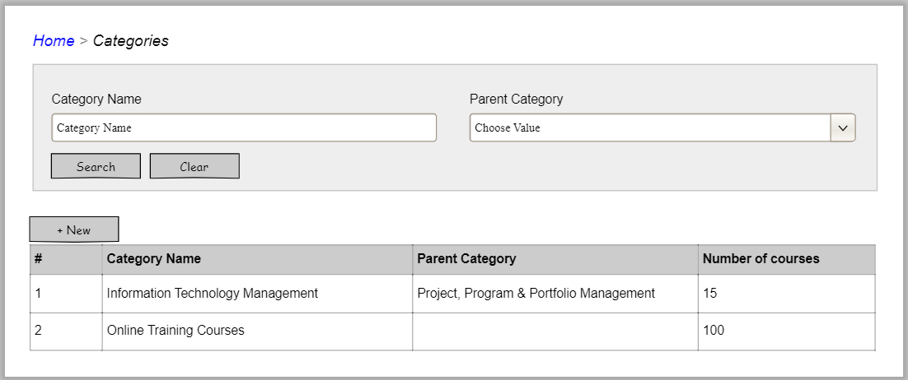
UI requirement : Categories

Slide 9
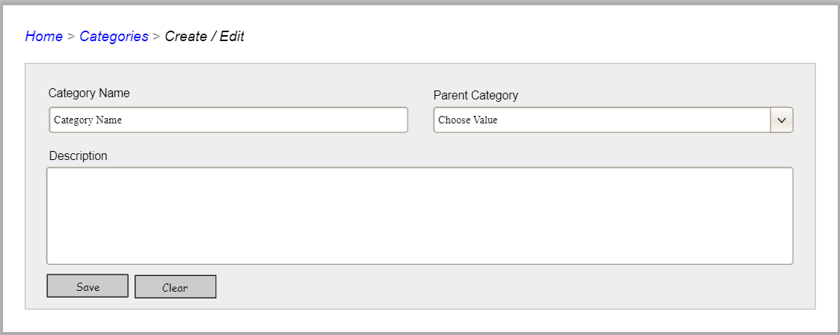
UI requirement : Edit Categories

Slide 10
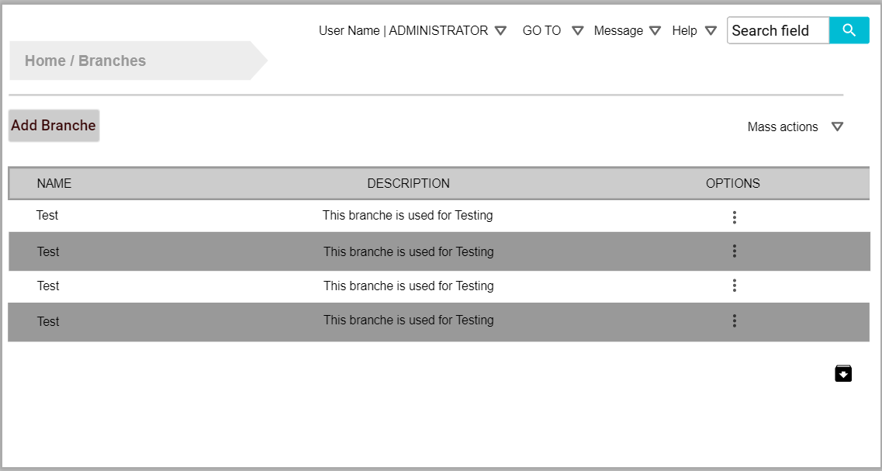
UI requirement : Branches

Slide 11
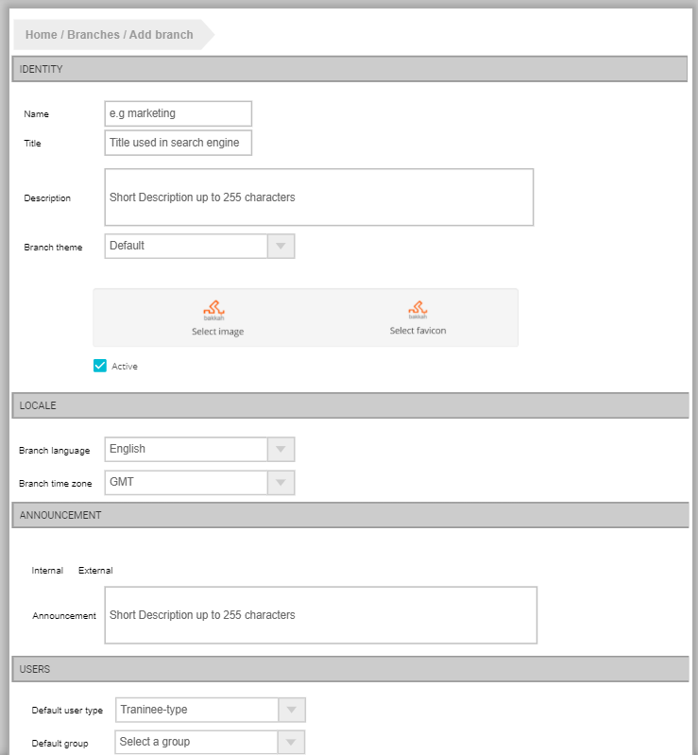
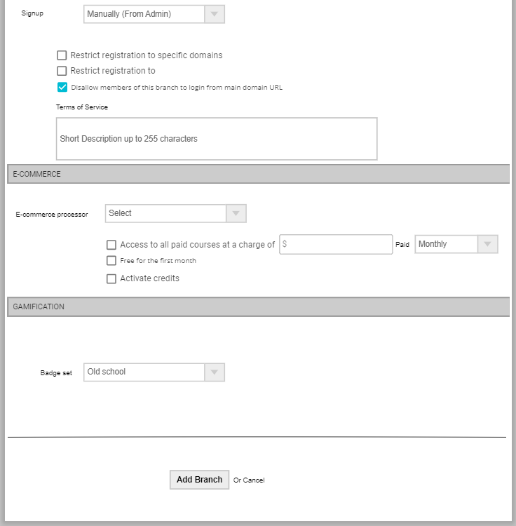
UI requirement : Add Branche

Slide 12
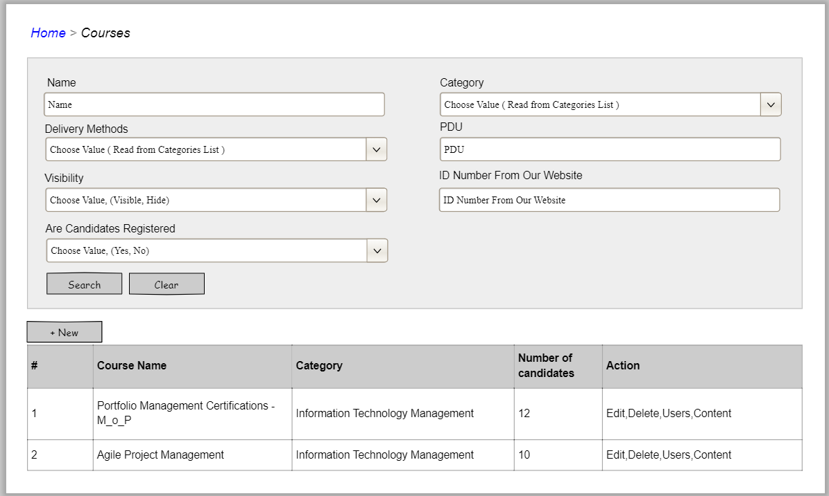
UI requirement : Courses

Slide 13
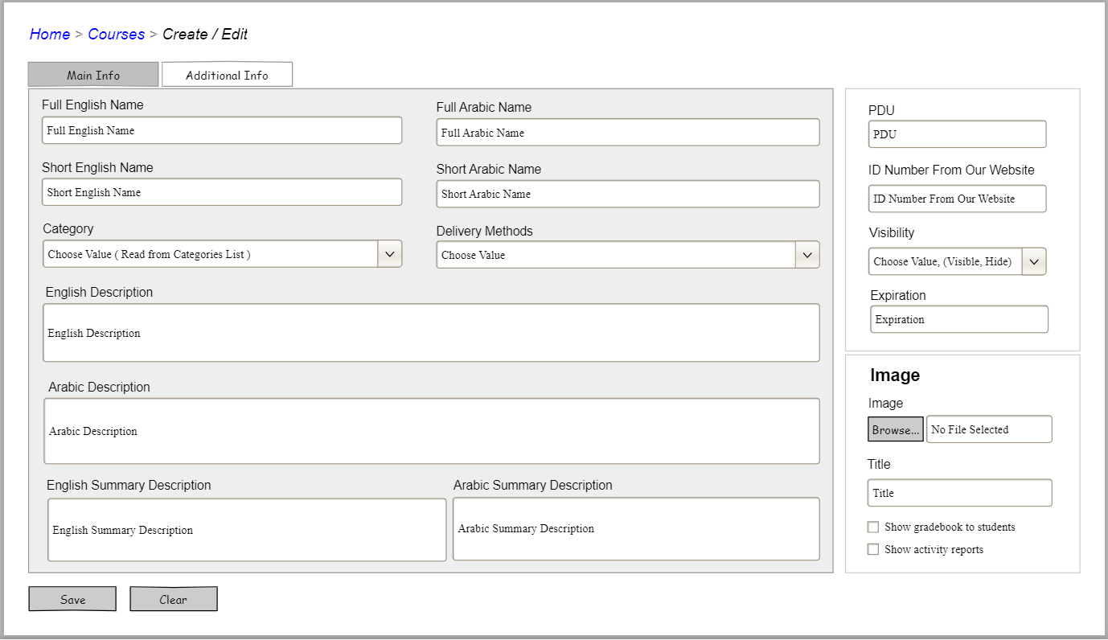
UI requirement : Courses – Main Info

Slide 14
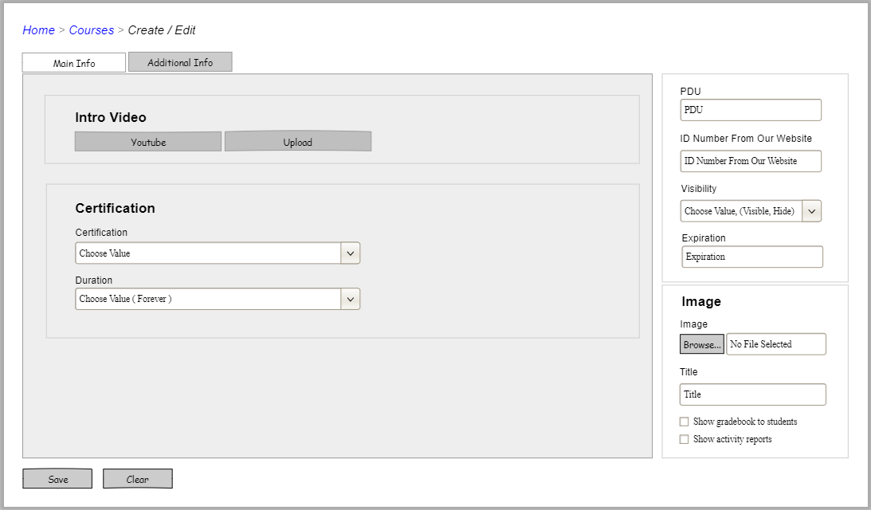
UI requirement : Courses – Additional info

Slide 15
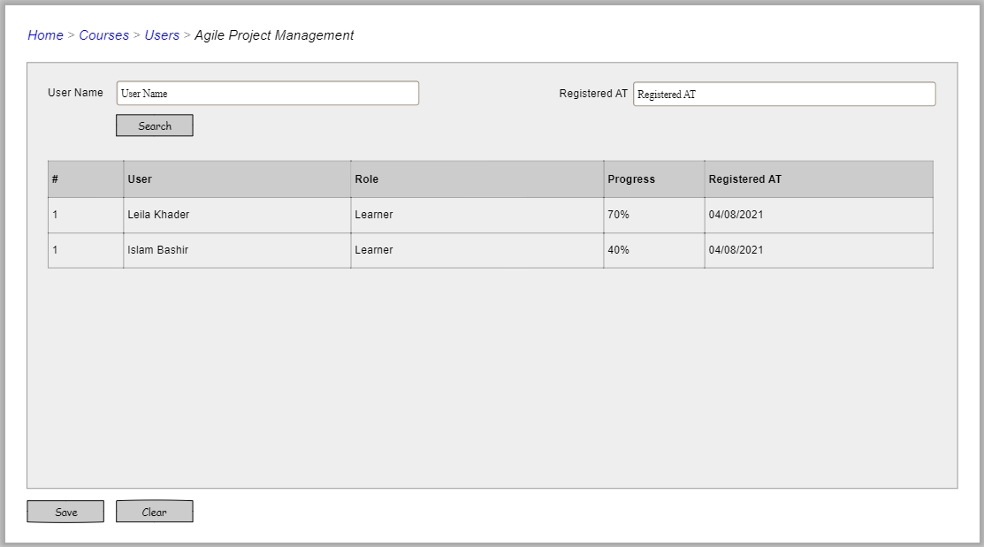
UI requirement : Courses – Users

Slide 16
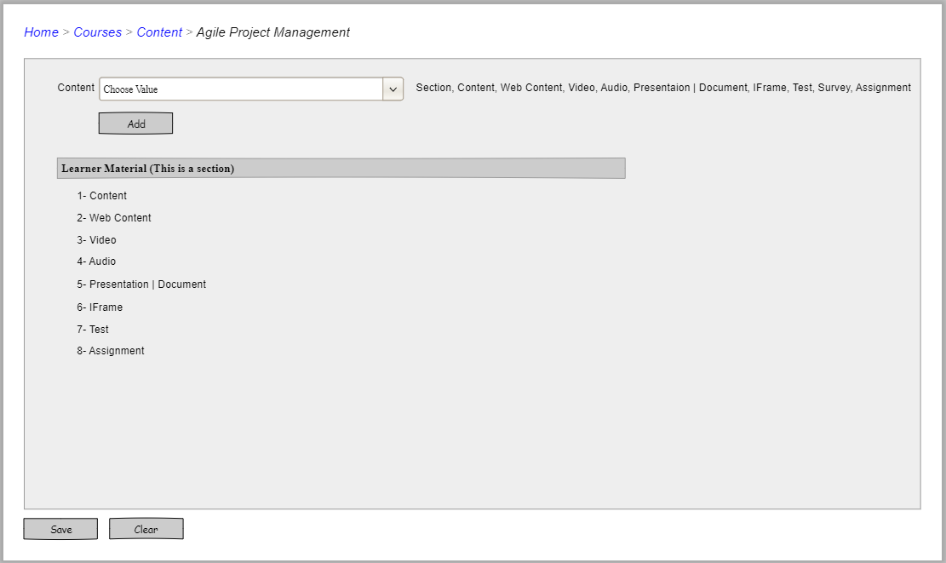
UI requirement : Courses – Content

Slide 17
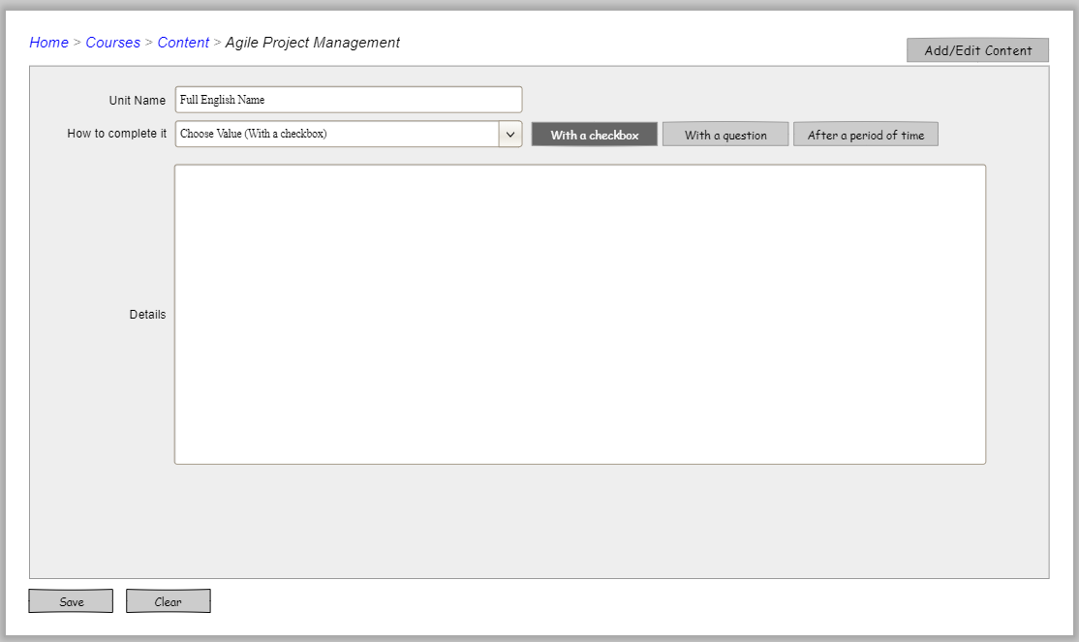
UI requirement : Courses – Content with checkbox

Slide 18
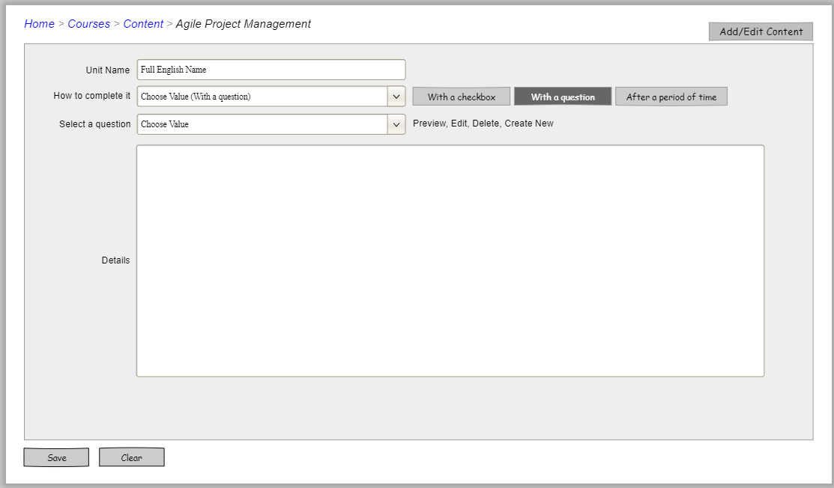
UI requirement : Courses – Content with question

Slide 19
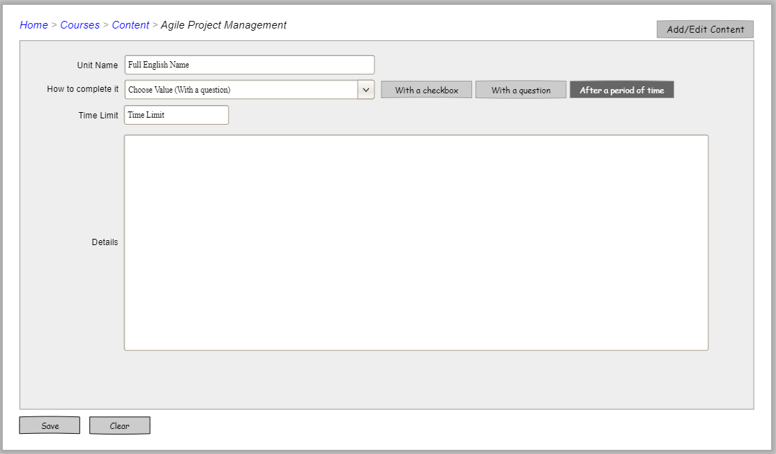
UI requirement : Courses – Content with period

Slide 20
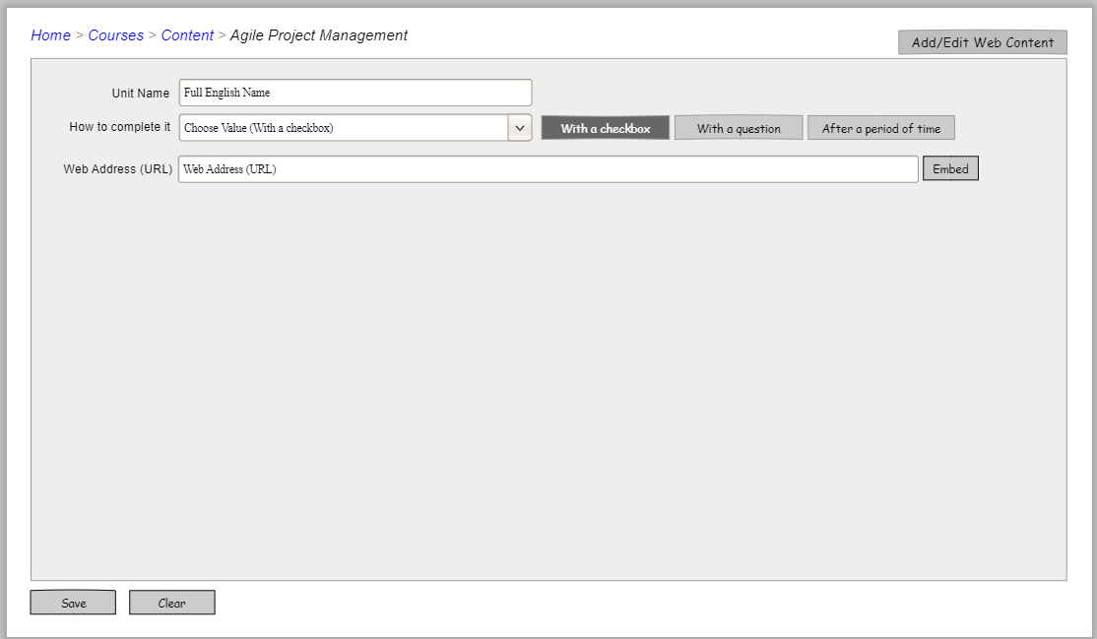
UI requirement : Courses – web content with checkbox

Slide 21
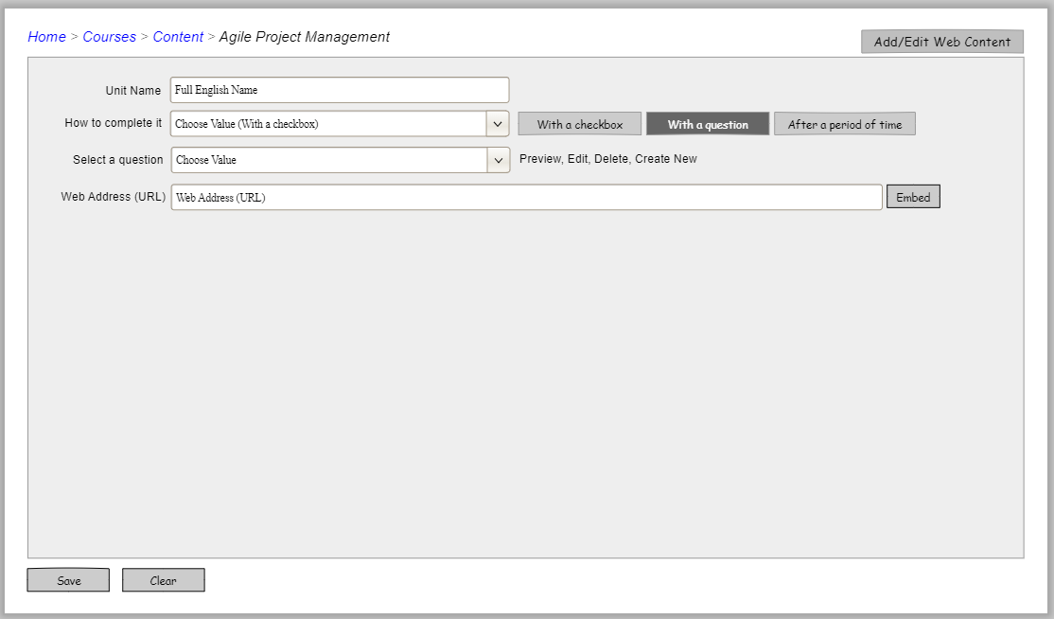
UI requirement : Courses – web content with question

Slide 22
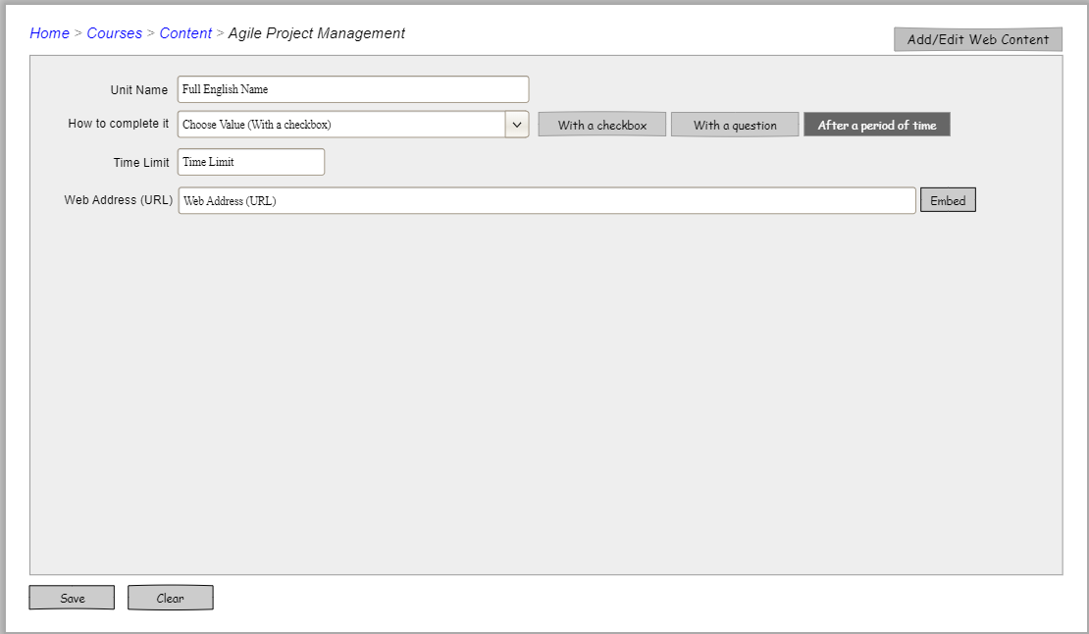
UI requirement : Courses – web content with period

Slide 23
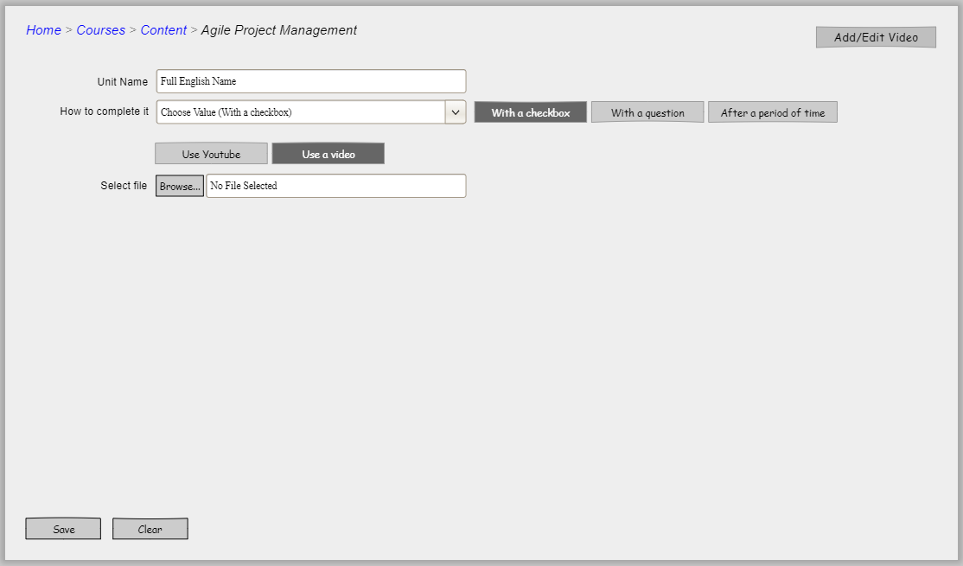
UI requirement : Courses – web content with video and checkbox

Slide 24
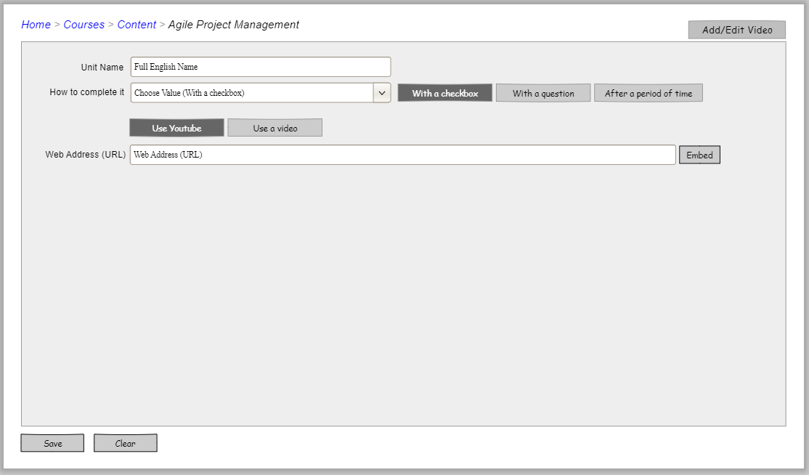
UI requirement : Courses – web content with YouTube and checkbox

Slide 25
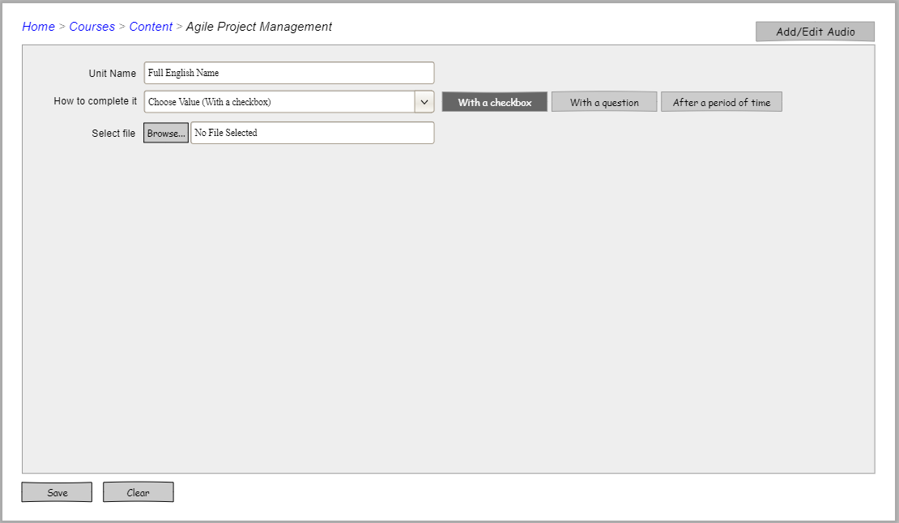
UI requirement : Courses – Audio with Checkbox

Slide 26
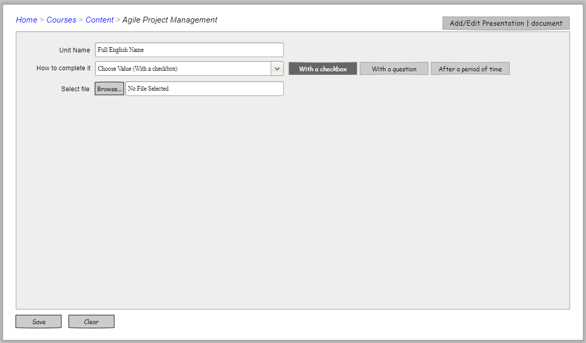
UI requirement : Courses – Presentation with Checkbox

Slide 27
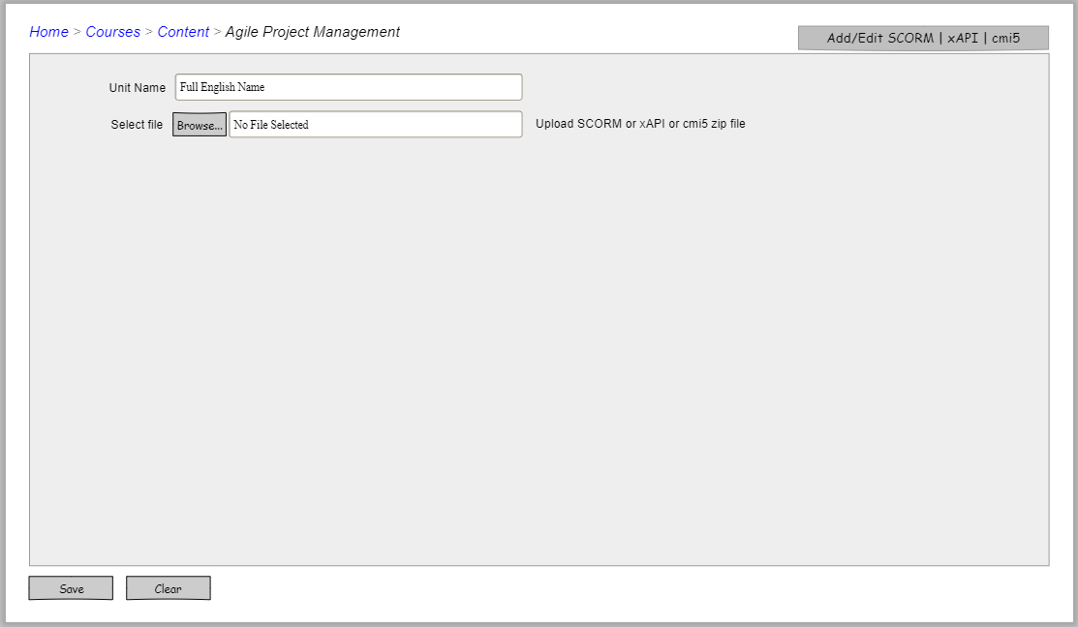
UI requirement : Courses – SCORM

Slide 28
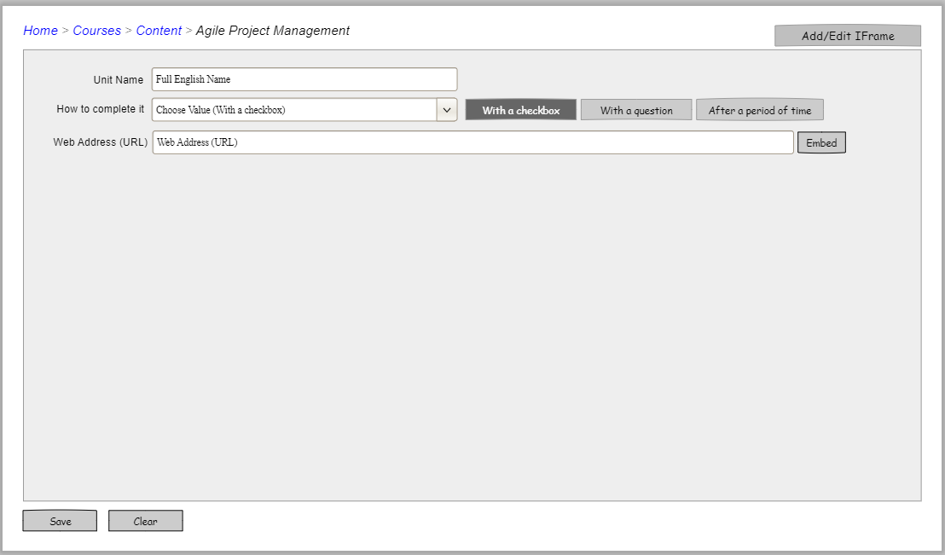
UI requirement : Courses – iframe with checkbox

Slide 29
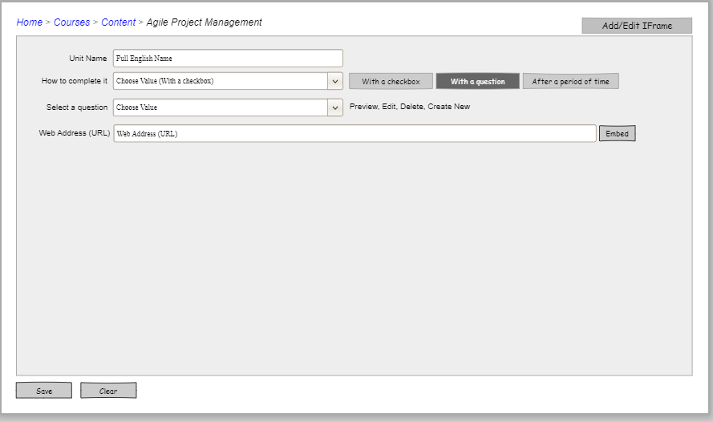
UI requirement : Courses – iframe with question

Slide 30
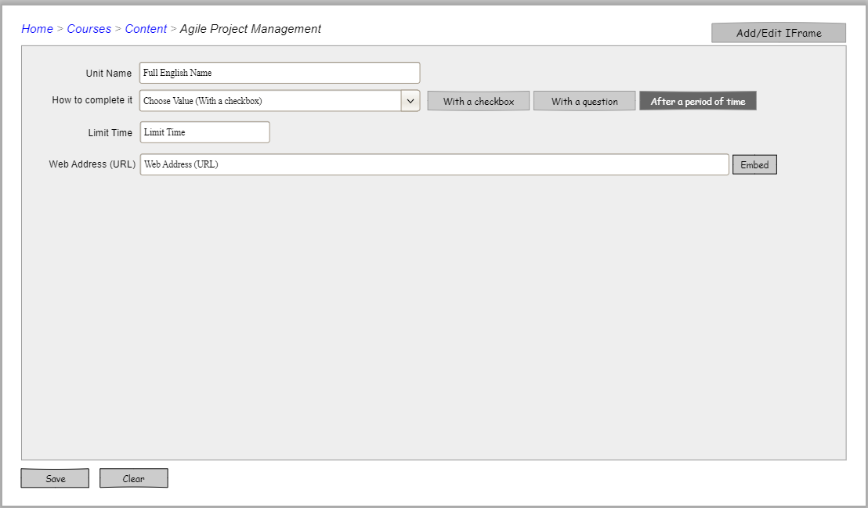
UI requirement : Courses – iframe with period

Slide 31
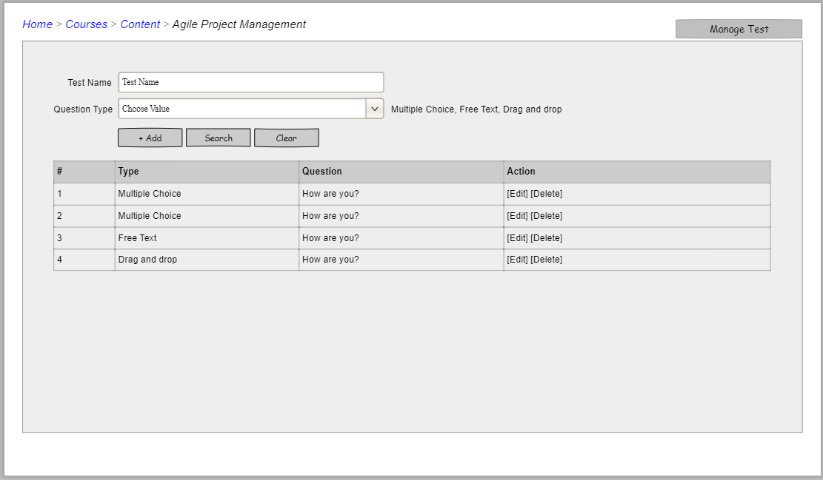
UI requirement : Courses – Test

Slide 32
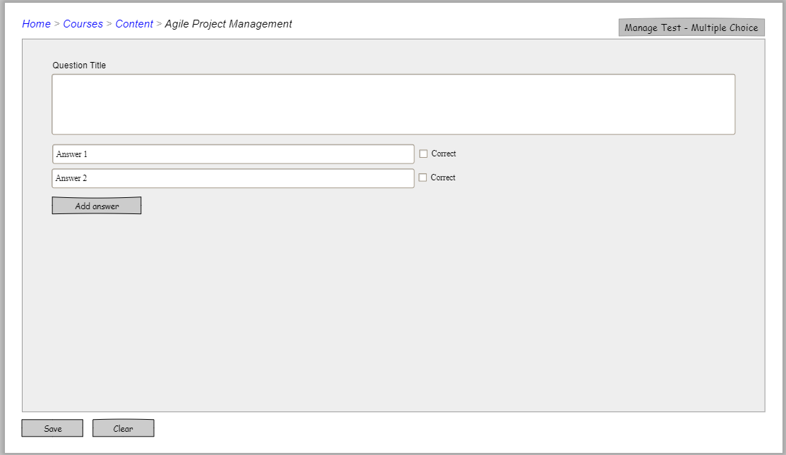
UI requirement : Courses – Test multiple chose

Slide 33
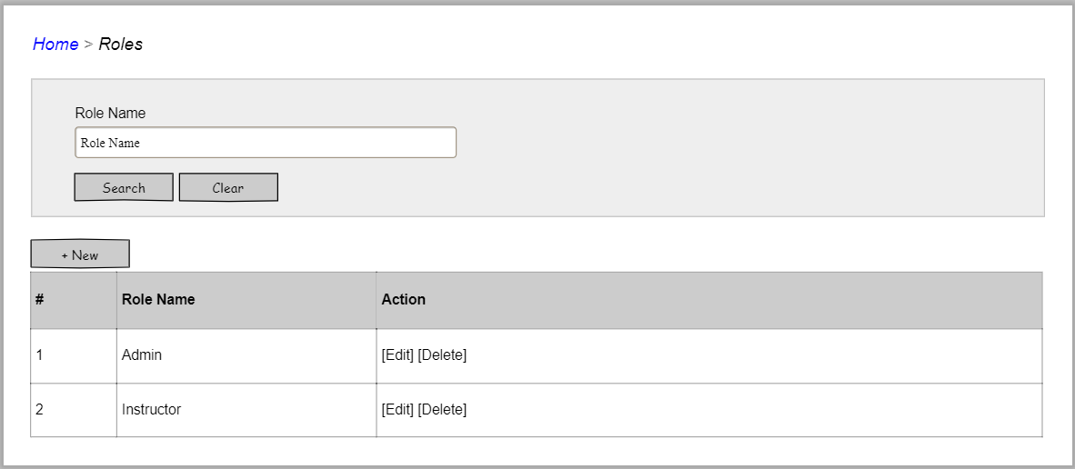
UI requirement : Roles

Slide 34
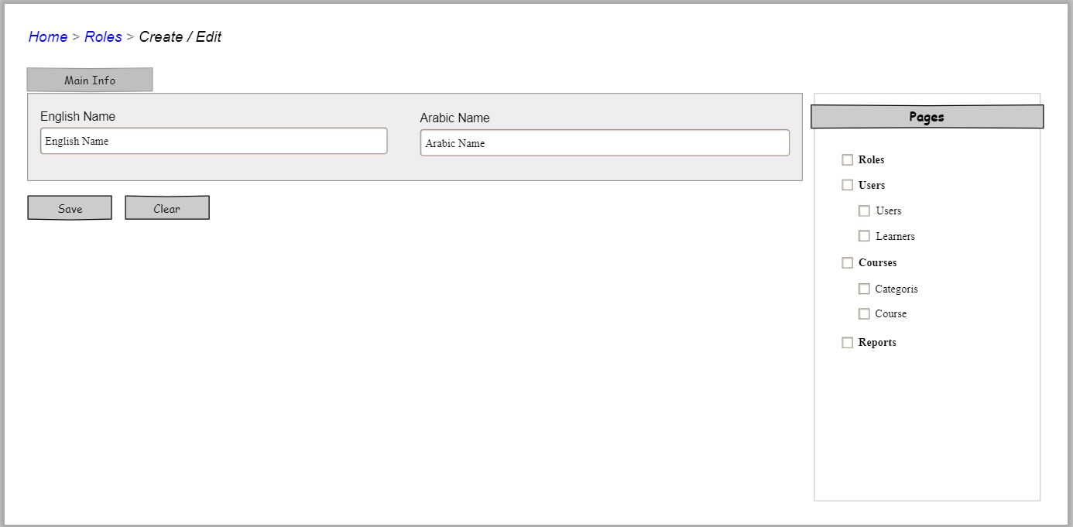
UI requirement : Roles - edit

Slide 35
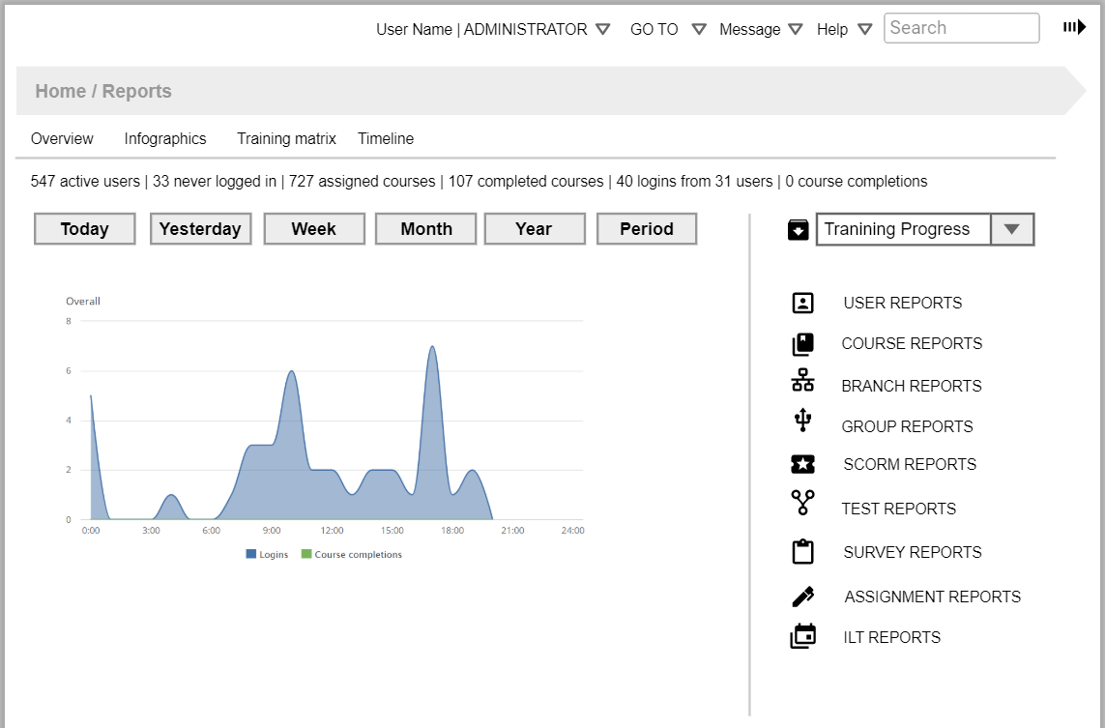
UI requirement : Reports Dashboard

Slide 36
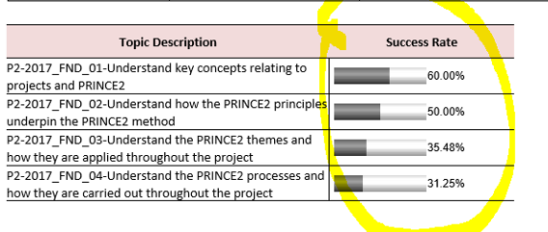
UI requirement : Reports Dashboard

Slide 37
UI requirement : Reports - Dashboard

Slide 38
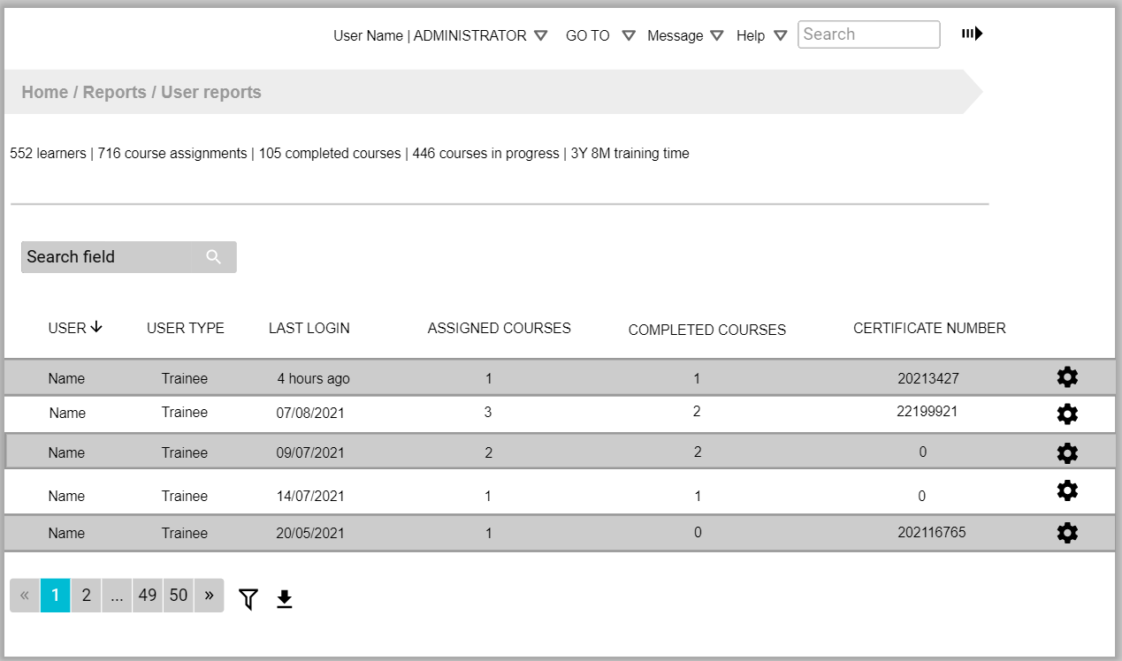
UI requirement : Reports – User reports

Slide 39
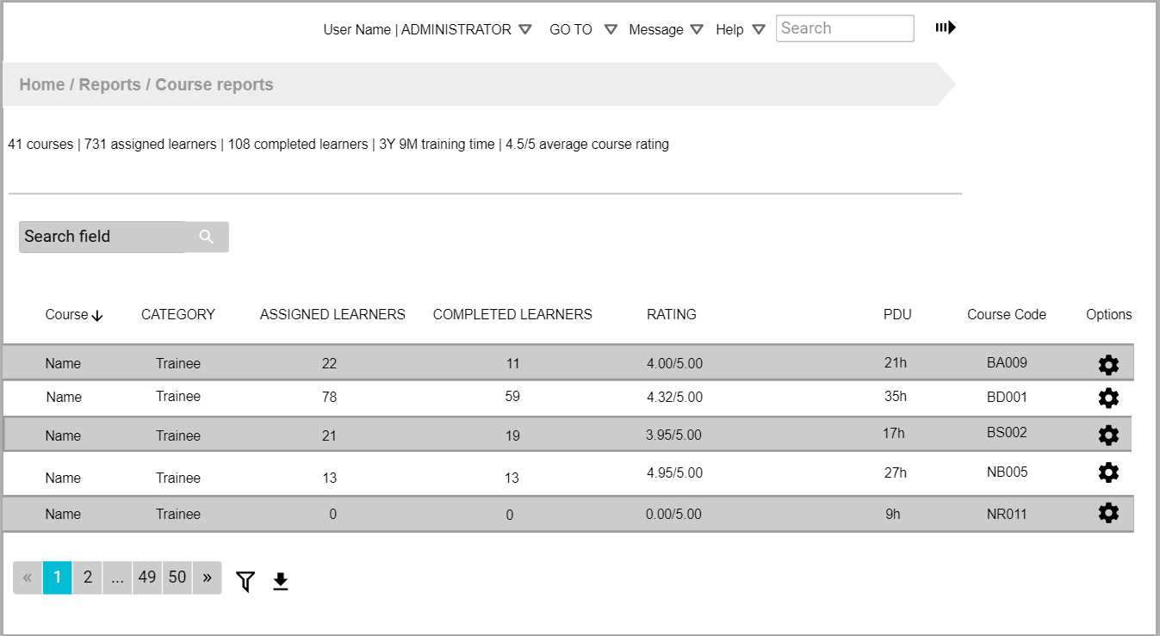
UI requirement : Reports – Course reports

Slide 40
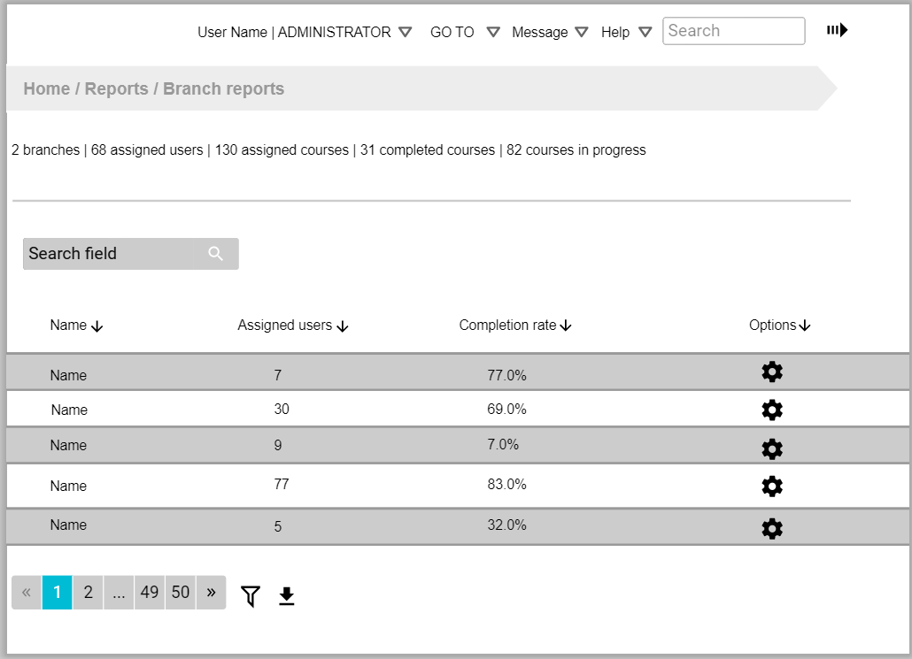
UI requirement : Reports – Branch reports

Slide 41
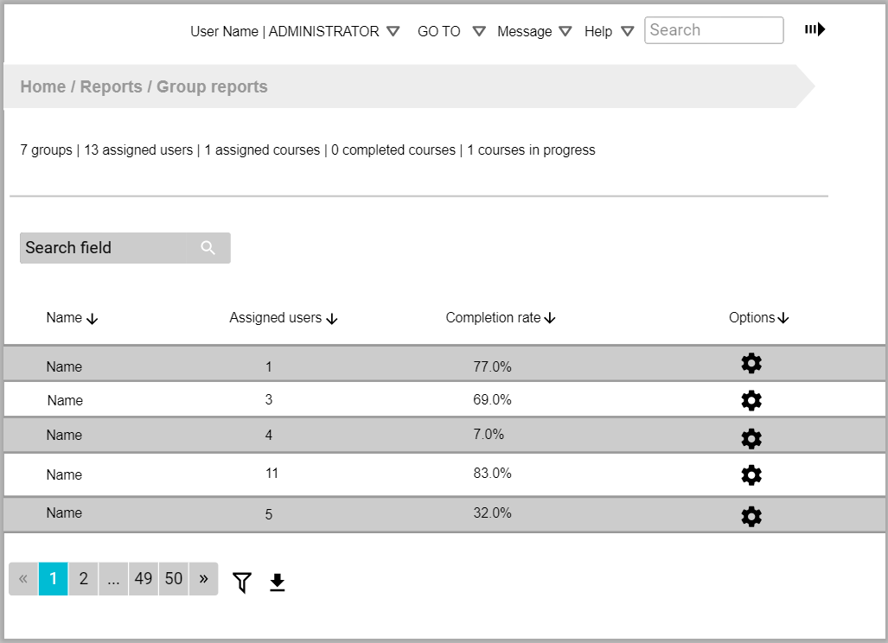
UI requirement : Reports – Group reports

Slide 42
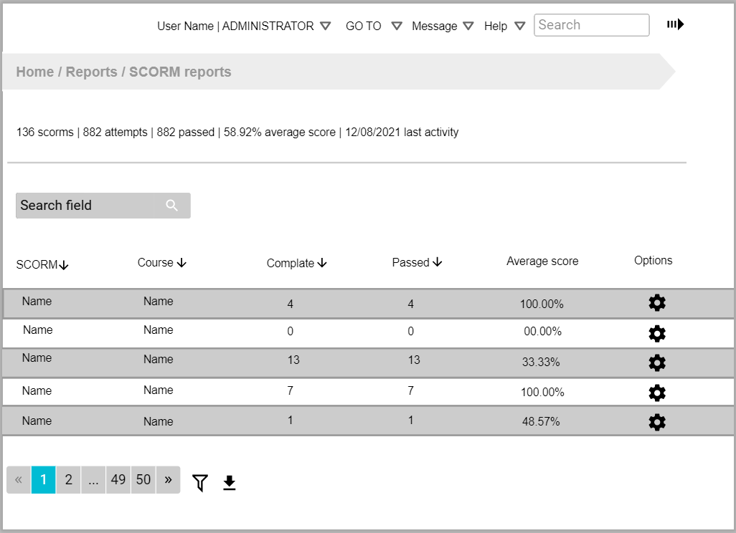
UI requirement : Reports – SCORM reports

Slide 43
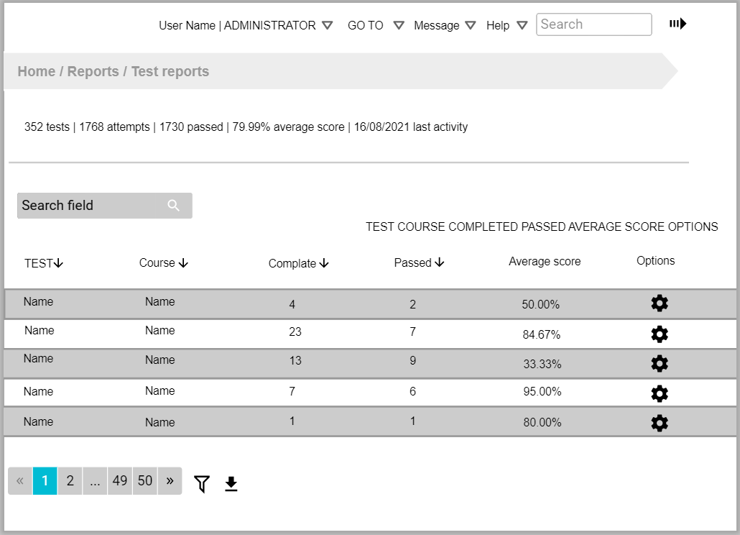
UI requirement : Reports – Test reports

Slide 44
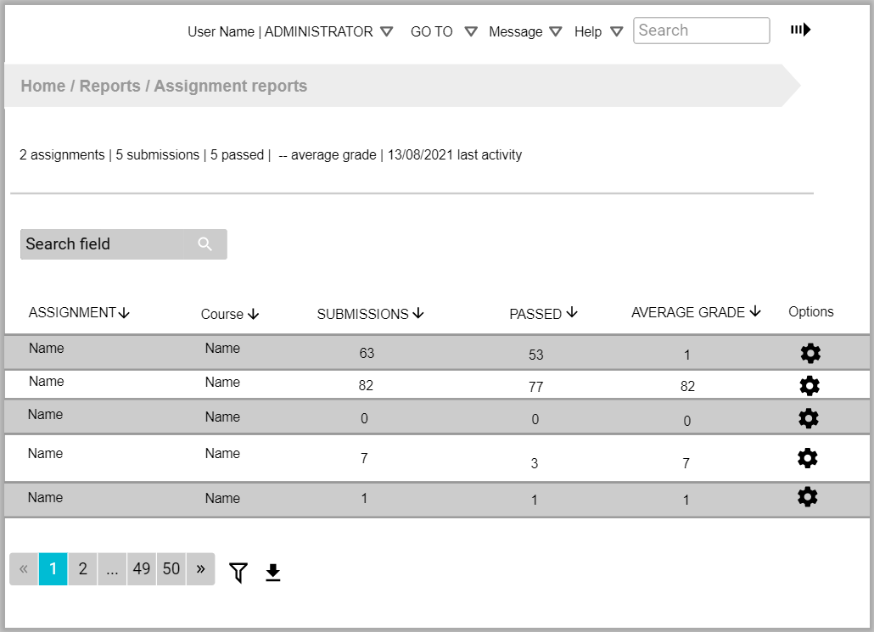
UI requirement : Reports – Assignment reports

Slide 45
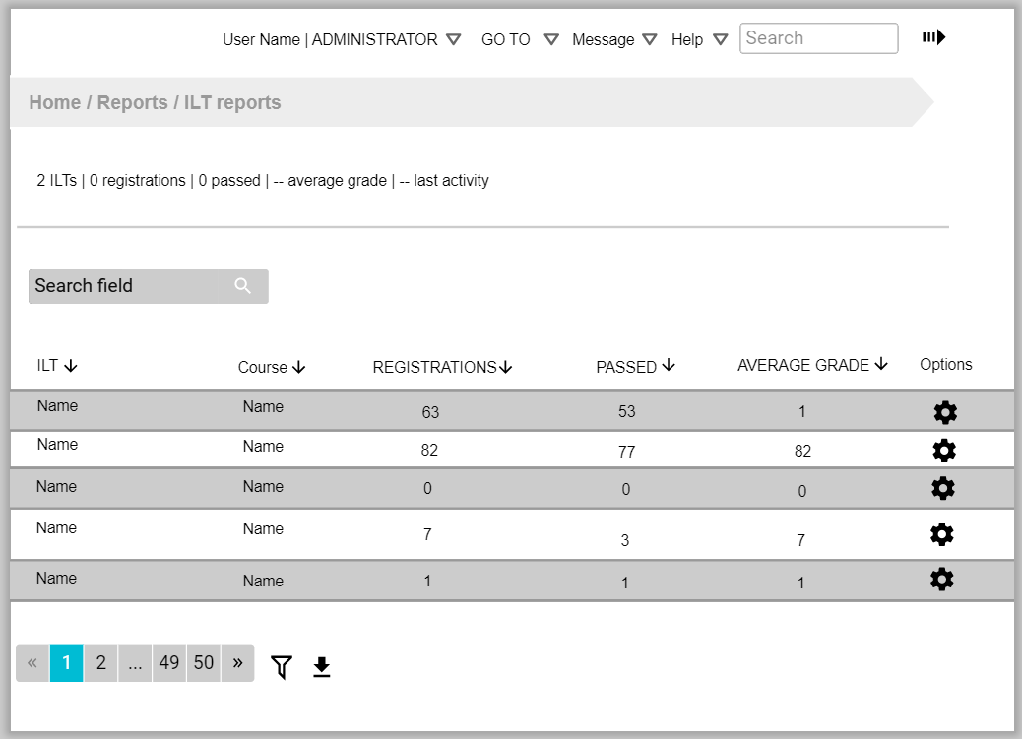
UI requirement : Reports – ILT reports

