Slide 2
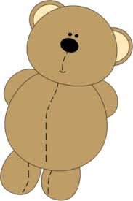
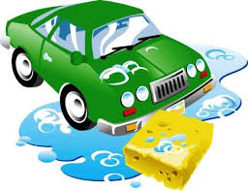


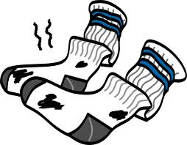


Notes:
We read a seemingly unrelated book with children featuring pairs of opposites.
For example_____
This was a surprisingly fun book for kids, and common to popular children’s books such as “Where’s the Green Sheep?” in which various opposites are named.
So the book an interesting and common activity for most children, and following the reading, we had children participate in the task exactly as in Experiment 2.
Mem Fox & Judy Horacek

Slide 3
Paired order
Scrambled order
Notes:
We read a seemingly unrelated book with children featuring pairs of opposites.
For example_____
This was a surprisingly fun book for kids, and common to popular children’s books such as “Where’s the Green Sheep?” in which various opposites are named.
So the book an interesting and common activity for most children, and following the reading, we had children participate in the task exactly as in Experiment 2.
Mem Fox & Judy Horacek

