Slide 1

Learn SQL from Scratch
Warby Parker Case
Andras Horvath
10 July 2018

Slide 2
Content
1
Short Introduction
Exercise 1
Exercise 2 and Exercise 3
Exercise 4
Exercise 5
Exercise 6
Insights
2
3
4
5
6
7
# 2

Slide 3
Short Introduction
1
Objective
The objective of this presentation is to help Warby Parker management make data-driven decisions on key processes, more specifically to address questions around the conversion rates within its sales/marketing “funnel”
B. Organisational Snapshot
The business is a maker and seller of quality leisure eyewear targeting a somewhat-pretentious, affluent hipster demographic in the US.
C. Methodology
Sales / marketing and customer data were analysed via SQL.
# 2

Slide 4

Exercise 1
2
The objective of this simply query is to identify the data types within the database. These are described below:
Documentation of code
Select * FROM Survey
Limit 10;
The objective of this simply query is to identify the data types within the database. These are described below:
Question | User ID | Response
1. What are you looking for? | 005e7f99-d48c-4fce-b605-10506c85aaf7 | Women's Styles
2. What's your fit? | 005e7f99-d48c-4fce-b605-10506c85aaf7 | Medium
# 2

Slide 5
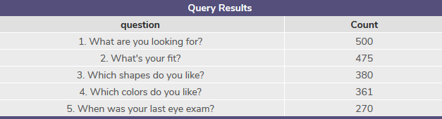
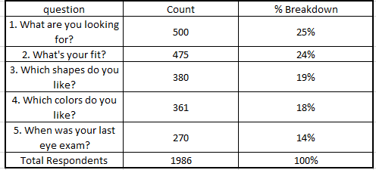
Exercise 2
3
The result of the query shows the breakdown of users who have answered each question.
Percentage breakdown of responses (calculated in external Excel sheet).
The gradually decreasing % of respondents is likely due to users simply abandoning filling out the survey.
SELECT question, Count(Distinct user_id) AS 'Count’
FROM Survey
Group by 1;
# 2

Slide 6
Exercise 2 and Exercise 3
3
The result of the query shows the breakdown of users who have answered each question.
Percentage breakdown of responses (calculated in external Excel sheet).
The gradually decreasing % of respondents is likely due to users simply abandoning filling out the survey.
SELECT question, Count(Distinct user_id) AS 'Count’
FROM Survey
Group by 1;
# 2

Slide 7
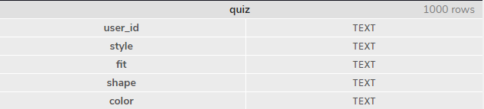
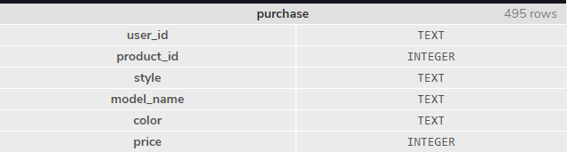

Exercise 4
4
The breakdown of the 3 tables in question is below:
Documentation of code
SELECT * FROM quiz
Limit 5
SELECT * FROM home_try_on
Limit 5
Select * from purchase
Limit 5;
# 2

Slide 8
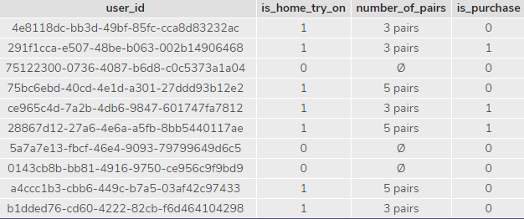
Exercise 5
5
The result of the top 10 entries from the query that reflects the “join” of the 3 database to allow for an in-depth analysis of the sales funnel
Documentation of code
SELECT distinct
quiz.user_id,
home_try_on.user_id IS NOT NULL AS 'is_home_try_on',
home_try_on.number_of_pairs,
purchase.user_id IS NOT NULL AS 'is_purchase’
from quiz
LEFT JOIN home_try_on
ON quiz.user_id = home_try_on.user_id
LEFT JOIN
purchase ON home_try_on.user_id = purchase.user_id
Limit 10;
# 2

Slide 9
Exercise 6.1
6
6.1 Analysis of conversions (from quiz to try-on to purchase)
WITH Sales AS (
SELECT distinct
quiz.user_id, home_try_on.user_id IS NOT NULL AS 'is_home_try_on',
home_try_on.number_of_pairs,
purchase.user_id IS NOT NULL AS 'is_purchase' from quiz
LEFT JOIN home_try_on
ON quiz.user_id = home_try_on.user_id
LEFT JOIN
purchase ON home_try_on.user_id = purchase.user_id)
SELECT count(*) AS 'num_quiz', SUM(is_home_try_on), sum(is_purchase),
1.0 * SUM(is_home_try_on) / COUNT(user_id) AS 'home_try_on_per_user',
1.0 * SUM(is_purchase) / SUM(is_home_try_on) AS 'home_try_on_to_purchase’
from Sales;
Of the total number of 1000 users who took the survey (num_quiz)
75% of respondents ended up trying a set of glasses (750 respondents)
66% of these respondents ended up making a purchase (495 respondents)
# 2

Slide 10
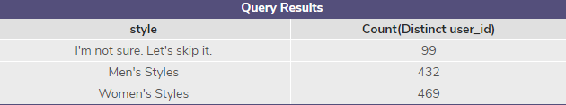
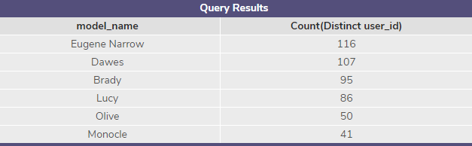
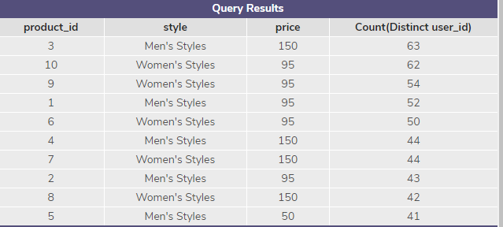
Exercise 6.2
6
Type of style sold, but 99 respondents have skipped
Analysis of best selling models
Analysis of highest selling products
SELECT style, Count(Distinct user_id) FROM quiz
GROUP by 1;
SELECT model_name, Count(Distinct user_id) FROM purchase
GROUP by 1
ORDER BY Count(Distinct user_id) DESC;
SELECT product_id, style, price, Count(Distinct user_id) FROM purchase
GROUP by 1
ORDER BY Count(Distinct user_id) DESC;
# 2

Slide 11
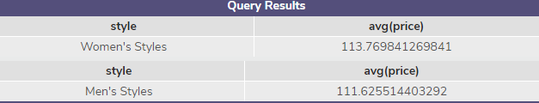
Exercise 6.3
6
Price comparison between women’s / men’s pricing
Analysis of best selling models
Analysis of highest selling products
SELECT style, Count(Distinct user_id) FROM quiz
GROUP by 1;
SELECT model_name, Count(Distinct user_id) FROM purchase
GROUP by 1
ORDER BY Count(Distinct user_id) DESC;
SELECT product_id, style, price, Count(Distinct user_id) FROM purchase
GROUP by 1
ORDER BY Count(Distinct user_id) DESC;
# 2

Slide 12
Actionable Insights
7
Continue to focus on pricier women’s styles
              1. The average prices within this category are higher
              2. Total profitability (price * quantity sold) is higher within this category
B. Consider discontinuing Product ID 5, lowest seller at lowest price, and continue marketing the highest selling models (Eugene Narrow and Dawes)
# 2

