Slide 1
MatCare — Obstetric Access in Texas
How the data was built, what was wrong with it, and what it shows
5,946,778
women 15–44 within 30 min of care
185,185
women 15–44 beyond 30 min
576,196
beyond 30 min of a NICU
211
active obstetric facilities
Every Texas census block routed on the real road network. No sampling, no API, fully reproducible.
Data: US Census (TIGER, 2020 Decennial, ACS 2019–2023) · Centers for Medicare & Medicaid Services (CMS) Provider of Services · HIFLD · OpenStreetMap
Project walkthrough · slide 1 of 15

Slide 2
THE PROBLEM
Why the standard measure is not good enough
The usual metric: “maternity care desert” = a county with no obstetric facility.
• A county is not a service area. Texas counties range from 386 to 16,040 km² — averaging access across one hides the variation a planner needs.
• It is binary. A county with one facility and a county with twenty score identically.
• It cannot distinguish a county that never had a hospital from one whose hospital closed its labour-and-delivery unit — clinically and politically very different problems.
• It ignores level of care. Reaching any hospital is not the same as reaching one that can manage a haemorrhage or a preterm birth.
Our approach: measure drive time from every one of the 668,757 census blocks, weighted by women aged 15–44.
Unit | Count | Resolution
County | 254 | too coarse
Census tract | 6,896 | coarse
Block group | 18,638 | ACS available here
Census block | 668,757 | what we use
Slide 2 of 15

Slide 3
DATA PROVENANCE
Which dataset came from where
Dataset | Source | What it provides
TIGER/Line 2024 blocks | census.gov | 668,757 block polygons + 2020 population
TIGER block groups / tracts | census.gov | 18,638 / 6,896 polygons
Centers of Population 2020 | census.gov | population-WEIGHTED centroids
ACS 2019–2023 table B01001 | census.gov bulk | women aged 15–44 by block group
ZCTA Gazetteer 2024 | census.gov | ZIP centroids (geocoding fallback)
Cartographic boundaries | census.gov | county / place outlines for maps
CMS Provider of Services | supplied (CMS) | WHICH hospitals provide obstetrics
HIFLD hospitals | supplied (HIFLD) | WHERE hospitals are (876 in TX)
OpenStreetMap Texas | Geofabrik | the road network (713 MB, ODbL)
Every download is recorded in data/_manifest.json with its URL, byte count, SHA-256 hash and retrieval time.
The OpenStreetMap extract was verified against Geofabrik's own published MD5 checksum — it matched exactly. Census block, block-group and tract populations independently agree at 29,145,505, the published 2020 Texas total.
Slide 3 of 15 · No API key is required anywhere in this pipeline

Slide 4
HOW IT RUNS
The processing pipeline, end to end
00
Download + hash every source
1.25 GB, resumable, SHA-256 manifest
05
Validate the facility list
independent cross-check vs OSM hospitals
01
Build the facility list
CMS POS ⋈ HIFLD, multi-stage match
06
Standard figures
maps + distributions
02
Build census geography
blocks, block groups, tracts, counties
07
Optimise siting
greedy Maximal Covering Location Problem
03
Build the road network
OSM → 11.0M nodes, 21.6M directed edges
08
Proposal figures
3 publication-quality figures
04
Compute access
multi-source Dijkstra, every block
10
Women 15–44 denominator
ACS B01001, block-group resolution
Slide 4 of 15 · Numbered, idempotent, no Docker, no routing server · full statewide run < 10 minutes

Slide 5
STEP 02
Population geography, and how we know it is right
Centroids: two definitions, chosen deliberately
• Block groups and tracts use the Census Bureau's official 2020 population-WEIGHTED centres of population.
• Blocks use the TIGER internal point — the Bureau publishes no weighted centroid at block level (verified: the directory holds only county/, tract/, blkgrp/).
• This matters. An areal centroid of a large rural county can sit in empty desert far from anyone, inflating measured travel. Blocks are small enough that the difference is ~100 m.
Integrity checks that passed
• Blocks, block groups and tracts independently total 29,145,505 — the published 2020 Texas population. Discrepancy: zero.
• 254 Texas counties, exactly as expected.
• Women 15–44 disaggregated to blocks reconciles to the block-group total with zero difference.
Layer | Count | 2020 population
Census blocks | 668,757 | 29,145,505
Block groups | 18,638 | 29,145,505
Census tracts | 6,896 | 29,145,505
Counties | 254 | 29,145,505
Populated blocks | 449,085 | 67.2% of blocks
Slide 5 of 15

Slide 6
STEP 10
The right denominator: women aged 15–44
Total population answers the wrong question.
• Obstetric care is used by women of reproductive age, and they are not distributed like everyone else — university towns, retirement communities and prisons all skew it.
• Source: ACS 2019–2023 5-year, table B01001 “Sex by Age”, at block-group resolution (ACS is not published for blocks).
• The 9 age bands are derived AT RUNTIME by parsing the official Census table shells, not typed from memory — so a mis-remembered variable number cannot silently corrupt the denominator.
• For block-level work, block-group counts are shared out to blocks in proportion to 2020 decennial population. This assumes a uniform age–sex mix within a block group, and is stated as an assumption.
api.census.gov now requires a key. We avoid it entirely by reading the bulk Summary File — identical data, no registration.
ACS variable | Female age band
B01001_030 | 15 to 17 years
B01001_031 | 18 and 19 years
B01001_032 | 20 years
B01001_033 | 21 years
B01001_034 | 22 to 24 years
B01001_035 | 25 to 29 years
B01001_036 | 30 to 34 years
B01001_037 | 35 to 39 years
B01001_038 | 40 to 44 years
TOTAL | 6,131,963 women
Slide 6 of 15 · 20.9% of the Texas population

Slide 7
STEP 01
Defining “an obstetric facility” needs two sources
Neither source alone is sufficient.
CMS Provider of Services
Knows WHICH hospitals provide obstetrics. Carries no coordinates.
HIFLD hospitals
Knows WHERE hospitals are (876 in Texas). Does not record obstetric service.
Neither carries the other's identifier — so they must be matched.
Note: the project's “CMOS” files are the CMS Provider of Services extract, confirmed from its own 733-page record layout — not a Texas HHS registry as previously assumed.
Eligibility rule | Effect
OB_SRVC_CD = 1 or 3 | obstetrics provided ON SITE
OB_SRVC_CD = 2 | under arrangement — excluded
PGM_TRMNTN_CD = 00 | active provider only
→ eligible Texas hospitals | 211
→ of which NICU on site | 117
Codes are quoted from the CMS record layout, not inferred:
0 = NOT PROVIDED · 1 = BY STAFF · 2 = UNDER ARRANGEMENT · 3 = BOTH
Slide 7 of 15

Slide 8
WHAT WAS WRONG
Discrepancy #1 — the exact-name join
The original facility list was built with one line:
matched_df = df2[df2['NAME'].isin(df1['FAC_NAME'])]
An exact, case-sensitive string equality between two agencies' spellings of a hospital name. It fails silently — no error, just a smaller table that looks plausible.
What it dropped | CMS name | HIFLD name
Acronym | BSA HOSPITAL | BAPTIST ST ANTHONYS HOSPITAL
Corporate rename | PARKLAND HEALTH AND HOSPITAL SYSTEM | PARKLAND MEMORIAL HOSPITAL
“System” vs site | UNIVERSITY HEALTH SYSTEM | UNIVERSITY HOSPITAL
Punctuation / abbrev. | ST. vs SAINT, MED CTR vs MEDICAL CENTER | —
Symptom that gave it away:
Jefferson County — Beaumont, population 256,526 — showed ZERO obstetric facilities and a 61.6-minute mean drive time. The second-worst county in Texas, in a metro of 400,000. That is not a finding about Texas; it is a defect in the input.
Slide 8 of 15 · The old join matched 136 of 211 eligible hospitals (64%)

Slide 9
HOW WE CORRECTED IT
Discrepancy #2 and the fix
#2 — Closed hospitals counted as open
The old join never filtered PGM_TRMNTN_CD. Of 377 Texas records reporting obstetric service, 163 were TERMINATED providers — merged, closed, or decertified — and were being counted as operating facilities.
Both errors push the same way: they manufacture deserts.
Matching pass | Matched
1. exact name + ZIP | 145
2. exact name + city | 9
3. address + ZIP | 39
4. address + city | 2
5. fuzzy name + ZIP | 11
7. fuzzy address + city | 1
TOTAL automatic | 207 of 211 (98.1%)
Residual → ZIP centroid, flagged | 4
The fix: progressive matching
Address passes run BEFORE loose fuzzy-name passes, on purpose: a shared street number and street name is far stronger evidence of identity than a similar corporate name.
Hospitals get renamed. They do not move.
170 → 211
facilities identified
61.6 → 18.7
Jefferson Co. mean drive (min)
−59%
change in Texans beyond 30 min
Slide 9 of 15 · Worst-county list now shows remote West Texas, not the Beaumont metro — the face-validity check that the fix worked

Slide 10
STEP 03
Building the road network
Source: OpenStreetMap Texas extract (Geofabrik), MD5-verified.
• Kept: motorway, trunk, primary, secondary, tertiary, unclassified, residential, living_street + all link ramps.
• Excluded: service roads (driveways, parking aisles) — 1.93M ways. A route therefore ends at the public road nearest the hospital, a median of 95 m from it.
• Excluded: ways barred to motor vehicles (access = no / private / customers…) — 32,502 ways.
• Directed graph: one-way streets and roundabouts are honoured.
• Edge length is GEODESIC on the WGS84 ellipsoid — not a projected approximation. Texas spans 13° of longitude, where projection distortion would be measurable.
Road class | Segments | km
residential | 15,624,231 | 958,560
tertiary | 1,961,368 | 124,110
secondary | 1,569,187 | 119,955
unclassified | 1,170,841 | 87,278
primary | 544,862 | 54,402
trunk | 237,239 | 30,806
motorway | 138,596 | 18,012
11.0M
network nodes
21.6M
directed edges
~700k km
of centreline road
Slide 10 of 15 · Parsed in 36 s, peak memory 2.2 GB

Slide 11
THE BIGGEST ASSUMPTION
How driving time was calculated — and what we assumed
Only 20.06% of road segments carry a posted maxspeed tag in OSM.
• Where OSM has a posted limit, we use it (parsing “60”, “60 mph”, “100 km/h”; a bare number means km/h per the OSM specification).
• For the other ~80%, we apply a free-flow default by road class — the table on the right. These are OUR assumptions, chosen to reflect typical Texas posted limits. They are not taken from any cited source, and they are recorded in network_meta.json so any run can be audited.
• Time = geodesic segment length ÷ assigned speed.
• Off-network “last mile”: the straight-line distance from a centroid to the nearest road is added back at an assumed 30 mph.
What this means, stated plainly
Travel times contain no congestion, no signal delay and no turn restrictions — they are BEST-CASE. Urban times are understated more than rural ones, so the reported urban–rural gap is conservative. Distances do not depend on speed at all and are the more robust metric.
Road class | Assumed mph
motorway | 70
trunk | 65
primary | 60
secondary | 55
tertiary | 45
unclassified | 40
residential | 30
living_street | 15
motorway_link | 45
trunk_link | 40
primary / secondary_link | 35
tertiary_link | 30
off-network last mile | 30
Slide 11 of 15 · Validating these against a commercial routing engine is Aim 1 of the proposal

Slide 12
STEP 04
The routing algorithm — why this is fast
The naive framing is unaffordable.
668,757 blocks × 211 facilities = 141 million origin–destination pairs. No routing API prices that. This is exactly why comparable studies sample, aggregate to counties, or fall back to straight lines.
The reformulation
Only the NEAREST facility matters. So seed a single Dijkstra search with all 211 facilities at once. Relaxing outward, it labels every node in Texas with its cost to the closest facility — and which one — in one pass.
Direction is handled correctly.
A multi-source search on the graph gives cost(facility → block). We need cost(block → facility) — a patient travelling TO care. On a one-way network those differ, so the search runs on the TRANSPOSED graph. Most comparable studies quietly assume symmetry.
~3 sec
per pass over 11M nodes
0
API calls / recurring cost
Two passes are run: one weighted by segment length (distance), one by segment time (travel time).
Every block is computed exactly. Nothing is sampled, interpolated or extrapolated.
Road detour ratio: 1.33×
Road travel is a third longer than straight-line distance, population-weighted. A buffer-based analysis understates real travel by that much.
Slide 12 of 15 · This is what makes an interactive planning tool possible

Slide 13
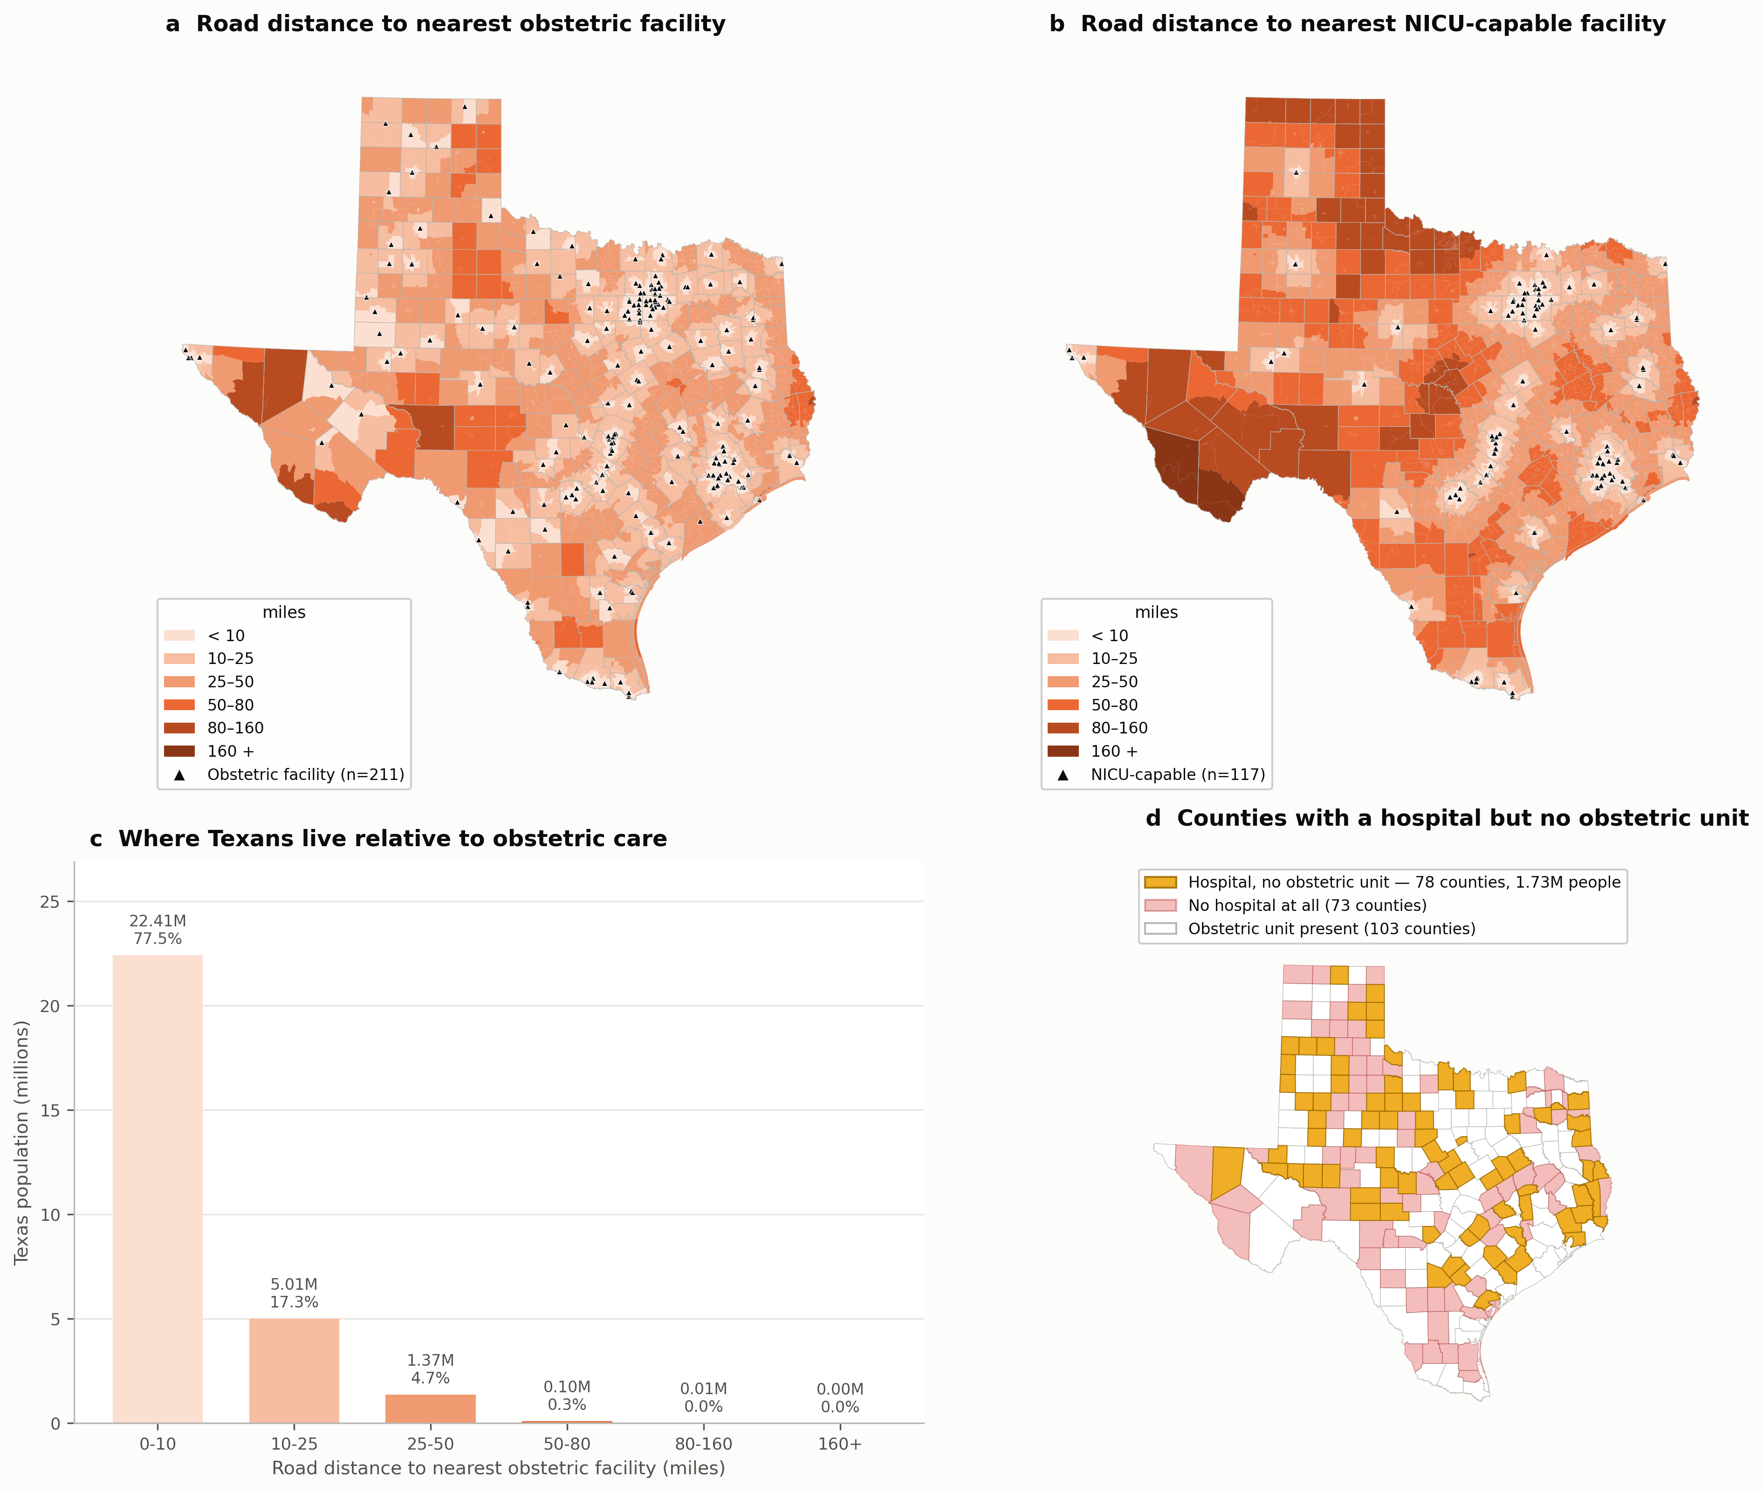
RESULTS
What we found
Slide 13 of 15 · (a) road distance to any obstetric facility (miles) (b) road distance to NICU-capable, same scale — visibly worse (c) population by distance band, miles (d) hospital but no obstetric unit

Slide 14
RESULTS
Access for women aged 15–44
95.8%
within 25 miles
98.6%
within 35 miles
99.7%
within 50 miles
97.0%
within 30 min
90.6%
within 30 min of a NICU
The headline is the gap, not the level.
Only 185,185 women aged 15–44 live more than 30 minutes from an obstetric facility — 3.0%. But 576,196 — 9.4%, more than three times as many — live more than 30 minutes from a facility with a NICU.
Proximity to a door is not proximity to care. The NICU gap is where preventable maternal and neonatal deaths occur, and it is invisible to any binary desert map.
Separately: 78 counties holding 1,730,926 residents have a hospital but no obstetric unit. Those need a unit RESTORED, not a hospital BUILT — a far cheaper intervention.
Worst counties for women 15–44 | Mean drive (min)
Crockett | 79.1
Culberson | 69.4
King | 68.1
Terrell | 66.5
Edwards | 66.4
Presidio | 66.0
Sutton | 64.1
Reagan | 64.0
Slide 14 of 15 · Block-group resolution, ACS 2019–2023

Slide 15
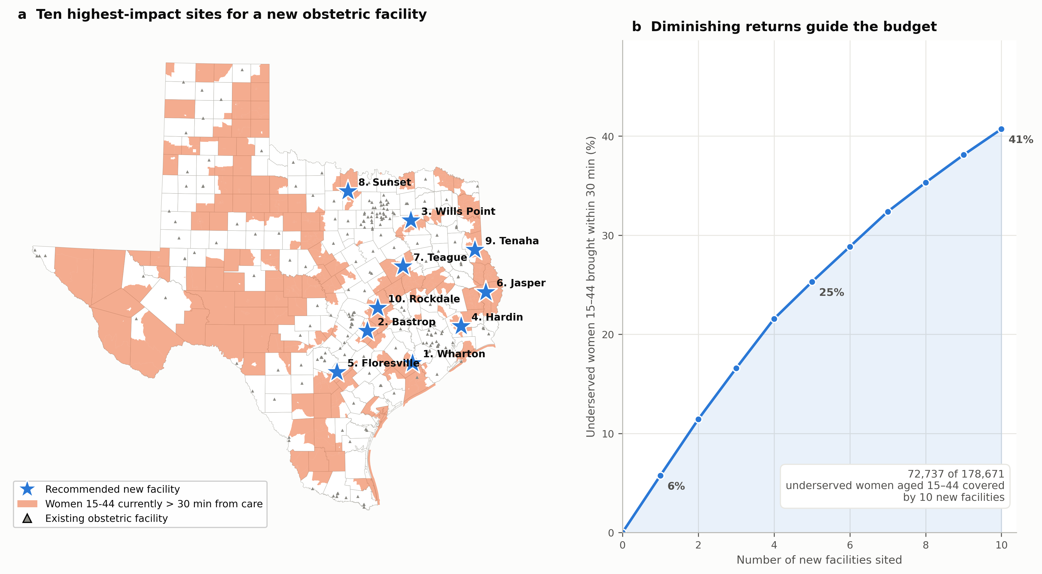
WHAT COMES NEXT
From diagnosis to decision — and the proposal
Already working
Ten optimally sited facilities would bring 72,737 of 178,671 underserved women aged 15–44 within 30 minutes — 40.7% of the gap.
Greedy carries a provable (1 − 1/e) ≈ 63% approximation guarantee, because coverage is monotone submodular. A bounded result, not a guess.
How to make the proposal competitive
• Lead with the 78 hospital-but-no-obstetrics counties — the cheapest intervention, and invisible to every published desert map.
• Lead with the NICU gap: 9.4% vs 3.0%.
• Show the siting plan. It already exists — that is the difference between promising analysis and delivering it.
• Show the correction. It demonstrates rigour and implicitly critiques the existing literature without naming anyone.
• Frame ILP as the shipped default and RL for the sequential, budget-phased problem — do not claim RL beats ILP on a static problem.
Slide 15 of 15 · Discovery Foundation · $29,150 requested

