Slide 1
Case Study 2: Attrition Rates
Allen Hoskins

Slide 2
22%
Notes:
According to the US Mercer Turnover Survey, US Companies averaged a turnover rate of 22% in 2018 with 15% of that attributed to voluntary turnover.
81% of those those employees who left voluntarily did so for a better job opportunity.

Slide 3
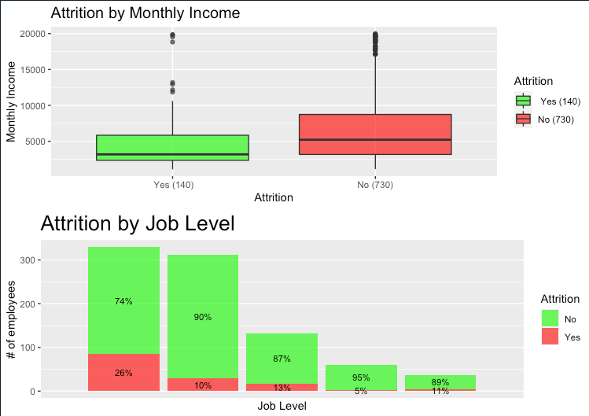
Notes:
The Supplied data set back up the survey as well. The data shows that attrition rates are higher when employees have a lower monthly income as well as lower level jobs. 26% of employees with the lowest level job left their company compared to only 5 and 11 percent in the two highest levels respectfully. With lower monthly incomes and job levels causing higher attrition rates, I then decided to take a look into if this trend was present in employees who work overtime.

Slide 4
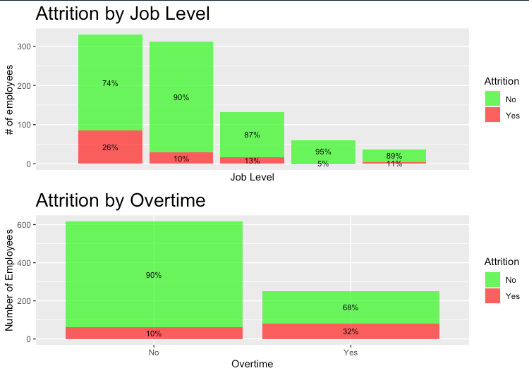
Notes:
Once I broke out the overtime employees, I was able to conclude that there is in fact a higher rate of attrition in employees that work overtime. With the higher rates of attrition due to overtime and job level, I decided to look into if Age had a high correlation with attrition.

Slide 5
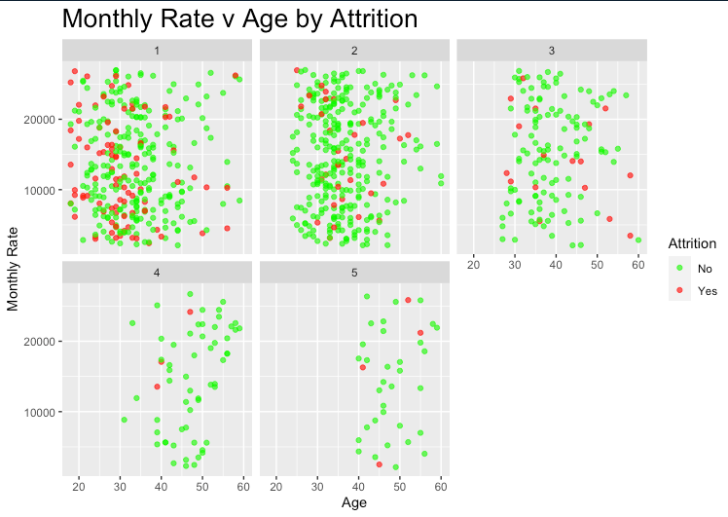
Notes:
Every day I hear something along the lines of “your generation just job hops” or “your generation is not loyal to one company”, so I decided that I would test this theory by breaking out Monthly rates, age and job level to see how this lines up with what I am told. In doing so, I was able to determine that yes, a younger population does seem to leave their job at a higher rate and that the higher level positions, usually older employees, are less likely to switch positions or move companies.

Slide 6

Attrition Rate Predictions
KNN: Accuracy of 84%
NB: Accuracy of 85%
RF: Accuracy of 81%
Notes:
After determining several of the seemingly most correlated data points to attrition rates, I ran several predictive models. The first model I ran was a KNN Classifier model which pulls in the most records like the employee in question and determines records that best fit if they will fall into a yes or not attrition bucket. This model performed with 83.9% accuracy. This model was specific but not very sensitive. Meaning it was able to predict members who were not in the attrition numerator at a high rate, but the false negatives were extremely high.
My second model was a Naive Bayes model. This model uses Bayes’ theorem which assumes that a particular feature or data point is unrelated to any other feature or data point. It performed at a sightly higher accuracy of just over 85%, but was extremely sensitive and not specific. This model was able to very accurately predict true negatives, but did not perform well with false positives.
My final model, Random Forest, this is a classification model that uses multiple hypothetical trees to determine outcome and the class that receives the most votes is the models prediction. This model was my best performing model. Its accuracy was slightly lower than KNN and Naive Bayes at 81%, and Even though the model was less accurate on true positives, it was overall a better model predicting true negatives and minimizing false negatives and false positives

Slide 7
Salary Model Predictions
LR: RMSE =1333.81
RF: RMSE = 1242.69

Slide 8
Notes:
Thank you for your time.

