Slide 1


Graduation project

Slide 2

Title of project :

Slide 3
Abstract :
Have you ever searched in a video ?
Sure, we all searched for a video before, but we didn't look for something in a video like a word, a picture, a sound, or an object inside a video, So we decided to produce a software that does these features .

Slide 4
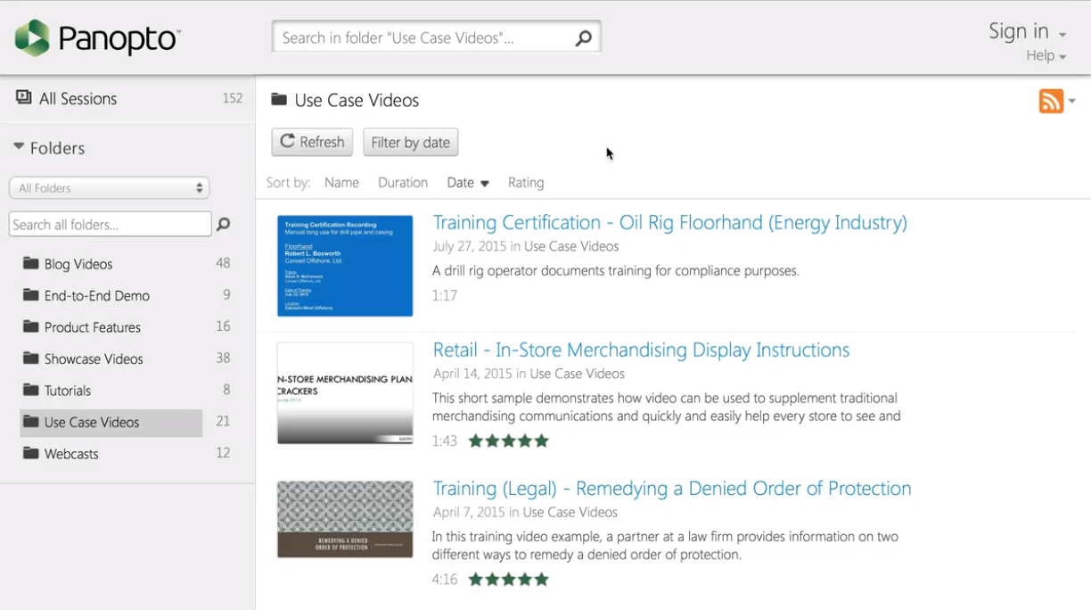
A lot of companies have produced software do the same task .
1>> Panopto Application

Slide 5
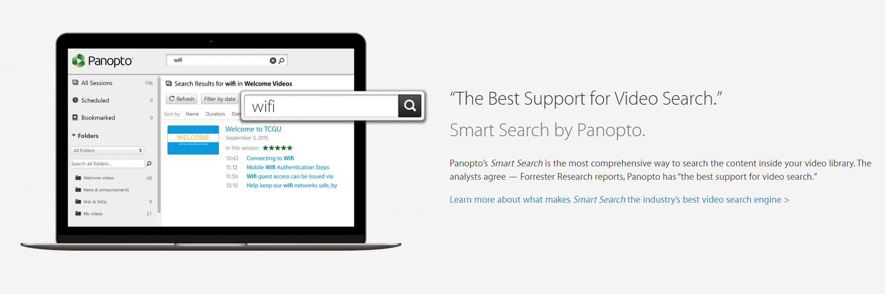

Slide 6
Panopto
Smart Search automatically indexes every word spoken or shown on-screen, so your viewers can find and fast-forward to the exact moment in videos where their search was mentioned. Whether the video was created with Panopto or not, every video uploaded to your video portal is searchable.
For more >>https://www.panopto.com/features/video-search/

Slide 7
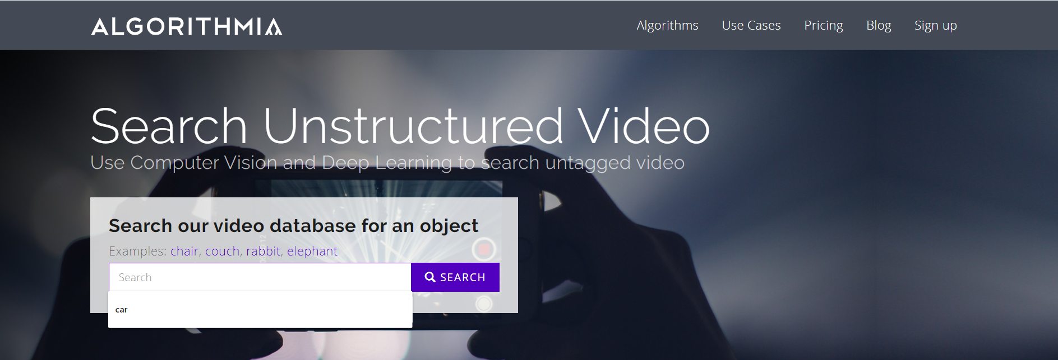
Algorithmia website

Slide 8
Our Application
How it Works :
Using computer vision and deep learning to search inside videos
Tools used :
Neural Network like Convolution neural network
(cnn).
Machine learning library>tensorflow library
Computer vision libraries > opencv
Android
Python language.

Slide 9
We will learn !
How to train a Convolutional Neural Network using Keras for image classification.
How to take that CNN and then use it for video classification
image classification with CNN.
video classification

Slide 10
Processing steps
Downloading a video.
SPLIT IN FRAMES
We will use python and opencv library to get the frames from the video.
The we will move the frames to our model to detect the objects in every frame .
Then we will tag the object .

Slide 11
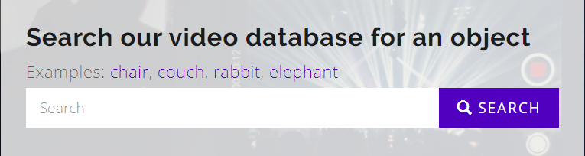
We can use data base like mysql..to store all our objects…this will fast the processing .
Search tag.

Slide 12
Search by text .
Search by image .
Search for an object in videos.
Search for an image in videos.

