Slide 1
PHYS 396 Update
Andrew Householder
4/29/22

Slide 2
Creating Horn Antenna
Working to make a good 2d representation of a horn antenna (with the right geometry)
Once a 2d layout is made using Klayout, can be imported and made 3d using MEEP

Slide 3
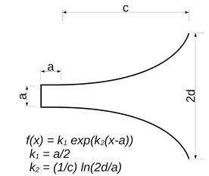
The Antenna We Want
The geometry is defined by the following equations and parameters

Slide 4
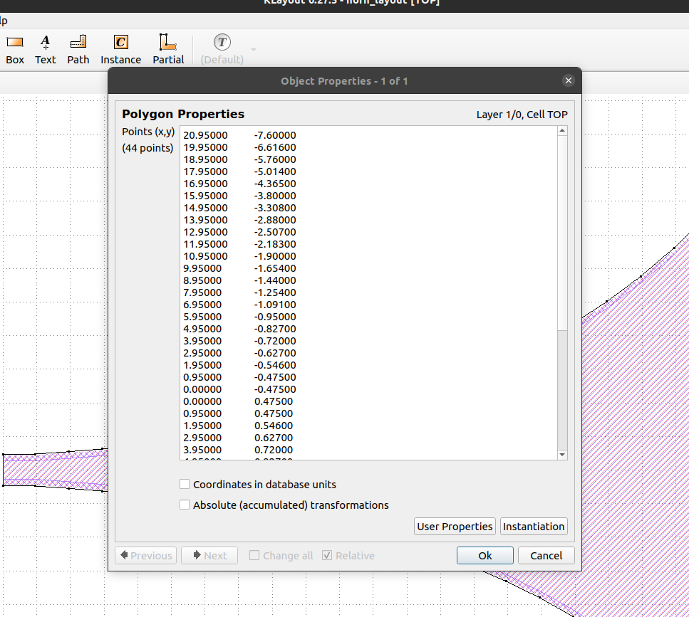
Creating Using Klayout
Can define polygons if you know its vertices
How to calculate all
these points?
Python!

Slide 5
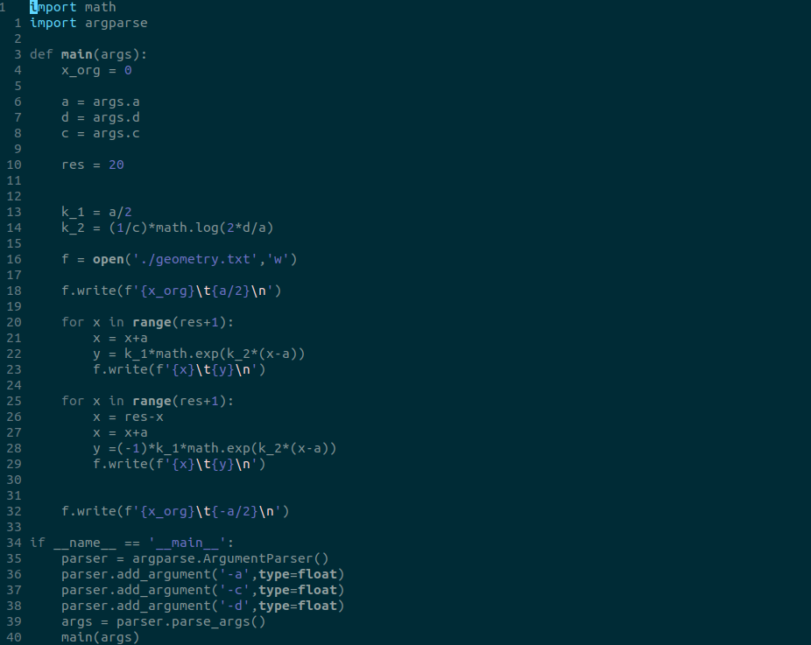
Defining Verticies

Slide 6
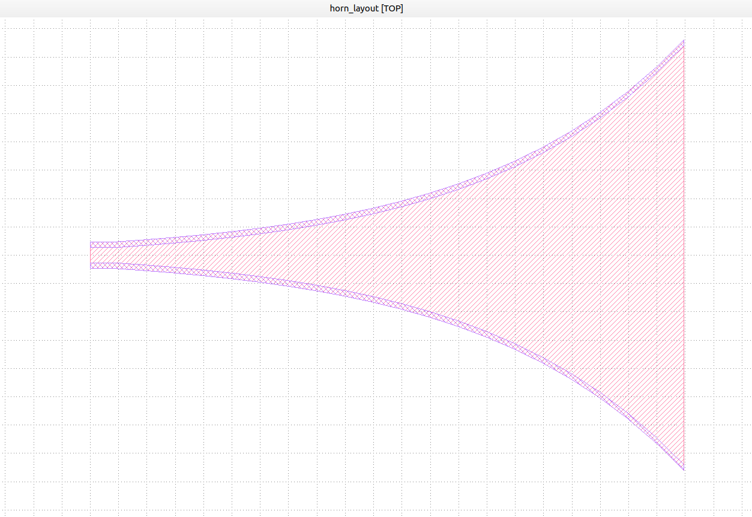
Results
Was able to use these techniques to create a layout which can be made 3d with empty space in middle (bottom layer, side supports, top layer)

Slide 7
Results

Slide 8
What’s Next?
Import into MEEP, make 3d, and run some simulations

