Slide 1


Introduction to XSLT: the XML Transformation Language
Alan Houser
Principal Consultant and Trainer
Tel: 412-450-0532
arh@groupwellesley.com
www.groupwellesley.com
Group Wellesley, Inc.

Slide 2



Your opinion is important to us! Please tell us what you thought of the lecture. We look forward to your feedback via smartphone or tablet under
http://IN50.honestly.de
or scan the QR code
The feedback tool will be available even after the conference!

Slide 3
What you will learn
Basic XSLT stylesheet structure and instructions
How to convert XML to XHTML for publishing
How to publish customized documents by selecting particular chunks of XML content
How to create hyperlinks for cross-references and navigation
How to simplify your XSLT stylesheets by using CSS

Slide 4
Why XSLT?
XSLT is a W3C-standard programming language for manipulating XML documents.
XSLT, along with its companion language XPath, allows you to transform your XML content to a form expected by your publishing engine; whether print, PDF, HTML, wireless device, or any other current or future publishing format.
XSLT provides the capability to select, sort, or filter XML content, allowing customized publishing based on XML metadata.

Slide 5
History and terminology
XSL – Extensible stylesheet language: original W3C working draft recommendation
XSLT – Extensible stylesheet language transformations
XPath – XML path language
XSL-FO – Extensible stylesheet language formatting objects

Slide 6
About this Workshop
During this workshop, we will learn enough XSLT to transform XML to HTML for publishing. Some knowledge of HTML will be helpful.
These tasks and techniques apply to transforming any XML documents (e.g. DITA, Docbook) to any other target vocabulary (e.g., XSL-FO).

Slide 7
About this Workshop
We will use:
Notepad, or your favorite text editor
MacOS: Safari Browser
Windows: Internet Explorer

Slide 8
Our Workflow
Extract sample files to any convenient location on your system.
Each XML document references a stylesheet:
<?xml version="1.0"?>
<?xml-stylesheet type="text/xsl" href=“navigation_working.xsl"?>
When you load an XML document into Internet Explorer, IE applies the specified XSLT stylesheet to the XML document and displays the result.

Slide 9
Anatomy of an XSLT Stylesheet
An XSLT stylesheet is a well-formed XML document.
All elements must be closed.
All attribute values must be quoted.
Required root element <xsl:stylesheet>.
XSLT instruction elements prefixed by “xsl:”
Literal result elements (e.g., HTML tags) have no namespace prefix.

Slide 10
About our XML Data
We will work with a set of (DITA-compliant) tasks.
Open task_no_stylesheet.xml and examine the XML structure.

Slide 11
Minimal XSLT Stylesheet
<?xml version="1.0" encoding="UTF-8"?>
<xsl:stylesheet version="1.0"
xmlns:xsl="http://www.w3.org/1999/XSL/Transform">
<xsl:output method="html" />
<!– match all elements, write their text content -->
<xsl:template match="*" >
<xsl:apply-templates />
</xsl:template>
</xsl:stylesheet>

Slide 12
Exercise: Minimal XSLT Stylesheet
Open minimal_stylesheet.xml. This applies the previous simple XSLT stylesheet to our XML data, and displays the result in the browser.
Note that only the content of the original XML document is passed through by the stylesheet. All original element boundaries (tags) are dropped.
We will add HTML tags in the next exercise.

Slide 13
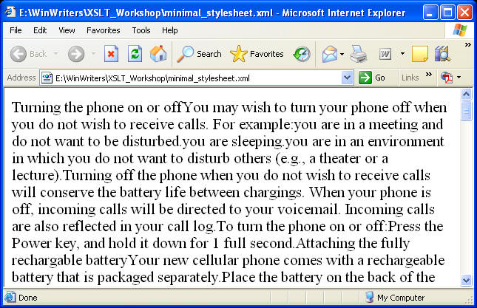
Exercise: Minimal XSLT Stylesheet
Result of opening minimal_stylesheet.xml in Internet Explorer.

Slide 14
Exercise: Minimal XSLT Stylesheet (2)
Use “View Source” to see the result of the XSLT transformation. This is what the browser is rendering.

Slide 15
Task: Converting XML to XHTML
Approach: Map XML elements to HTML elements.
Use <xsl:template match=“element name“> for each XML element to be converted.
Use <xsl:apply-templates /> to continue processing child elements.
Example: Convert <body> to <p>:
<xsl:template match=“body”>
<p></xsl:apply-templates /></p>
</xsl:template>

Slide 16
Task: Converting XML to XHTML
Use these mappings for the provided sample files. Note that names are case-sensitive.
XML | HTML
steps | ol
step | li
li | li
ul | ul
uicontrol | em
tasklist | html/body
XML | HTML
title | h1
cmd | p
p | p
info | p

Slide 17
Exercise: Converting XML to XHTML
Modify convert_to_html.xsl to convert XML elements to HTML. Use <xsl:template> and <xsl:apply-templates/> for each element to be converted.
As you work, open convert_to_html.xml in a browser to view your progress.

Slide 18
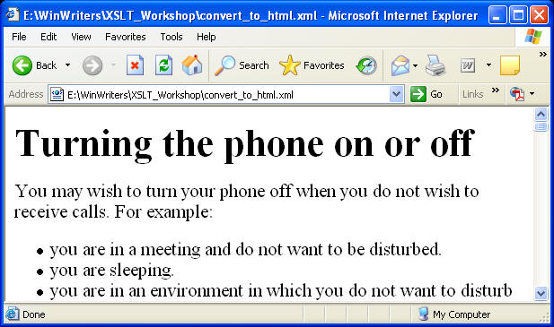
Exercise: Converting XML to XHTML
Result of opening convert_to_html.xml in Internet Explorer.

Slide 19
Task: Combining XSLT and CSS
I know XSLT, but my designer knows CSS. How can I design an XSLT stylesheet that will leverage both of our skill sets?
Our corporate Web design guidelines are strict, change regularly, and are specified as a cascading stylesheet. How can I design my XSLT stylesheet so that my HTML will automatically pick up changes in our Web site CSS file?

Slide 20
Task: Combining XSLT and CSS
To separate “transformation” from “formatting”, specify a CSS stylesheet link in the result HTML document.
<xsl:template match=“tasklist">
<html>
<head>
<link rel="StyleSheet" href=“task.css“ type="text/css" media="screen"/>
</head>
<body>
<xsl:apply-templates />
</body>
</xsl:template>

Slide 21
A Little Bit of CSS
body {display:block; font-family:'Helvetica, sans-serif'; }
CSS (particularly CSS3) provides some of the capabilities of XSLT. Examples:
Select element based on its context.
Show/hide elements.
But XSLT supports much richer transformations, like changing one XML vocabulary to another or sorting XML content.

Slide 22
Exercise: Combining XSLT and CSS
Modify convert_with_css.xsl to reference the CSS stylesheet “tasks.css” in the HTML result.
Open convert_with_css.xml in your browser to view your progress.
Experiment by modifying tasks.css. Refresh your browser to see any changes.

Slide 23
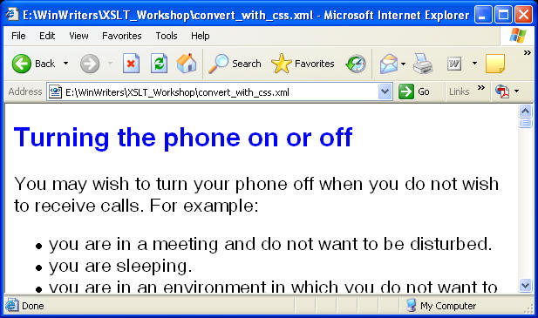
Exercise: Combining XSLT and CSS
Result of opening convert_with_css.xml in Internet Explorer.

Slide 24
Task: Filtering content from XML source
My XML document includes metadata that identifies particular categories of content.
I want to suppress some categories in my result file.
or
I want to include only specific categories in my result file.

Slide 25
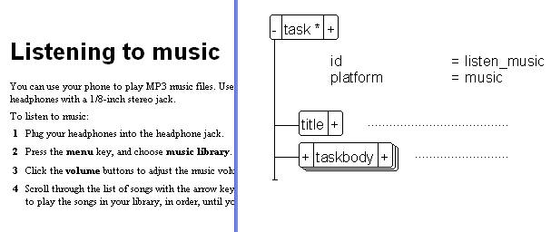
Task: Filtering content from XML source
Scenario: Building documentation for a cell phone model that does not provide music support

Slide 26
Task: Filtering content from XML source
Create an “empty” template that matches the elements you want to suppress from your output.
<xsl:template match=“topic[@platform=‘music’]”/>
Be sure a more general template matches other instances of the element.
<xsl:template match=“topic"> <xsl:apply-templates/> </xsl:template>

Slide 27
Exercise: Filtering content from XML source
Modify filter_content.xsl to supress tasks with a platform value of “music” or “video”. Open filter_content.xml and verify that these tasks do not appear in the result.

Slide 28
Task: Adding named anchors for linking
To support HTML links, each potential target needs a named anchor. If your XML includes unique ID attributes, you can build the named anchors with the following template:
<xsl:template match=”task” >
<a name=“{@ID}" />
<xsl:apply-templates />
</xsl:template>

Slide 29
Task: Adding named anchors for linking
If link targets in your XML source (for example, heading elements) do not include unique ID attributes, you can use the generate-id() function to create unique named anchors for linking.
<xsl:template match="task" >
<a name="{generate-id()}" />
<xsl:apply-templates />
</xsl:template>

Slide 30
Exercise: Adding named anchors for linking
Modify named_anchors.xsl to add an HTML “named anchor” to each task. Open named_anchors.xml and verify that the named anchors appear in the HTML result (hint: use the right-click “View XSL Output” command).

Slide 31
Concept: XPath Expressions
Xpath is a companion language to XSLT. The two languages are separate W3C Recommendations, but are always used together.
Xpath includes functions that are useful for testing XML content (for example, comparing strings) and expressions for addressing parts of the XML tree.

Slide 32
Concept: XPath Expressions
Question: How do we create a link to another element in the XML tree?
Answer: Use XPath axes to address elements from the perspective of the “current” element. (Formally known as the “context node”).

Slide 33
Task: Adding Top and Bottom Links
We can add “go-to-top” and “go-to-bottom” navigation links by linking to the first and last topics. XPath provides a last() function that we can use for addressing the first and last topic.
<xsl:template match=”topic” >
<tr>
<td><a href="#{generate-id( preceding::task[last()])}">First</a></td>
<td><a href="#{generate-id( following::task[last()])}">Last</a></td>
</tr>
</xsl:template>

Slide 34
Exercise: Adding Top and Bottom Links
Modify nav_links_top_bottom.xsl to add a “First” and “Last” link to each task. Open nav_links_top_bottom.xml and verify that the links work as expected.

Slide 35
Task: Adding Prev/Next Navigation Links
For each task, we can add links to the “Previous” and “Next” tasks.
<a href="#{generate-id( preceding::task[1])}">Prev</a></td>
<a href="#{generate-id( following::task[1])}">Next</a></td>

Slide 36
Exercise: Adding Prev/Next Navigation Links
Modify nav_links_sequence.xsl to add a “Prev” and “Next” link to each task. Open nav_links_sequence.xml and verify that the links work as expected.

Slide 37
Concept: Conditional Tests
XSLT supports conditional testing.
<xsl:if test=”boolean condition">
Statements, literal elements
</xsl:if>
If boolean condition is true, content of <xsl:if> is executed.

Slide 38
Task: Conditionalize Navigation Links
A “Prev” navigation link is meaningless for the first topic. A “Next” navigation link is meaningless for the last topic. If this topic is first, don’t include a “Prev” link. If last, don’t include a “Next” link.
<xsl:if test="preceding::task[1]">
<a href="#{generate-id(preceding::task[1])}">Prev</a>
</xsl:if>
<xsl:if test="following::task[1]">
<a href="#{generate-id(following::task[1])}">Next</a>
</xsl:if>

Slide 39
Exercise: Conditionalize Navigation Links
Modify nav_links_conditional.xsl to check that a “Prev” or “Next” topic exists. Open nav_links_conditional.xml and verify that the first topic does not have a “Prev” link and that the last topic does not have a “Next” link.

Slide 40
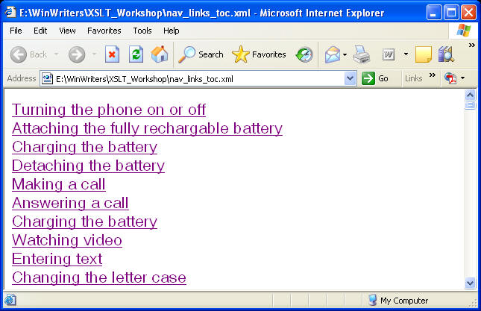
Task: Adding TOC links
We can automatically generate TOC links from our XML content.

Slide 41
Concept:Iterating through an XML Tree
You can use <xsl:for-each > to iterate over a series of XML elements.
In template that sets up the HTML page, iterate through each task. Generate a link to each task using the generate-id() function.
<xsl:for-each select="task" >
<a href="#{generate-id(.)}"> <xsl:value-of select="title"/></a>
<br />
</xsl:for-each>

Slide 42
Task: Adding TOC links
In template that sets up the HTML page, iterate through each task. Generate a link to each task using the generate-id() function.
<xsl:for-each select="task" >
<a href="#{generate-id(.)}"> <xsl:value-of select="title"/></a>
<br />
</xsl:for-each>

Slide 43
Exercise: Adding TOC links
Modify nav_links_toc.xsl to generate a list of topics at the top of the HTML page. Open nav_links_toc.xml to verify the result.
Extra credit: Use <xsl:sort /> in the <xsl:for-each> element to sort the TOC links. Verify that the links work.
Extra credit: Use <xsl:sort /> to sort the order of the tasks in the body of the HTML document.

Slide 44
Manipulating DITA Documents
Unlike other XML vocabularies, DITA elements are not (should not be) manipulated by name, but by the value of the element’s class attribute. This is an artifact of the DITA specialization mechanism.
Matching class attribute values is a bit tricky, and yields more complex stylesheets.

Slide 45
Manipulating DITA Documents (2)
<step class ="- topic/li task/step ">
<!-- steps -->
</step>
<xsl:template match="*[contains(@class,' task/step ')]”>
<!-- Process step -->
</xsl:template>

Slide 46
Contact Us!
We hope you enjoyed this presentation. Please feel free to contact us:
Alan Houser arh@groupwellesley.com Group Wellesley, Inc. 933 Wellesley Road Pittsburgh, PA 15206 USA 412-450-0532 www.groupwellesley.com

Slide 47
Your opinion is important to us! Please tell us what you thought of the lecture. We look forward to your feedback via smartphone or tablet under
http://IN50.honestly.de
or scan the QR code
The feedback tool will be available even after the conference!

