Slide 1

The Success of Book to Film Adaptations
What book characteristics are associated with film success?
Team Stegosaurus: Matthew Bishop, Ashley Gates, Lauren To

Slide 2
Agenda
Background
Analysis
Conclusion
Implications

Slide 3
Background
“Do book adaptations perform well as movies?”
Explored book ratings, page counts, genre, audience, publisher type.
Analyzed 45,000 movies released from March 1910 to July 2017, to find that 835 movies were based on novels during that time period. Performed EDA on 11,128 books via the Goodreads.
Final dataset consisted of 105 books and corresponding movies.

Slide 4
Approach
Identify data sources and dependencies
Collect and clean movie and book data
Merge (5) datasets based on which movies have corresponding book data
Run analysis and visualizations of consequential attributes
Analyze results—Regression, ANOVA, and T-tests

Slide 5
Approach
Limitations:
Limited sample size (both book and film data)
Limited time, scope of project
Book editions are from 1910 on
Books can be adapted more than once
Film release and book sales influence one another
Assumptions:
Assume data is correct
Assume that “Based on Novel” is correctly attributed in the dataset
Assume that movie and book IDs match correctly

Slide 6
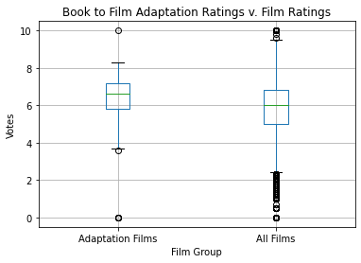
Hypothesis One: Book to film adaptations have ratings that are statistically different than most films.

Slide 7
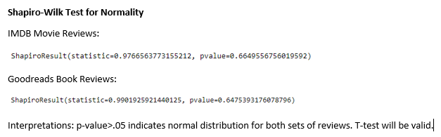

Slide 8
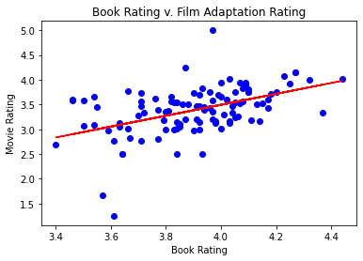
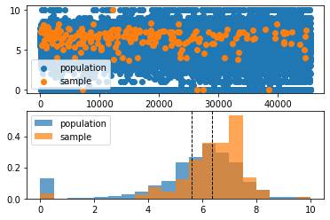
Hypothesis One: Book to film adaptations have ratings that are statistically different than most films.
The r-value is: 0.4813170546977568
statistic=8.333635521004798, pvalue=8.03194619929397e-15

Slide 9
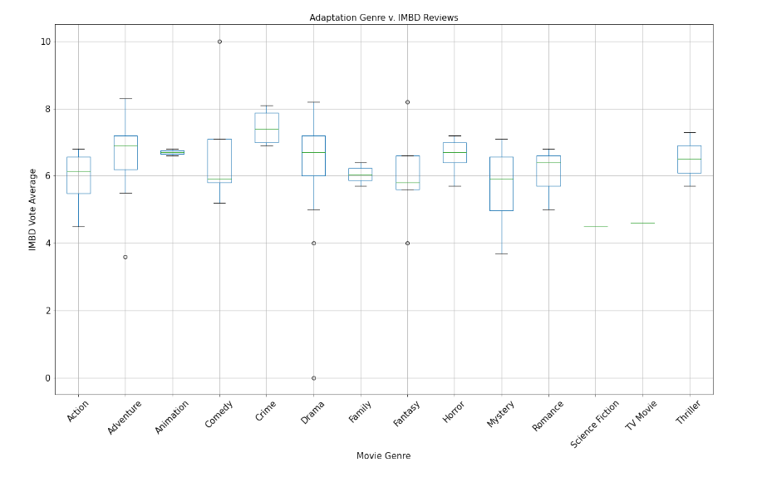
Hypothesis Two: Horror adaptation ratings are statistically different from adaptation ratings of other film genres.
statistic=1.4613602433882171, pvalue=0.22261097775355887

Slide 10
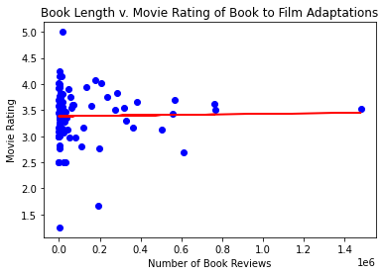
Hypothesis Three: There is a relationship/correlation between the number of reviewers of a book and the adaptation rating.
The r-value is: 0.019169007359004328

Slide 11
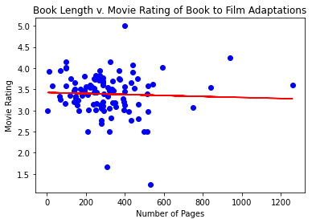
Hypothesis Four: There is a relationship/correlation between the number of Goodreads reviews and the adaptation rating.
The r-value is: -0.043778432195029734

Slide 12
Conclusion
Hypotheses
1. Are ratings of Book Adaptations statistically different from most films? Y
2. Are Book ratings positively correlated to Film ratings? Y
3. Are Horror Adaptation ratings statistically different from ratings of other film genres? N
4. Is there a relationship / correlation between the number of reviewers of a book, and the movie rating? N
5. Is there a relationship / correlation between the number of Goodreads book reviews and the movie rating?

Slide 13
Conclusion
Ideas for Further Exploration
Explore further correlations between books and movies, there’s more data to be analyzed
Use predictive methods to choose books to adapt to movies
Business Implications
Movie studios would find this data helpful in choosing where to invest production dollars, namely book rating
Book publishers could promote highly rated books for movie optioning
Could also have implications for which books get published
Could encourage book publishers and film companies to collaborate

Slide 14
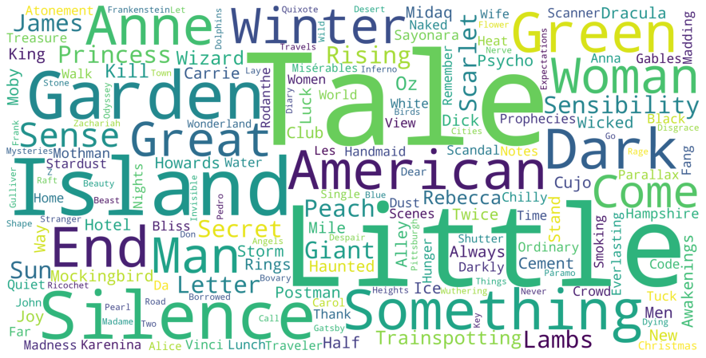
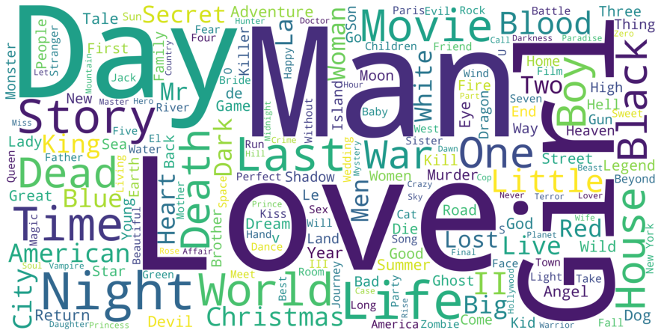
Further Exploration

Slide 15

Questions?

