Slide 1
Wholesaler with Web-shop
A database with data from a wholesaler. The database also offer access to create web-shops and manage restocking the supply.

Slide 2
Design
Requirement specification
Database considerations
Authentication (Row Level Security)
GUID and function
Attributes

Slide 3
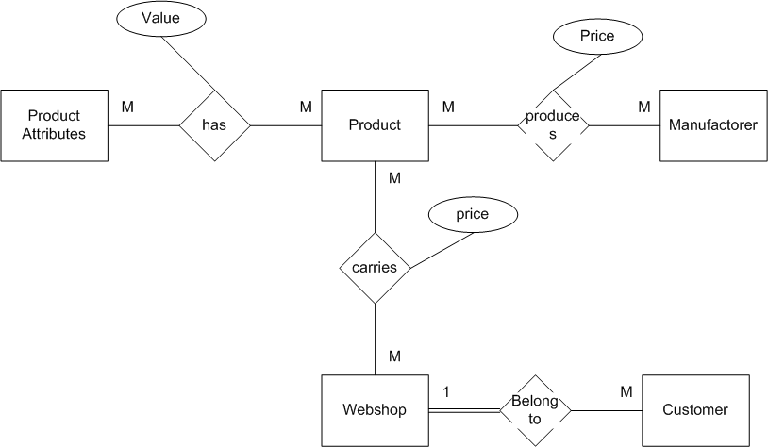
ER diagram – overall view

Slide 4
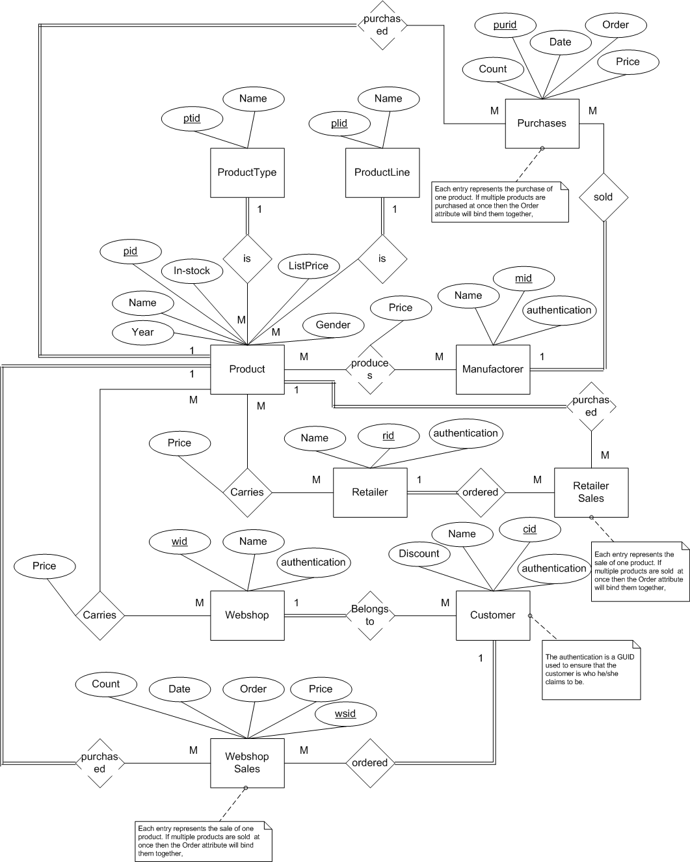
Version one of the ER-diagram. Has not been updated to the latest design considerations

Slide 5
Next step
Update ER-diagram
Create test database
Experiment with RLS
Create views and queries

