Slide 1
Emergency call button
Safety and Simplicity,
the elderly can have it all!

Slide 2
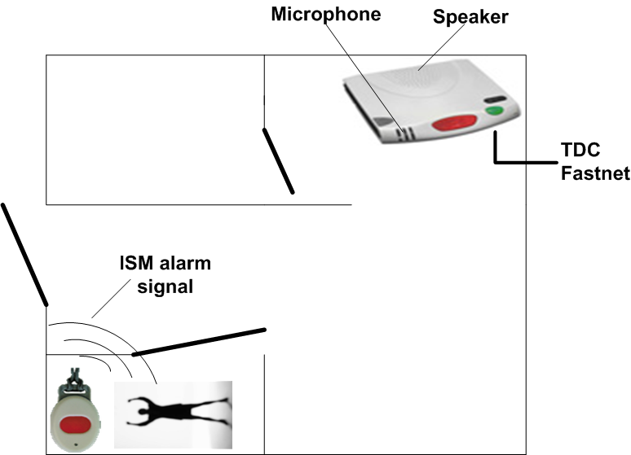
Today’s world

Slide 3
Problems?
The speaker and the person is in different rooms
The system requires a land-line (expensive)

Slide 4
Solution
Move the speaker and microphone to the button.
Use an alternate (existing) communication line.

Slide 5
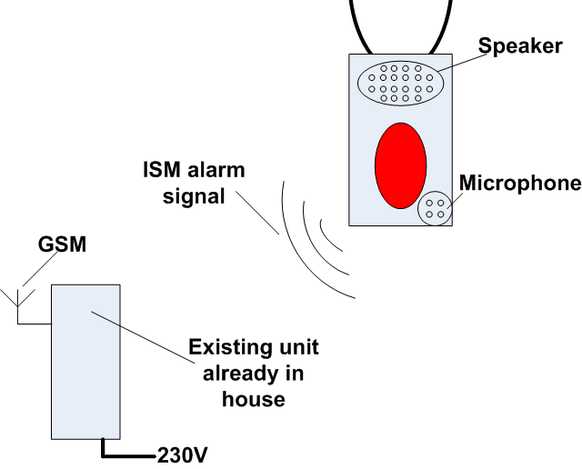
Emergency call button

Slide 6
Challenges
Battery must support two-way Audio
Old type can last 5 years on a single battery
Elderly and especially senile may have a problem remembering to recharge the unit.
Speaker must be strong enough to be heard by elderly
Teleslynge may be used with hearing aid (future)

