Slide 1
Wholesaler with Web-shop
A database with data from a wholesaler. The database also offer access to create web-shops and manage restocking the supply.

Slide 2
Database implementation
CREATE TYPE productattributetype AS ENUM ('string', 'integer', 'float');
-- weight is in grams so integer is fine.
CREATE TABLE products (
pid SERIAL PRIMARY KEY,
name VARCHAR(128) NOT NULL,
instock INTEGER NOT NULL DEFAULT 0,
weight INTEGER NOT NULL
);
CREATE TABLE productattributes (
name VARCHAR(128) PRIMARY KEY,
type productattributetype NOT NULL
);
CREATE FUNCTION trigfunc_customer_order() RETURNS trigger AS $$
BEGIN
UPDATE products SET instock=p.instock-cop.count FROM customerorders co INNER JOIN customerorderproducts cop ON co.orderid=cop.orderid INNER JOIN products p ON cop.productid=p.pid WHERE co.orderid=NEW.orderid;
return NEW;
END
$$ LANGUAGE plpgsql;
-- This trigger is only for debugging as we would like to insert an order directly (not via update)
CREATE TRIGGER update_in_stock_customer
AFTER UPDATE ON customerorders
FOR EACH ROW
WHEN (NEW.deliveryid IS NOT NULL AND OLD.deliveryid IS NULL)
EXECUTE PROCEDURE trigfunc_customer_order();

Slide 3
Test DB
100000 products
5000 productlines + 1 no-line
20 brands + 1 no-brand
All products has size 0 - 79 (XXS - XXXL)
All products hsa a colour ("red", "white", "green", "blue", "lightblue", "baige", "black", "multicoloured")
10 manufactorers with random currency
10000 pricing plans without discount
10000 pricing plans with discount
2000 of the pricing plans has quantity discounts.
Each product is produced by 1 or 2 manufactorers with random pricing plans.
Each product has been belivered between 1 and 15 times and in each order is between 1 and 10 products
There are 60 webshops
Each webshop carries between 1000 and 10000 products
Each webshop has between 50 and 1000 customers
Each customer has purchased between 0 and 100 products.
Each order from the customer consists of between 1 and 10 products.
Each product is purchased in a quantity of 1 to 3 units

Slide 4
Test DB
Cheat trigger by single order insert and manual calc count.
Update exec > 1 hour
C# program (450 linier) – besværligt
130 MB tekst fil (43MB zip)
Execution time (1 core): 3min and 15sec
SELECT setval('customerorders_orderid_seq', " + (startID - 1) + ");
INSERT INTO products (name,instock,weight) VALUES ('Product 0',476,730),('Product 1',509,800),…

Slide 5
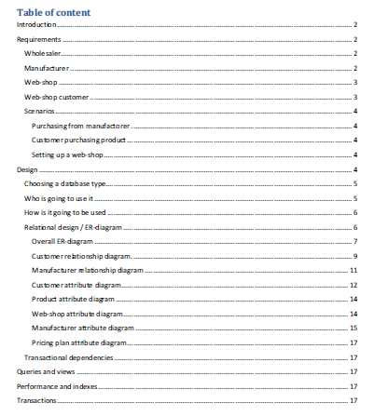
Rapport

Slide 6
ER diagram – overall view

Slide 7
Customer

Slide 8
PricingPLan

Slide 9
Next step
Complete documentation og ER-diagram
Requirement tracability
Functional dependencies
Create views and queries
How many outstanding payments are there
Low stock, low sale, …
Optimal pricing plan (discount selection)
Performance og indexes

