Slide 1
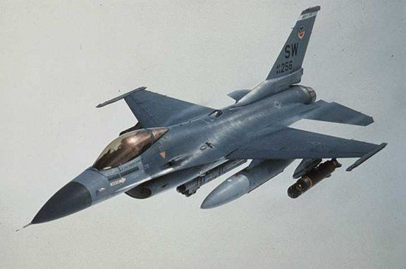
Self Protecting Suite for F-16
The best defence is not always an attack!

Slide 2
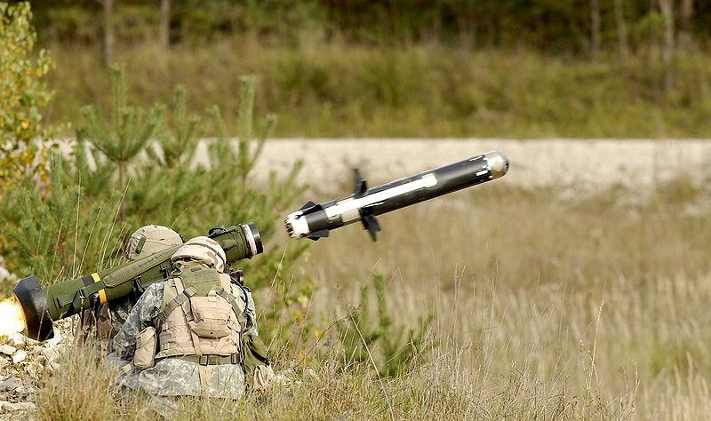
Why does an F-16 need protection?
Over the last 10 years the portable ultra-light heat-seaking ground-to-air missile
has become the personal property of any self-respecting warloard or drug-dealer,
not to mention hostile nationes or rogue fractions within our allies.

Slide 3
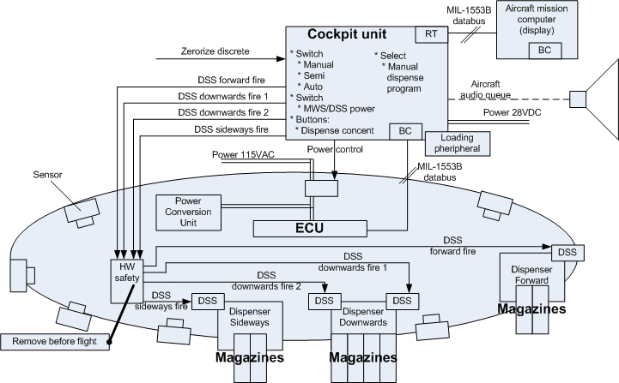
Alternatives?
- Accept the risk
- Avoid conflicts
- Company F Self protection suite for F-16

Slide 4
Why not just run the risk?
It costs more than 10 million DKR to train
just one F-16 fighter pilot, and that does
not include experience.
An F-16 costs approximately 50-55 million USD
= 302,5 million DKR
No one wants to explain an avoidable loss of
life to the family, the public and the politicians.

Slide 5
Danmark har 62 F-16
What will it cost?
The list price for outfitting one F-16 with the
Company F Self protection suite for F-16 is
8,000,000.-
Denmark has a total of 62 F-16s, giving a total price
of 496 million DKR, but with gross discount we are
talking closer to 450 million, or the price of 1½
aircraft, without pilot.
With the added protection of the aircraft the pilots
may also be able to complete missions with a higher
risk to great benefit to our selves and out allies.

Slide 6
The design

