Slide 1
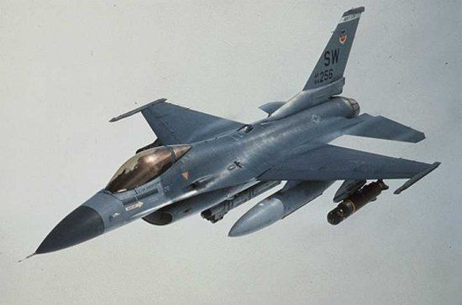
Self Protecting Suite for F-16
The best defence is not always an attack!

Slide 2
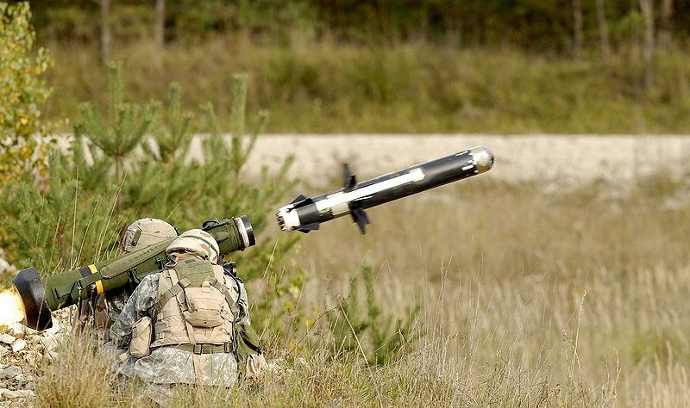
Why does an F-16 need protection?
Over the last 10 years the portable ultra-light heat-seaking ground-to-air missile
has become the personal property of any self-respecting warloard or drug-dealer,
not to mention hostile nations or rogue fractions within our allies.

Slide 3
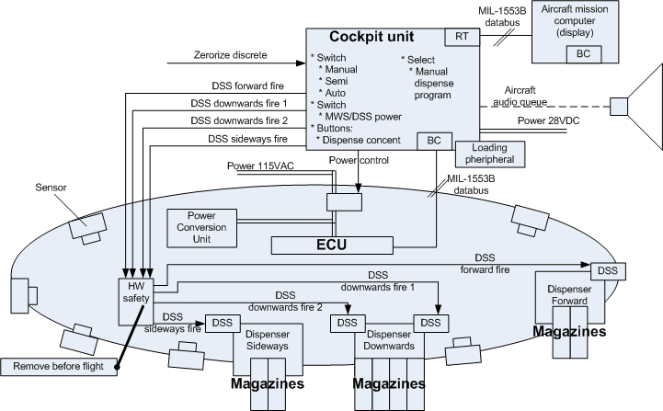
Alternatives?
- Accept the risk
- Avoid conflicts
- Company F Self protection suite for F-16

Slide 4
Why not just run the risk?
It costs more than 10 million DKR to train
just one F-16 fighter pilot, and that does
not include experience.
An F-16 costs approximately 50-55 million USD
= 302,5 million DKR
No one wants to explain an avoidable loss of
life to the family, the public and the politicians.

Slide 5
What will it cost?
F-16s in Denmark: 62
Operational fleet: 32
Max combat fleet: 10
The list price for outfitting one F-16 with the
Company F Self protection suite for F-16 is:
1 POD: 7,500,000.-
1 Cockpit unit: 500,000.-
62 cockpit units + 10 PODs = 106million or
1/3 the price of one F-16 without a pilot.
It saves money AND lives!

Slide 6
The requirements
Optimal coverage
Do not interfere with the existing system (subcontractor)
Use GFE
PCU available
Ground dispense protection
Customer feedback
High detail level in system requirements (missile coverage, response pattern, power and weight, pin layout, …)

Slide 7
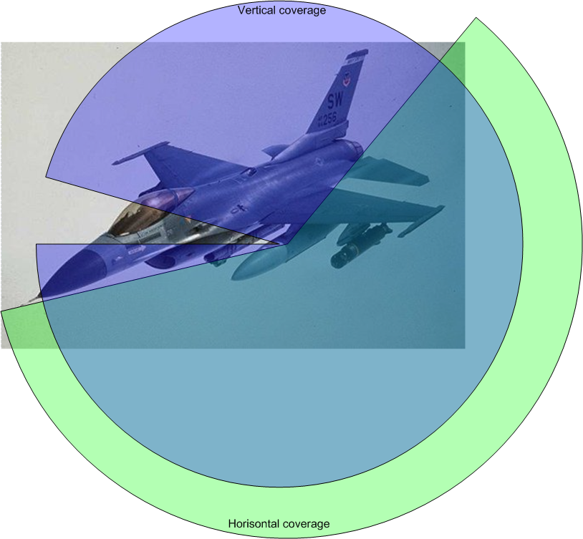
Missile coverage – one or two PODs?

Slide 8
The design
Simplify, simplify, simplify (DSS fire, PCU)
Lower risk, faster, replacable, reliable
HW safety with physicaly removable pin
Experienced subcontractor with clear requirements (standards)
Cold restart power control
Use standards where available
SysML

Slide 9
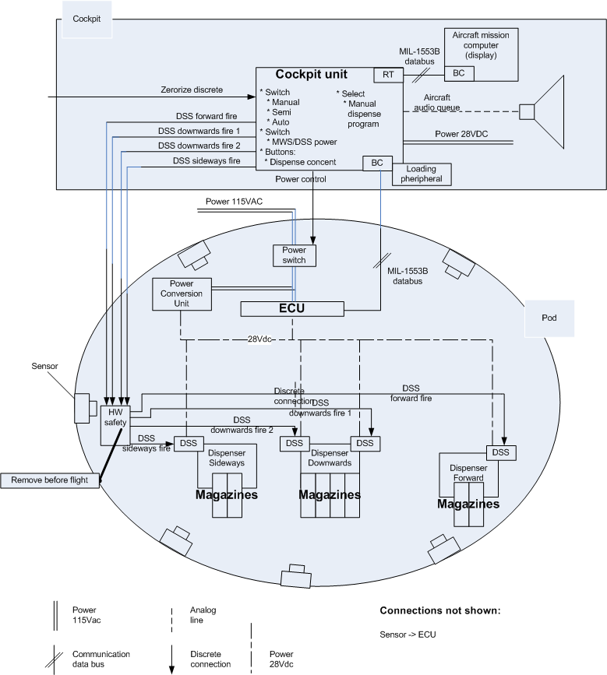

Slide 10
The process
We at Company F believe in employing the best, and when the best won’t come to you, you must go to the best.
Geographically distributed development.
Google code, Wiki, Subversion, meetings and late nights.
Internal reviews.
Building the unknown in 32 hours.

Slide 11
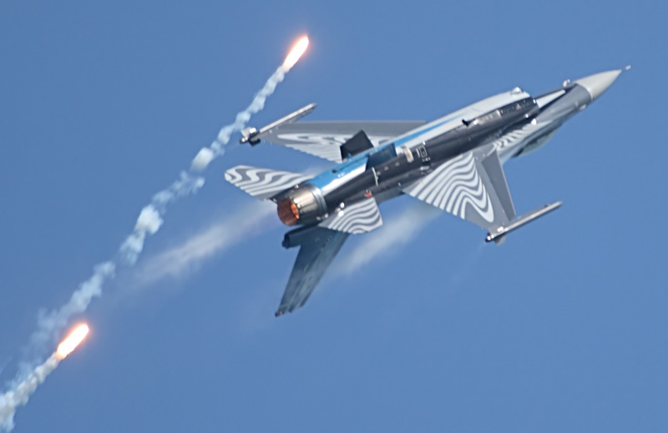
Questions?

Slide 12
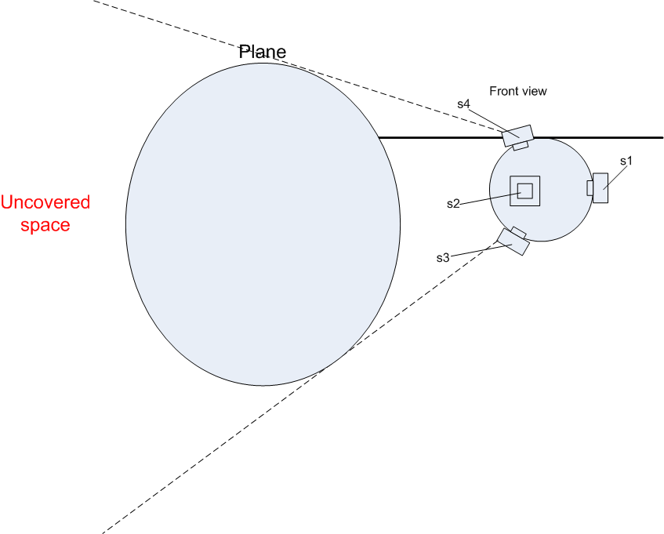

Slide 13
