Slide 1

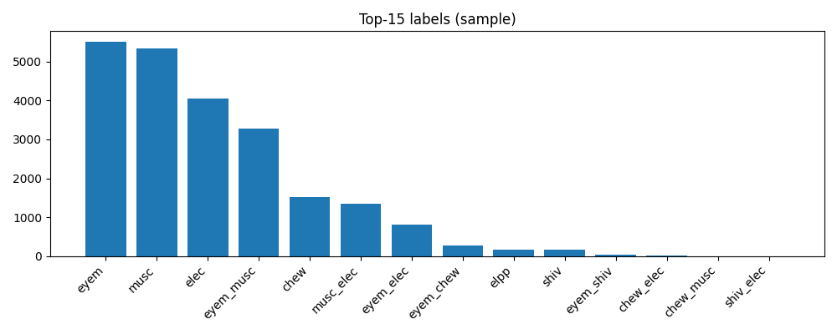
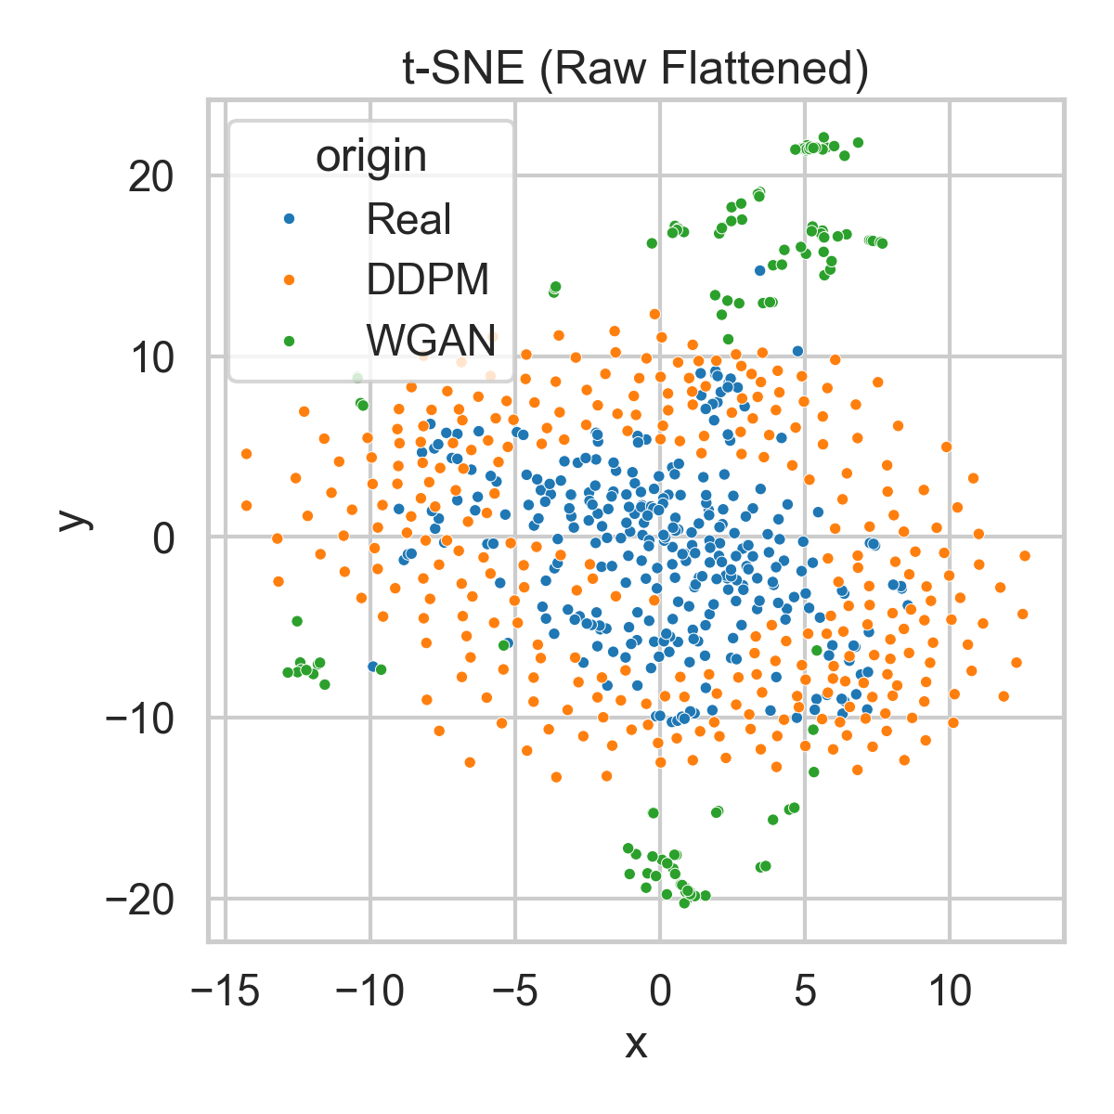
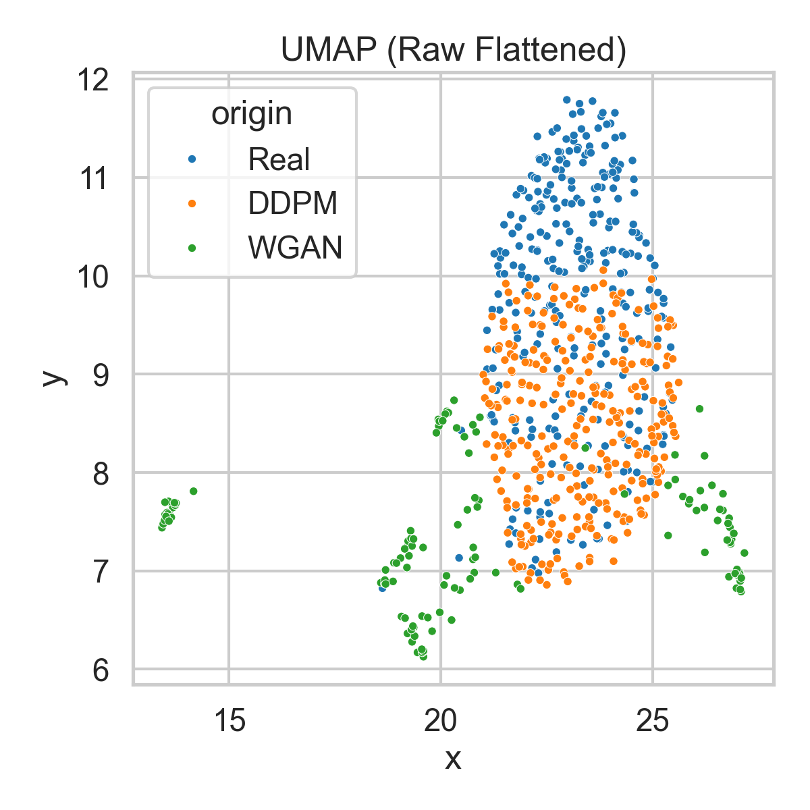
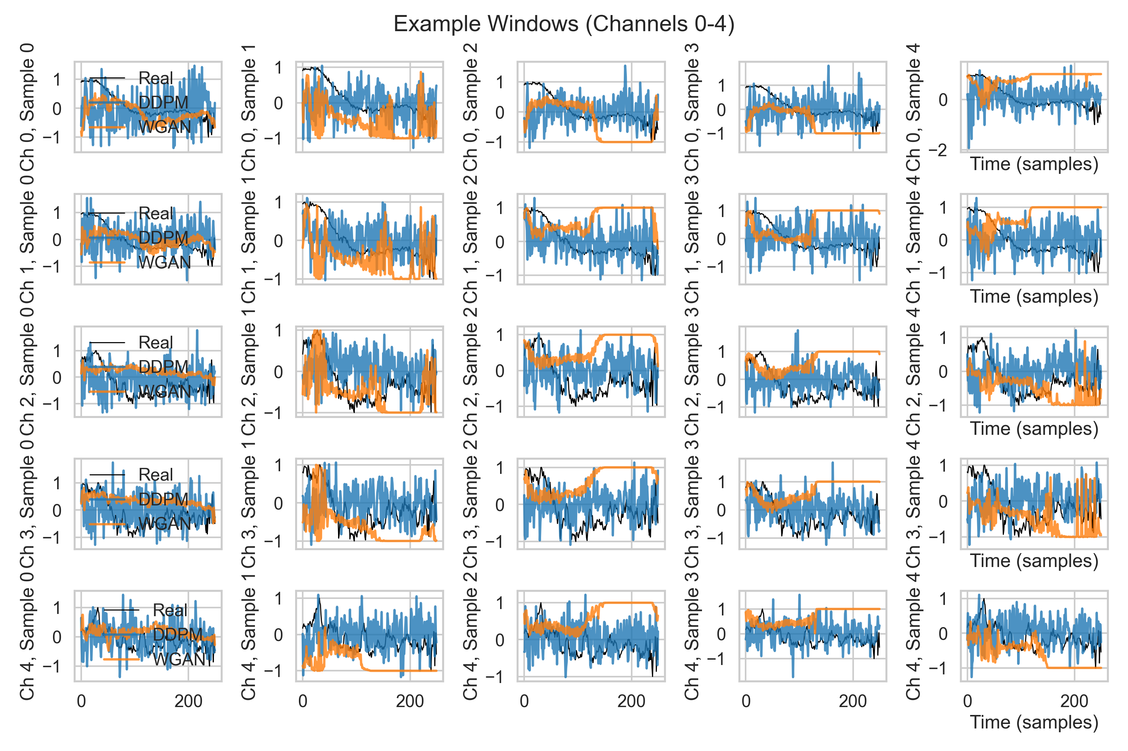
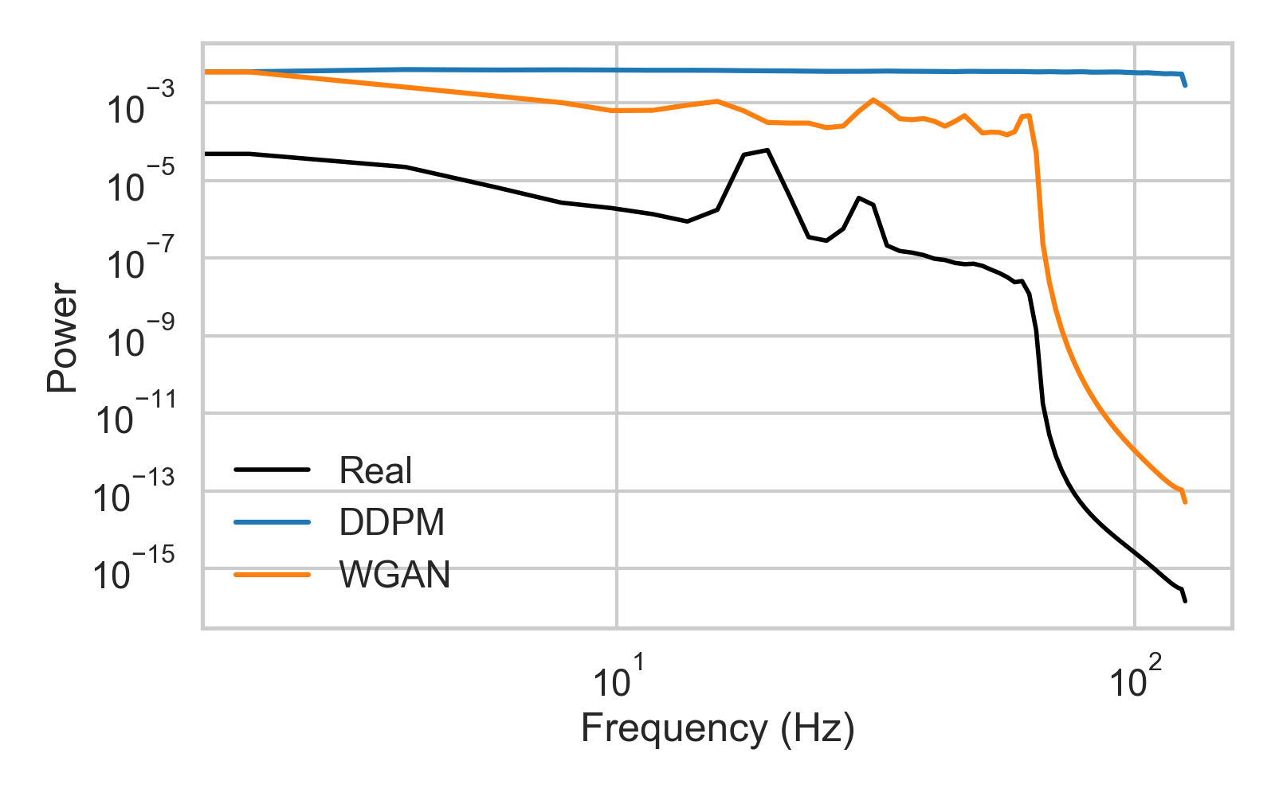


ArtifactGen: Benchmarking WGAN-GP vs Diffusion for Label-Aware EEG Artifact Synthesis
Hritik Arasu, Faisal R. Jahangiri
Abstract
Introduction
To address the difficulty of obtaining labeled EEG artifact data, we developed ArtifactGen to benchmark WGAN-GP against Diffusion models for synthesizing realistic artifact segments. Our evaluation found that the WGAN-GP model currently produces signals with better spectral realism than the Diffusion baseline, though both models face challenges with precise class conditioning
Evaluation Challenge: Evaluating synthetic EEG requires metrics aligned with neurophysiological structure (spectra, covariance) rather than standard image heuristics.
Contribution: A reproducible framework, ArtifactGen, establishing a baseline for EEG artifact synthesis and surfacing actionable failure modes.
Purpose & Research Question
The Problem: Real-world EEG recordings are rife with non-neural artifacts that can degrade downstream analysis and confound learning systems.
The Gap: While artifact removal is well-studied, large public corpora like TUAR remain label-limited for training robust models that generalize across conditions.
Subjects, Methods & Analysis
Results
Data Source: TUH EEG Artifact (TUAR) corpus with subject-wise splits (149 train, 32 val, 32 test) to prevent leakage.
Artifact Classes: Five distinct classes: Muscle, Eye, Electrode, Chewing, and Shiver.
Preprocessing:
Montage: Fixed 8-channel montage (Fp1, Fp2, C3, C4, O1, O2, T3, T4) at 250 Hz.
WGAN-GP: 1.0s windows with per-window min-max normalization to $[-1, 1]$.
Diffusion: 2.0s windows with per-recording, per-channel z-score normalization.
GANs: Specifically WGAN-GP with projection discriminators, known for stability and sample efficiency.
Conditional WGAN with gradient penalty and a projection discriminator for label injection
Diffusion Models: DDPMs with classifier-free guidance, known for state-of-the-art generative quality but higher sampling latency.
1D U-Net with FiLM conditioning and classifier-free guidance
Spectral Alignment: The WGAN-GP model consistently achieved lower relative band-power errors and smaller MMD to the real distribution compared to the diffusion baseline.
Design Factors: WGAN performance was likely aided by the projection discriminator explicitly shaping the decision boundary and min-max scaling emphasizing local amplitude dynamics.
Diffusion Limitations: The diffusion model exhibited wider band-power errors, potentially due to aggressive classifier-free guidance scales and limited sampling steps (50).
Morphology Mismatch: Both models showed non-trivial covariance distances, indicating residual mismatches in temporal dependency and inter-channel coupling.
Conclusions
Directions for Future Research
Baseline Performance: For short-horizon artifact synthesis (1–2s), the conditional WGAN-GP remains a strong baseline, outperforming the diffusion model in spectral fidelity in this setting
Future Directions: Closing the gap for diffusion models will likely require more sampling steps, spectral-consistency objectives (e.g., auxiliary PSD loss), and montage-aware architectures.
Apply with new datasets
Getting feedback from more clinicians
Explore additional explainability
Identify additional differences between natural and synthetic
Improve and advance current model and evaluation
References
A. Hamid, K. Gagliano, S. Rahman, N. Tulin, V. Tchiong, I. Obeid, and J. Picone. "The Temple University Artifact Corpus: An annotated corpus of EEG artifacts." 2020 IEEE Signal Processing in Medicine and Biology Symposium (SPMB), pages 1–4, 2020.
Ishaan Gulrajani, Faruk Ahmed, Martin Arjovsky, Vincent Dumoulin, and Aaron C. Courville. "Improved training of Wasserstein GANs." Advances in Neural Information Processing Systems (NeurIPS), 2017. Ho, Ajay Jain, and Pieter Abbeel. "Denoising Diffusion Probabilistic Models." Advances in Neural Information Processing Systems (NeurIPS), 2020.

