Slide 1
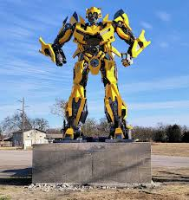
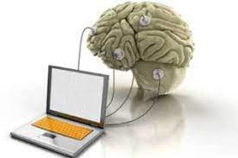
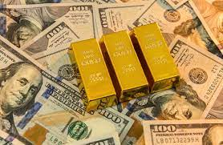
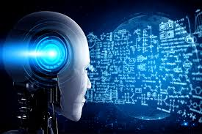
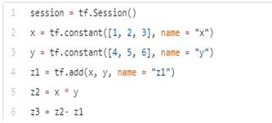

Thinking about Deep Learning and Artificial Intelligence
What my family thinks I do
What my friends think I do
What engineer and other scientist think I do
What mathematicians think I do
What I think I do
What I really do

