Slide 1
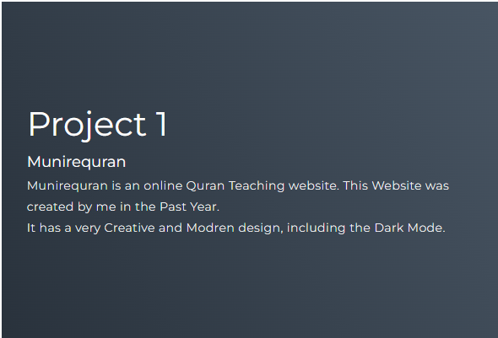
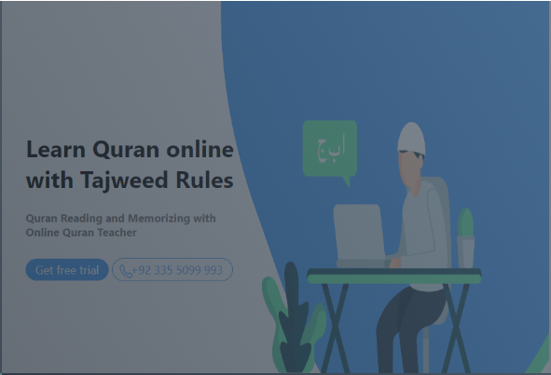
Building a Personal Portfolio Website: A Step-by-Step Guide
This presentation provides a comprehensive guide to developing a personal portfolio website, covering its essential components, key design considerations, and implementation details using HTML, CSS, and JavaScript.

Slide 2
1. HTML Structure: Defining the Foundation
Index.html
Key Sections
The index.html file is the core of your portfolio website, defining its basic structure and content. It contains multiple key sections, each fulfilling a specific purpose.
Header (#header): Houses the navigation menu, using an unordered list (ul) and a hamburger menu (div.hamburger) for mobile navigation.
Hero Section (#hero): Displays your name and a portfolio button that links to the projects section.
Projects Section (#projects): Showcases your past work with individual project items (div.project-item), featuring images and brief descriptions.

Slide 3
2. CSS Styling: Enhancing Visual Appeal
Global Styling
Navigation and Header
Global styling sets the foundation for the website's visual aesthetic. This includes applying a consistent font like Montserrat, ensuring smooth scrolling for navigation, and establishing a clear hierarchy for visual elements.
The header is made sticky, remaining visible even when scrolling. The navigation menu is initially hidden and slides in on click, providing a smooth user experience.

Slide 4
3. JavaScript Functionality: Adding Interactivity
Hamburger Menu Toggle
JavaScript Code
JavaScript plays a crucial role in enhancing the website's interactivity, particularly in the navigation menu. The hamburger menu toggle script ensures responsiveness across various screen sizes, allowing users to access the navigation menu easily on mobile devices.
const hamburger = document.querySelector(".hamburger");
const navList = document.querySelector(".nav-list ul");
hamburger.addEventListener("click", () => {
navList.classList.toggle("active");
});

Slide 5
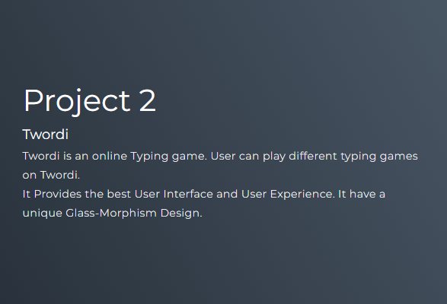
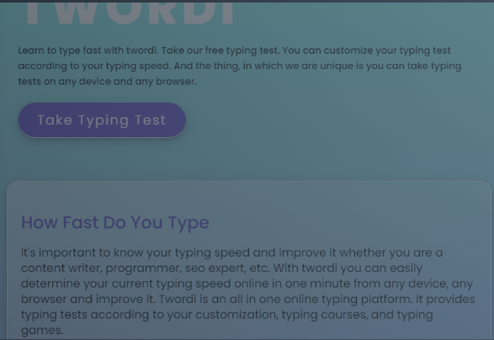
4. Responsiveness and Adaptability
1
Media Queries
2
Mobile Navigation
CSS media queries are essential for achieving responsiveness, allowing different styles to be applied based on the screen size and orientation. This ensures your website adapts seamlessly to different devices.
Media queries are used to create a mobile-friendly navigation menu, often transforming the horizontal menu into a hamburger menu, providing a compact and user-friendly experience on smaller screens.
3
Image Optimization
Optimizing images for different screen sizes is crucial for performance. Using responsive images allows the website to load faster and display appropriately on various devices.

Slide 6
5. Content and Branding: Making a Lasting Impression
Content Strategy
Visual Identity
Craft compelling content that showcases your skills, experience, and personal brand. Use clear and concise language that effectively communicates your value proposition to potential employers or clients.
Develop a consistent visual identity for your portfolio website, using a cohesive color palette, typography, and imagery. This creates a visually appealing and memorable experience for visitors.

Slide 7
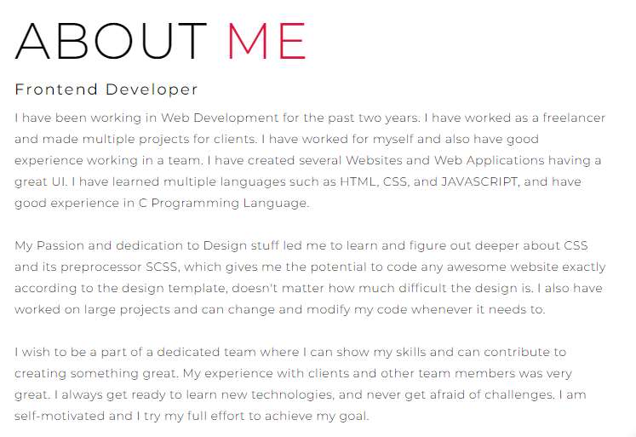
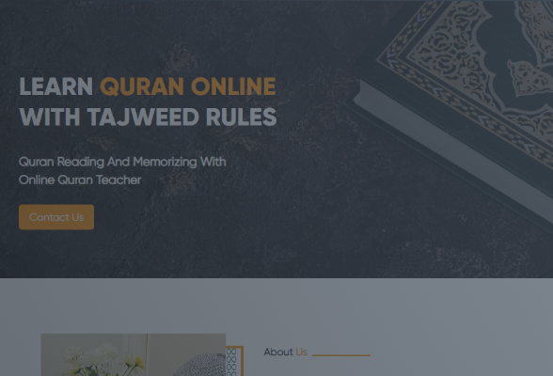
6. Project Showcase: Highlighting Your Accomplishments
Clear & Concise
Organized & Engaging
Present your projects in a clear and concise manner, using high-quality images, brief descriptions, and relevant keywords. Each project should highlight its key features and your contributions.
Organize your projects into logical categories, making it easy for visitors to navigate and discover relevant projects. Consider using interactive elements like hover effects to enhance the user experience.

Slide 8


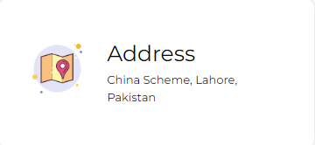
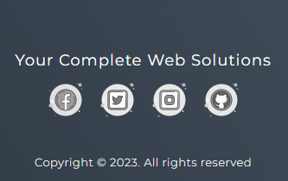
7. Call to Action: Encouraging Engagement
Contact Form
Social Media Links
Include a clear and accessible contact form that allows visitors to easily reach out to you. Ensure the form is user-friendly and collects essential information for communication.
Include links to your social media profiles, allowing visitors to connect with you on other platforms and learn more about your interests and professional activities.
Portfolio Button
The portfolio button on the hero section should be prominent and engaging, providing a clear visual cue to visitors to explore your projects.

Slide 9





Key Takeaways: Building a Winning Portfolio
1
Structure
2
Content
3
Branding
4
Responsiveness
5
Interaction
Building a personal portfolio website requires careful planning and execution. By focusing on a solid structure, compelling content, a strong brand identity, responsiveness across devices, and engaging interactions, you can create a professional and effective online showcase of your skills and achievements.

Slide 10
This Presentation is made in group with our valuable members.
Leader
Muhammad Ahmad 027
Members
Muhammad Zubair 049
Ahsan Hammad 015
Ahsan Rehman 003

