Slide 1
USGS Discharge Analysis
Location: Delaware River at Trenton NJ
(USGS Site No. 01463500)
cc
Ahsan Aziz
Ahsan Karim
Moshe Fixler
Syed Lakitullah
Muhammad Anwar
Notes:
Ahsan A

Slide 2
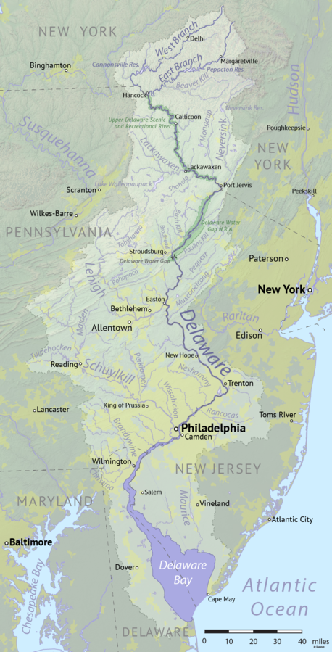
Delaware River map
Notes:
Ahsan A

Slide 3
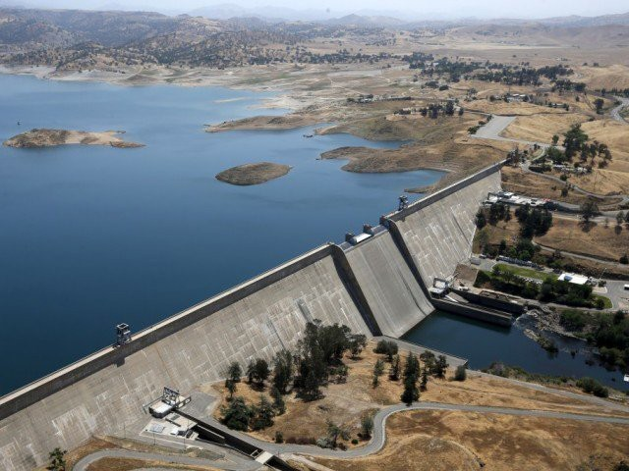
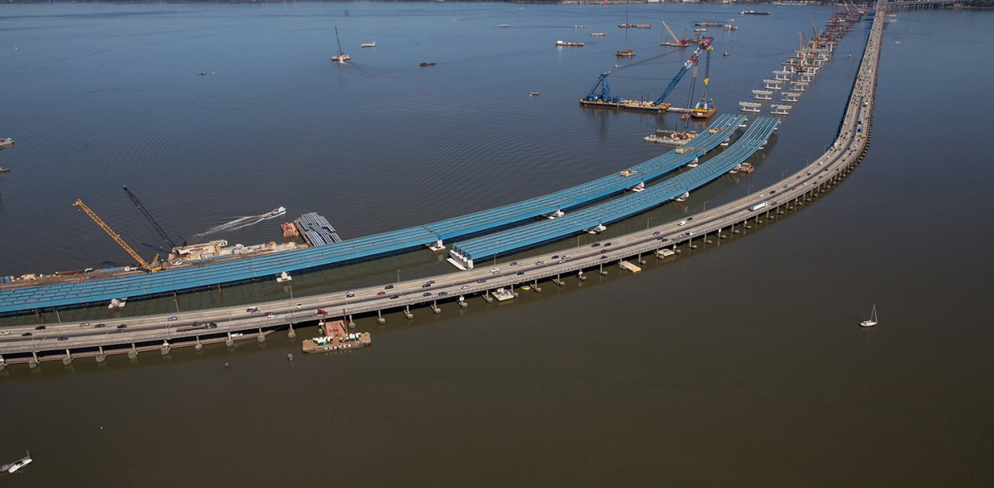
Purpose for recording and analyzing discharge data
Keeping discharge records is used to study natural water resources
Model information about the past, present, and future of the discharge at specific location
Creating structures like dams, bridges, oil rigs, we need to know about how much discharge the body of water will have in a certain period of time
Understand effects of natural hazards and like storms, floods, and rain on bodies of water
Help scientists learn about the natural landscape and topography and how it is shaped by discharge
Regulate water resources in states for public use
Analyze on a global scale the conditions of water level and water flow as global warming and climate change is taking place and how discharge is affected
Notes:
Ahsan A

Slide 4
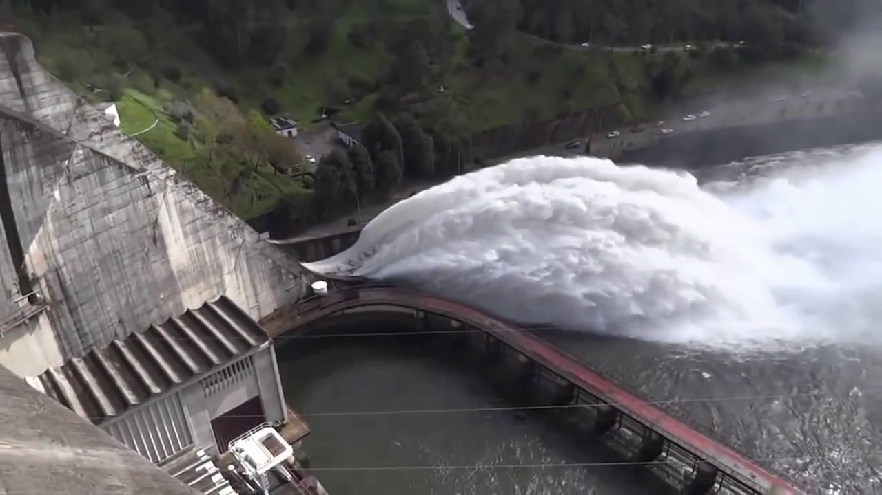
What is discharge?
In hydrology, discharge is the volume rate of water flow that is transported through a given cross-sectional area.
In fluid dynamics and hydrometry, the volumetric flow rate, (also known as volume flow rate), is the volume of fluid which passes per unit time.
Notes:
Ahsan A

Slide 5
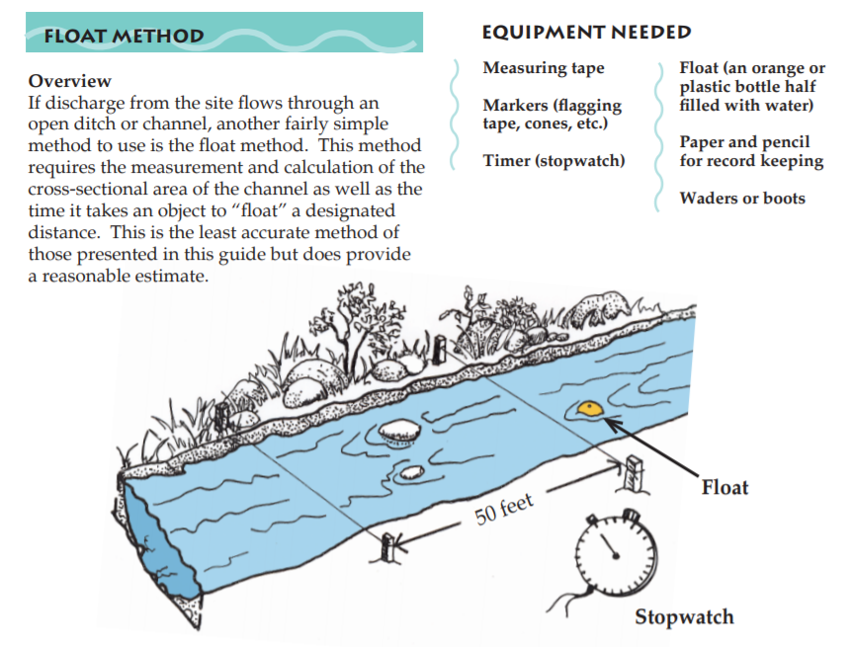
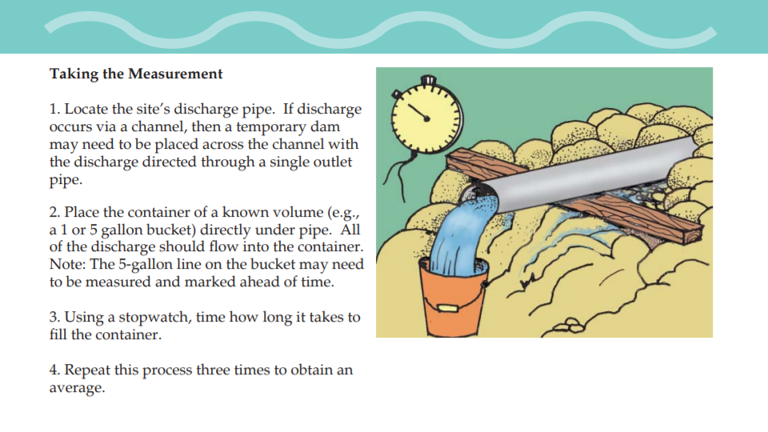
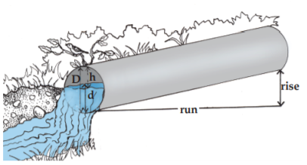
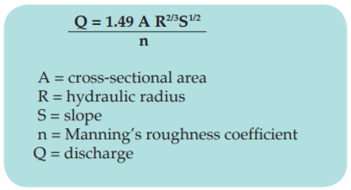
Methods of collecting discharge data
Float method: Bucket and stopwatch method: Manning’s equation method:
Notes:
Ahsan A

Slide 6
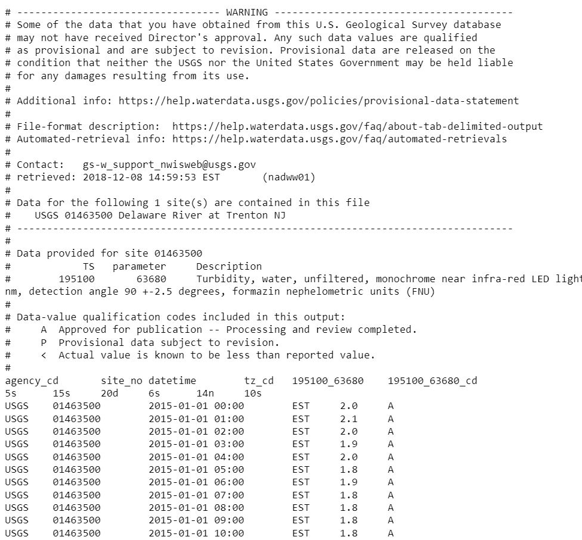
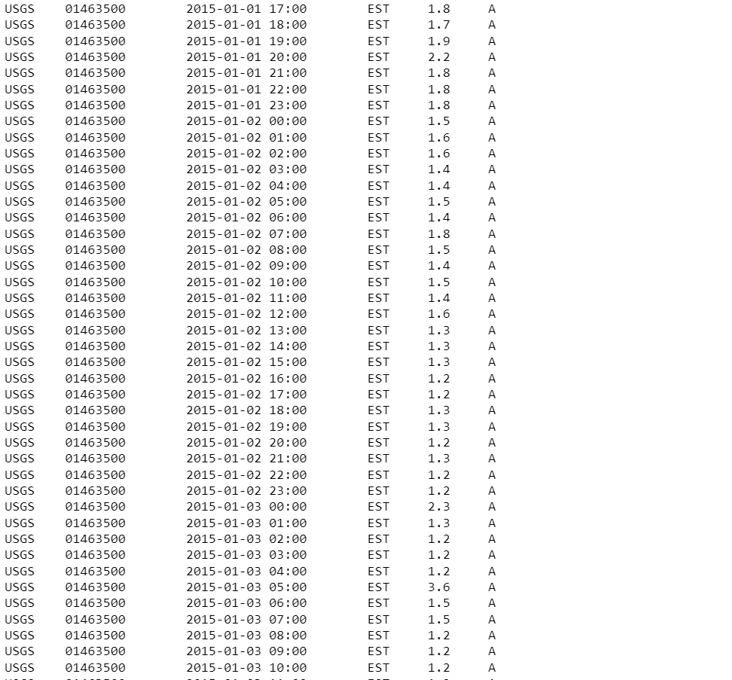
Procedure for our project
Google search “usgs water data”
On the USGS site, click on “Surface Water”
On the next page, click on “Daily Data”
Choose site selection criteria
Site location: State/Territory
Site Identifier: Site Number “01463500”
When found the desired site, select dates
When selecting type, select Tab-Separated format
Save this url as text file named “USGS_01463500_Delaware_River_at_Trenton_NJ”
Read instructions in project description for creating graphs
Many of the function names are given in project description
Plot the necessary graphs and analyze the data
Notes:
Ahsan Karim (60 sec)

Slide 7
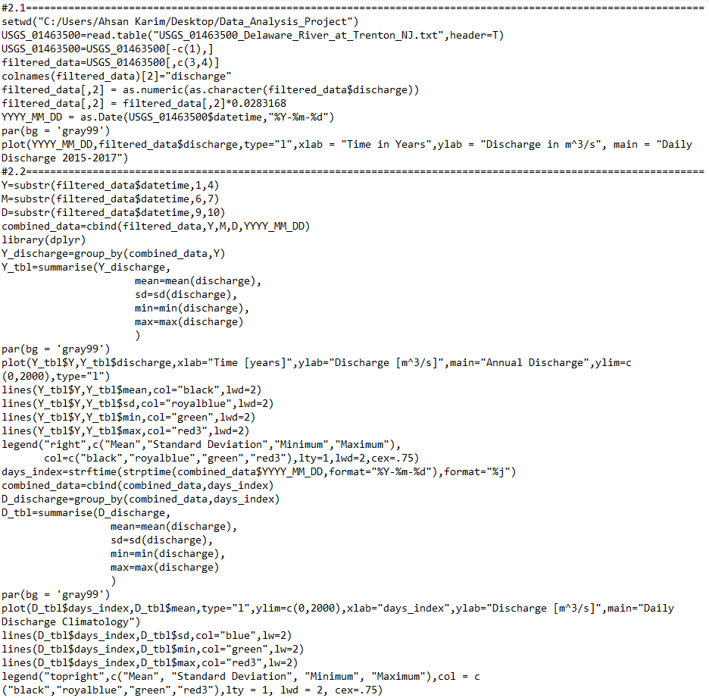
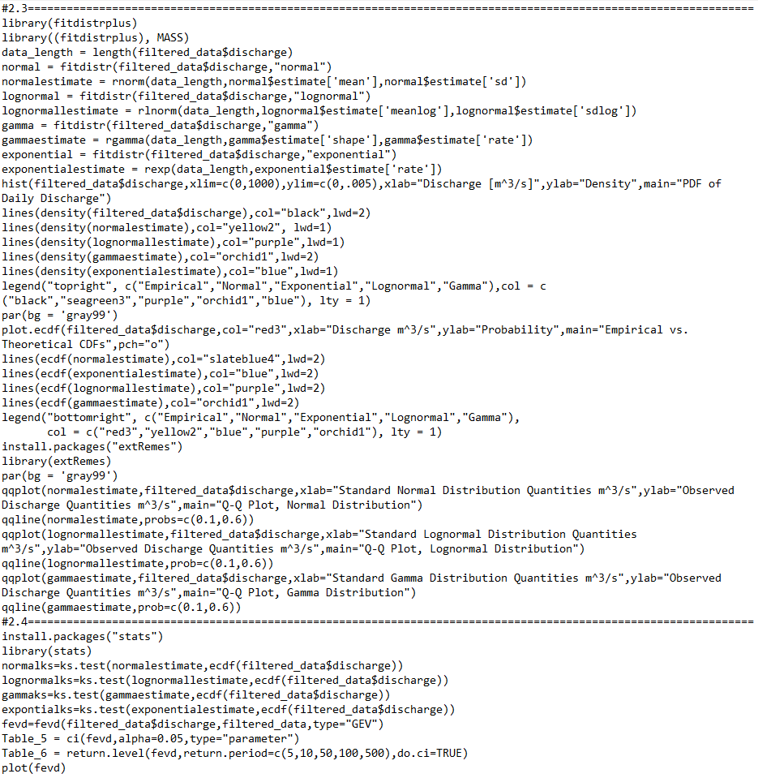
R programming
Notes:
Ahsan Karim (60 sec)

Slide 8
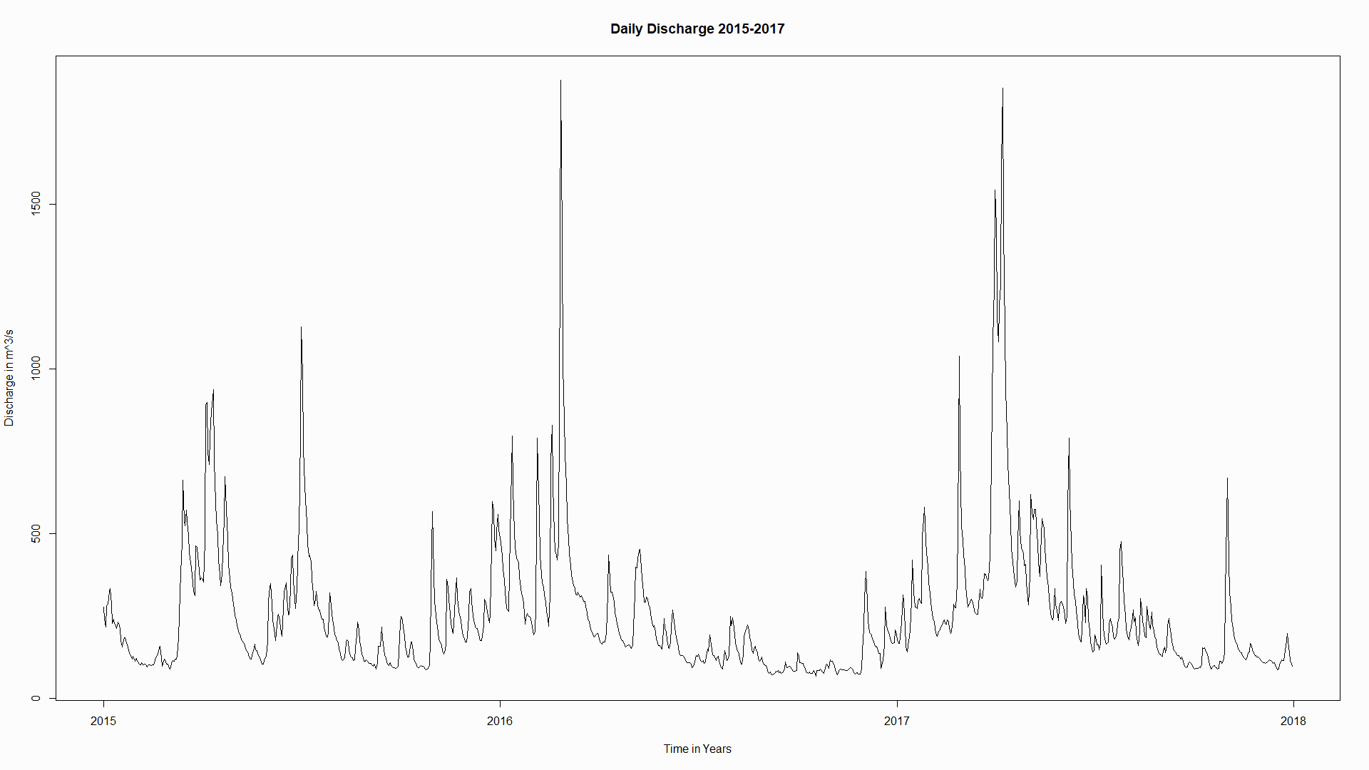
Daily discharge over 3 years
Showing daily statistics of water discharge at
Peak occurences of water discharge in 2016 and 2017 with discharge levels being greater than 1500 [m^3/s]
Inconsistent discharge records throughout these 3 years, 2015 is most inconsistent
Severe storm on February 24th, 2016 which affected water discharge nearby
Discharge values stayed low during the middle of the year in 2016 and 2017
Notes:
Ahsan Karim (30 sec)

Slide 9
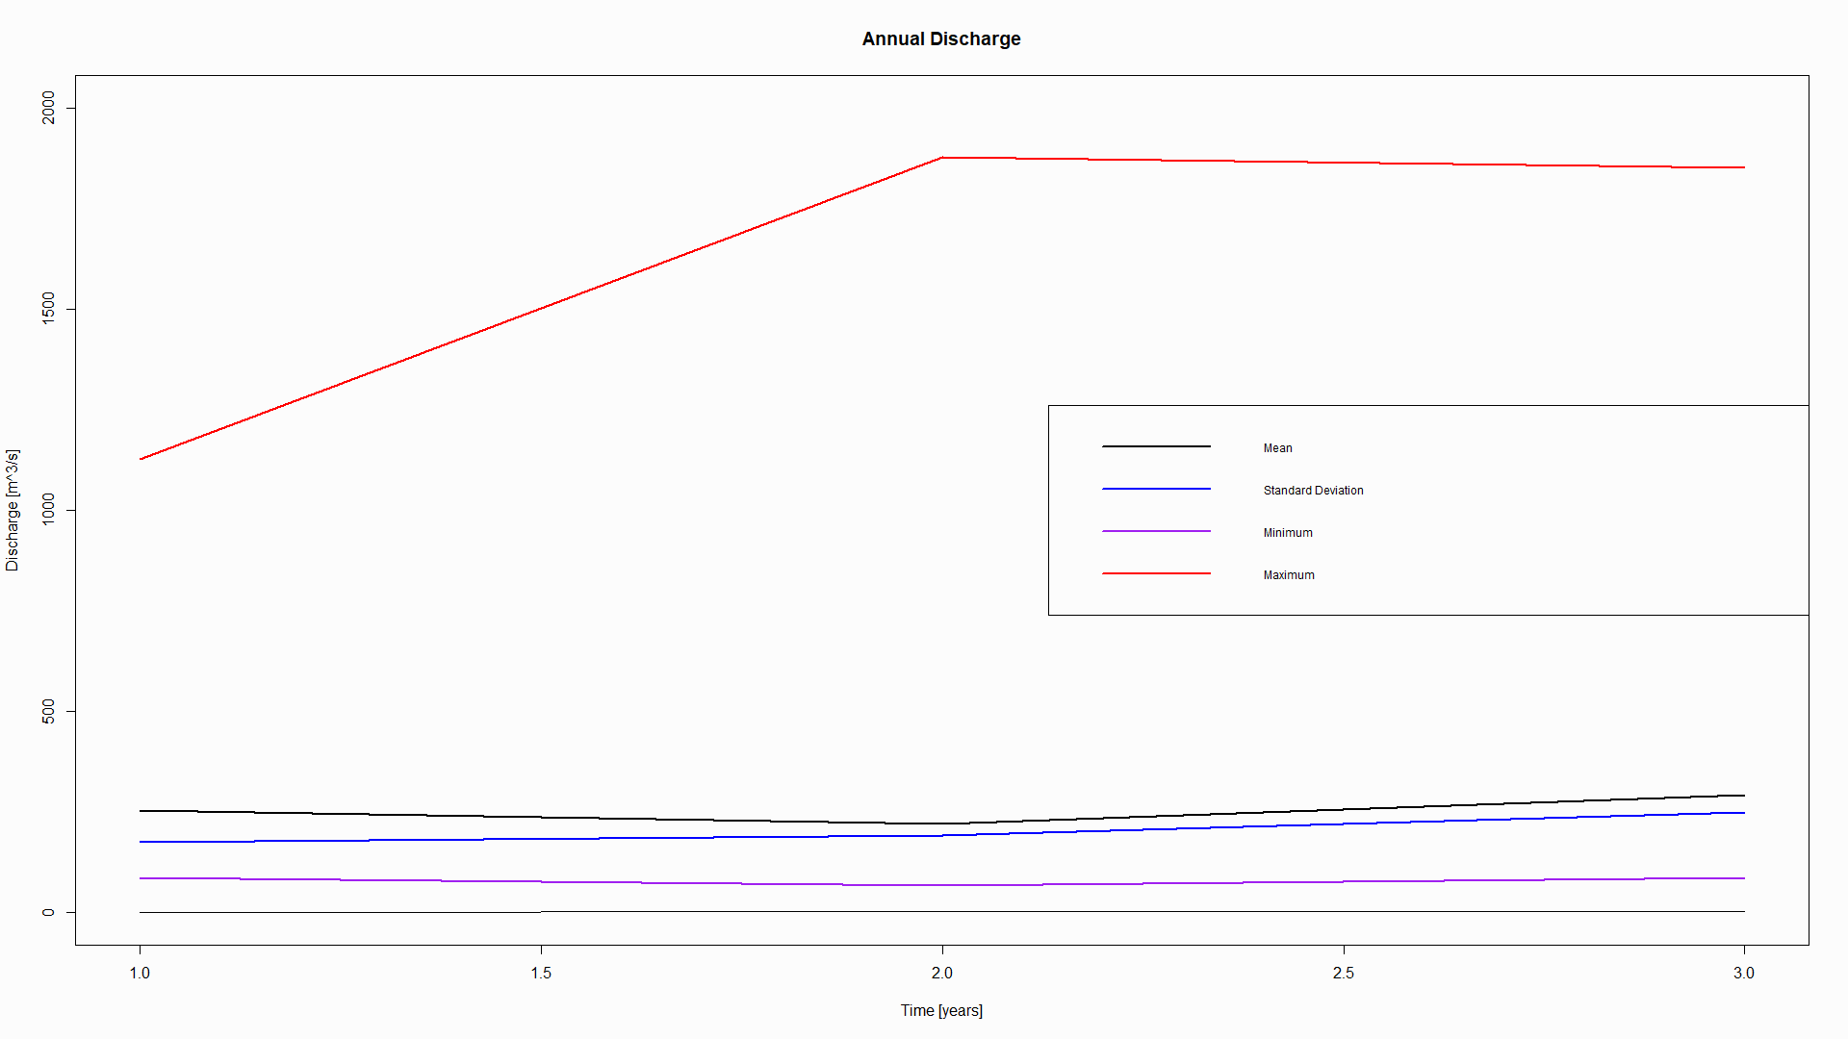
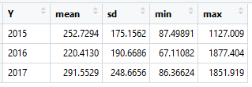
Statistics for each year
Mean, standard deviation and minimum discharges were all similar for the three years
Maximum discharges increased drastically by over 750 [m^3/s] from 2015-2016
Interesting to see the maximum did not affect the average on graph, implies heavy rainfall once or twice a year do not significantly impact the river’s discharge average
Notes:
Ahsan Karim (30 sec)

Slide 10
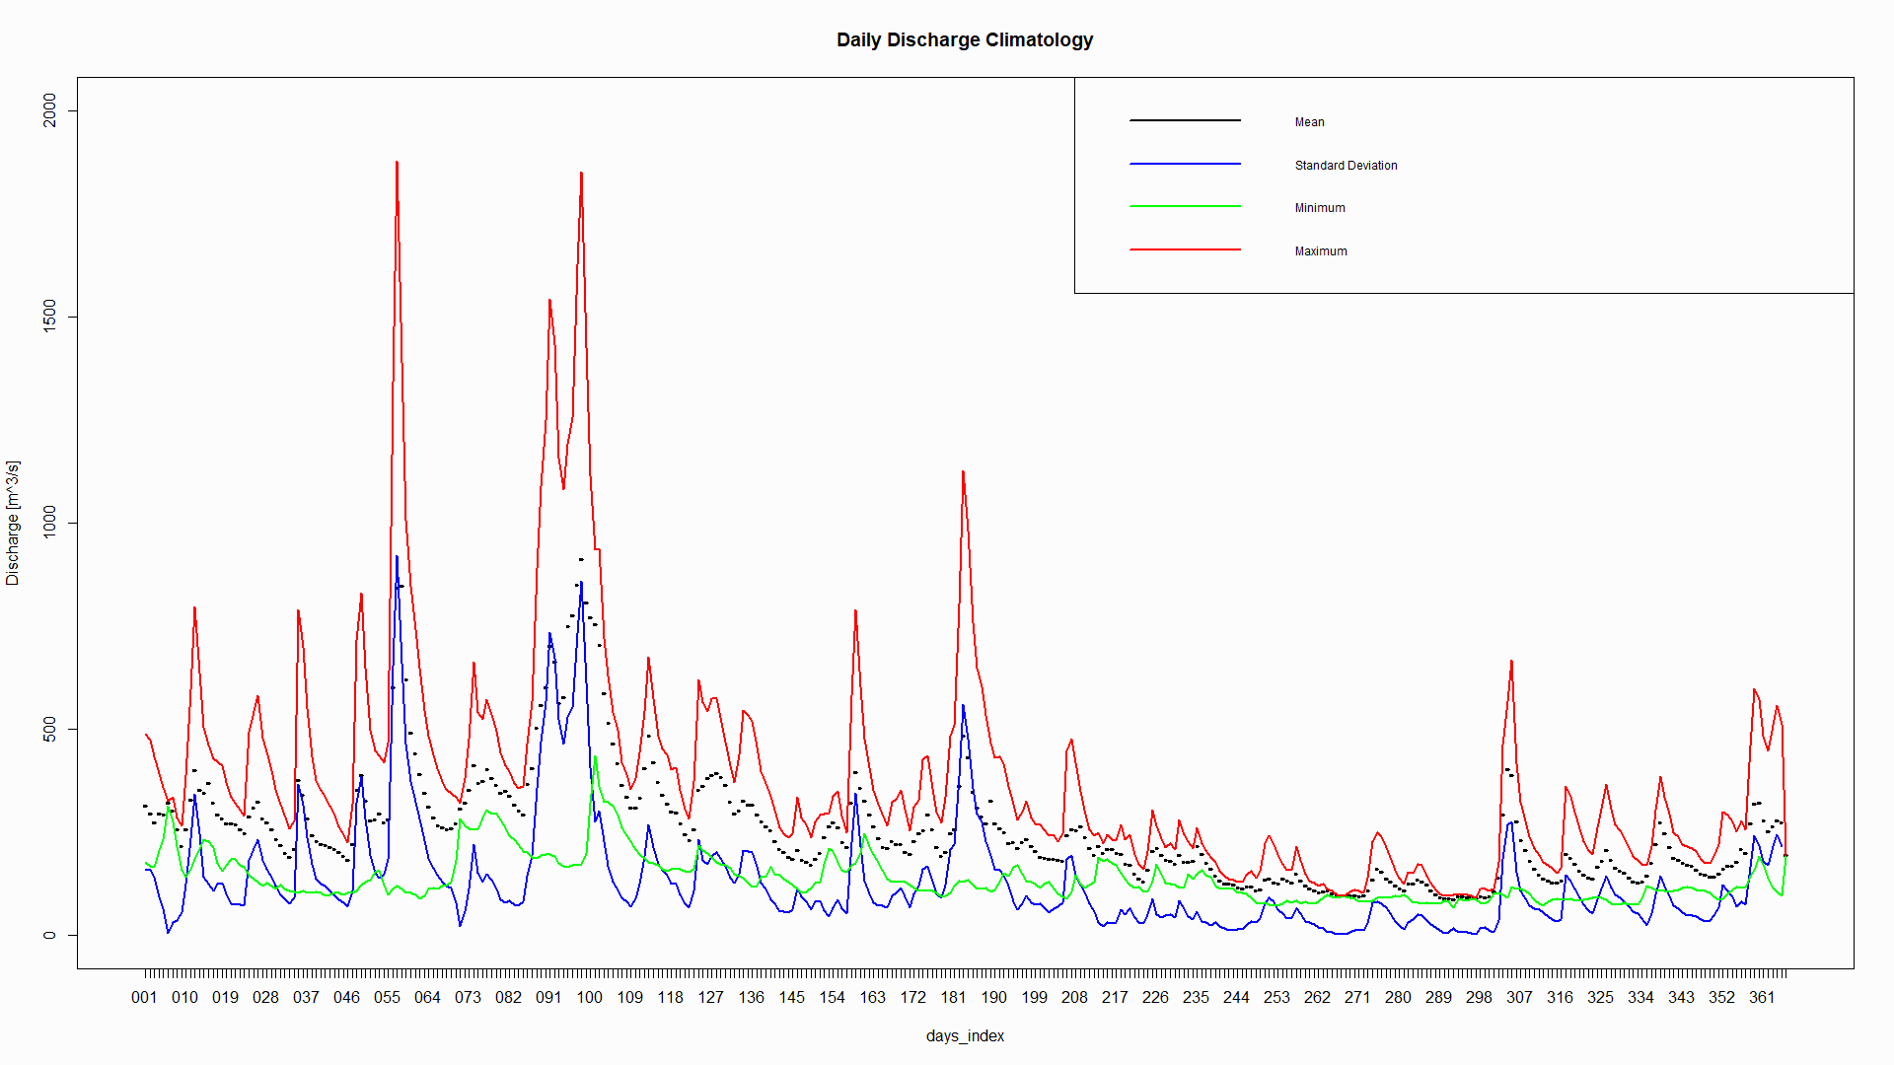
Statistics for each day
From this graph we can see that the mean values indicated by black representing the data correctly
The maximum of each day is shown to be greater in the range of days 60-110, from March to April
Standard deviation is showing similar trend to the maximum, which makes sense because as discharge values are extensively away from the mean, the standard deviation is also extended
Notes:
Ahsan Karim (30 sec)
Total time = 3 min 30 sec

Slide 11
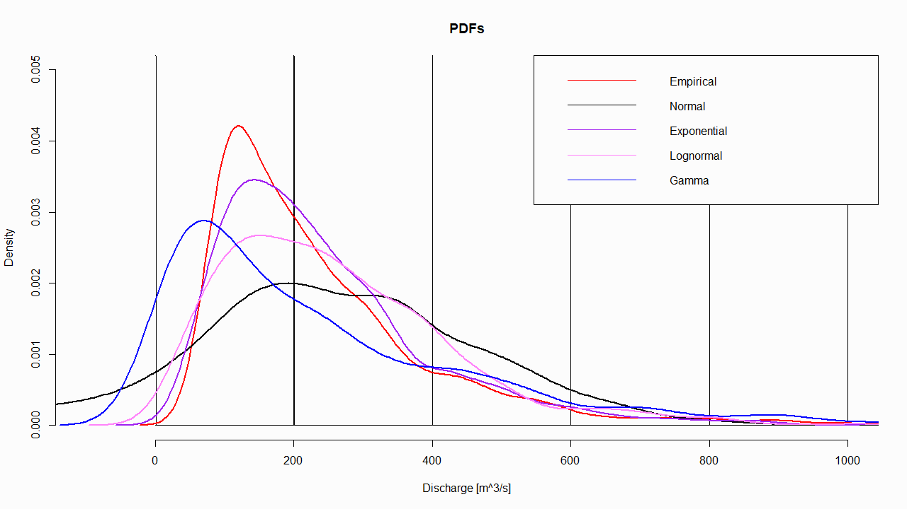
PDFs
Empirical distribution is from USGS data
Normal, Exponential, Lognormal and Gamma are distributions are from model-simulated data based on their parameters
From this plot we can see that exponential distribution best fits the empirical distribution
Notes:
Moshe
We used the lines(density()) functions in RStudio to generate the PDF plots of the discharge
We plotted the empirical, normal, exponential, lognormal, and gamma distributions.
The parameters for the normal distribution are mu and sigma; for the exponential distribution is lambda; for the lognormal distribution is mu and sigma; and for the gamma k for the shape, theta for the scale, alpha for the shape, and beta for the rate.
The difference between the distributions is ……
The exponential PDF best relates to the empirical distribution which is just based on the actual discharge values - as is evident from the plot.

Slide 12
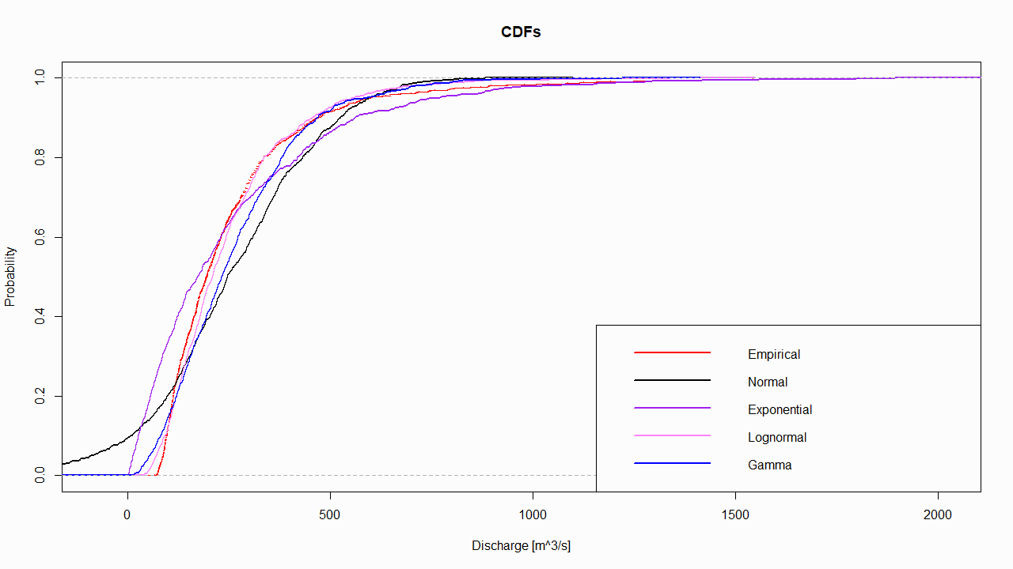
CDFs
Cumulative Density Function as the name suggests shows the sum of the individual probabilities for each type of distributions
Sum of each of the probabilities equal to 1.0
We used the plot.ecdf() function in RStudio to generate the CDF plots of the discharge for each distribution.
The lognormal CDF best relates to the empirical CDF - as is evident from the plot.
Notes:
Moshe
We used the plot.ecdf() function in RStudio to generate the CDF plots of the discharge for each distribution.
The lognormal CDF best relates to the empirical CDF - as is evident from the plot.

Slide 13
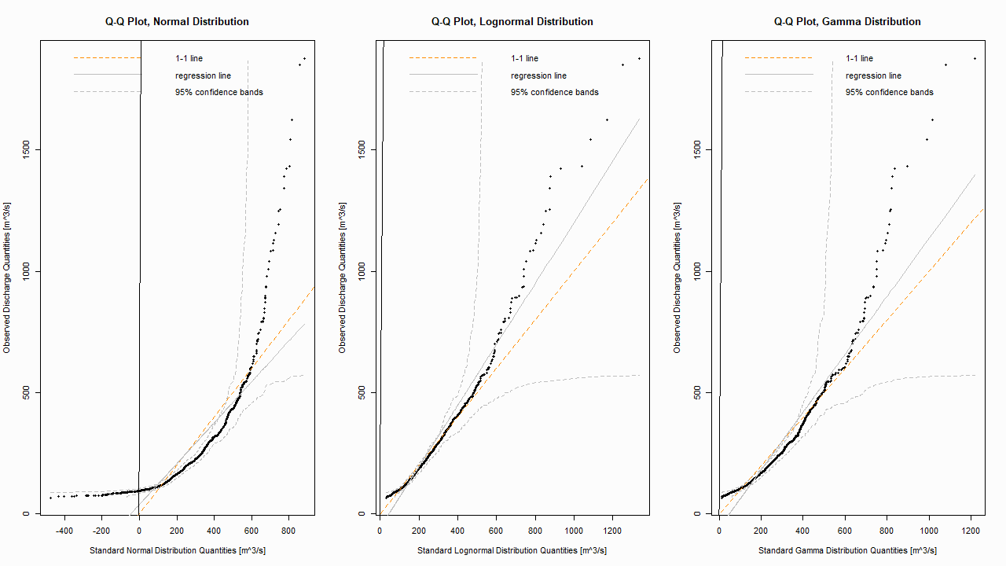
Quantile-Quantile Plots
Notes:
The Q-Q plot, or quantile-quantile plot, is a graphical tool to help us assess if a set of data plausibly came from some theoretical distribution such as a Normal or exponential.
In the Q-Q plots, Observed discharge quantiles are compared with theoretical discharge quantiles.
The regression line is compared with the experimental plotted data to see which distribution fits the best.
This comparison tells that our sets of quantiles truly comes from a Lognormal Distributions.
Test for normality: Q-Q Plots used to assess a given distribution
Symmetric histogram => dots perfectly fitted on normal Q-Q
Symmetric with fat tails => dots fitted under regression line on left bound, and dots fitted over regression line on right bound
Positive skew of histogram => dots are fitted in curve over the regression line, as seen ->
Negative skew of histogram => dots are fitted in curve under the regression line

Slide 14
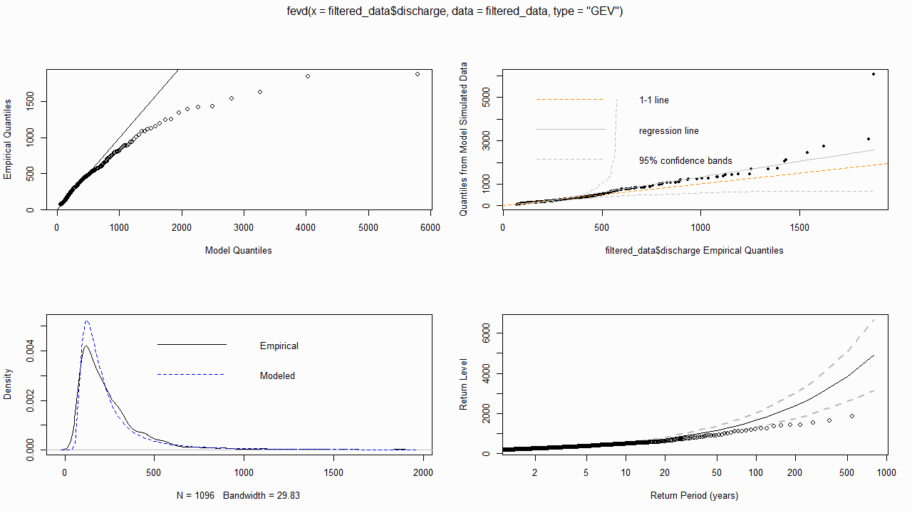
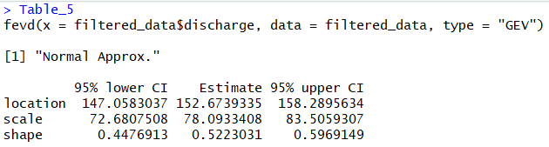
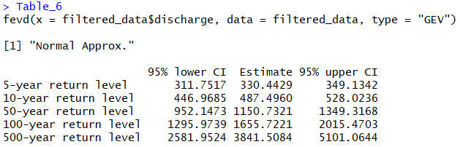
Extreme value
Notes:
Using"fevd()", a power function in R we can generate extreme value distribution (GEV) tables and plots for the given real discharge data. This will help us predict future extreme discharge event.

Slide 15
Conclusion
What we learned from working on this project:
Retrieve data from USGS database
Significance of recording discharge data
Program in R
Analyze the discharge data
Apply different distributions of data and compare them
How we can apply this knowledge in the future:
Work with large data in various fields
Make predictable inferences based on statistical models
Create valuable graphs and data representations for general public
Notes:
Muhammad Ali
Recap what this project was about
What we learned from doing this project
How can data analysis help us in our fields?

Slide 16
References
Evenson, E.J., Orndorff, R.C., Blome, C.D., Böhlke, J.K., Hershberger, P.K., Langenheim, V.E., McCabe, G.J., Morlock, S.E., Reeves, H.W., Verdin, J.P., Weyers, H.S., and Wood, T.M., 2013, U.S. Geological Survey water science strategy—Observing, understanding, predicting, and delivering water science to the Nation: U.S. Geological Survey Circular 1383–G, 49 p.
“Manning's Equation.” Continuity Equation - Manning's Equation, <www.fsl.orst.edu/geowater/FX3/help/8_Hydraulic_Reference/Manning_s_Equation.htm.>
“USGS Water Data for the Nation” U.S. Department of the Interior. U.S. Geological Survey. Data 2018-12-09. <https://waterdata.usgs.gov/nwis>

