Slide 1
Introduction to Git
Dr. Noman Islam

Slide 2
Introduction
A version control system is a tool that manages changes made to the files and directories in a project.
Nothing that is saved to Git is ever lost, so you can always go back to see which results were generated by which versions of your programs.
Git automatically notifies you when your work conflicts with someone else's, so it's harder (but not impossible) to accidentally overwrite work.
Git can synchronize work done by different people on different machines, so it scales as your team does.

Slide 3
Repository
Each of your Git projects has two parts: the files and directories that you create and edit directly, and the extra information that Git records about the project's history.
The combination of these two things is called a repository.
Git stores all of its extra information in a directory called .git located in the root directory of the repository.
Git expects this information to be laid out in a very precise way, so you should never edit or delete anything in .git.

Slide 4
Checking status
When you are using Git, you will frequently want to check the status of your repository.
To do this, run the command git status, which displays a list of the files that have been modified since the last time changes were saved.

Slide 5
Staging
Git has a staging area in which it stores files with changes you want to save that haven't been saved yet.
Putting files in the staging area is like putting things in a box, while committing those changes is like putting that box in the mail: you can add more things to the box or take things out as often as you want, but once you put it in the mail, you can't make further changes.

Slide 6
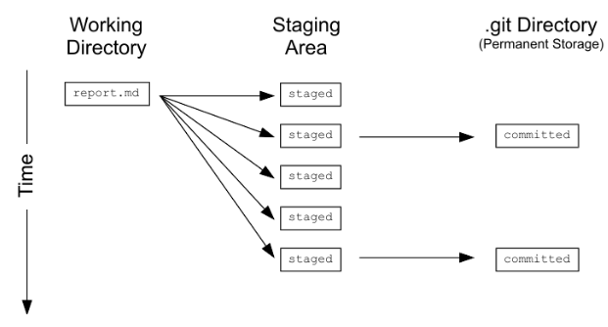

Slide 7
git diff
In order to compare the file as it currently is to what you last saved, you can use git diff filename.
git diff without any filenames will show you all the changes in your repository , while git diff directory will show you the changes to the files in some directory.

Slide 8
Commit
You commit changes to a Git repository in two steps:
Add one or more files to the staging area.
Commit everything in the staging area.
To add a file to the staging area, use git add filename.
To save the changes in the staging area, you use the command git commit. It always saves everything that is in the staging area as one unit

Slide 9
When you commit changes, Git requires you to enter a log message.
This serves the same purpose as a comment in a program: it tells the next person to examine the repository why you made a change.
git commit -m "Program appears to have become self-aware.“
git commit --amend - m "new message"

Slide 10
View history
The command git log is used to view the log of the project's history.

Slide 11
Writing a better log message
If you run git commit without -m "message", Git launches a text editor

Slide 12
Git Three level structure
A commit contains metadata such as the author, the commit message, and the time the commit happened. In the diagram below, the most recent commit is at the bottom (feed0098), and vertical arrows point up towards the previous ("parent") commits.
Each commit also has a tree, which tracks the names and locations in the repository when that commit happened. In the oldest (top) commit, there were two files tracked by the repository.

Slide 13
For each of the files listed in the tree, there is a blob. This contains a compressed snapshot of the contents of the file when the commit happened. (Blob is short for binary large object, which is a SQL database term for "may contain data of any kind".)
In the middle commit, report.md and draft.md were changed, so the blobs are shown next to that commit. data/northern.csv didn't change in that commit, so the tree links to the blob from the previous commit. Reusing blobs between commits help make common operations fast and minimizes storage space.

Slide 14
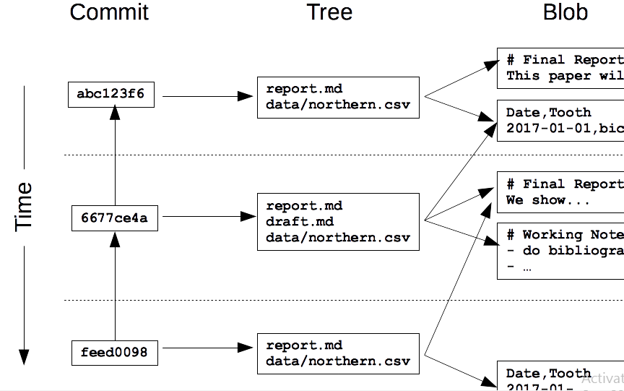

Slide 15
Hash
Every commit to a repository has a unique identifier called a hash
Hashes are what enable Git to share data efficiently between repositories. If two files are the same, their hashes are guaranteed to be the same.
Similarly, if two commits contain the same files and have the same ancestors, their hashes will be the same as well.
Git can therefore tell what information needs to be saved where by comparing hashes rather than comparing entire files.

Slide 16
Viewing a specific commit
To view the details of a specific commit, you use the command git show with the first few characters of the commit's hash
A hash is like an absolute path: it identifies a specific commit.
Another way to identify a commit is to use the equivalent of a relative path.
The special label HEAD, which we saw in the previous chapter, always refers to the most recent commit.
The label HEAD~1 then refers to the commit before it, while HEAD~2 refers to the commit before that, and so on.

Slide 17
Viewing more details
git log displays the overall history of a project or file, but Git can give even more information: the command git annotate file shows who made the last change to each line of a file and when.

Slide 18
Seeing the changes between commits
git show with a commit ID shows the changes made in a particular commit. To see the changes between two commits, you can use git diff ID1..ID2, where ID1 and ID2 identify the two commits you're interested in, and the connector .. is a pair of dots.

Slide 19
Ignoring files
Data analysis often produces temporary or intermediate files that you don't want to save.
You can tell it to stop paying attention to files you don't care about by creating a file in the root directory of your repository called .gitignore and storing a list of wildcard patterns that specify the files you don't want Git to pay attention to

Slide 20
.gitignore contains
build
*.mpl
Then Git will ignore any file or directory called build (and, if it's a directory, anything in it), as well as any file whose name ends in .mpl

Slide 21
Remove unwanted files
Git can help you clean up files that you have told it you don't want.
The command git clean -n will show you a list of files that are in the repository, but whose history Git is not currently tracking.
A similar command git clean -f will then delete those files.

Slide 22
Git configuration
Like most complex pieces of software, Git allows you to change its default settings.
To see what the settings are, you can use the command git config --list with one of three additional options:
--system: settings for every user on this computer.
--global: settings for every one of your projects.
--local: settings for one specific project

Slide 23
Change git configuration
Most of Git's settings should be left as they are.
However, there are two you should set on every computer you use: your name and your email address.
These are recorded in the log every time you commit a change, and are often used to identify the authors of a project's content in order to give credit

Slide 24
git config --global setting.name setting.value

Slide 25
Unstaging a file
The syntax for staging a single file is git add path/to/file.
If you make a mistake and accidentally stage a file you shouldn't have, you can unstage the additions with:
git reset HEAD and try again.

Slide 26
Undo changes to unstaged file
Suppose you have made changes to a file, then decide you want to undo them. Your text editor may be able to do this, but a more reliable way is to let Git do the work. The command:
git checkout – filename
will discard the changes that have not yet been staged.

Slide 27
Undo changes to stage file
At the start of this chapter you saw that git reset will unstage files that you previously staged using git add.
By combining git reset with git checkout, you can undo changes to a file that you staged changes to.
git reset HEAD path/to/file
git checkout -- path/to/file

Slide 28
Restoring old version of a file
You previously saw how to use git checkout to undo the change that you made since the last commit.
This command can also be used to go back even further into a file's history and restore versions of that file from a commit.
In this way, you can think of committing as saving your work, and checking out as loading that saved version.

Slide 29
git checkout 2242bd report.txt would replace the current version of report.txt
Restoring a file doesn't erase any of the repository's history.
Instead, the act of restoring the file is saved as another commit, because you might later want to undo your undoing.

Slide 30
Git log with parameters
One more thing: there's another feature of git log that will come in handy here.
Passing - then a number restricts the output to that many commits.
For example, git log -3 report.txt shows you the last three commits involving report.txt.

Slide 31
Undoing all the changes
One way to do this is to give git reset a directory.
For example, git reset HEAD data will unstage any files from the data directory.
Even better, if you don't provide any files or directories, it will unstage everything.
Even even better, HEAD is the default commit to unstage, so you can simply write git reset to unstage everything.

Slide 32
Similarly git checkout -- data will then restore the files in the data directory to their previous state.

