Slide 1
Introduction to Python
Dr. Noman Islam

Slide 2
Print
In Python, the command print tells the program to display words or numbers on the screen
Keywords
String

Slide 3
Variables
name=“Noman”
Variables can change their values
With variables, Python is blind to semantics
Give your variables meaningful names
You can have spaces between variable assignments:
nickname = "Bub“
Variable names can't have spaces in them

Slide 4
Variables for numbers
weight = 150
Consider
original_num = 23
new_num = original_num + 7
Python substitutes the original_number with value 23
original_num = original_num + 10
A variable can start out as one type of variable, then become another type of variable.

Slide 5
Variable names
1st_prime_number = 2 is illegal. Why?
prime_number_that_comes1st = 2 is legal

Slide 6
Math expressions
+, -, *, /
popular_number = 2 + 2
sum_of_numbers = num + another_num

Slide 7
Legal and illegal variable names
You can't enclose variable names in quotation marks.
You can't have any spaces in it.
It can't be a number or begin with a number
A variable can't be any of Python's reserved words, also known as keywords

Slide 8
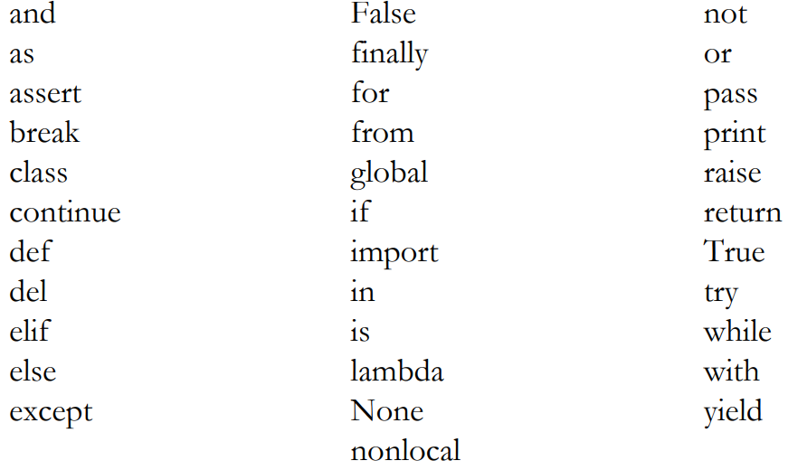
Python keywords

Slide 9
Variable names are case-sensitive
Python's governing body recommends breaking up multi-word variables with underscores
You should balance readability with conciseness

Slide 10
Unfamiliar operators
whats_left_over = 10 % 3
% is the modulo operator.
age += 1
age -= 2
age *= 3

Slide 11
Math Expressions: Eliminating ambiguity
total_cost = 1 + 3 * 4
In Python, as in algebra, the ambiguity is cleared up by precedence rules
Multiplication operations are completed before addition operations
Parentheses override all the other precedence rules.

Slide 12
Concatenating text strings
greeting = "Hello"
addressee = "World“
whole_greeting = greeting + addressee
You can use the plus sign to sum numbers, and you can use it to concatenate strings
But you can't use the plus sign to combine strings and numbers
print("The sum of 2 plus 2 is " + 4)

Slide 13
If statements
if species == "cat":
print("Yep, it's cat.")
Note that it's two equal signs, ==, not one
if 2 + 2 == 4:
print("Everything makes sense.")
Indentation is very important

Slide 14
Comparison operators
== is a type of comparison operator, specifically it's the equality operator
!=
>
<
>=
<=

