Slide 1
Comparison of old and new work
Ahsan Z Rizvi
Updated on: 20/9/2024

Slide 2
SE FASTA samples (M)
ZE FASTA samples (N)
Step 1.
miRNA prediction using miRDeep-P2
Non-Redundant FASTA files (M)
Non-Redundant FASTA files (N)
Pip_mirDP2 (M)
Pip_mirDP2 (N)
Prediction files (M)
Prediction files (N)
Prediction file with Plant criteria (M)
Predicted sequences for (M) files
Predicted sequences for (N) files
Prediction file with Plant criteria (N)
Combined list of prediction files (M+N)
Non-Redundant sequence with plant criteria, SE
Non-redundant predicted sequence, SE
Step 2.
Annotation of predicted miRNA
Non-redundant predicted sequence, ZE
Non-Redundant sequence with plant criteria, ZE

Slide 3
Non-Redundant sequence with plant criteria, SE
Non-redundant predicted sequence, SE
Step 2. Annotation of miRNA
Non-redundant predicted sequence, ZE
Non-Redundant sequence with plant criteria, ZE
Combined list of prediction files (M+N)
Total predicted miRNA sequences (T)
Picea_mature.fa
yes
Known Predicted sequences, ZE
yes
yes
yes
yes
Known Predicted sequences, SE
Known sequence with P criteria, ZE
Known sequence with P criteria, SE
Predicted miRNA sequences are searched against the miRBase database by using blastn
Variant Predicted sequences, ZE
Variant Predicted sequences, SE
yes
Variant (V)
T
Variant sequence with P criteria, ZE
Variant sequence with P criteria, SE
K
K
--
V
Known( K)
V
K+V
yes
V
K
V
yes
Index for DGE
bowtie-build Picea_mature.fa
Step 3.
Differential expression
analysis
K
N=T-(K+V)
Novel (N)

Slide 4
SE FASTA samples (M)
Step 3. Differential expression analysis
ZE FASTA samples (N)
Index for DGE
bowtie-build Picea_mature.fa
Mapping
Mapping
SE samples (M) count files
ZE samples (N) count files
Combined count files with M column
Combined count files with N column
SE Design file
with M rows
DESeq2
DESeq2
ZE Design file
with N rows

Slide 5
TAB 3 | SE (Old ms) |  | ZE (Old ms)
 | Novel | Known | Novel | Known
Identified | 64 | 358 | 81 | 259
Filtered | 46 | 294 | 63 | 227
DE | 15 | 105 | 11 | 96
TAB4 | SE (New) |  |  | ZE (New)
 | Novel | Known | Variant | Novel | Known | Variant
Identified by pipeline, Non-Redundant | 657 | 131 | 64 | 1019 | 138 | 60
Filtered with P criteria | 245 | 125 | 54 | 254 | 134 | 49
DE, Filtered with P criteria | 97 | 43 | 16 | 112 | 51 | 24

Slide 6
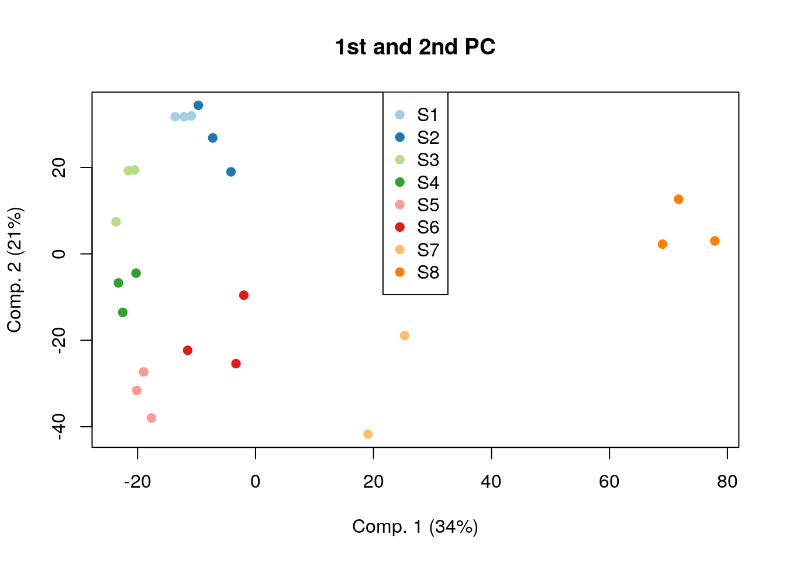
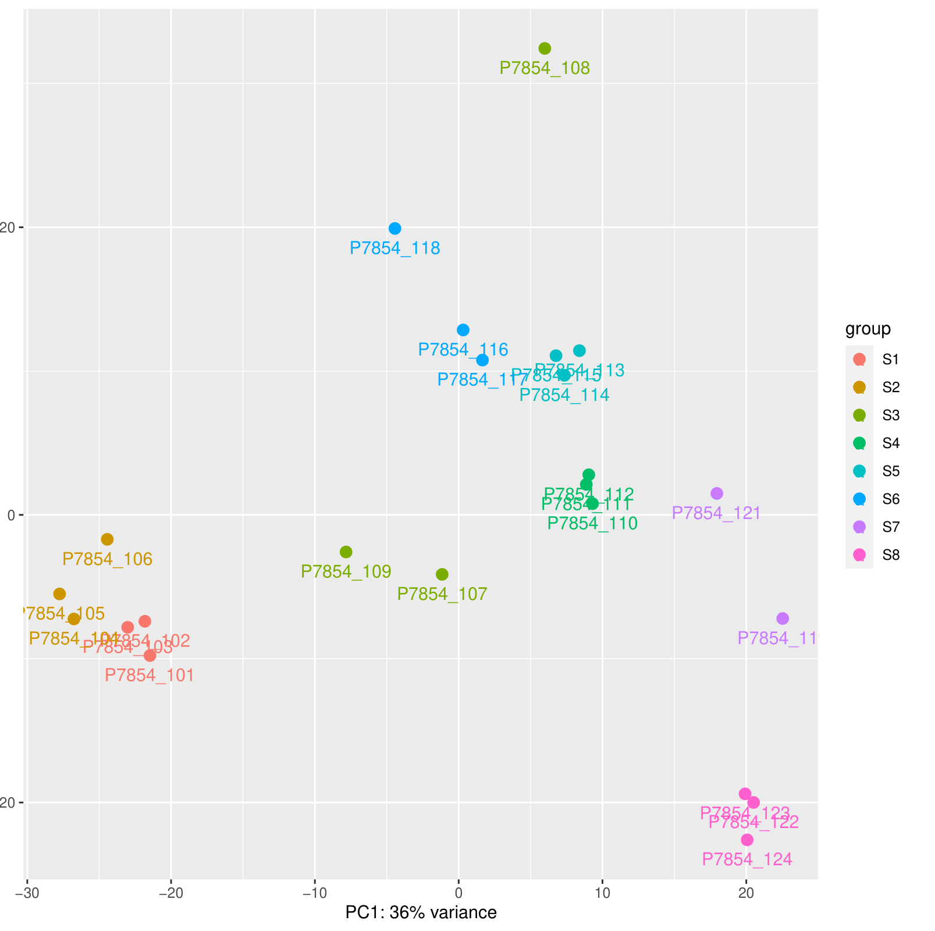
SE New
SE Old

Slide 7
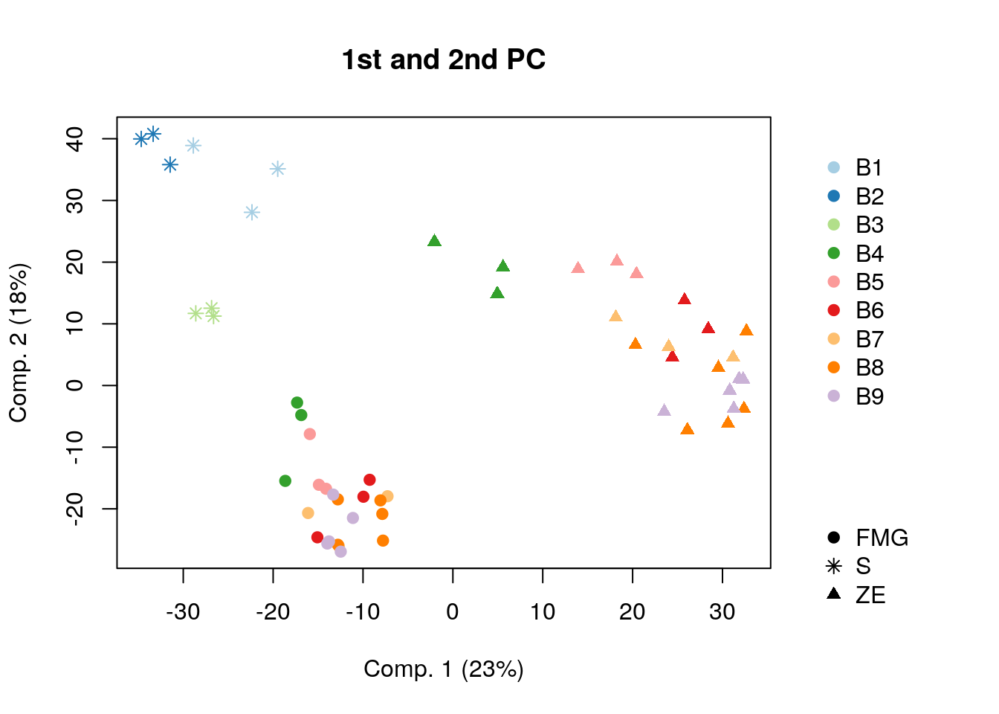
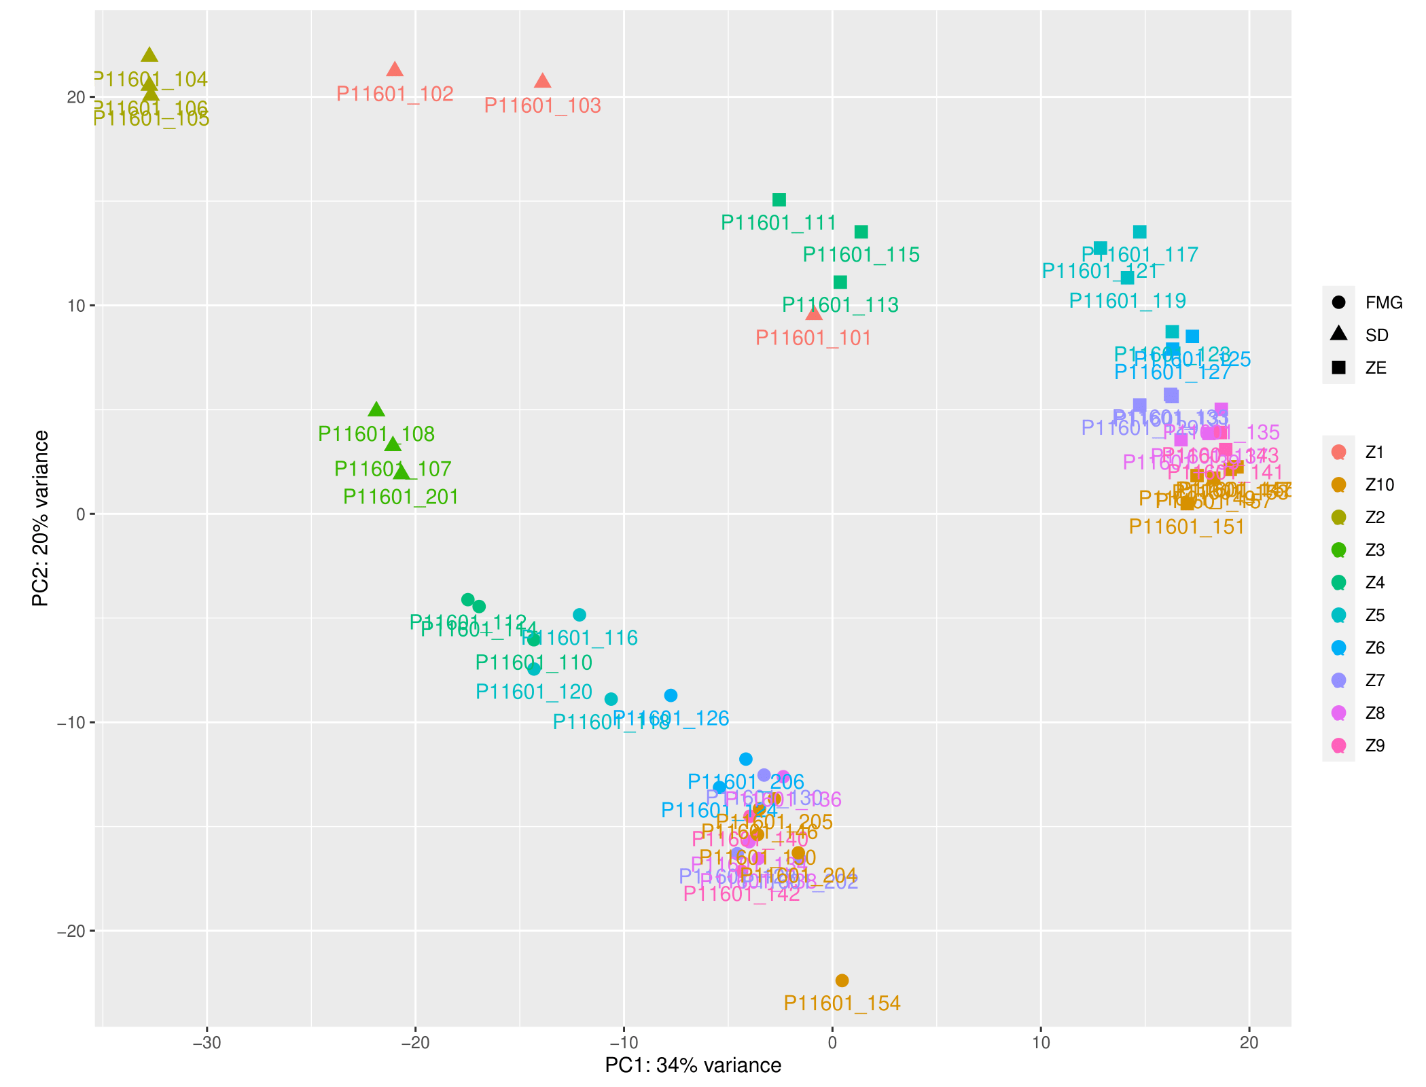
ZE New
ZE Old

Slide 8
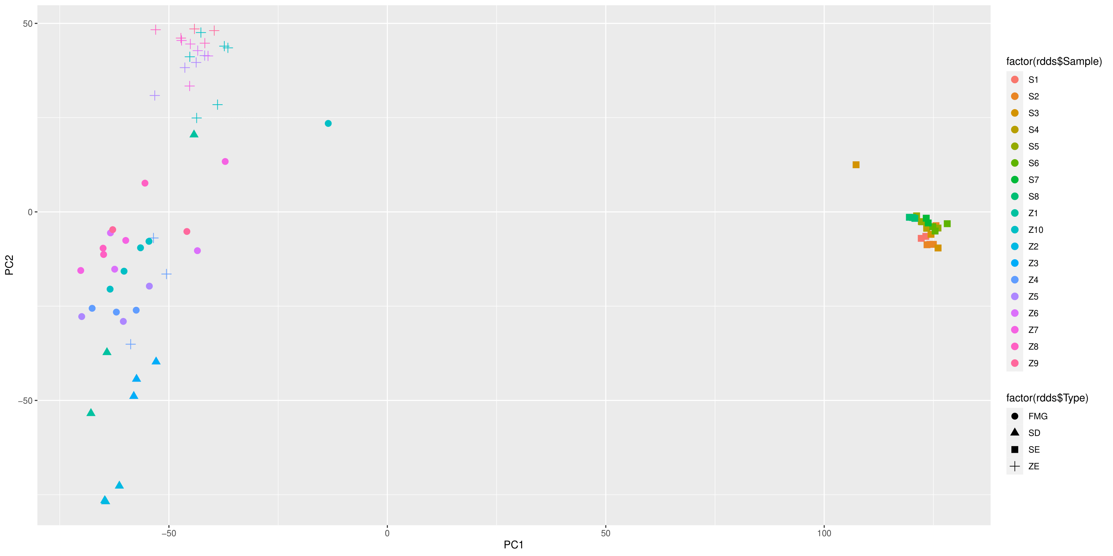
Combined PCA for SE and ZE

Slide 9
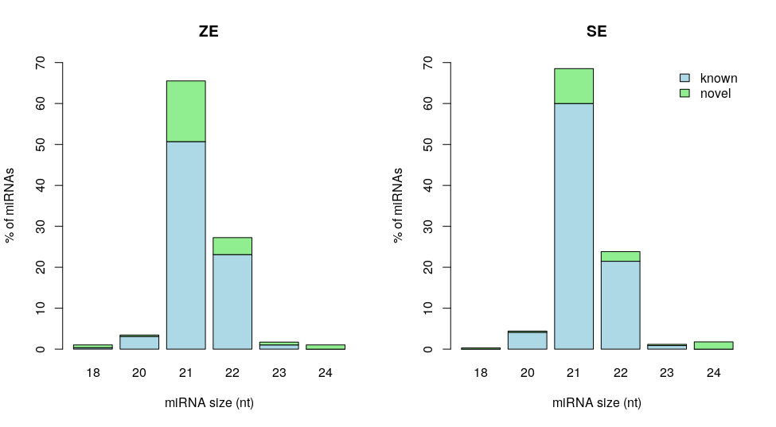
SE/ZE Old
SE/ZE New, P-criteria

Slide 11
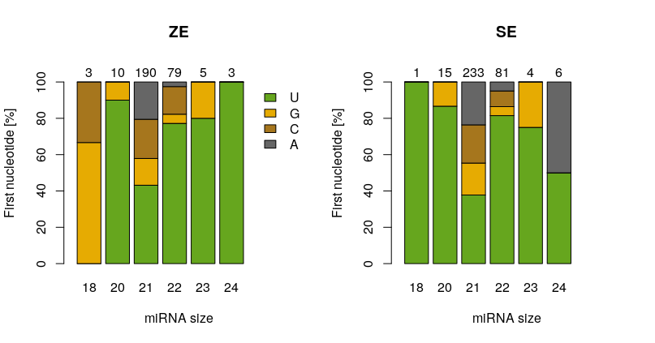
SE-ZE Old
SE-ZE New, P criteria

Slide 12
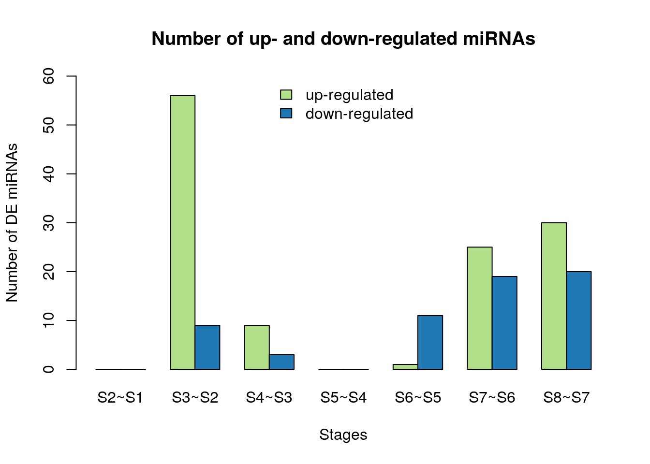
SE Old
SE New With P criteria,
Pvalue=0.01, Log2FC threshold=0.5, Padj method= ‘BH’
SE New With P criteria,
Pvalue=0.05, Log2FC threshold=0.5, Padj method= ‘BH’

Slide 13
SE New With P criteria, Pvalue=0.01, Log2FC threshold=0.5, Padj method= ‘BH’

Slide 14
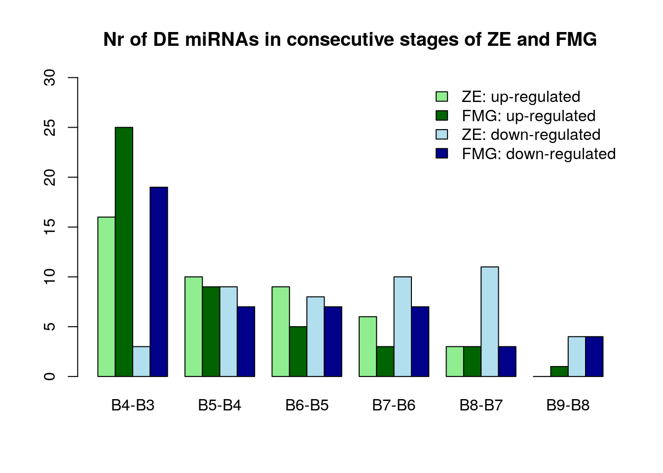
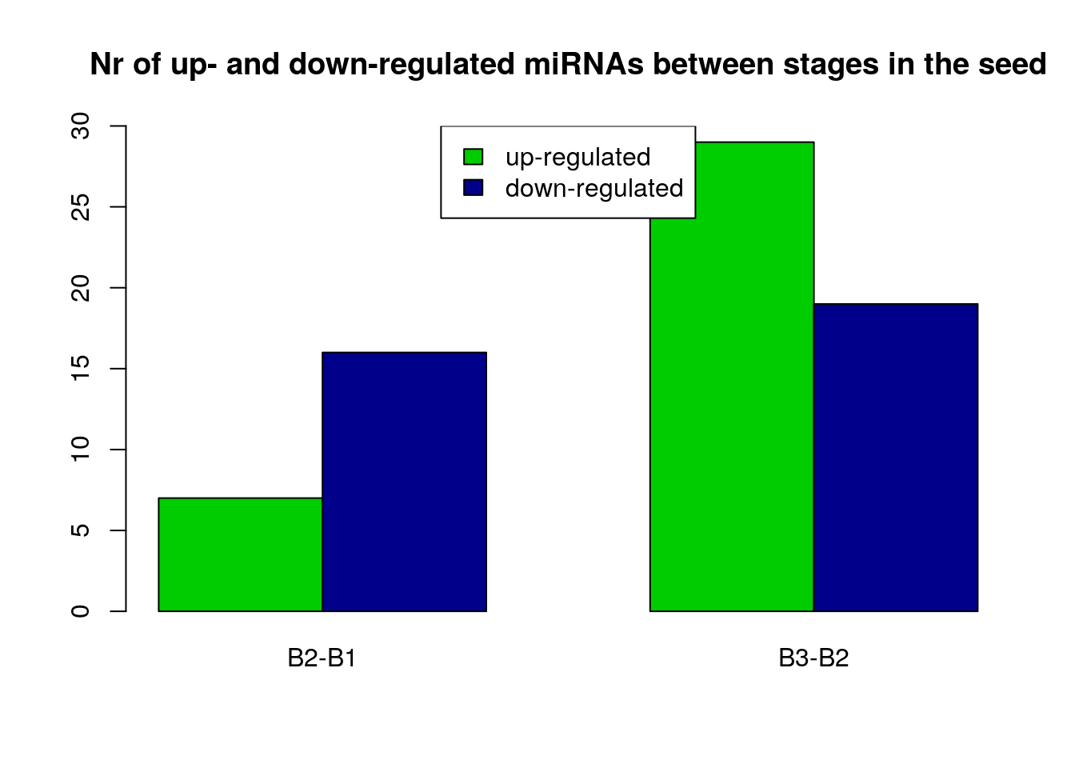
ZE New With P criteria,
Pvalue=0.01, Log2FC threshold=0.5
ZE Old

Slide 16
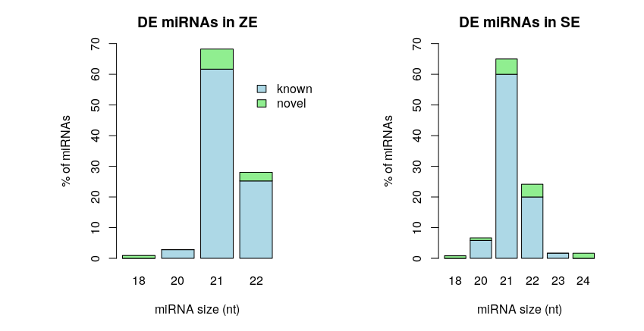
DE-SE Old
DE-SE New

Slide 17
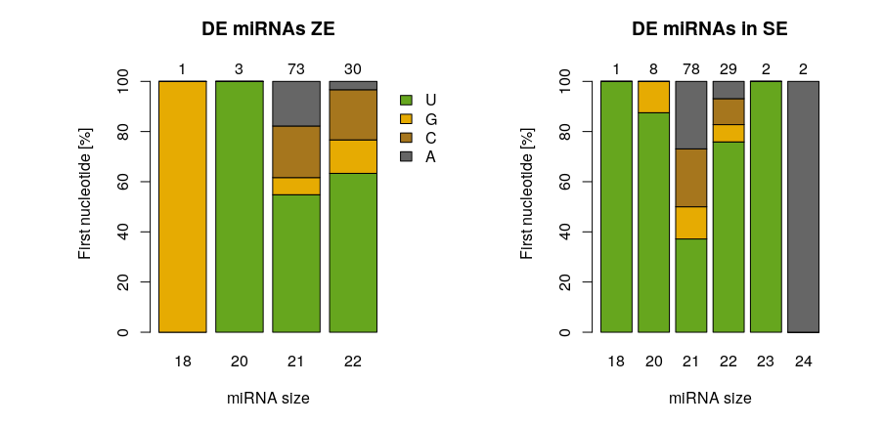
SE Old
SE New, P-criteria + DE

Slide 18
Members of miRNA families in SE and ZE

