Slide 1

Predicting Loan Defaults
Ahsan Ahmed Raunak Sharma Scott Silverstein Rylan Tribush

Slide 2
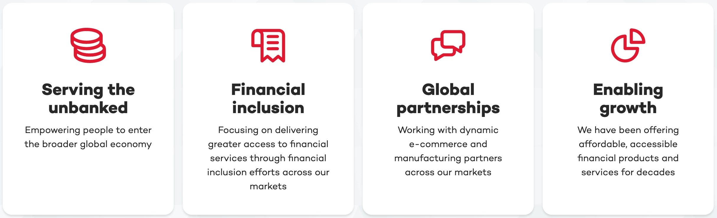
The Heart of Home Credit

Slide 3
Our Goal: Improve Financial Inclusion Through Access to Credit
How Do We Achieve that?
Better Identification of Creditworthy Customers!

Slide 4
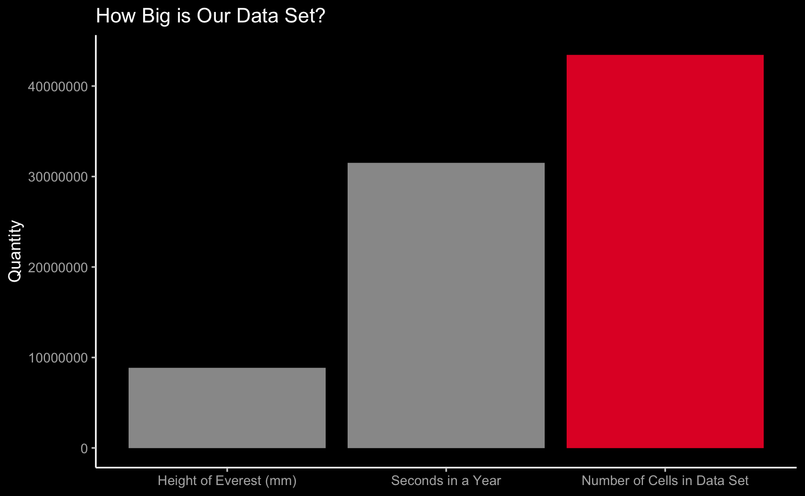
Finding #1: Quantity of Data

Slide 5
Data Set Summary
Home Credit Default Risk Data Set
Application Data: Core data with individual loan applications, personal and financial details.
Credit Bureau Data: past credits from other financial institutions.
Previous Loan Performance: with home credit.
Repayment History: records of payments made and missed for previously disbursed credits

Slide 6
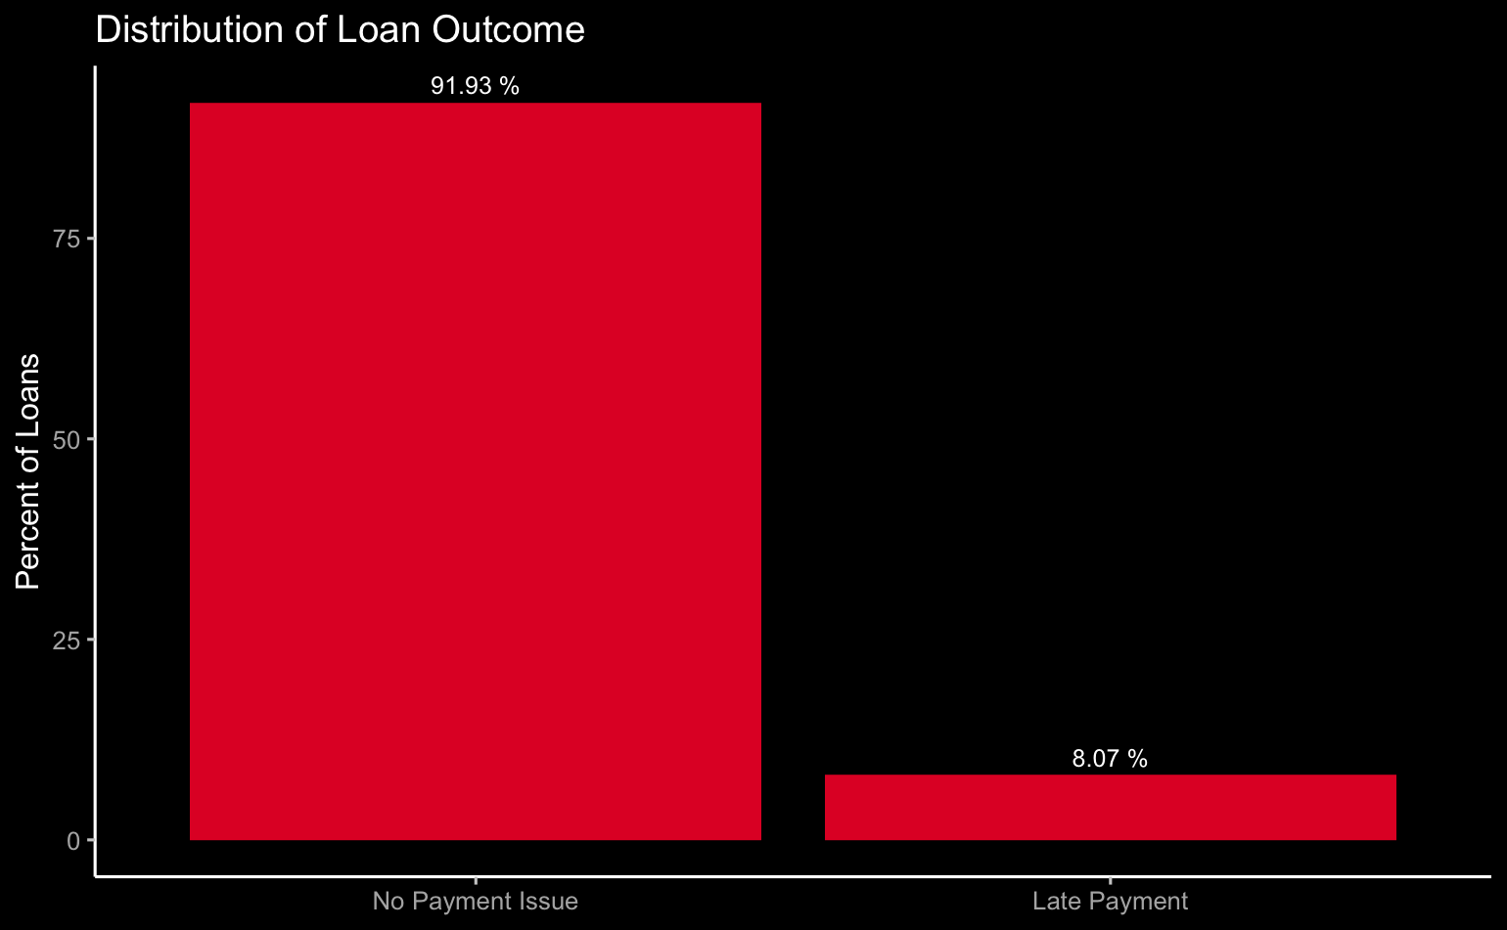
Finding #2: Imbalanced Target

Slide 7
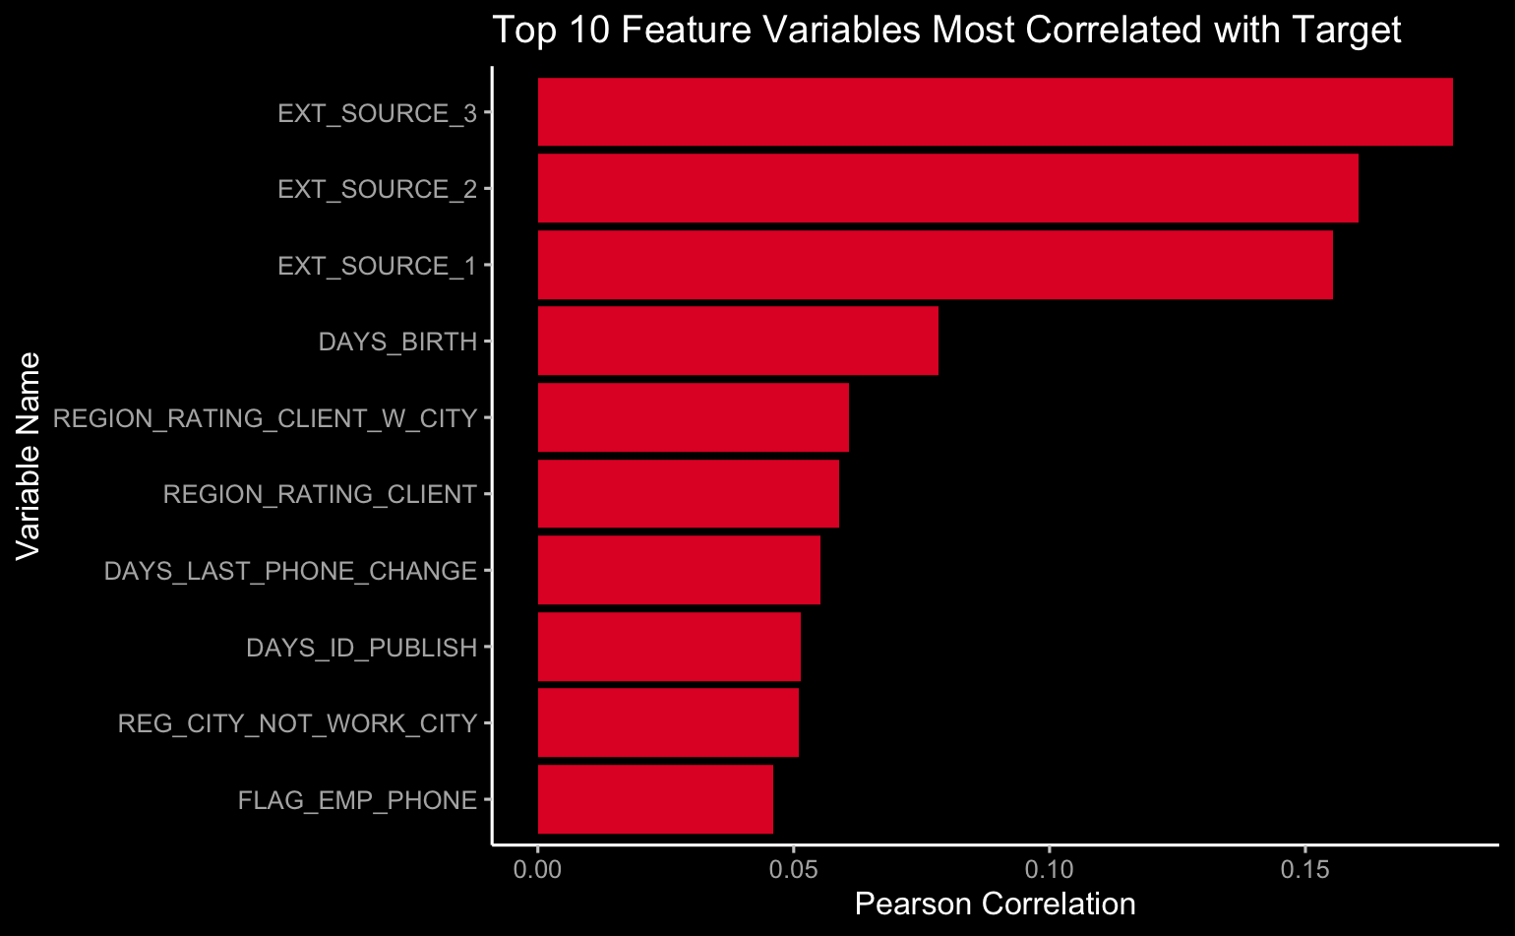
Finding #3: Some Features are More Important

Slide 8
Our Solution: XGBoost
Usable with big data sets
Handles imbalanced targets
Automatically identifies important features
Uses regularization to avoid overfitting
High performance and customization
Test Set AUC: 0.76

Slide 9
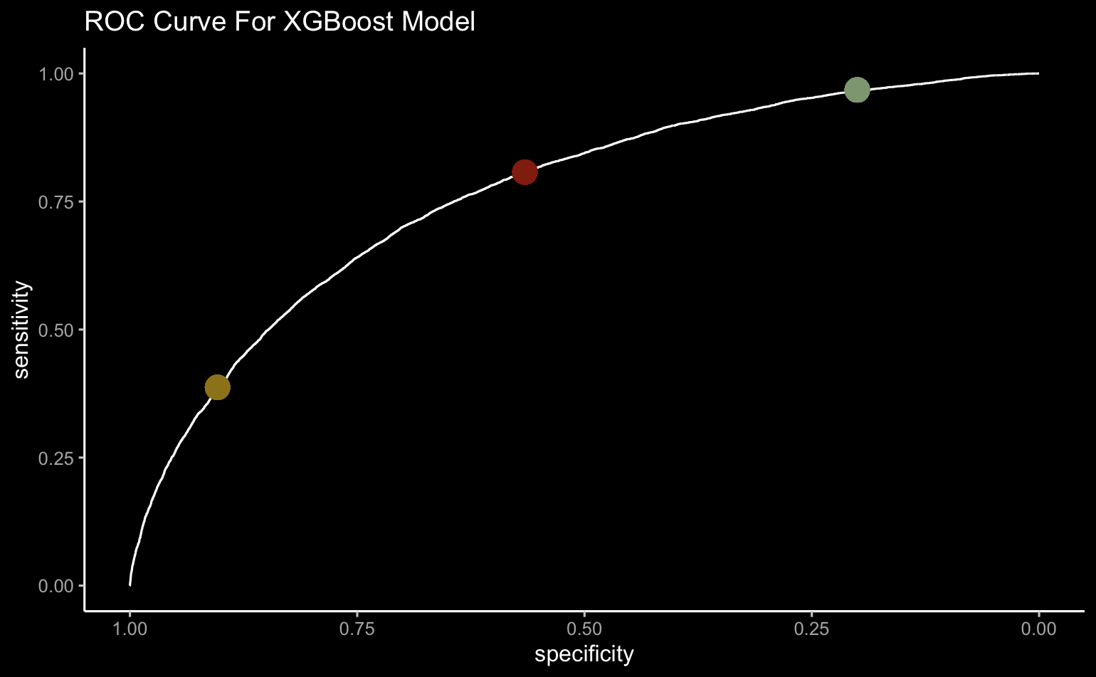
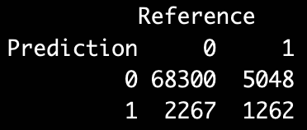
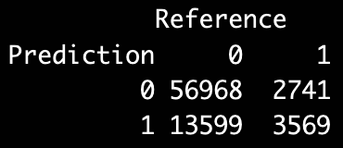
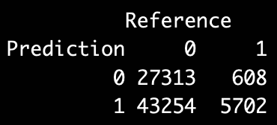
Our Model Provides Performance and Adaptability

Slide 10
Model Value: A Cost-Benefit Analysis
Loss of Revenue due to Default =
(Loan Amount * APR) * P(Default)
Opportunity Cost of Refusing Loan =
Potential Profit from Interest + Goodwill + Processing Fee
These values can change over time!

Slide 11
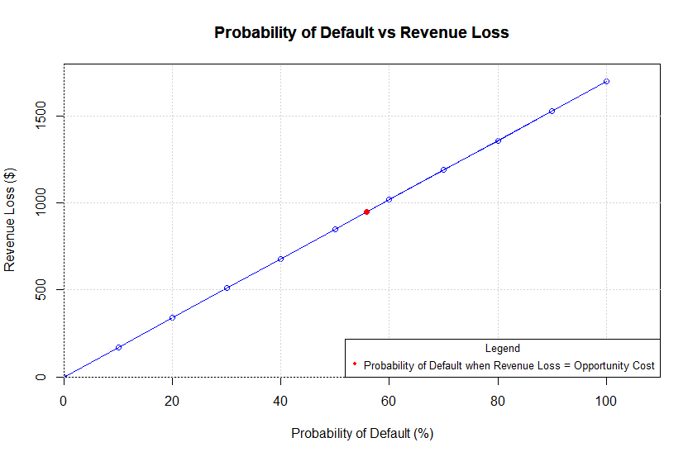
Example Analysis Under Current Market Conditions
Notes:
Whenever the probability of default > 55.76%, HomeCredit should not give out loan to the customer as Revenue loss > Opportunity cost

Slide 12

Thank You!

