Slide 1
Data Science Capstone project
Md Ahsan Habib
09/01/2021
Notes:
<number>

Slide 2

Outline
Executive Summary
Introduction
Methodology
Results
Conclusion
Appendix
<number>
Notes:
<number>

Slide 3

Executive Summary
Summary of methodologies
Summary of all results
<number>
Notes:
<number>

Slide 4

Introduction
Project background and context
Problems you want to find answers
<number>
Notes:
<number>

Slide 5

Methodology
Data collection methodology:
Describe how data were collected
Perform data wrangling
Describe how data were processed
Perform exploratory data analysis (EDA) using visualization and SQL
Perform interactive visual analytics using Folium and Plotly Dash
Perform predictive analysis using classification models
How to build, tune, evaluate classification models
<number>
Notes:
<number>

Slide 6
Methodology
<number>

Slide 7
Data collection
Describe how data sets were collected.
You need to present your data collection process use key phrases and flowcharts
<number>

Slide 8
Data collection – SpaceX API
Added a flowchart of SpaceX API calls here
Present your data collection with SpaceX REST calls using key phrases and flowcharts
Add the GitHub URL of the completed SpaceX API calls notebook (must include completed code cell and outcome cell), as an external reference and peer-review purpose
<number>

Slide 9
Data collection – Web scraping
Add a flowchart of web scraping here
Present your web scraping process use key phrases and flowcharts
Add the GitHub URL of the completed web scraping notebook, as an external reference and peer-review purpose
<number>

Slide 10
Data wrangling
Describe how data were processed
You need to present your data wrangling process using key phrases and flowcharts
Add the GitHub URL of your completed data wrangling related notebooks, as an external reference and peer-review purpose
<number>

Slide 11
EDA with data visualization
Summarize what charts were plotted and why used those charts
Add the GitHub URL of your completed EDA with data visualization notebook, as an external reference and peer-review purpose
<number>

Slide 12
EDA with SQL
Summarize performed SQL queries using bullet points
Add the GitHub URL of your completed EDA with SQL notebook, as an external reference and peer-review purpose
<number>

Slide 13
Build an interactive map with Folium
Summarize what map objects such as markers, circles, lines, etc. you created and added to a folium map
Explain why you added those objects
Add the GitHub URL of your completed interactive map with Folium map, as an external reference and peer-review purpose
<number>

Slide 14
Build a Dashboard with Plotly Dash
Summarize what plots/graphs and interactions you have added to a dashboard
Explain why you added those plots and interactions
Add the GitHub URL of your completed Plotly Dash lab, as an external reference and peer-review purpose
<number>

Slide 15
Predictive analysis (Classification)
Summarize how you built, evaluated, improved, and found the best performing classification model
You need present your model development process using key phrases and flowchart
Add the GitHub URL of your completed predictive analysis lab, as an external reference and peer-review purpose
<number>

Slide 16
Results
Exploratory data analysis results
Interactive analytics demo in screenshots
Predictive analysis results
<number>
Notes:
<number>

Slide 17
EDA with Visualization
<number>

Slide 18
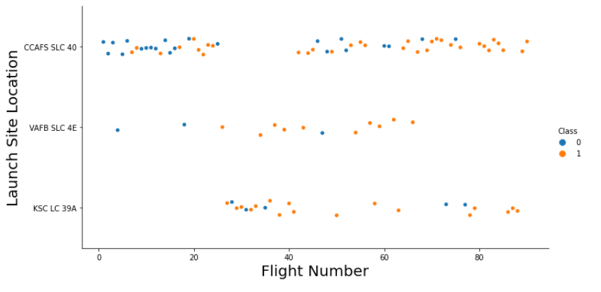
Flight Number vs. Launch Site
Show a scatter plot of Flight Number vs. Launch Site
Show the screenshot of the scatter plot with explanations
<number>

Slide 19
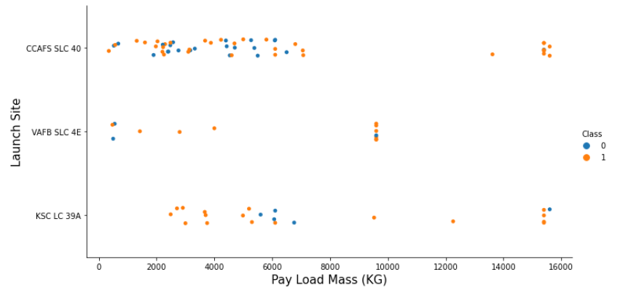
Payload vs. Launch Site
Show a scatter plot of Payload vs. Launch Site
Show the screenshot of the scatter plot with explanations
<number>

Slide 20
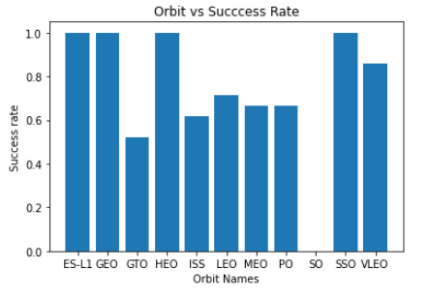
Success rate vs. Orbit type
Show a barchart for the success rate of each orbit type
Show the screenshot of the scatter plot with explanations
<number>

Slide 21
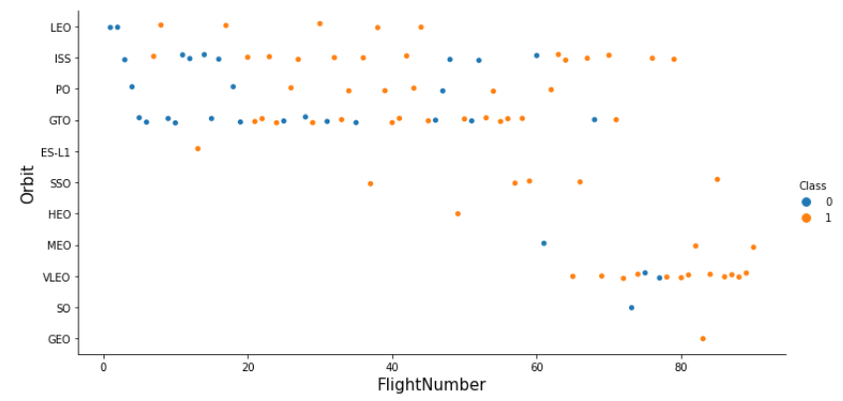
Flight Number vs. Orbit type
Show a scatter point of Flight number vs. Orbit type
Show the screenshot of the scatter plot with explanations
<number>

Slide 22
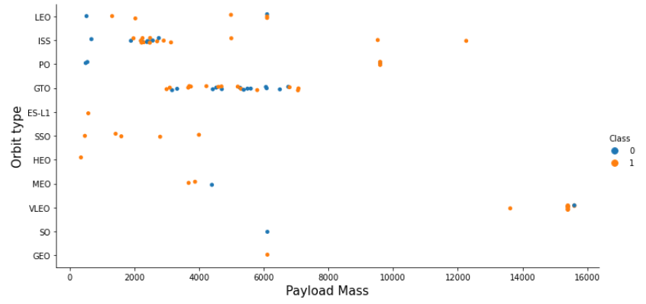
Payload vs. Orbit type
Show a scatter point of payload vs. orbit type
Show the screenshot of the scatter plot with explanations
<number>

Slide 23
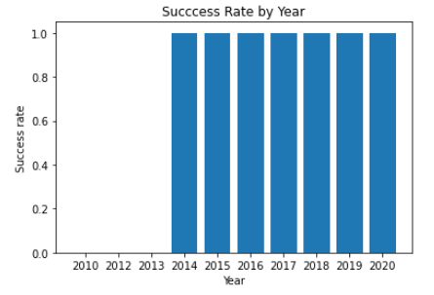
Launch success yearly trend
Show a line chart of yearly average success rate
Show the screenshot of the scatter plot with explanations
<number>

Slide 24
EDA with SQL
<number>

Slide 25
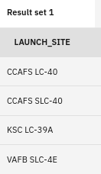
All launch site names
Find the names of the unique launch sites
%%sql
select unique(launch_site) from spacextable;
Present your query result with a short explanation here.
<number>

Slide 26
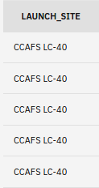
Launch site names begin with `CCA`
Find all launch sites begin with `CCA`
%%
select launch_site from spacextable
where launch_site like 'CCA%' limit 5;
<number>

Slide 27
Total payload mass
Calculate the total payload carried by boosters from NASA
%%sql
select sum(payload_mass__kg_) as sumpayload
from spacextable
where payload like '%CRS%';
<number>

Slide 28
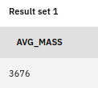
Average payload mass by F9 v1.1
Calculate the average payload mass carried by booster version F9 v1.1
%%sql
select avg(payload_mass__kg_) from spacextable
where booster_version like 'F9 v1.1';
<number>

Slide 29
First successful ground landing date
Find the date when the first successful landing outcome in ground pad
select unique(mission_outcome) from spacextable;
select min(date) from spacextable
where landing__outcome like '%Success%';
<number>

Slide 30
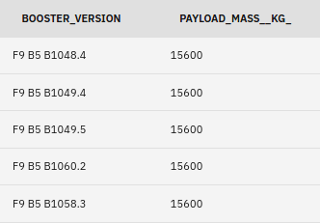
Successful drone ship landing with payload between 4000 and 6000
select booster_version from spacextable
where payload_mass__kg_ between 4000 and 6000
and landing__outcome = 'Success (drone ship)';
<number>

Slide 31
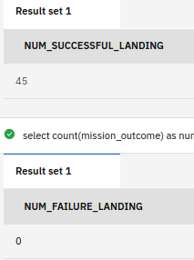
Total number of successful and failure mission outcomes
select count(mission_outcome) as num_successful_landing
from spacextable
where mission_outcome like '%Success%';
select count(mission_outcome) as num_failure_landing
from spacextable
where mission_outcome like '%Failure%';
<number>

Slide 32
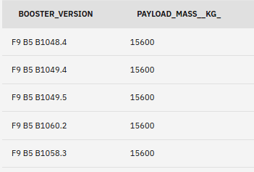
Boosters carried maximum payload
select booster_version, payload_mass__kg_ from spacextable
where payload_mass__kg_ = (select max(payload_mass__kg_) from spacextable);
<number>

Slide 33
2015 launch records
select landing__outcome, booster_version, launch_site, DATE
from spacextable
where landing__outcome = 'Failure (drone ship)'
and date like '%2015%';
<number>

Slide 34
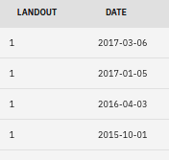
Rank success count between 2010-06-04 and 2017-03-20
select count(*) as landout, date from spacextable
where date between '2010-06-04 ' and '2017-03-20'
and landing__outcome = 'Success (ground pad)'
or landing__outcome = 'Failure (drone ship)'
group by date
order by date
desc;
<number>

Slide 35
Interactive map with Folium
<number>

Slide 36
<Folium map screenshot 1>
Replace <Folium map screenshot 1> title with an appropriate title
Show the screenshot of all launch sites’ location markers on a global map
Explain the important elements and findings on the screenshot
<number>

Slide 37
<Folium map screenshot 2>
Replace <Folium map screenshot 2> title with an appropriate title
Show the screenshot of color-labeled launch records on the map
Explain the important elements and findings on the screenshot
<number>

Slide 38
<Folium map screenshot 3>
Replace <Folium map screenshot 3> title with an appropriate title
Show the screenshot of a selected launch site to its proximities such as railway, highway, coastline, with distance calculated and displayed
Explain the important elements and findings on the screenshot
<number>

Slide 39
Build a Dashboard with Plotly Dash
<number>

Slide 40
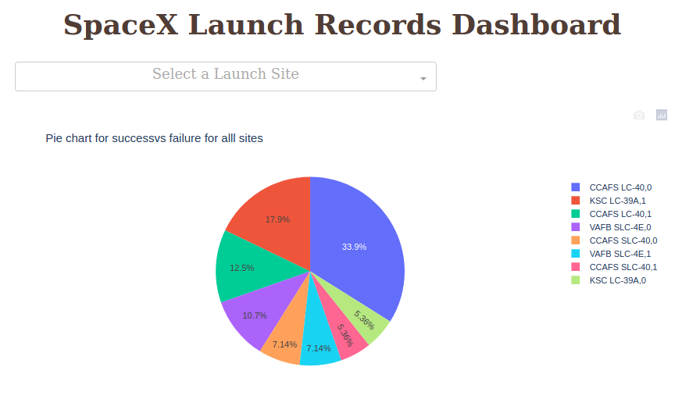
<Dashboard screenshot 1>
<number>

Slide 41
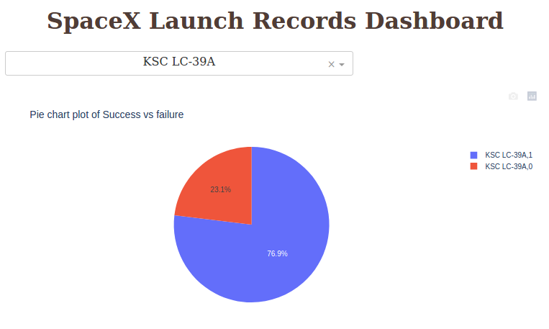
<Dashboard screenshot 2>
<number>

Slide 42
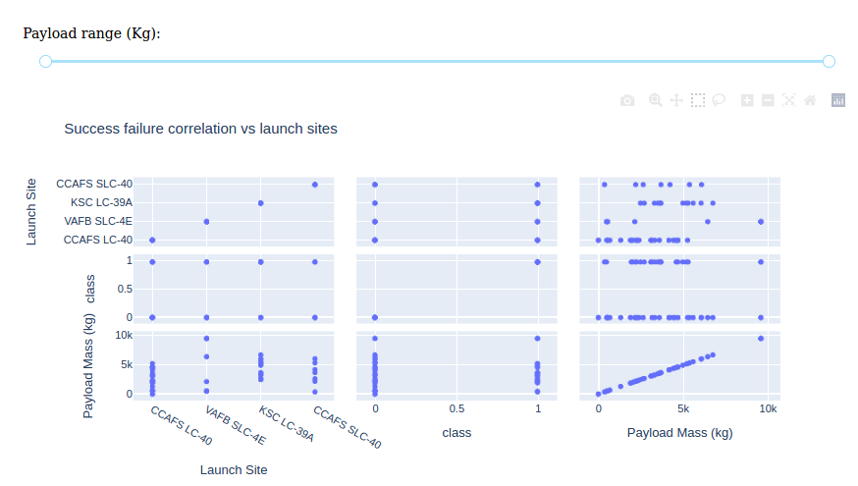
<Dashboard screenshot 3>
<number>

Slide 43
Predictive analysis (Classification)
<number>

Slide 44
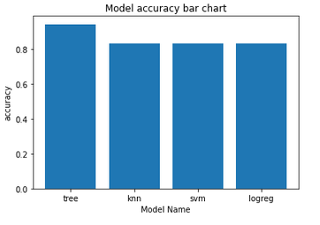
Classification Accuracy
Visualize all the built model accuracy for all built models, in a barchart
Find which model has the highest classification accuracy
<number>

Slide 45
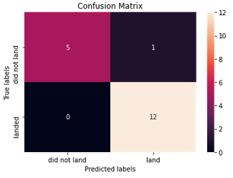
Confusion Matrix
Show the confusion matrix of the best performing model with explanation
<number>

Slide 46

CONCLUSION
Point 1
Point 2
Point 3
Point 4
…
<number>

Slide 47

APPENDIX
Include any relevant assets like Python code snippets, SQL queries, charts, Notebook outputs, or data sets that you may have created during this project
<number>

