Slide 1
📊 Sales & Profit Analysis Dashboard
Superstore Dataset

Slide 2
🎯 Objective of the Task
Create a dashboard for business decision-making.
Track Sales, Profit, and Growth KPIs.
Add interactivity with slicers (filters).
Provide clear visualizations using charts and cards.
Use Power BI on 'Sample Superstore' dataset.

Slide 3
🧹 Dataset & Preprocessing
Source: Sample Superstore dataset (Kaggle).
Removed null values and duplicate records.
Standardized column names and fixed data types.
Formatted dates, categories, and currency fields.
Ensured clean and structured format for visuals.

Slide 4
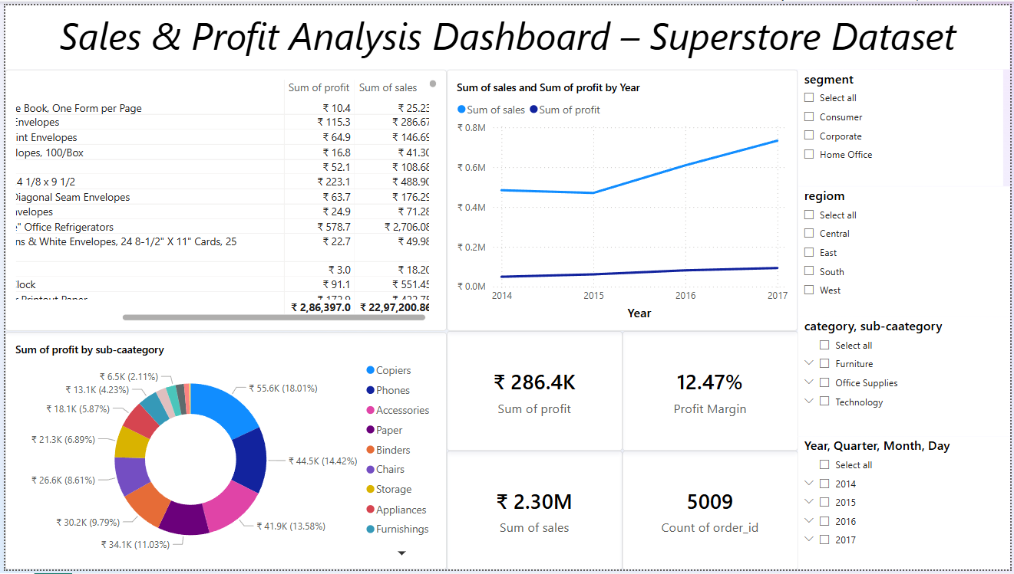
📈 Final Dashboard Overview

Slide 5
🧩 Key Visual Elements in Dashboard
KPI Cards: Total Sales, Profit, Margin, Order Count.
Line Chart: Sales & Profit trends (Yearly).
Donut Chart: Profit by Sub-category.
Table: Sales & Profit breakdown by Product.
Slicers: Region, Segment, Category, Sub-category, Time.

Slide 6
🌀 Dashboard Interactivity
Slicers dynamically filter all visuals in real-time.
Date hierarchy allows drilling from Year to Day.
Hover-over tooltips for deeper insights per chart.
Filters help focus on region, segment, and product categories.

Slide 7
💡 Business Insights Derived
Total Sales: ₹2.30M | Total Profit: ₹286.4K
Profit Margin: 12.47% | Orders: 5009
Copiers generated highest profit (₹55.6K).
Sales peaked in 2017 with clear growth trend.
Furniture category underperformed in profit.

Slide 8
✅ Conclusion & Learnings
Built a business-ready dashboard using Power BI.
Practiced data cleaning, KPI design, and visual storytelling.
Implemented interactive slicers and trend analysis.
Learned to communicate business performance visually.

