Slide 1
EXPENSY
End-to-End DevOps Deployment on Amazon EKS
Terraform • Kubernetes • CI/CD • HTTPS • Monitoring • Security
Presented by Ahsan
1

Slide 2
Project Goal
Take a simple expense tracker from local development to a secure, observable EKS deployment.
1 Local Development
Frontend + backend run with Node.js, with MongoDB for data and Redis for caching.
2 Containerized
Dockerfiles for frontend/backend and Docker Compose for the complete local stack.
3 Cloud Deployment
Terraform provisions EKS; Kubernetes deploys the app; GitHub Actions automates delivery.
• Goal: repeatable deployment, secure access, easy monitoring of the application and infrastructure.
2

Slide 3
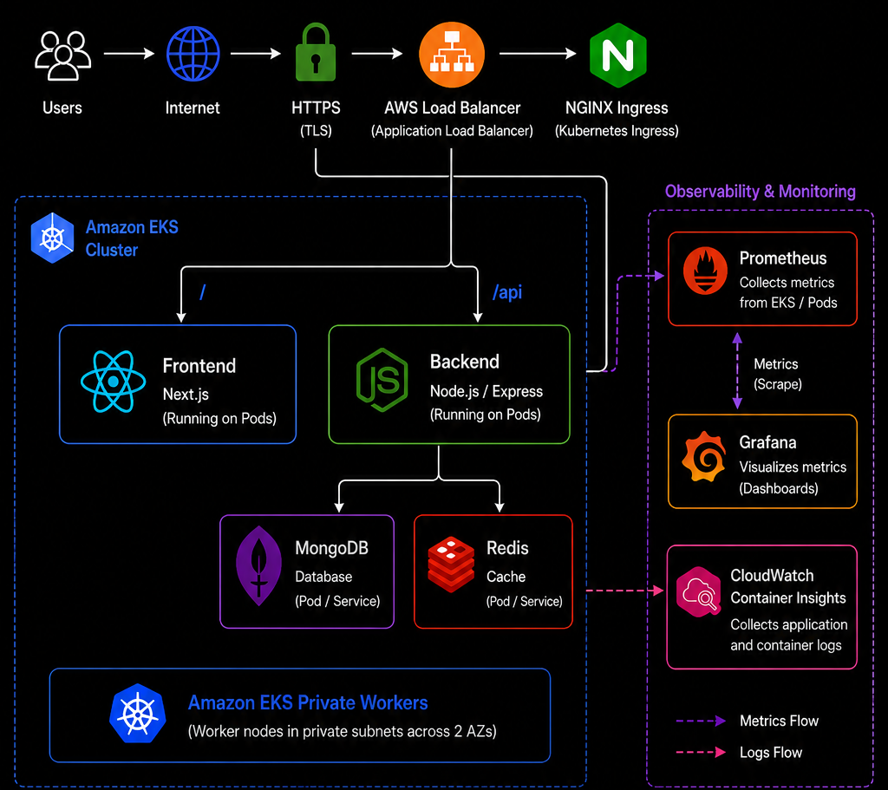
Architecture
Public HTTPS entry point - application workloads run on private EKS worker nodes.
3

Slide 4
Implementation
Infrastructure and application delivery are separated but reproducible.
Git Push
Docker Build
Docker Hub
AWS / EKS
kubectl Apply
Terraform
VPC, public/private subnets, NAT Gateway, EKS cluster, and managed t3.medium worker nodes.
Kubernetes
Deployments + ClusterIP services for frontend, backend, MongoDB and Redis; NGINX Ingress routes traffic.
GitHub Actions
Builds and pushes images, creates/updates Kubernetes secrets, applies manifests, and verifies rollout.
4

Slide 5
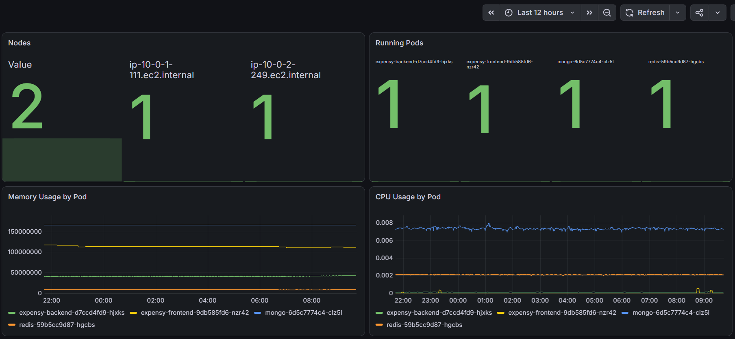
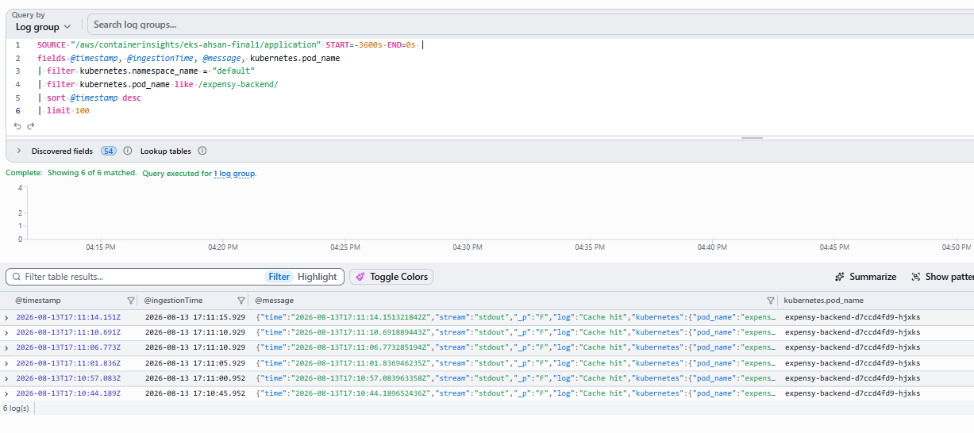
Security & Observability
Security controls and monitoring were part of the deployment
• Private EKS worker subnets - public traffic only through NGINX / LoadBalancer
• HTTPS with Route 53, cert-manager and Let's Encrypt
• Kubernetes + GitHub Actions Secrets - real secrets.yaml is gitignored
• Prometheus + Grafana for metrics - CloudWatch Container Insights for logs
5

Slide 6
Challenges & Solutions
Two issues that required debugging across the application and observability layers.
1 Frontend → Backend API URL
Problem
The frontend could load, but API operations were not reliable because the production API URL was not embedded correctly in the Next.js build.
Solution
Passed NEXT_PUBLIC_API_URL as a Docker build argument, rebuilt the frontend image, and redeployed it with the HTTPS application URL.
Learning
NEXT_PUBLIC_* values used by browser-side Next.js code must be available at build time.
2 Verifying CloudWatch Logging
Problem
I needed to verify that backend container logs were actually reaching CloudWatch.
Solution
Used CloudWatch Logs Insights to filter the expensy-backend pod and searched for application activity such as “Cache hit”.
6

Slide 7
Conclusion
The project met the core DevOps objectives end to end.
• Infrastructure is reproducible with Terraform.
• The application is containerized and orchestrated on EKS.
• CI/CD automates image build, push and Kubernetes deployment.
• HTTPS, secrets, private workers, monitoring and centralized logging are implemented.
• Main learning: DevOps is the integration of application, infrastructure, delivery, security and observability.
Terraform
Kubernetes
GitHub Actions
HTTPS
Grafana
CloudWatch
7

Slide 8
EXPENSY
Thank You
Questions?
8

Slide 9
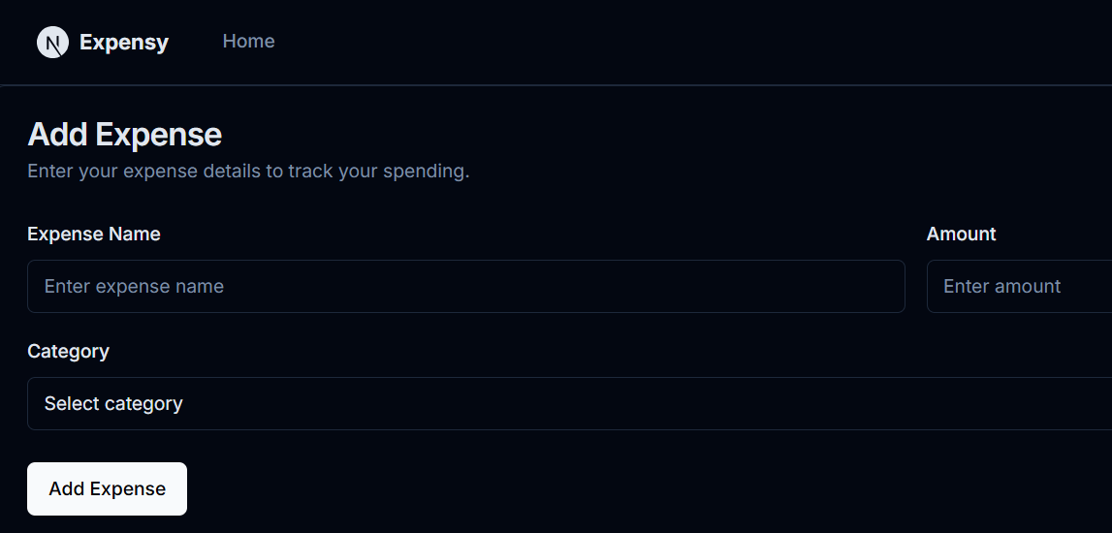
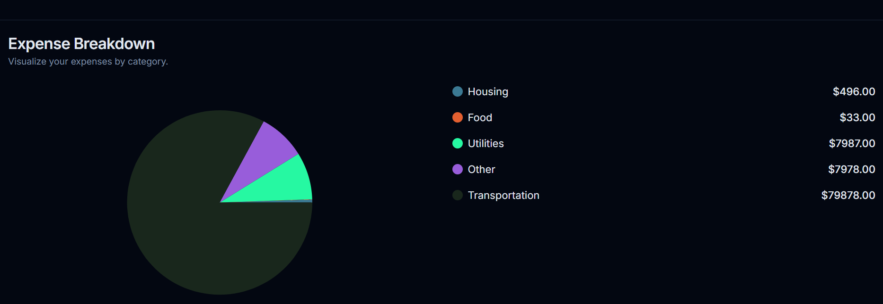
DEMO
9

