Slide 1
Week 9:
Exceptions and Exception Handling in Java
Writing Reliable and Error-Resilient Code for Robust Java Applications

Slide 2
Objectives
Understand what exceptions are and their purpose in Java.
Learn how to handle exceptions using try-catch blocks and finally.
Explore custom exceptions and best practices for exception handling.
Apply exception handling techniques to the Quiz Manager System.

Slide 3
Understanding Exceptions
Definition: An exception is an event that disrupts the normal flow of a program.
Purpose: To handle errors gracefully and prevent application crashes.
Examples:
  Dividing by zero.
  Accessing an invalid array index.
  File not found.

Slide 4
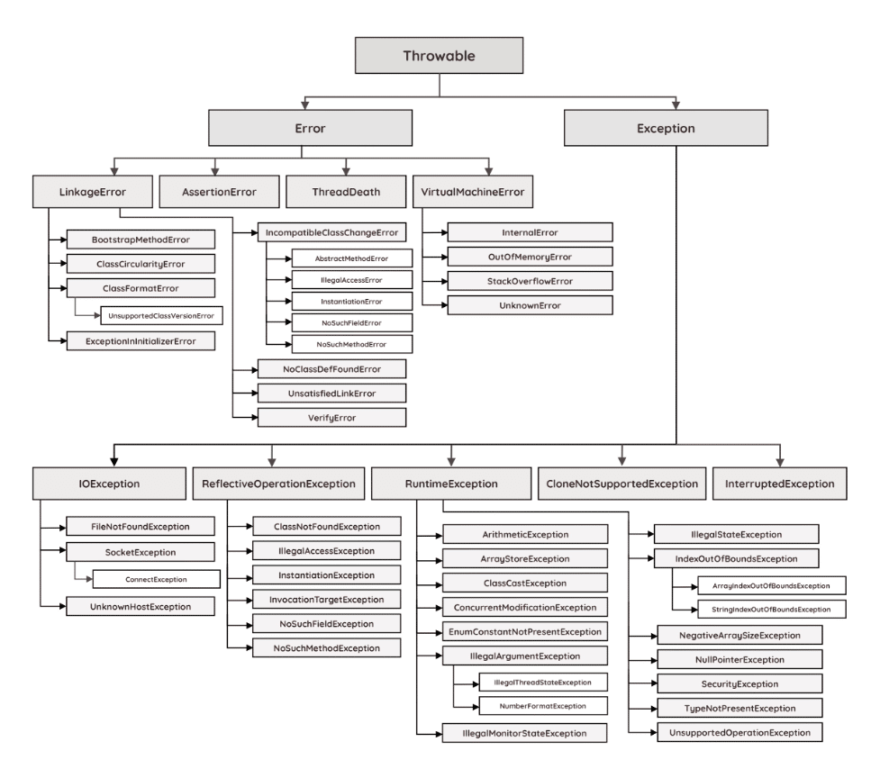
Throwable Class Hierarchy (java.lang)
Error: Severe issues (e.g. OutOfMemoryError).
Exception: Recoverable problems (e.g. FileNotFoundException).
https://docs.oracle.com/javase/8/docs/api/java/lang/package-summary.html

Slide 5
Types of Exceptions: Checked vs Unchecked
Checked Exceptions | Unchecked Exceptions
Subclass of Exception. | Subclass of RuntimeException.
Checked at compile time | Occur at runtime, not at compile time
Must be handled with try-catch or declared with throws. | Can be ignored, but may cause runtime errors.
Examples: IOException (java.lang) SQLException (java.sql) | Examples: NullPointerException ArithmeticException

Slide 6
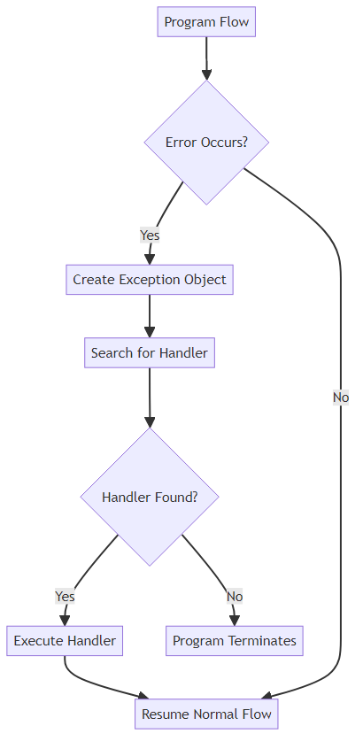
Basic Exception Handling
How to Catch Exceptions: The try-catch Block
A try-catch block handles exceptions gracefully.
Syntax:
try {
// Code that might throw an exception
} catch (ExceptionType e) {
// Handle the exception
}

Slide 7
Practical Exception Example
Example:
Handling a Division by Zero Exception
try {
int result = 10 / 0;
} catch (ArithmeticException e) {
System.out.println("Cannot divide by zero!");
}

Slide 8
Using Finally Blocks
The Finally Block
Purpose: Executes code that must run regardless of whether an exception occurs.
Syntax:
Example: Closing a file or database connection.
try {
// Code that might throw an exception
} catch (ExceptionType e) {
// Handle the exception
} finally {
// Code that always run
}

Slide 9
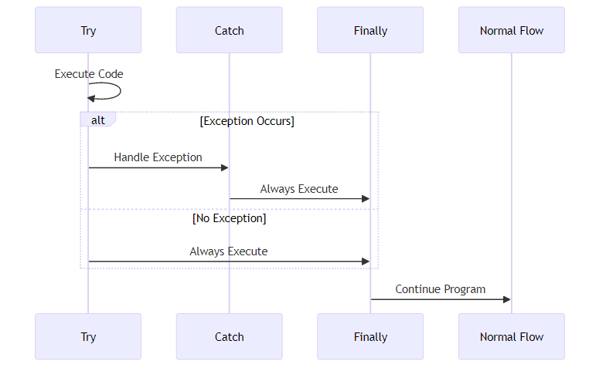
Understanding Finally Blocks

Slide 10
Throwing Exceptions Manually
Throwing Exceptions
Use the throw keyword to explicitly throw an exception.
Example:
if (value < 0) {
throw new IllegalArgumentException("Value cannot be negative!");
}

Slide 11
Method Exception Declarations
Using Throws in Method Signatures
Declare exceptions that a method might throw using the throws keyword.
Example:
public void readFile(String fileName) throws IOException {
// Code to read a file
}

Slide 12
Creating Custom Exceptions
Creating Custom Exceptions
Define your own exception classes by extending Exception or RuntimeException.
Example:
public class InvalidQuizException extends Exception {
public InvalidQuizException(String message) {
super(message);
}
}

Slide 13
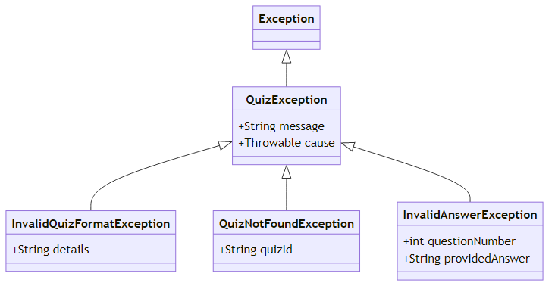
Example of Custom Exception

Slide 14
Exception Handling Guidelines
Best Practices for Exception Handling
Handle exceptions at the appropriate level.
Avoid catching generic Exception unless necessary.
Use meaningful exception messages.
Log exceptions for debugging.
Avoid overusing exceptions for normal control flow.

Slide 15
Discussion Break: Exception Benefits
Prompt:
How do exceptions improve software reliability?
What challenges might arise when handling exceptions in large applications?
Have a minute to think about this
Discuss with your neighbour for 5 minutes
Then I will ask for ideas from the class

Slide 16
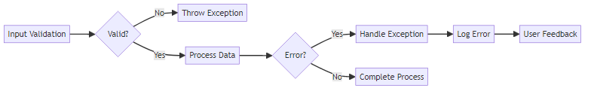
Quiz Manager Exception Strategy
Case Study: Applying Exception Handling to the Quiz Manager
Scenario:
Handle invalid user input (e.g., entering a non-numeric value for a quiz answer).
Handle file-related errors (e.g., missing quiz files, non-valid data).

Slide 17
Handling Invalid Quiz Input
Scanner scanner = new Scanner(System.in);
System.out.print("Enter your answer: ");
int answer = Integer.parseInt(scanner.nextLine());
System.out.println("You entered: " + answer);

Slide 18
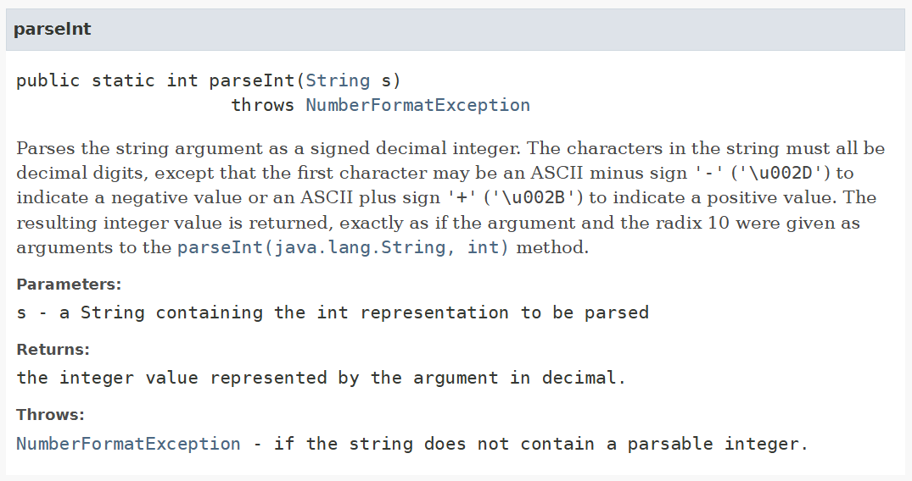
Handling Invalid Quiz Input

Slide 19
Handling Invalid Quiz Input
Scanner scanner = new Scanner(System.in);
try {
System.out.print("Enter your answer: ");
int answer = Integer.parseInt(scanner.nextLine());
System.out.println("You entered: " + answer);
} catch (NumberFormatException e) {
System.out.println("Invalid input! Please enter a number.");
}

Slide 20
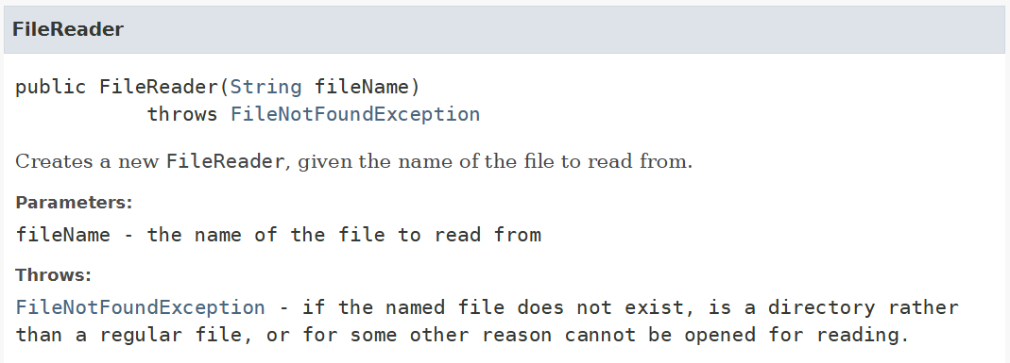
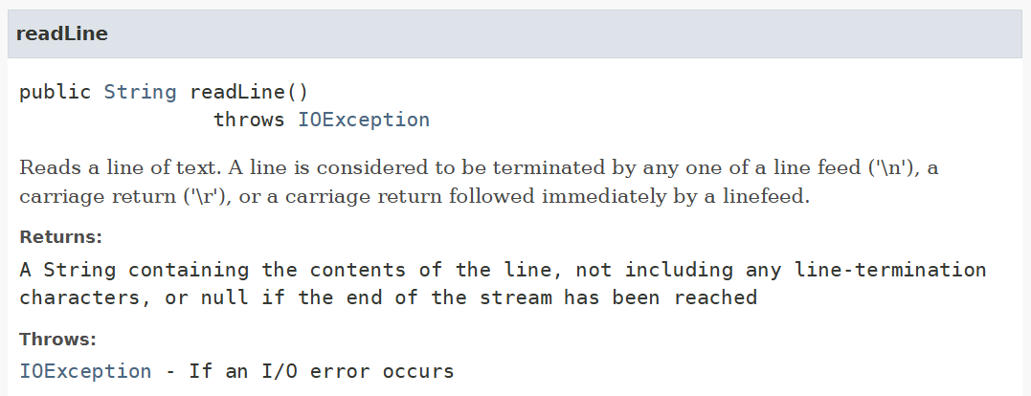
File Reading Error Handling

Slide 21
File Reading Error Handling
try {
BufferedReader reader = new BufferedReader(new FileReader("quiz.txt"));
System.out.println(reader.readLine());
reader.close();
} catch (FileNotFoundException e) {
System.out.println("Quiz file not found!");
} catch (IOException e) {
System.out.println("Error reading the file!");
}

Slide 22
Using custom exception for invalid quiz data
public class InvalidQuizException extends Exception {
public InvalidQuizException(String message) {
super(message);
}
}

Slide 23
Using custom exception for invalid quiz data
public void validateQuiz(Quiz quiz) throws InvalidQuizException {
if (quiz.getQuestions().isEmpty()) {
throw new InvalidQuizException("Quiz must contain at least one question!");
}
}

Slide 24
Real-World Exceptions: Discussion Break
Prompt:
What types of exceptions have you encountered in real-world applications?
How were they handled (or not handled)?
Have a minute to think about this
Discuss with your neighbour for 5 minutes
Then I will ask for ideas from the class

Slide 25
Advanced Exception Concepts (1/2)
Multiple Exceptions
Use multiple catch blocks to handle different exceptions.
Code Example (already seen)
try {
// Code that might throw multiple exceptions
} catch (IOException e) {
System.out.println("File error: " + e.getMessage());
} catch (NumberFormatException e) {
System.out.println("Input error: " + e.getMessage());
}

Slide 26
Advanced Exception Concepts (2/2)
Chaining Exceptions
Preserve the original exception details when throwing a new one.
Code Example
try {
// Code that throws an exception
} catch (IOException e) {
throw new RuntimeException("Failed to process file", e);
}

Slide 27
Hands-on Activity to try later
Practical Activity:
Adding Exception Handling to the Quiz Manager System
Task:
1. Add exception handling for invalid answers in the CLI version of the Quiz Manager.
2. Use a custom exception to handle missing quizzes in the data layer.

Slide 28
Summary
Key Takeaways
Exceptions help handle errors gracefully and improve software reliability.
Use try-catch blocks, finally, and custom exceptions effectively.
Apply exception handling to real-world scenarios, such as input validation and file management.

Slide 29
Preview: Advanced GUI Development
Next Week
Topic: Advanced Graphical User Interfaces
Overview: Explore advanced GUI techniques using JavaFX or Swing.
Practical Focus: Building a multi-screen GUI for the Quiz Manager System with navigation and styling.

