Slide 1
Week 11:
Advanced Graphical User Interfaces
Advanced Techniques with JavaFX and Swing

Slide 2
Objectives
Review GUI basics and event-driven programming.
Explore advanced GUI concepts like layout managers, multi-screen navigation, and custom components.
Learn how to style GUIs with CSS (JavaFX) and enhance usability.
Build a multi-screen GUI for the Quiz Manager System.

Slide 3
GUI Basics:
Graphical User Interfaces (GUIs)
  Simple use of JavaFX
Web Interfaces
  Simple use of HTML, CSS, and JavaScript.
Event-driven programming
  Handling user actions with event listeners.

Slide 4
Graphical User Interface (GUI)
Description:
A visual interface that uses windows, buttons, and other graphical elements to interact with the user.
Advantages:
Intuitive and user-friendly.
Supports rich visual elements like images and animations.
Suitable for a wide range of users.
Challenges:
More complex to implement compared to CLI.
Requires additional libraries or frameworks (e.g., JavaFX, Swing).
Swing now exists in "maintenance mode" (no new features)

Slide 5
GUI Example using JavaFX (week5.ppt):
import javafx.application.Application;
import javafx.scene.Scene;
import javafx.scene.control.Button;
import javafx.scene.control.Label;
import javafx.scene.layout.VBox;
import javafx.stage.Stage;
public class GraphicalInterface extends Application {
@Override
public void start(Stage primaryStage) {
Label label = new Label("Welcome to the Quiz Manager!");
Button startButton = new Button("Start Quiz");
startButton.setOnAction(e -> System.out.println("Quiz Started"));
VBox layout = new VBox(10, label, startButton);
Scene scene = new Scene(layout, 300, 200);
primaryStage.setScene(scene);
primaryStage.setTitle("Quiz Manager");
primaryStage.show();
}
public static void main(String[] args) {
launch(args);
}
}

Slide 6
GUI Example using Swing and AWT
import javax.swing.*;
import java.awt.event.ActionEvent;
import java.awt.event.ActionListener;
public class ButtonClickCounter {
public static void main(String[] args) {
JFrame frame = new JFrame("Click Counter");
JButton button = new JButton("Click me!");
JLabel label = new JLabel("Count: 0");
int[] count = {0};
button.addActionListener(e -> {
count[0]++;
label.setText("Count: " + count[0]);
});
frame.setLayout(new java.awt.FlowLayout());
frame.add(button);
frame.add(label);
frame.setSize(200, 100);
frame.setDefaultCloseOperation(JFrame.EXIT_ON_CLOSE);
frame.setVisible(true);
}
}
Warning: Swing now exists in "maintenance mode" (no new features)

Slide 7
HTML/Web Interface
Description:
A web-based interface that runs in a browser, using HTML, CSS, and JavaScript.
Advantages:
Accessible from any device with a browser.
Can be styled and customized extensively.
Supports integration with other web-based tools and services.
Challenges:
Requires knowledge of web technologies (HTML, CSS, JavaScript).
Needs a backend server to handle business logic and data storage.

Slide 8
Example:
<!DOCTYPE html>
<html>
<head>
<title>Quiz Manager</title>
</head>
<body>
<h1>Welcome to the Quiz Manager</h1>
<button onclick="startQuiz()">Start Quiz</button>
<script>
function startQuiz() {
alert("Quiz Started!");
}
</script>
</body>
</html>
But we would need to be able to serve this file to a client.

Slide 9
A very quick and dirty way to serve a file
import java.io.*;
import java.net.ServerSocket;
import java.net.Socket;
public class SimpleWebServer {
//first let's have a utility method to read a file, returning its content as a string or returning
//HTML error message if the file is not found
private static String readFile(String fileName) {
File file = new File(fileName);
if (file.exists()) {
try (BufferedReader fileReader = new BufferedReader(new FileReader(file))) {
StringBuilder content = new StringBuilder();
String line;
while ((line = fileReader.readLine()) != null) {
content.append(line).append("\n");
}
return content.toString();
} catch (IOException e) {
e.printStackTrace();
}
}
return "<html><body><h1>404 Not Found</h1></body></html>";
}

Slide 10
//and a simple utiltity method to serve a file
private static void serveFile(String fileName, PrintWriter out) {
String content = readFile(fileName);
out.println("HTTP/1.1 200 OK");
out.println("Content-Type: text/html");
out.println("Content-Length: " + content.length());
out.println();
out.println(content);
}

Slide 11
public static void main(String[] args) {
try (ServerSocket serverSocket = new ServerSocket(8080)) {
System.out.println("Server started on port 8080");
while (true) {
try (Socket clientSocket = serverSocket.accept();
BufferedReader in = new BufferedReader(new InputStreamReader(clientSocket.getInputStream()));
PrintWriter out = new PrintWriter(clientSocket.getOutputStream(), true)) {
String line;
//get the filename to serve
String fileName = in.readLine().split(" ")[1].substring(1);
//read the file
String content = readFile(fileName);
//send the HTTP response
serveFile(fileName, out);
} catch (IOException e) {
e.printStackTrace();
}
}
} catch (IOException e) {
e.printStackTrace();
}
}
}
There are so many things to be improved in this code, but it’s a start.

Slide 12
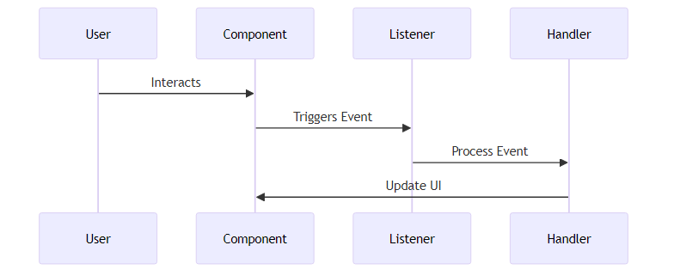
GUI Event Handling Process

Slide 13
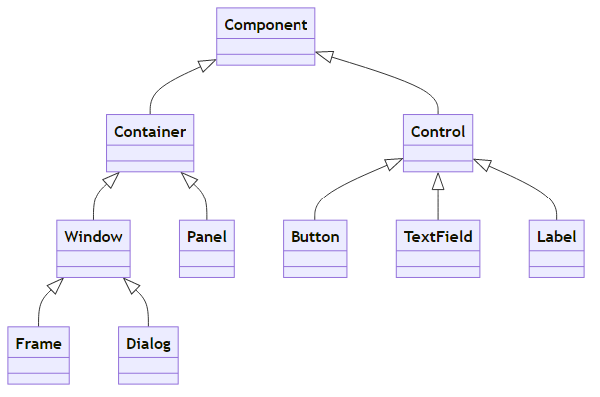
Hierarchy of GUI Components (java.awt)
control
https://docs.oracle.com/javase/8/docs/api/java/awt/package-tree.html

Slide 14
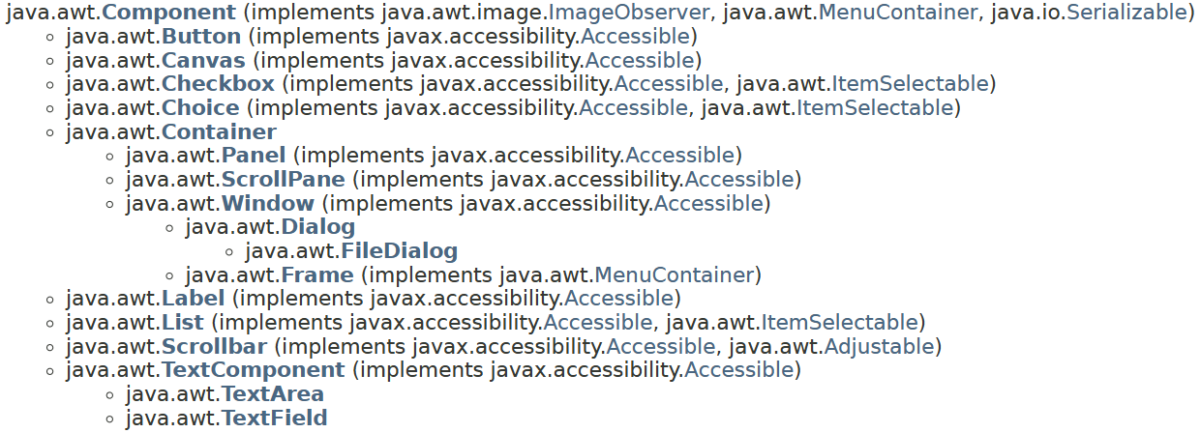
java.awt vs javax.swing vs javafx
https://docs.oracle.com/javase/8/docs/api/java/awt/package-tree.html

Slide 15
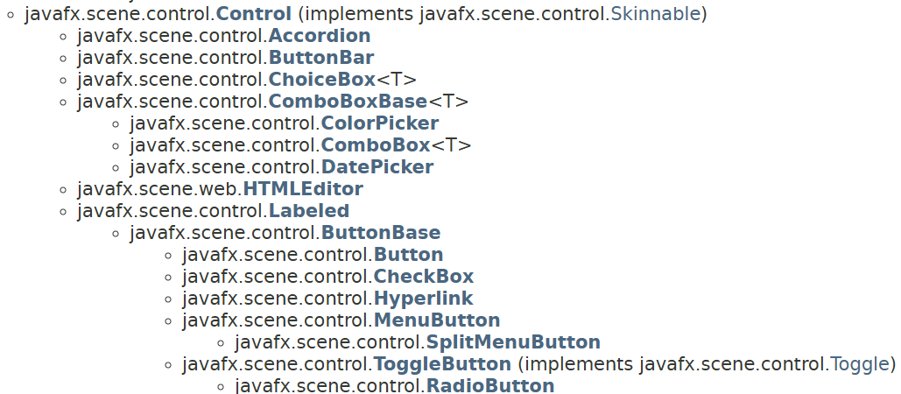
java.awt vs javax.swing vs javafx
… many more classes in javafx.scene.control

Slide 16
Layout Managers: Organizing GUI Components
Definition. Layout managers control the arrangement of components within a Container.
Why Use Layout Managers?
Ensure proper alignment and resizing.
Adapt GUIs to different screen sizes and resolutions.

Slide 17
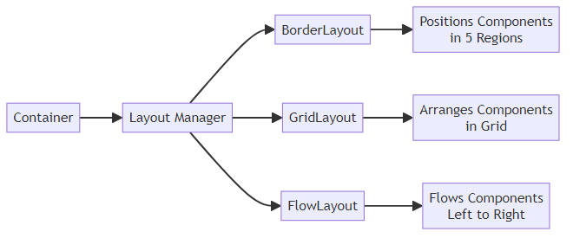
Common Layout Manager Classes
Technical clarification:
Layout Manager is a java.awt interface
BorderLayout, GridLayout, and FlowLayout are java.awt classes implementing Layout Manager

Slide 18
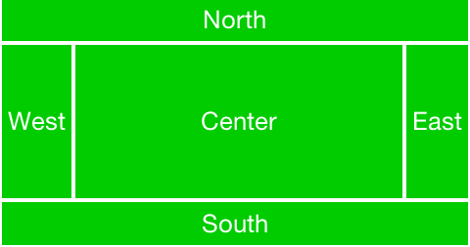
Common Layout Managers (java.awt)
BorderLayout: Divides the container into five regions (North, South, East, West, Center).
  Example (javax.swing & java.awt):
    JFrame frame = new JFrame();
    frame.setLayout(new BorderLayout());
    frame.add(new Button("North"), BorderLayout.NORTH);

Slide 19
Common Layout Managers (java.awt)
BorderLayout: Divides the container into five regions (North, South, East, West, Center).
  Example:
    frame.setLayout(new BorderLayout());
    frame.add(new JButton("North"), BorderLayout.NORTH);
GridLayout: Arranges components in a grid of rows and columns.
  Example:
    frame.setLayout(new GridLayout(2, 2));
    frame.add(new Button("1"));
    frame.add(new Button("2"));
FlowLayout: Arranges components left-to-right, top-to-bottom.
  Example:
    frame.setLayout(new FlowLayout());
    frame.add(new Button("Button"));

Slide 20
Choosing the Right Layout Manager
Layout Manager | Best For | Example Use Case
BorderLayout | Dividing into distinct regions | Dashboards with toolbars and content.
GridLayout | Uniform grids | Calculator buttons.
FlowLayout | Simple, flexible arrangements | Dialog boxes.

Slide 21
Layout Managers in javafx.scene.layout
https://docs.oracle.com/javase/8/javafx/api/javafx/scene/layout/package-summary.html
BorderPane: Divides the container into five regions (Top, Bottom, Left, Right, and Center).
GridPane: Arranges components in a grid of rows and columns.
FlowPane: Arranges components left-to-right, top-to-bottom.
VBox: Arranges components in a single vertical column.
  Auto width, spacing, alignment options.
5. StackPane: Layers components on top of each other (in a stack).
Many others available.

Slide 22
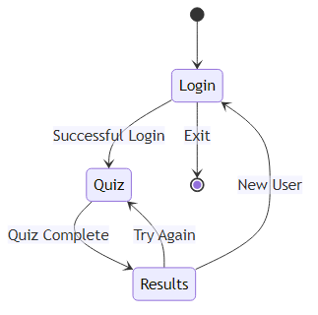
Building Multi-Screen GUIs
Problem: Many applications require multiple screens (e.g., login, main menu, quiz, results).
Solution: Use containers to switch between screens dynamically.

Slide 23
Example Multi-Screen Navigation
Scenario: A quiz manager system with three screens: login, quiz, results.
Example code:
import java.awt.CardLayout;
import javax.swing.JPanel;
CardLayout cardLayout = new CardLayout();
JPanel mainPanel = new JPanel(cardLayout);
mainPanel.add(new LoginPanel(cardLayout,mainPanel), "Login");
mainPanel.add(new QuizPanel(cardLayout,mainPanel), "Quiz");
mainPanel.add(new ResultsPanel(cardLayout,mainPanel), "Results");
//we switch to the Login view
cardLayout.show(mainPanel, "Login");
For the example to work:
We would need to add mainPanel to a JFrame and use the frame setVisible(true)
We would need to have defined each of the JPanels separately and switch the view as needed

Slide 24
Styling GUIs with CSS (javafx)
Why Style GUIs?
Enhance visual appeal.
Improve usability and branding.
Adding CSS
1. Create a .css file (e.g. “styles.css”)
Apply the stylesheet in JavaFX
Scene scene = new Scene(root);
scene.getStylesheets().add("styles.css");

Slide 25
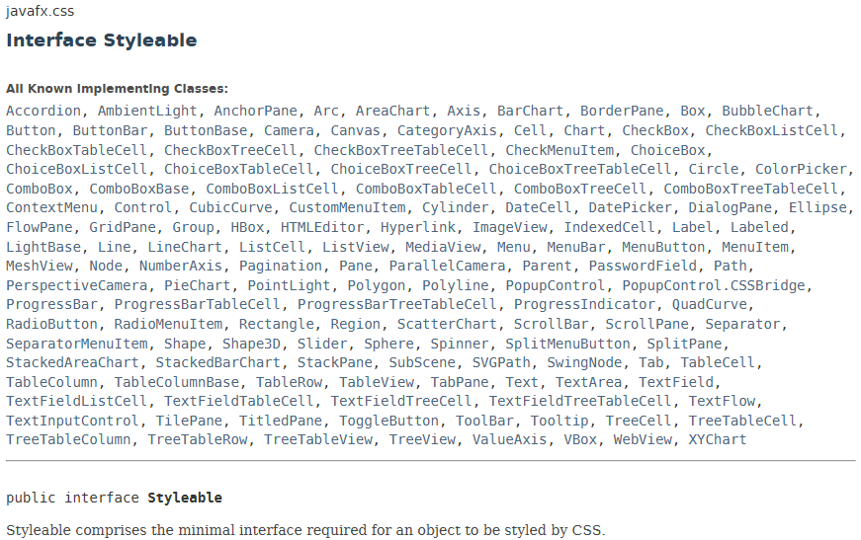

Slide 26
Styling the GUI Example using JavaFX from week5.ppt
import javafx.application.Application;
import javafx.scene.Scene;
import javafx.scene.control.Button;
import javafx.scene.control.Label;
import javafx.scene.layout.VBox;
import javafx.stage.Stage;
public class GraphicalInterface extends Application {
@Override
public void start(Stage primaryStage) {
Label label = new Label("Welcome to the Quiz Manager!");
Button startButton = new Button("Start Quiz");
startButton.setOnAction(e -> startButton.setText("Quiz Started"));
VBox layout = new VBox(10, label, startButton);
Scene scene = new Scene(layout, 300, 200);
scene.getStylesheets().add("styles.css");
primaryStage.setScene(scene);
primaryStage.setTitle("Quiz Manager");
primaryStage.show();
}
public static void main(String[] args) {
launch(args);
}
}

Slide 27
styles.css
.root {
-fx-background-color: #f4f4f4; /* Light gray background */
-fx-font-family: "Arial";
}
.label {
-fx-font-size: 18px;
-fx-font-weight: bold;
-fx-text-fill: #333333; /* Dark gray text */
-fx-padding: 10px;
}
.button {
-fx-background-color: #0078D7; /* “True blue” */
-fx-text-fill: white; /* White text */
-fx-font-size: 14px;
-fx-font-weight: bold;
-fx-padding: 10px 20px;
-fx-border-radius: 5px;
-fx-border-color: #005A9E;
}
.button:hover {
-fx-background-color: #005A9E; /* Darker blue on hover */
}
.vbox {
-fx-spacing: 15;
-fx-padding: 20px;
}

Slide 28
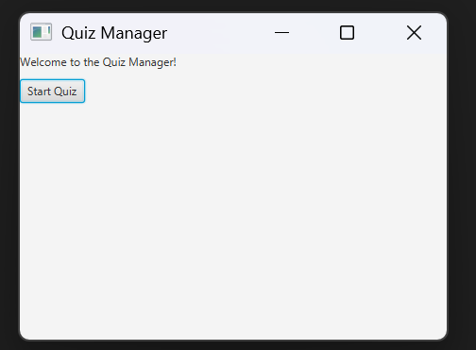
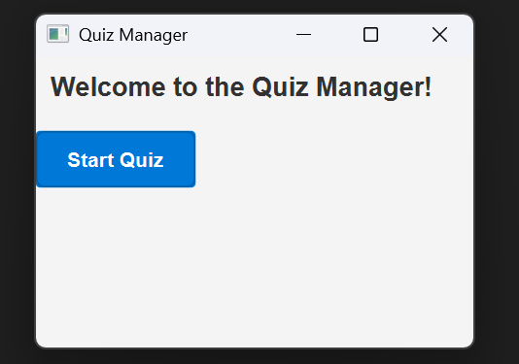
Result of Styling GUIs with CSS
Not using CSS
Using CSS

Slide 29
Adding Menus and Toolbars (javax.swing)
Menus:
  Use JMenuBar, JMenu, and JMenuItem in Swing.
  Example setting up a MenuBar with a File menu containing an Exit option:
    JMenuBar menuBar = new JMenuBar();
    JMenu fileMenu = new JMenu("File");
    fileMenu.add(new JMenuItem("Exit"));
    menuBar.add(fileMenu);
    frame.setJMenuBar(menuBar);
Toolbars:
  Provide quick access to common actions.
  Example:
    JToolBar toolbar = new JToolBar();
    toolbar.add(new JButton("Save"));
    frame.add(toolbar, BorderLayout.NORTH);

Slide 30
Adding Menus and Toolbars (javafx)
Menus:
  Use MenuBar, Menu, and MenuItem from javafx.scene.control.
  Example setting up a MenuBar with a File menu containing an Exit option:
    MenuBar menuBar = new MenuBar();
    Menu fileMenu = new Menu("File");
    fileMenu.getItems().add(new MenuItem("Exit"));
    menuBar.getMenus().add(fileMenu);
    borderpane.setTop(menuBar);
Toolbars:
  Use ToolBar from javafx.scene.control.
  Example:
    ToolBar toolbar = new ToolBar();
    toolbar.getItems.add(new Button("Save"));
    borderpane.setTop(toolbar);

Slide 31
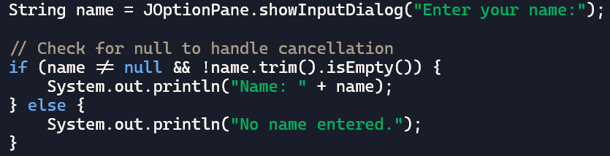
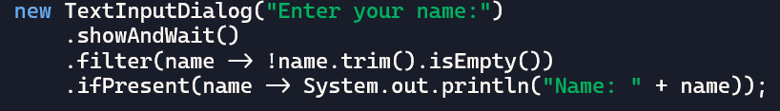
Adding Dialogs (swing and javafx)
Dialogs: Use for temporary popups or user input.
Example (using javax.swing.JOptionPane)
Example (using javafx.scene.control.TextInputDialog)

Slide 32
Adding Charts
Chart Objects (javafx.scene.chart)
Example: Bar chart for quiz statistics
  BarChart<String, Number> chart = new BarChart<>(new CategoryAxis(), new NumberAxis());
AreaChart
PieChart
BarChart
BubbleChart
Chart
LineChart
XYChart
ScatterChart
StackedAreaChart
StackedBarChart

Slide 33
Adding Tables
Tables using javax.swing
Tables using javafx.scene.control
String[] columnNames = {"Question", "Your Answer", "Correct Answer", "Score"};
Object[][] data = {
{"What is 2+2?", "4", "4", "1"},
{"Capital of France?", "Paris", "Paris", "1"},
{"Largest planet?", "Earth", "Jupiter", "0"}
};
JTable table = new JTable(data, columnNames);
TableView<Quiz> table = new TableView<>();
Implementation of tables using javafx is not as straightforward.
Flexibility (not allowing just 2D[][] static arrays) comes at a price.

Slide 34
Tables: swing vs javafx
Feature | Swing (JTable) | JavaFX (TableView)
Data model | Object[][] | Custom objects (Observable)
Column definition | Simple, static | Type-safe, dynamic
UI updates on data change | Manual | Automatic (binding)
Custom rendering/editing | Complex | Built-in support via cellFactory

Slide 35
Discussion Break: Enhancing User Experience
Prompt:
How does styling and navigation improve the user experience?
What challenges might arise when building multi-screen GUIs?
Have a minute to think about this
Discuss with your neighbour for 5 minutes
Then I will ask for ideas from the class

Slide 36
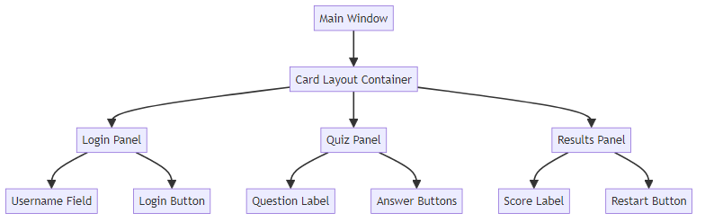
Quiz Manager Example
Case Study: Quiz Manager GUI
Scenario: Three screens: login, quiz, results

Slide 37
Main Class
import javax.swing.JFrame;
import java.awt.CardLayout;
import javax.swing.JPanel;
public class Main_Panel {
public static void main(String[] args) {
JFrame frame = new JFrame("Quizz app");
CardLayout cardLayout = new CardLayout();
JPanel mainPanel = new JPanel(cardLayout);
mainPanel.add(new LoginPanel(cardLayout,mainPanel), "Login");
mainPanel.add(new QuizPanel(cardLayout,mainPanel), "Quiz");
mainPanel.add(new ResultsPanel(cardLayout,mainPanel), "Results");
cardLayout.show(mainPanel, "Login"); //we switch to the Login view
frame.setDefaultCloseOperation(JFrame.EXIT_ON_CLOSE);
frame.setSize(400, 300);
frame.add(mainPanel);
frame.setVisible(true);
}}

Slide 38
Step 1: Login Screen
import javax.swing.*; import java.awt.*; import java.awt.event.ActionListener;
public class LoginPanel extends JPanel {
private CardLayout cardLayout;
private JPanel mainPanel;
public LoginPanel(CardLayout cardLayout, JPanel mainPanel) {
this.cardLayout = cardLayout;
this.mainPanel = mainPanel;
JPanel loginPanel = new JPanel();
loginPanel.setLayout(new FlowLayout());
JTextField usernameField = new JTextField(20);
JButton loginButton = new JButton("Login");
loginButton.addActionListener(e -> {
System.out.println("Username: " + usernameField.getText());
cardLayout.show(mainPanel, “Quiz"); //we switch to the Quiz view
} ) ;
loginPanel.add(new JLabel("Username:"));
loginPanel.add(usernameField);
loginPanel.add(loginButton);
this.add(loginPanel); }}

Slide 39
Step 2: Quiz Screen
import javax.swing.*; import java.awt.*; import java.awt.event.ActionListener;
public class QuizPanel extends JPanel {
private CardLayout cardLayout;
private JPanel mainPanel;
public QuizPanel(CardLayout cardLayout, JPanel mainPanel) {
this.cardLayout = cardLayout;
this.mainPanel = mainPanel;
JPanel quizPanel = new JPanel();
quizPanel.setLayout(new GridLayout(3, 1));
JLabel questionLabel = new JLabel("What is 2 + 2?");
JButton option1 = new JButton("3");
JButton option2 = new JButton("4");
option1.addActionListener(e -> System.out.println("Wrong Answer!"));
option2.addActionListener(e -> cardLayout.show(mainPanel, "Results"));
quizPanel.add(questionLabel);
quizPanel.add(option1);
quizPanel.add(option2);
this.add(quizPanel); }}

Slide 40
Step 3: Results Screen
import javax.swing.*; import java.awt.*; import java.awt.event.ActionListener;
public class ResultsPanel extends JPanel {
private CardLayout cardLayout;
private JPanel mainPanel;
public ResultsPanel(CardLayout cardLayout, JPanel mainPanel) {
this.cardLayout = cardLayout;
this.mainPanel = mainPanel;
JPanel resultsPanel = new JPanel();
resultsPanel.setLayout(new FlowLayout());
JLabel scoreLabel = new JLabel("Your Score: 1/1");
JButton restartButton = new JButton("Restart");
restartButton.addActionListener(e -> cardLayout.show(mainPanel, “Login"));
resultsPanel.add(scoreLabel);
resultsPanel.add(restartButton);
this.add(resultsPanel);
}}

Slide 41
Best Practices for GUI Development
Keep the interface simple and intuitive.
2. Use consistent layouts and styles.
3. Handle user input gracefully (e.g., validation).
4. Test GUIs on different screen sizes and resolutions.

Slide 42
Summary
Key Takeaways
Advanced GUIs enhance usability and interactivity.
Layout managers and multi-screen navigation improve organization.
Styling with CSS (JavaFX) makes GUIs visually appealing.
Building GUIs for the Quiz Manager System (or your project) provides hands-on experience with real-world applications.

