Slide 1
CS1OP Week 2
2026

Slide 2
Understanding Message Passing in OOP
Objective
  Explore the concept of message passing in Object-Oriented Programming (OOP).
  Discuss the benefits and limitations of thinking in terms of message passing.
  Understand how this concept encourages good design and coding practices.

Slide 3
What is Message Passing?
Definition: Message passing is a technique in OOP where objects communicate by sending and receiving messages.
  A “message” is essentially a request for an object to perform a specific action or behavior.
Key Points
  Objects as Independent Entities
  Message Passing vs Method Calls
  Encapsulation and Abstraction

Slide 4
What is Message Passing? (Cnt.)
Key Points
  Message Passing vs Method Calls
    In many OOP languages (e.g., Java), message passing is implemented as method calls.
    For example:
      object.methodName(parameters);
    Here, the object receives a “message” (method call) and decides how to respond internally.
message

Slide 5
What is Message Passing? (Cnt.)
Key Points
  Encapsulation and Abstraction
    Message passing hides the internal implementation of objects.
    The sender doesn’t need to know how the receiver processes the message, only that it will.

Slide 6
Why Message Passing?
Benefits
  1. Encourages Modularity
    Objects are self-contained and interact only through well-defined messages.
    This reduces tight coupling and makes systems easier to maintain and extend.
  2. Promotes Abstraction
    By focusing on “what” an object does (the message) rather than “how” it does it.
    Developers can design systems at a higher level of abstraction.

Slide 7
Why Message Passing? (Cnt.)
Benefits
  3. Improves Flexibility
    Objects can be replaced or modified without affecting other parts of the system, as long as they respond to the same messages.
  4. Simulates Real-World Interactions
    Thinking in terms of objects sending messages mirrors real-world systems, making it easier to model complex problems.

Slide 8
Why Not Always Use Literal Message Passing?
Limitations
  Performance Overhead
    Literal message passing (e.g., in distributed systems) can introduce latency and complexity.
    For example, sending messages between processes or over a network is slower than direct method calls.

Slide 9
Why Not Always Use Literal Message Passing? (Cnt.)
Limitations
  Complexity in Implementation
    Literal message passing requires additional infrastructure to handle message queues, serialization, and error handling.

Slide 10
Why Not Always Use Literal Message Passing? (Cnt.)
Limitations
  Not Always Necessary
    In many cases, direct method calls are simpler and more efficient while still adhering to the principles of message passing.

Slide 11
Why Thinking in Terms of Message Passing Encourages Good Design
Encourages Encapsulation
  By focusing on messages, developers naturally hide the internal details of objects.
  This reduces dependencies and makes systems more robust to change.

Slide 12
Why Thinking in Terms of Message Passing Encourages Good Design (Cnt.)
Promotes Separation of Concerns
  Each object is responsible for its own behavior and communicates only through messages.
  This aligns with the principle of separation of concerns, making systems easier to understand and maintain.

Slide 13
Why Thinking in Terms of Message Passing Encourages Good Design (Cnt.)
Supports Polymorphism
  Objects of different types can respond to the same message in different ways.
  This makes systems more flexible and extensible.

Slide 14
Example
public class Animal {
public void makeSound() {
System.out.println("Some generic animal sound");
}
}
public class Dog extends Animal {
@Override
public void makeSound() {
System.out.println("Woof!");
}
}

Slide 15
Example
public class Cat extends Animal {
@Override
public void makeSound() {
System.out.println("Meow!");
}
}

Slide 16
Example
public class Main {
public static void main(String[] args) {
Animal myDog = new Dog();
Animal myCat = new Cat();
// Sending the same "makeSound" message to different objects
myDog.makeSound(); // Output: Woof!
myCat.makeSound(); // Output: Meow!
}
}

Slide 17
Discussion - How would we do this by literally passing messages?
What would be the benefits of passing messages in this case?
What would be the drawbacks?
How would we implement this in a literal message passing system?
What would be the implications for performance and complexity?
Have a minute to think about this
Discuss with your neighbour for 5 minutes
Then I will ask for ideas from the class

Slide 18
Software Engineering point to consider
Maximising speed of running code is not always the most important factor
  Maintainability is often more important
  Readability is often more important
  Flexibility is often more important
  Scalability is often more important

Slide 19
Loose Coupling vs Tight Coupling: Benefits and Drawbacks
Tight Coupling
  Advantages
    Easier to implement initially.
    Can lead to better performance in some cases (e.g., fewer abstractions).
  Disadvantages
    Harder to maintain and extend.
    Changes in one component can cause a ripple effect.
    Reduced reusability of components.

Slide 20
Loose Coupling vs Tight Coupling: Benefits and Drawbacks (Cnt.)
Loose Coupling
  Advantages
    Easier to maintain and extend.
    Components are more reusable.
    Changes in one component have minimal impact on others.
  Disadvantages
    May require more effort to design and implement.
    Can introduce performance overhead due to abstractions.

Slide 21
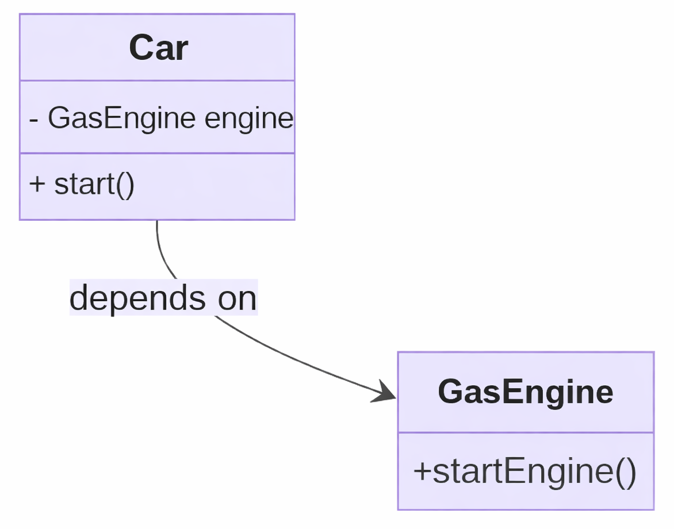
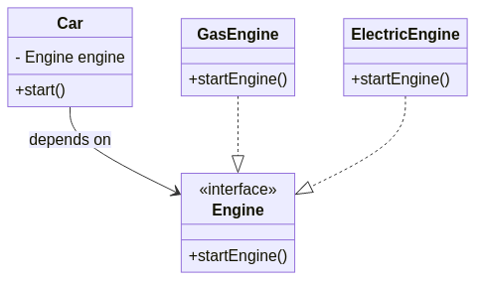
UML Class Diagram: Loose Coupling Example
Scenario
  A Car class directly depends on a GasEngine class. If the engine type changes (e.g., to ElectricEngine), the Car class must also change. Instead, we can do this:

Slide 22
Wait a minute! What is this interface thing?!
An interface is a contract that defines a set of methods that a class must implement.
It specifies what an object can do, but not how it does it.
Interfaces promote loose coupling by allowing classes to interact based on shared behavior rather than concrete implementations.

Slide 23
Must be time to talk about Classes, Interfaces and Abstract Classes
Classes
  A class is a blueprint for creating objects.
Interfaces
  An interface is a contract that defines a set of methods that a class must implement.
Abstract Classes
  An abstract class is a class that cannot be instantiated on its own.

Slide 24
Must be time to talk about Classes, Interfaces and Abstract Classes (Cnt.)
Classes
  A class is a blueprint for creating objects.
  It defines the properties (fields) and behaviors (methods) of objects.
  Classes can be instantiated to create objects.
public class Car {
// Properties (fields)
String color;
int year;
// Behaviour (methods)
void start() {
System.out.println(”Car started");}
void stop() {
System.out.println(”Car stopped");}
}
Car myCar = new Car();
myCar.color = “Red”();
myCar.year = 2026;
myCar.start();
myCar.stop();

Slide 25
Must be time to talk about Classes, Interfaces and Abstract Classes (Cnt.)
Interfaces
  An interface is a contract that defines a set of methods that a class must implement.
  It specifies what an object can do, but not how it does it.
  Interfaces promote loose coupling by allowing classes to interact based on shared behavior rather than concrete implementations.
public interface Animal {
void makeSound();
}
public class Dog implements Animal{
public void makeSound(){
System.out.println(”Woof!");
}
}

Slide 26
Must be time to talk about Classes, Interfaces and Abstract Classes (Cnt.)
Abstract Classes
  An abstract class is a class that cannot be instantiated on its own.
  It can contain abstract methods (methods without a body) that must be implemented by subclasses.
  Abstract classes can provide a common base for related classes.
  Abstract classes can also have concrete methods (since Java 8) - methods with a body.
public class Car extends Vehicle{
void move() {
System.out.println(”Car drive on road");}
}
void start() {
System.out.println(”Car engine started");}
}
abstract class Vehicle{
void move() {//implemented
System.out.println(”Vehicle moving");}
abstract void start(); //must be implemented
}

Slide 27
When to Use Classes, Interfaces, and Abstract Classes
Classes
  Use classes to define concrete objects with specific properties and behaviors.
Interfaces
  Use interfaces to define common behavior that multiple classes can implement.
  Use interfaces to promote loose coupling and flexibility in your design.
Abstract Classes
  Use abstract classes to provide a common base for related classes.
  Use abstract classes when you want to define some methods but leave others to be implemented by subclasses.
  Use abstract classes when you want to prevent instantiation of the class itself.
  To make a class abstract, use the abstract keyword in the class declaration.

Slide 28
Discussion - When to Use Classes, Interfaces, and Abstract Classes
Can you think of a real-world example where you would use a class?
Can you think of a real-world example where you would use an interface?
Can you think of a real-world example where you would use an abstract class?
Have a minute to think about this
Discuss with your neighbour for 5 minutes
Then I will ask for ideas from the class

Slide 29
Summary
Message passing is a key concept in OOP where objects communicate by sending and receiving messages.
Benefits of message passing include modularity, abstraction, flexibility, and real-world modeling.
Limitations of literal message passing include performance overhead and complexity.
Thinking in terms of message passing encourages good design practices like encapsulation, separation of concerns, and polymorphism.

Slide 30
Summary part 2
Classes define the properties and behaviors of objects.
Interfaces define a set of methods that a class must implement.
Abstract classes provide a common base for related classes and can contain abstract methods that must be implemented by subclasses.
Use classes, interfaces, and abstract classes based on the specific requirements of your design.

Slide 31
Lab Session
The lab will focus on designing classes with message passing in mind.
You will create classes that interact through messages to perform specific actions.
You will use classes, interfaces, and abstract classes to model different behaviors and relationships.

