Slide 1
Week 7:
Build Tools in Software Development
Automating Builds
Managing Dependencies
Streamlining Development

Slide 2
Objectives
Understand the purpose of build tools.
Explore different types of build tools:
  command line
  batch files
  makefiles
  Gradle
  Maven
  Rake
Learn how to automate builds and manage dependencies.

Slide 3
Source Code vs Compiled Code
Cow.class
Cow.java
Êþº¾ A FarmAnimal <init> (Ljava/lang/String;)V java/lang/System out Ljava/io/PrintStream; Moo! java/io/PrintStream println Cow Code LineNumberTable makeSound ()V SourceFile Cow.java ! " *+· ± % ² ¶ ±
public class Cow extends FarmAnimal {
public Cow(String name) {
super(name);
}
@Override
public void makeSound() {
System.out.println("Moo!");
}
}

Slide 4
Java JAR libraries: source or compiled code?
junit-platform-console-standalone-1.9.3.jar (extract)
PK A META-INF/þÊ PK PK A META-INF/MANIFEST.MF•SËnÛ0¼
Ð?96zØU¬À»94ˆ‹ vs§Å•K‡"U’r¿ï*’;UöD`vf¸œ]®˜XG^ÀX¡UD4ô½E-$'_˜ƒ,ˆÃ8!á„ÄŸOø3DKÞò”‡I1R^ä,I“°Øò(NòiÁ'|²MÃYFñ,8I7¢DËð6‹Ó,žÑi]‡qØÝèÈâ-
¾+á‚
°²A—@V]—}“q_úÆÃVó$™+´)ƒ¥VVKÖŽ)Î¤VÐó×oåVK‘·º}:Ru:’·:bÿÔå3£‰ï-
`:ü½ã(¥!£H¹Ö…ë€ë[ò¸Y}ï^í„ê-H{é¾®„“ÓÖptÊ±ô¤¯e%¡]CÚ'ÿí„/ ¸6’j³`\¾ËÚ8òÄò×÷†^µ“BÝÀ«êF‘ÍuÕœLÞ´5šk)!o0{âù^0HÝJZÔê’üW¦PèƒÙ!<ÌÝ³;Òc)©Â1ÛŠåp†UÌX|]ƒ O Z‡-ÏXÎ0e›<‡0ÊõŽ>} c?Þ`¤ôW’7<ß[1¡ÈR2k³ )´©ŸæE»yÑnkñêjéþ6 ÌbäÎÔ8ÉgøY
dÉ*¶R8\@mw‚Üø‡p¥æW£O£›?`—ëûñèÐt>¯|o]A.
‘ÿï]êÖè#ár‹|ï7PK 8ï“³
q PK A LICENSE-junit.txtÅZK“Û¸µÞãW ¼±»JÖMr“Üª™•FM»y#KQm—µ0æC!¨–õïó€)µ3É&®šš–œçwÀÿ?U¦"É
s´Z>ž¶…ÉåÂäºÂÇ÷òEþqú !6‰œÍç«O³å×tùQ>®W×³O2ÍèÏÏé}r/Ÿ–÷ÉZÒÒM²þ”ÉÕ |À‚d¾H³D>>ý²Hçÿ%K||÷föq$Ÿ’åæÍÝT‚°|Ê’‰\' xÿ4ß¤«¥\­å}šmÖé/Oîó >À/æ«e¶I7O›$Ã¾yú˜‚ÚÛŒxM7³å<é¸è›
ñÇ©¼O>¤Ë”hfB¼™×UÛ˜í©5uõF–ZUö'!$ÿSwÒT²=h™+è¤Þóßz3ªÝÎº™~Èë–ªÚy*ø·«óS©«VÑ)rg¬Û¨wòTítƒÝÆÊÙs£5­šD›·W,h•¤=m­þÇ ‹c6:ÆÍÌªzÖV¶5ï~lêçF•ŽtX…ej·3ÄÔxáÏaÑù óph ÿS7¯n•ucžM¥Z-÷M]Òr©-b±·ìP­<ª¦5ù©PM, \BÆv‘o;’ö­'*¢õÒì¥iåYYb
äGá4`°¥µºØK’£ºÔ•*oMõ,qÚxí[+·ú ŠýtÀ•…YeU·0P^œÈä‘BD|þù`òÃOòé›”©!6©§¬w§
…Um½oÏôc¬%S‰¼®~;U9kálÚÃ@®à<Ú4²>W²ðÁ«ž„sÝÁ‚˜Åó?|Ñò\7ßlðjOs*ã˜¨¤$yÔPH›Ö›°gØŽ “|„´Uk¥£«ÓG™Ê”Ös­¶…&C©•XsŽwkkUcŠ
ô²o`«àGZž(4iUÁ!ÛýG°°dzštZnM…Ýc…ÏþÏ 7ý:2úÀ@RåyÝìT•ë@.e¢¸Ö¹9|ˆtIìœµl Laošu€ Ây¹¨*àcqÈŸ¦¨¸Üæ­Ó›,Â°ì´ýMçmˆŠV7¥7ûuYbíSèCÃ`
Æ°QUWïõw0dÁý„<©ØÍ6õEíåýd„Ç
"÷Ðv®‰Èhô±ãçX|l(ô-§Äœ‘`nhüX¨Kô

Slide 5
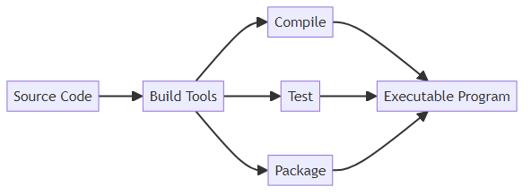
Understanding Build Tools
What Are Build Tools?

Slide 6
Definition: Build tools automate the process of creating an executable program from source code.
Purpose:
  Compile source code into binaries.
  Manage dependencies.
  Package code for deployment.
  Run tests.

Slide 7
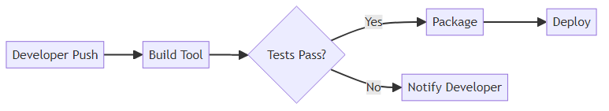
Build Tools and Code Development
Debug

Slide 8
Why Are Build Tools Important?
Save time and reduce human error.
Ensure consistency in builds across development environments.
Enable Continuous Integration/Continuous Deployment (CI/CD).

Slide 9
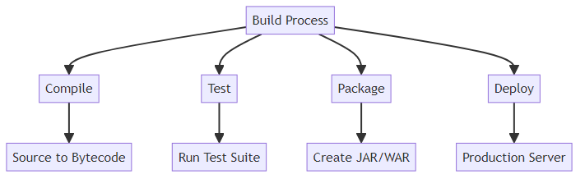
Essential Build Tasks
Debug

Slide 10
Build Tasks
Compiling: Converting source code into bytecode or machine code.
Testing: Running automated tests to ensure quality.
Debugging: Manually fixing code bugs [not done by build tools]
Packaging: Bundling code into distributable formats (e.g., JAR, WAR).
Dependency Management: Resolving and downloading required libraries.
Dependency: A software changes with or requires another one.

Slide 11
Types of Build Tools
Command Line: Basic manual builds using compilers (e.g., javac).
Batch Files: Automating command sequences.
Makefiles: Using make for build automation (allowing dependencies).
Ant: XML-based build tool with task and dependency support.
Rake: Ruby-based build tool using a Rakefile to define tasks.
Gradle: Modern build tool for flexibility and performance.
Maven: Popular dependency and project management tool.

Slide 12
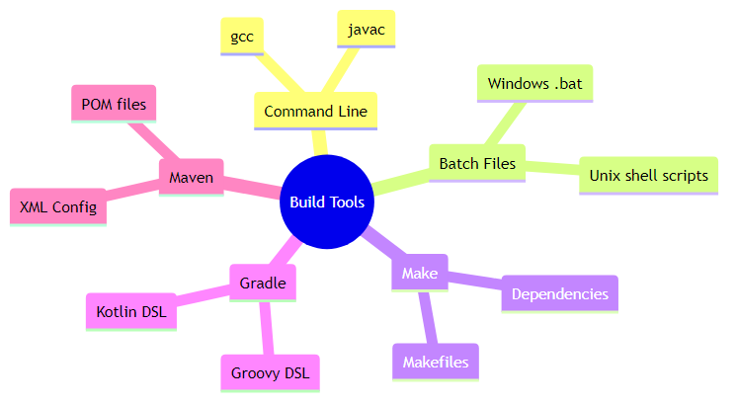
Build Tool Categories

Slide 13
Command Line Building
Use javac to compile Java code and java to run it.
Example commands:
javac MyProgram.java
java MyProgram
Advantages
Lightweight and simple for small projects.
Disadvantages
Tedious for larger projects with multiple files.

Slide 14
Batch File Automation
- Automate command sequences in Windows using .bat files.
- Example
Advantages
- Easy to set up for repetitive tasks.
Disadvantages
- Limited functionality compared to modern build tools.
@echo off
javac MyProgram.java
java MyProgram

Slide 15
Make and Makefiles
GNU Makefiles
- Use the make command to automate builds (dependencies).
- Example Makefile syntax
Advantages
- Widely used in C/C++ projects.
Disadvantages
- Syntax can be difficult for beginners.
- Dependencies need to be set up manually
build: MyProgram.java
javac MyProgram.java
Windows installation tip:
winget install ezwinports.make

Slide 16
Ant
Ant uses xml build files
- Use the ant command to automate builds (dependencies).
- Example build file
- Example build commands
ant compile (–f build.xml)
ant run (–f build.xtml)
Advantages
- Handy to manage jar libraries.
ant jar (–f build.xml)
Disadvantages
- Syntax difficult for beginners.
- Manually coding dependencies.
<project>
<target name="compile">
<mkdir dir="classes"/>
<javac srcdir="src" destdir="classes"/>
</target>
<target name="run" depends="compile">
<java classname=“MyClass" fork="true">
<classpath path="classes"></classpath>
</java>
</target>
</project>

Slide 17
Introduction to Rake
What is Rake?
A build tool written in Ruby – "Ruby Make"
Inspired by make; tasks defined as Ruby code
Created by Jim Weirich (2003); cross-platform
Tasks live in a plain text file called Rakefile
Key Features
Full Ruby language available inside task bodies
Declare dependencies between tasks
Built-in file utilities (mkdir, cp, rm_rf …)
FileList globs track source files automatically
Installation: gem install rake

Slide 18
Rake for Java – A Rakefile Example
Rakefile
SRC_DIR = 'src'
BIN_DIR = 'bin'
JAR_FILE = 'app.jar'
SOURCES = FileList["#{SRC_DIR}/**/*.java"]
directory BIN_DIR
task :default => :compile
task :compile => BIN_DIR do
sh "javac -d #{BIN_DIR} #{SOURCES.join(' ')}"
end
task :run => :compile do
sh "java -cp #{BIN_DIR} Main"
end
task :jar => :compile do
sh "jar cf #{JAR_FILE} -C #{BIN_DIR} ."
end
task :clean do
rm_rf BIN_DIR
rm_f JAR_FILE
end
Running Rake
rake # runs :default → compile
rake compile # compiles all .java files
rake run # compiles then runs Main
rake jar # packages app.jar
rake clean # removes bin/ and jar
How it works
Each task declares its dependencies.
Rake builds only what is needed.
FileList auto-detects new source files.
task :run => :compile means run depends on compile
FileList globs:
FileList['src/**/*.java'] collects every .java under src/

Slide 19
Rake Task Dependencies
Dependencies in Action
When you run rake jar :
rake jar requires :compile
rake compile requires BIN_DIR to exist
rake directory creates bin/ (only once)
Rake traces the dependency graph and executes each
task exactly once, in the correct order.
Advantages of Rake
Pure Ruby – any logic can drive your build
Incremental builds: skips tasks already up-to-date
Simpler syntax than Ant XML or Makefile rules
Disadvantages of Rake
Requires Ruby to be installed
Less common than Gradle/Maven in enterprise Java

Slide 20
Build Tools: A Goal-Oriented Paradigm
Imperative vs Goal-Oriented
Imperative (step-by-step):
1. Run "javac" on every .java file
2. Run "jar" to package the class files
3. Run "java" to start the program
You specify HOW to achieve the result.
Goal-Oriented (declarative):
task :run depends on :compile
task :compile depends on BIN_DIR existing
"I want :run – you figure out the steps."
You specify WHAT you want; the tool resolves the how.
This shift mirrors other paradigms:
SQL – describe the data you want, not how to fetch it
CSS – describe how things should look, not how to render
Prolog – state facts and rules; query for goals

Slide 21
The Goal-Oriented Paradigm
Core idea
Declare goals and their dependencies.
The system determines execution order automatically.
Key properties
Idempotent – re-running achieves the same result
Minimal work – only rebuild what has changed
Composable – goals combine without side-effects
Parallelisable – independent goals can run concurrently
Connection to broader CS concepts
Dependency graphs underpin package managers (npm, pip, Maven)
Logic programming (Prolog) reasons about goals the same way
Dataflow languages evaluate nodes when their inputs are ready
Takeaway
Build tools teach us to think in goals and dependencies –
a powerful mental model beyond software builds.

Slide 22
Build Tool Discussion Break
Prompt:
What are the limitations of manually building a project using command line tools?
How can automation improve the development process?
Have a minute to think about this
Discuss with your neighbour for 5 minutes
Then I will ask for ideas from the class

Slide 23
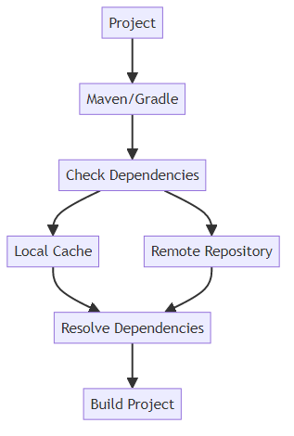
Introduction to Gradle
What is Gradle?
A modern build tool for managing builds, dependencies, and automation.
Key Features:
Supports multiple programming languages.
Highly customizable with Groovy or Kotlin scripts.

Slide 24
Gradle Configuration
Gradle Example
A simple build.gradle file (using Groovy language):
plugins {
id 'java'
}
repositories {
mavenCentral()
}
dependencies {
testImplementation 'org.junit.jupiter:junit-jupiter:5.7.0'
}

Slide 25
Gradle Build Commands
Running a Gradle Build
1. Install Gradle.
2. Navigate to your project directory.
3. Run commands:
- gradle build (build the project).
- gradle test (run tests).
- gradle clean (clean build files).

Slide 26
Benefits and Limitations of Gradle
Advantages of Gradle
1. Faster builds with incremental compilation.
2. Flexible scripting with Groovy or Kotlin.
3. Built-in support for dependency management.
Challenges of Gradle
1. Steeper learning curve for beginners.
2. Requires a configuration file (build.gradle).

Slide 27
Introduction to Maven
What is Maven?
A popular dependency and project management tool for Java.
Key Features:
Uses an XML file (pom.xml) for configuration.
Simplifies dependency management with Maven Central.

Slide 28
Maven Configuration
Maven Example
A simple pom.xml:
<project>
<modelVersion>4.0.0</modelVersion>
<groupId>com.example</groupId>
<artifactId>my-program</artifactId>
<version>1.0.0</version>
<dependencies>
<dependency>
<groupId>org.junit.jupiter</groupId>
<artifactId>junit-jupiter</artifactId>
<version>5.7.0</version>
</dependency>
</dependencies>
</project>

Slide 29
Maven Build Commands
Running a Maven Build
1. Install Maven.
2. Navigate to your project directory.
3. Run commands:
- mvn compile (compile the project).
- mvn test (run tests).
- mvn package (create a distributable JAR file).

Slide 30
Benefits and Limitations of Maven
Advantages of Maven
1. Standardized project structure.
2. Large ecosystem of plugins and dependencies.
3. Integration with many IDEs.
Challenges of Maven
1. Verbose XML configuration.
2. Less flexible than Gradle.

Slide 31
Build Tools Comparison
Tool | Strengths | Weaknesses
CLI | Simple, lightweight | Tedious for large projects
Batch | Automates repetitive CLI tasks | Limited functionality
Makefiles | Widely used, simple for small builds | Complex syntax for larger projects
Gradle | Flexible, fast, modern | Steeper learning curve
Maven | Standardized, integrates with IDEs | Verbose XML syntax

Slide 32
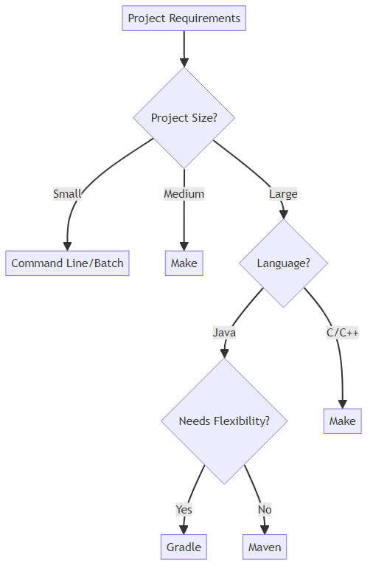
Choosing the Right Build Tool
When to Use Each Tool?

Slide 33
CLI/Batch: Small, simple projects.
Makefiles: C/C++ or small Java projects.
Rake: Ruby-enabled scripting; great for polyglot or custom build workflows.
Gradle: Modern, scalable projects with advanced requirements.
Maven: Standardized Java projects with dependency management needs.

Slide 34
Build Tool Best Practices
Best Practices for Build Tools
1. Use version control to track your configuration files (e.g., pom.xml, build.gradle).
2. Automate as much as possible to save time.
3. Keep configurations simple and well-documented.

Slide 35
Build Tool Selection Discussion
Discussion Break
Prompt:
How do you decide which build tool to use for a given project?
Share your experience (if any) with tools like Gradle, Maven, or Makefiles.

Slide 36
Key Takeaways
Conclusion
Build tools automate repetitive tasks and improve consistency.
Gradle and Maven are powerful tools for managing dependencies and builds in Java.
Choosing the right tool depends on project size, team expertise, and specific requirements.

Slide 37
Learning Path Forward
Next Steps
Explore Make, Rake, Gradle and Maven in your projects.
Practice writing simple batch files and makefiles.
Experiment with automating builds for the Quiz Manager System.

Slide 38
Case Study: Quiz Manager System
Case Study: Using Build Tools in the Quiz Manager System
Scenario:
You are managing a growing Quiz Manager System with multiple files and dependencies like JUnit for testing.
Manually compiling, testing, and packaging the project is time-consuming and error-prone.
Solution:
Use Make, Gradle or Maven to automate the build process and manage dependencies.

Slide 39
Implementing Gradle in Quiz Manager
Example: Gradle for the Quiz Manager System
Create a build.gradle file (using Groovy language):
  plugins {
  id 'java'
  }
  repositories {
  mavenCentral()
  }
  dependencies {
  testImplementation 'org.junit.jupiter:junit-jupiter:5.9.3’
  }
Run commands:
  gradle build: Compile and package the project.
  gradle test: Run unit tests for the system.

Slide 40
Implementing Maven in Quiz Manager
Example: Maven for the Quiz Manager System
Create a pom.xml file:
  <project>
  <modelVersion>4.0.0</modelVersion>
  <groupId>com.example.quizmanager</groupId>
  <artifactId>quiz-manager</artifactId>
  <version>1.0.0</version>
  <dependencies>
  <dependency>
  <groupId>org.junit.jupiter</groupId>
  <artifactId>junit-jupiter</artifactId>
  <version>5.9.3</version>
  </dependency>
  </dependencies>
  </project>
Run commands:
  mvn compile: Compile the system.
  mvn test: Run tests.
  mvn package: Create a distributable JAR.

Slide 41
Build Tool Implementation Challenges
Class Discussion: Challenges with Build Tools
Prompt:
What challenges might you face when introducing build tools to a new project?
How would you overcome issues such as configuring dependencies or dealing with tool-specific syntax?
Key Points for Discussion:
Misconfigurations can lead to build failures.
Tool-specific syntax (e.g., XML for Maven, Groovy for Gradle) requires practice.
Documentation and community resources are valuable for overcoming challenges.

Slide 42
Hands-on Activity to try later:
Quiz Manager Build
Practical Activity: Automating the Quiz Manager Build
Task:
1. Set up Gradle or Maven for your Quiz Manager System.
2. Add dependencies for JUnit testing.
3. Automate the process of compiling, testing, and packaging your project.

